Slide 1


Pubmed Miner – AI Tool to Extract Sequence Features

Slide 2
Introduction
Project Name: PubMed Miner – AI Tool to Extract Sequence Features from Literature
Theme: Automated Knowledge Extraction and Curation
Team Members:
  Indresh Singh – Director of Bioinformatics, J. Craig Venter Institute (JCVI)
  Shubham Deshmukh – AI Software Development Engineer Intern, J. Craig Venter Institute (JCVI)
Goal:
Develop an AI-driven system that automatically mines latest PubMed literature to extract, validate, and organize viral sequence features such as mutations, motifs, and conserved regions for improved pathogen analysis and public health response.

Slide 3
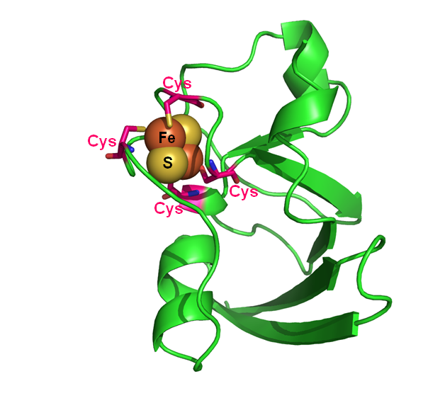
Importance of Sequence Features
SVFs represent genetic differences such as codon usage, motifs, domains, and mutations.
They define viral functionality and adaptability.
SVFs help identify virulence and transmissibility factors.
They guide vaccine and antiviral design through conserved region detection.
Used as features for AI models predicting pathogenicity or host interaction.

Slide 4

Challenges & Motivation
Manual review of literature is time and resource-intensive.
Databases lack the latest experimental mutation data.
Extracting structured biological data from text is complex.
High false-positive rates in mutation identification.
Need for scalable, automated, and accurate sequence feature extraction.

Slide 5



Methodology
Automated PubMed search and retrieval of full-text articles.
Use of LLMs (Gemini, GPT-4, LLaMA) for extracting biological entities.
Cleaning and structuring of extracted data (mutations, residue positions).
Rule-based validation using gene names and coordinate ranges.
User-friendly interface for data visualization and download.

Slide 6
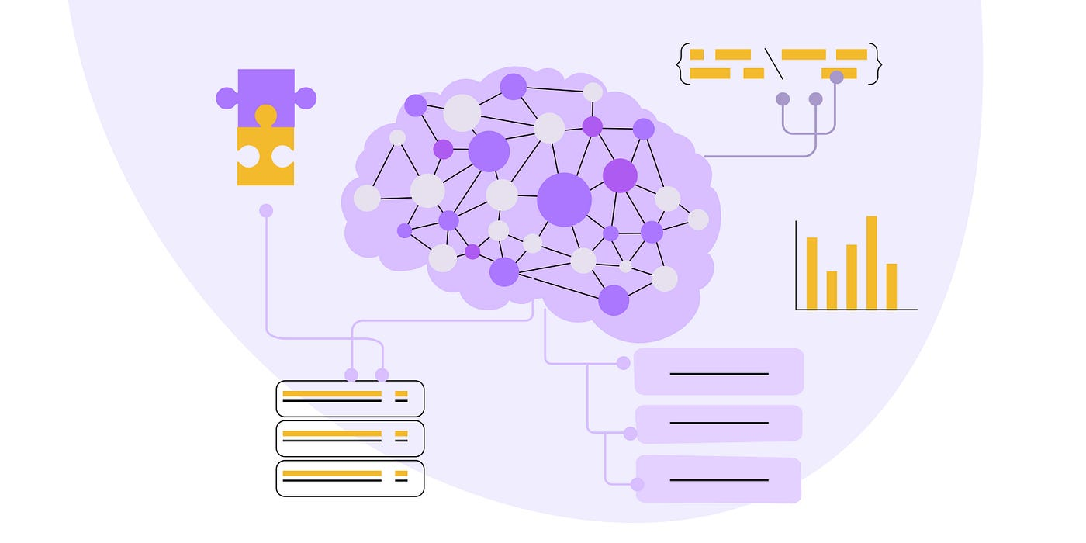
Outcome
Functional prototype achieving 75–85% accuracy on viral families.
Reduced false positives through multi-layer validation.
Enhanced database of curated sequence features.
Accelerates outbreak response via rapid literature mining.
Promotes scalable AI automation for infectious disease research.

