Slide 1





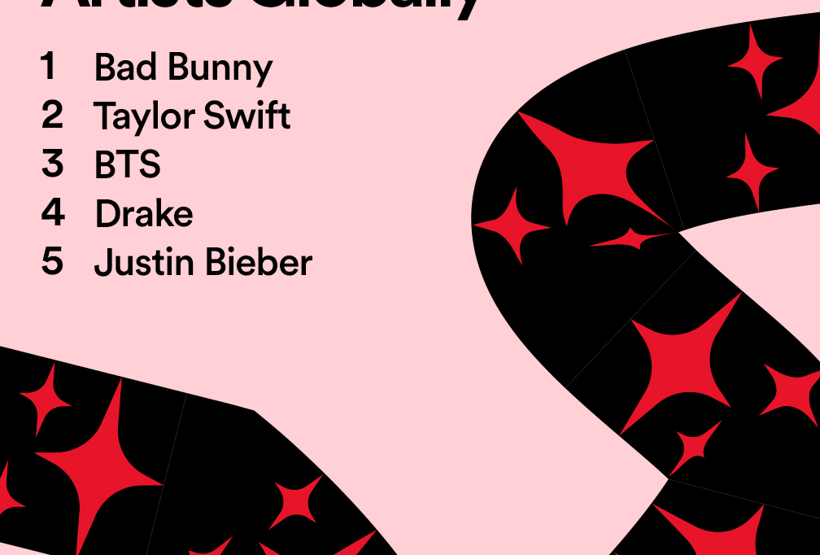


girlbosswords, wrapped (2021)
favorite grids

Slide 2
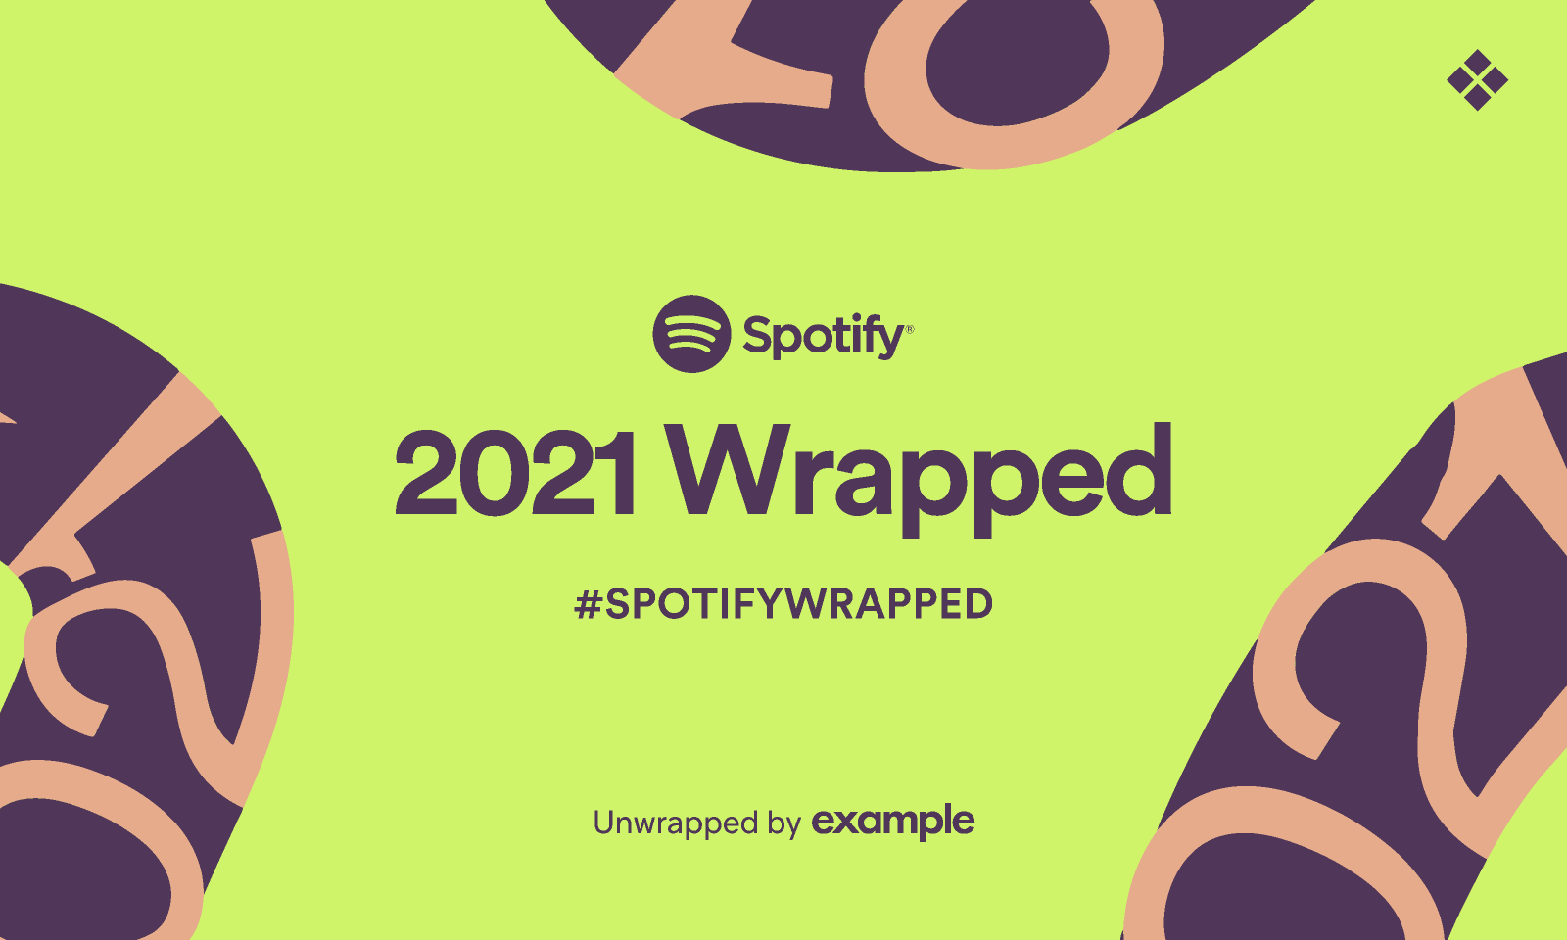
girlbosswords, wrapped (2021)
numbers
37 puzzles + 42 7xwords
8 collabs with 7 different constructors
14 puzzles paid puzzles (8 USAT + 2 Univ + AVCX + Boswords + MGWCC + Pandora’s Blocks)
4 meta puzzles

Slide 3
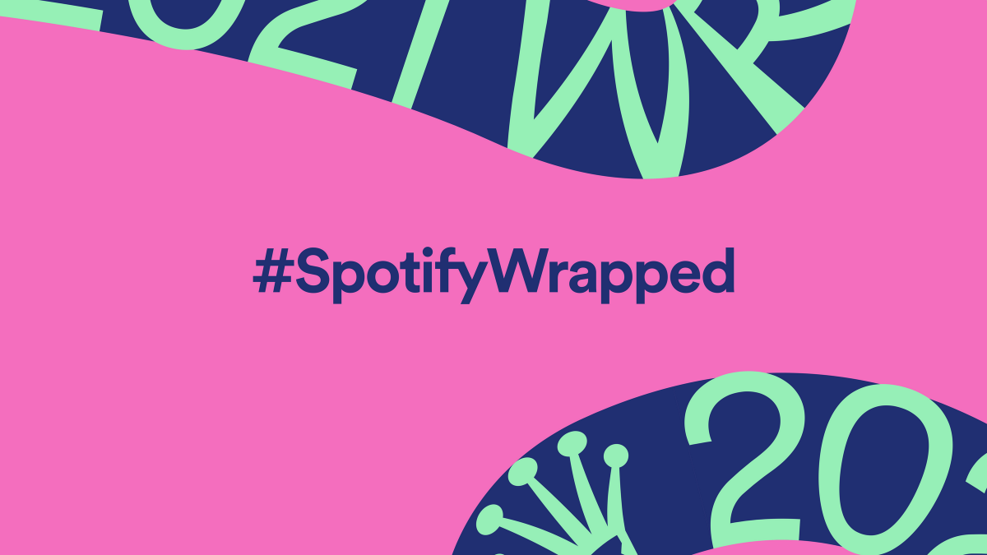
Watery sound? for INLET
It’s a non-starter? for ENTREE
What is this? A city for ANTS?? for COLONY
Bang on descriptor? for DTF
They may take a toll? for CAR TRIPS
Event where both sides are making equally good points? for CLOSE GAME
Wireless device? for BRALETTE
It’s a fucking record! for SEX TAPE
Brand that gives glamour tips? for OPI
Did a spit take? for MADE OUT
Amazing Grace? for HOPPER
Beach bars? for SONG OF THE SUMMER
Attentive listener? for AUDIOPHILE
Crowning moment? for CORONATION
favorite clues

Slide 4
