Slide 1
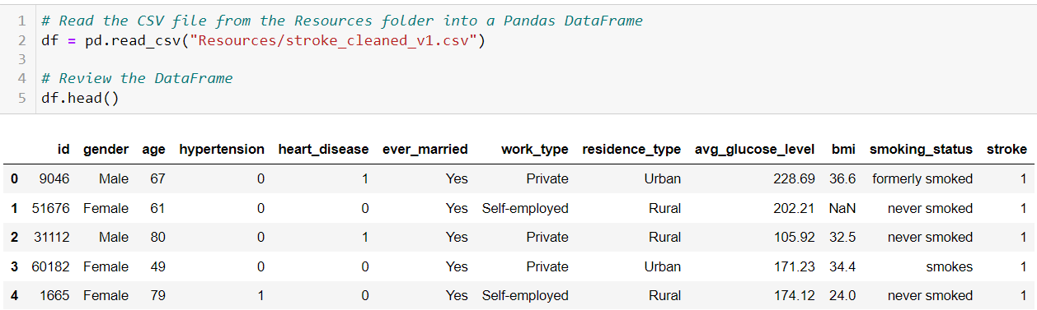
Preprocessing for Models
Step 1: Filling the Null Values with Median:
median_bmi = df['bmi'].median()
df['bmi'] = df['bmi'].fillna(median_bmi)
Step 2: Dropping some columns
df = df.drop( ['id', 'work_type'], axis=1)

Slide 2
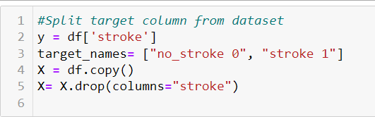

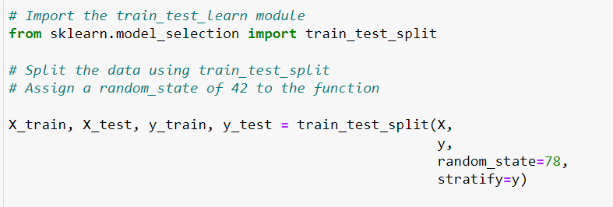
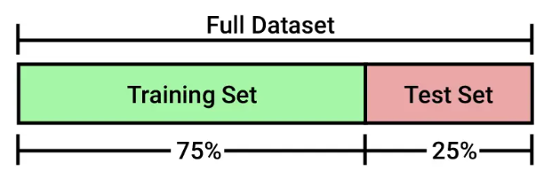
Splitting the data into Training and Testing Sets
Balance of our target values(y)

Slide 3
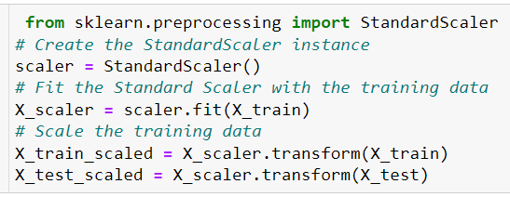


Standardize Data and Dummy encoding
Applies on Numeric columns
Transforms the data to have mean of ‘0’ and Standardization of ‘1’
Creates binary columns for each category

Slide 4
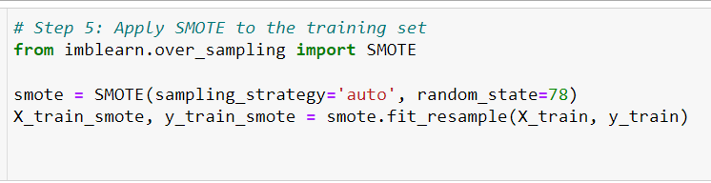

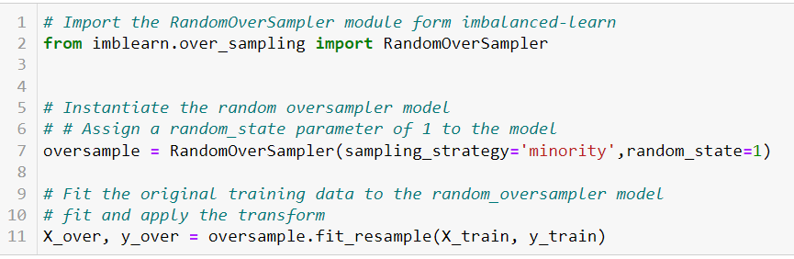

Handling Imbalanced Data
by Oversampling with SMOTE And RandomOverSampler
Smote
It creates synthetic, diverse samples.
Effective in handling class imbalance by introducing new information.
RandomOverSampler
No creation of synthetic samples
uses existing data, duplicates samples.

Slide 5
Supervised Machine Learning Models
Logistic Regression Model
Model_LR = LogisticRegression(solver='lbfgs’, max_iter=200,random_state=78)
K_nearest neighbors
Model_knn = KNeighborsClassifier(n_neighbors=5)
Descision Tree
model_DT = tree.DecisionTreeClassifier()
Random Forest
rf_model = RandomForestClassifier(n_estimators=500, random_state=78)
Support Vector Machine (SVM)
model_svm = SVC(kernel='linear')

Slide 6
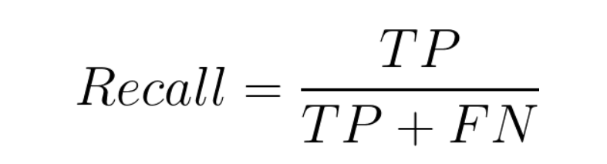
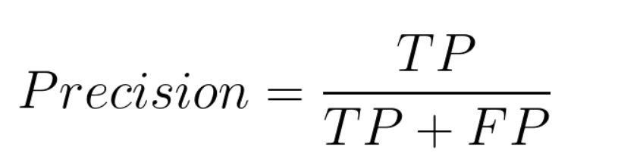
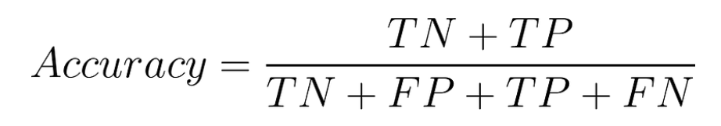
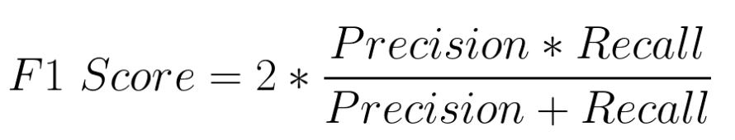
Evaluation Of Models
Metrices to evaluate Models

Slide 7
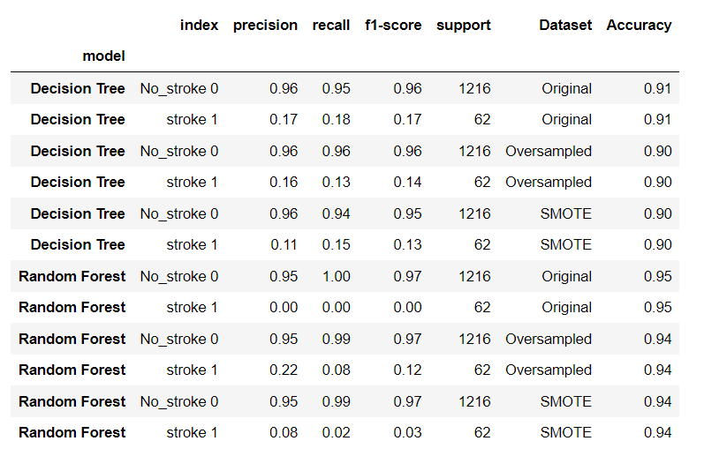
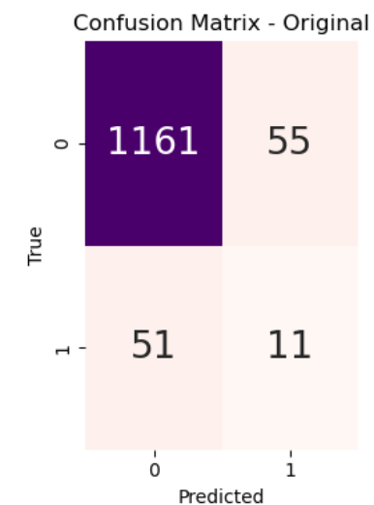
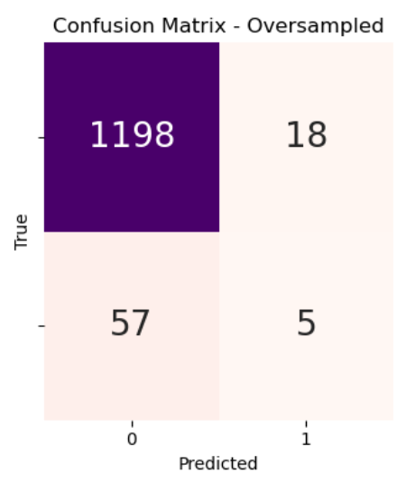
Decision Tree Model And Random Forest Model
In Decision Tree Model 51 people who actually have Stroke, model is predicting them as they don’t have stroke while 55 are those who actually do not have stroke and model is predicting them as they have stroke.
In Random Forest Model 57 people who actually have Stroke, model is predicting them as they don’t have stroke while 18 are those who actually do not have stroke and model is predicting them as they have stroke.

Slide 8
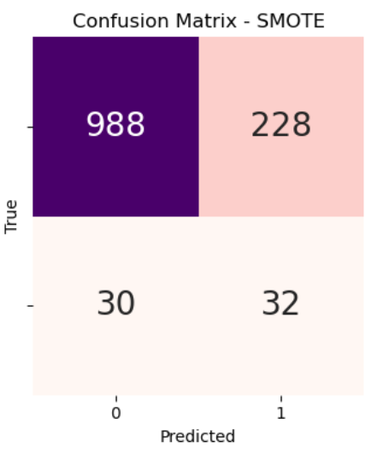
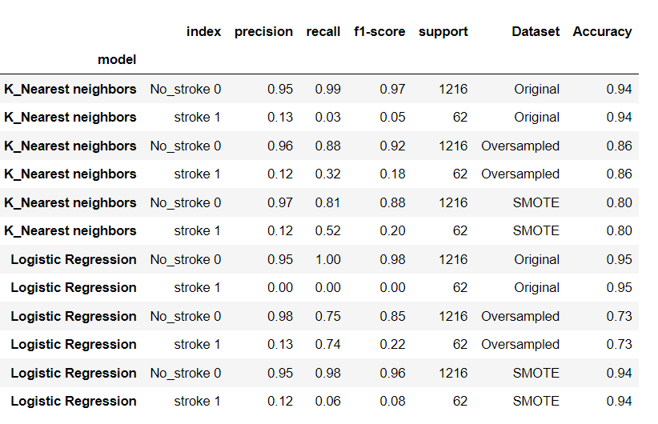
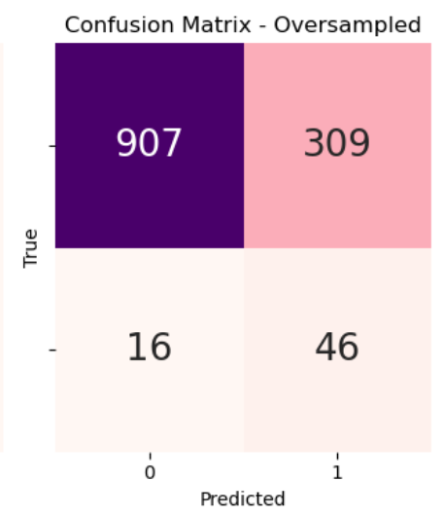
K_Nearest neighbors Model And Logistic Regression Model
KNN Model(Smote), with 30 people who actually have Stroke, model is predicting them as they don’t have stroke while 228 are those who actually do not have stroke and model is predicting them as they have stroke.
Logistic Regression Model (Oversampled): FN is 16 ,FP is 309

Slide 9
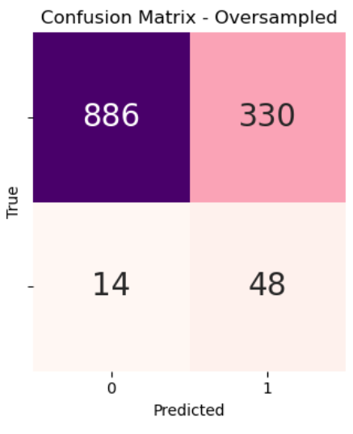
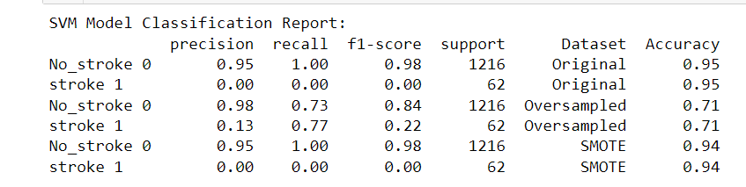
Support Vector Machine (SVM)
SVM with Oversampled Data shows some promising results with a recall for Stroke1 77% and with 14 FN. Though the number of FP is High.

