Slide 1
Google Play Console
Internal App Sharing & Testing Understanding the Best Way to Share & Test App Builds

Slide 2
Internal App Sharing?
Internal App Sharing allows developers to quickly share AAB files with a link.
Testers can install specific versions Works similarly to TestFlight on iOS.

Slide 3
What is Internal, Closed, & Open Testing?
Internal Testing: ✅ Limited to 100 testers. ✅ Requires Google Play review. ✅ One active version at a time.
Closed Testing: ✅ For selected users. ✅ Multiple tracks can be created. ✅ Testers must manually opt-in & out. ✅ One active version at a time in the tracks.
Open Testing: ✅ Available to anyone with a link. ✅ Useful for public beta testing. ✅ One version active at a time. https://support.google.com/googleplay/android-developer/answer/9844679 https://support.google.com/googleplay/android-developer/answer/9845334

Slide 4
Challenges in Testing Tracks
🔹 Internal, Closed & Open Testing allow only one active version at a time.
🔹 Testers must manually opt-in & out of different tracks.
🔹 Internal App Sharing allows testing all builds without restrictions.
🔹 Best solution: Use Internal App Sharing for quick testing & debugging.

Slide 5
Summary & Key Takeaways
✅ App Bundle Explorer provides shareable links for every build.
✅ Unlike Internal, Closed, & Open Testing, Internal App Sharing allows all builds to remain available.
✅ For faster testing, QA teams should use Internal App Sharing instead of traditional testing tracks.

Slide 6
Shareable Links for All Testing Tracks
✅ No matter where a build is uploaded (Internal, Closed, Open) and published, Google Play generates a shareable link. ✅ Requirement: The version code must be incremented for testing tracks. ✅ Managed URL Structure for Testing Tracks:
https://play.google.com/apps/test/<package_name>/<version_code>
✅ Internal App Sharing URL is Random, while Testing classes URLs follow a structured format.

Slide 7
Uploading Builds in Internal App Sharing
✅ Every upload generates a new, unique installable link.
✅ Ideal for quick testing without Play Store version restrictions. https://play.google.com/console/internal-app-sharing

Slide 8
Internal Testing – The Best Quick Review Approach
✅ Internal Testing requires a faster Google Play review compared to Closed/Open Testing. ✅ Best Strategy:
Step 1: Publish the build in Internal Testing.
Step 2: Get the Managed Shareable Link from Google Play.
Step 3: Share with testers for a structured rollout. ✅ A great approach for fast internal testing without delays.

Slide 9
Note About App Bundle Explorer
Once you upload an App Bundle (AAB) to any testing channel (Internal, Closed, or Open Testing), App Bundle Explorer will be enabled for your app.
✅ You can also upload builds directly in App Bundle Explorer, but the version code must be incremented for each upload. ❌ However, these builds will remain inactive unless you assign them to a testing track (Internal, Closed, Open) or Production.
🚀 Best Practice
Instead of uploading builds separately in App Bundle Explorer, it’s better to directly upload and publish builds in a testing channel to avoid unnecessary inactive versions. 🚀

Slide 10
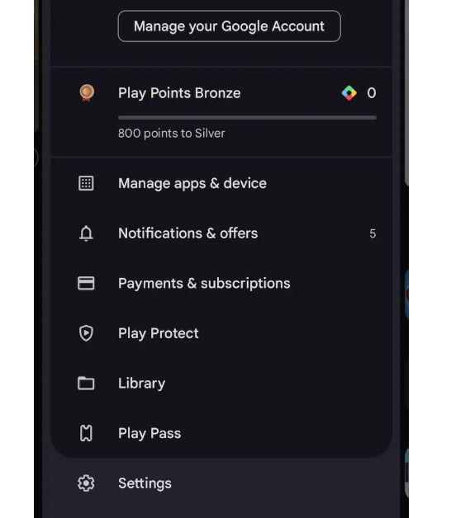
Enable Developer Options for Internal App Sharing
First, you must be part of a testing user from any channel, whether it’s open beta, closed beta, or any internal channel. Then, you need to activate the developer options in the Play Store app on the device where you will test it.
Go to the Play Store app on your device, press the profile button located at the top right, and select the Settings option.

Slide 11
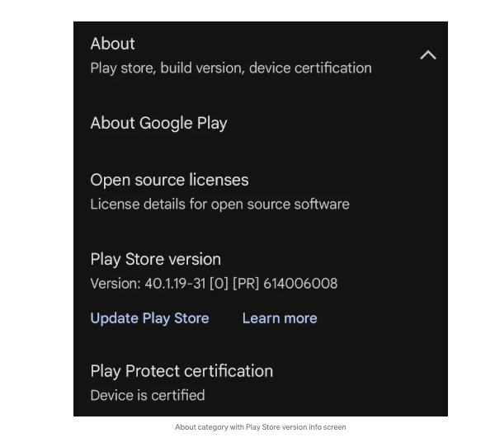
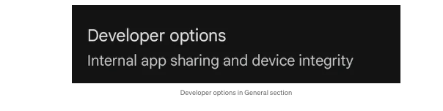
In the About section, you will find the Play Store version option. Tap it seven times to activate the developer menu.
Now that it’s activated, go to the General section, the first one on the options list. You’ll see Developer options there. Tap it to access its settings.

Slide 12
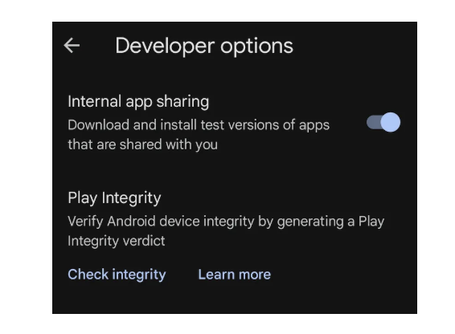
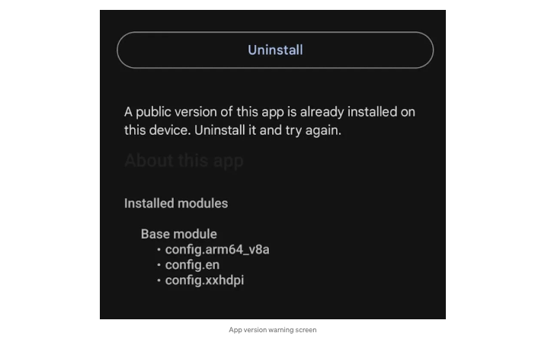
And finally in Developer options, enable the Internal app sharing option.
You just need to open the link we generated on the internal sharing page from the device you’ll use for testing. This will redirect you to the Play Store, where you’ll see the version available for download, which you can then use for testing.

Slide 13
How Internal App Sharing Allows Testing of Any Build
App Bundle Explorer stores all uploaded builds.
Each version has a fixed link pattern: https://play.google.com/apps/test/<package_name>/<version_code>
Testers can install older versions by modifying the version code.
Unlike testing tracks, QA teams can test multiple versions.

Slide 14
Web Page for Build Selection & Testing
Website: https://malihassan-virk.github.io/test/index.html
Users enter Build Number → Redirects to Google Play build page.

