Slide 1
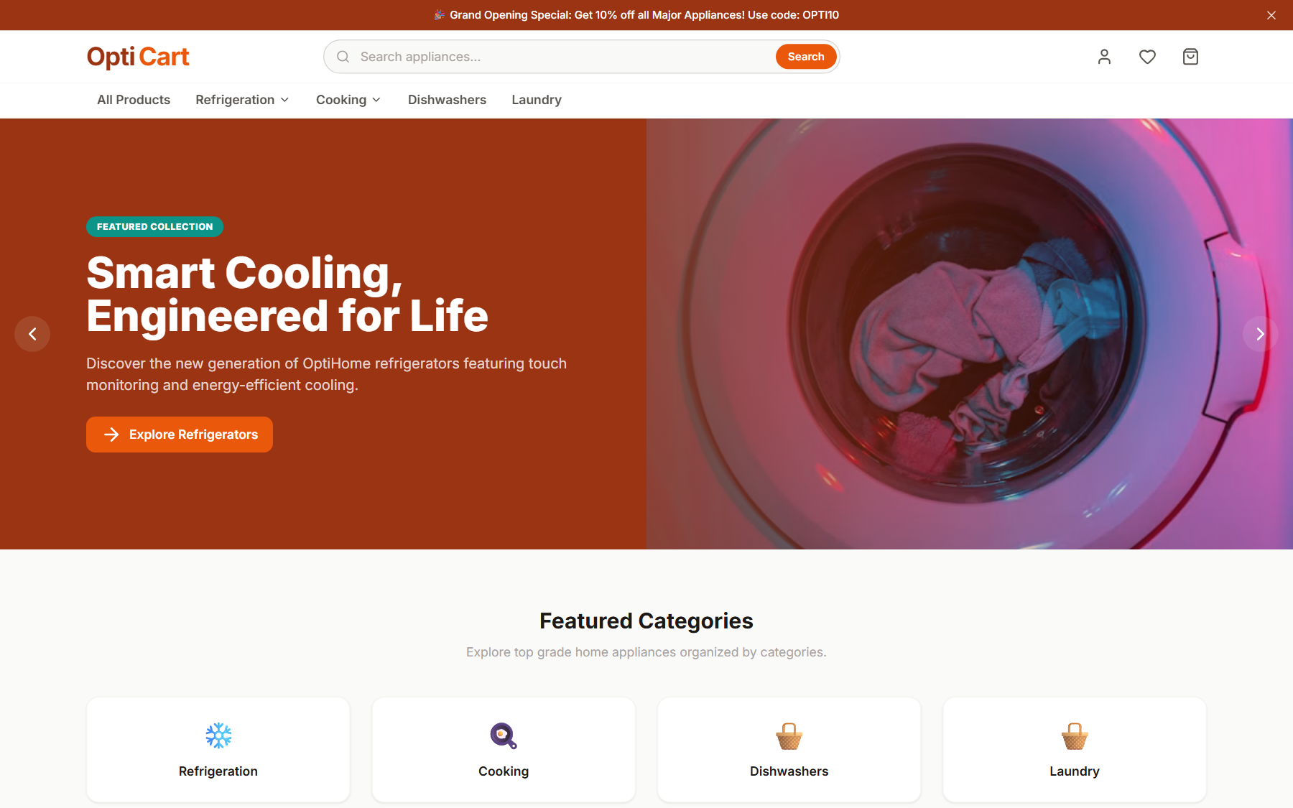
Opti
Cart
BUSINESS PRESENTATION
One connected commerce operation
From product discovery to business decision.
CUSTOMER JOURNEY
BUSINESS CONTROL
A complete appliance commerce platform
<->
MALIK
01 / 06

Slide 2
THE BUSINESS NEED
Two sides. One product.
Shared commerce data gives customers continuity and staff the control they need.
C
B
Customer experience
Business operations
Discover clearly
<->
See orders needing action
Keep saved choices
Protect product availability
Know what happens next
SHARED DATA
Learn from activity
MALIK
02 / 06

Slide 3
PILLAR 1 - CUSTOMER EXPERIENCE
Make buying easier to complete
OptiCart reduces breaks between discovery, purchase, and post-purchase service.
1
Discover
Categories, search, filters
2
Evaluate
Variants, ratings, reviews
3
Save
Guest cart and wishlist
4
Complete
Coupon and checkout
5
Stay informed
History, updates, feedback
REAL PRODUCT UI
MAHMOD
03 / 06

Slide 4
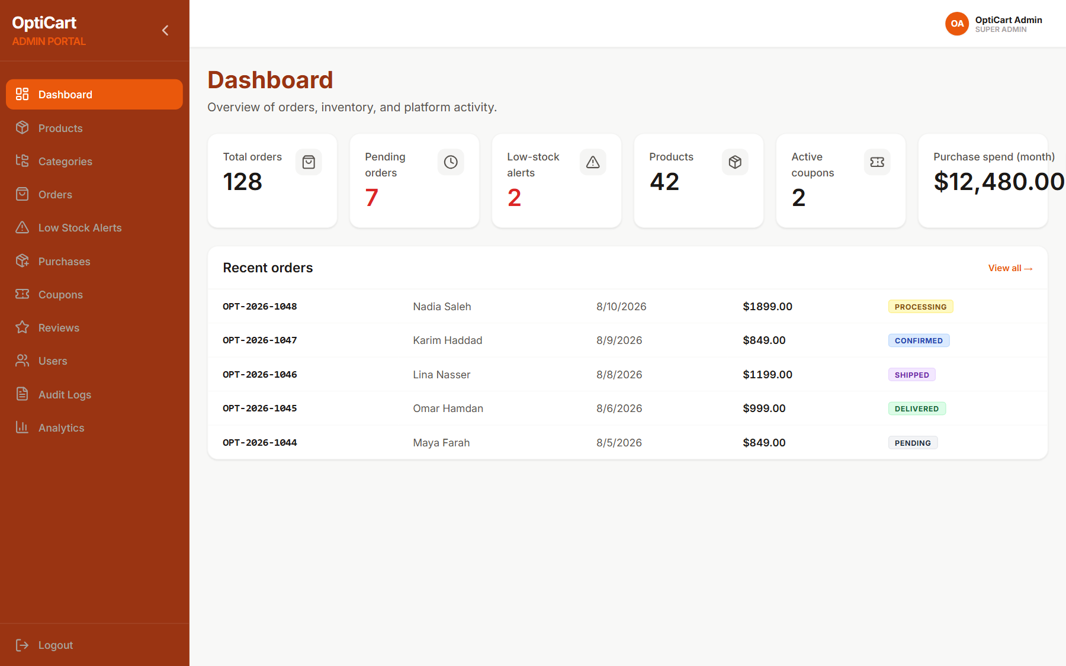
PILLAR 2 - BUSINESS OPERATIONS
Turn demand into coordinated action
The platform converts customer demand into visible, controlled operational work.
Fulfillment control
Move orders through clear statuses and keep customers informed.
Inventory awareness
Threshold alerts surface stock risk before it becomes a surprise.
Procurement traceability
Supplier purchases update stock and capture cost together.
ROLE-BASED CONTROLS + AUDIT LOGS
REPRESENTATIVE LOCAL TEST DATA
MAHMOD
04 / 06

Slide 5
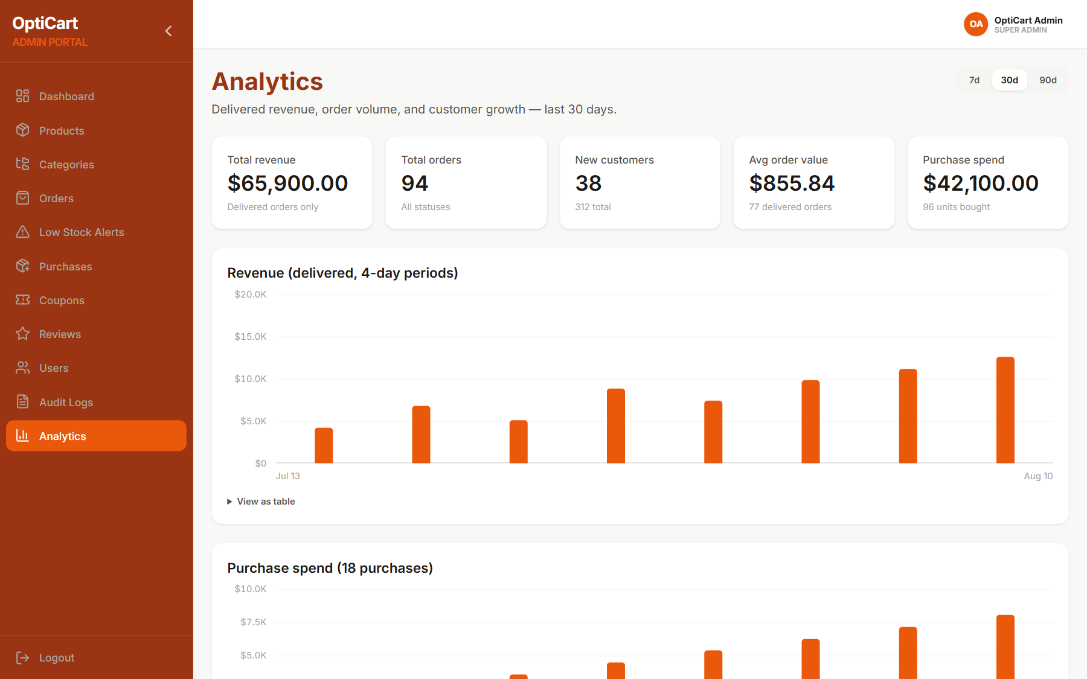
MANAGEMENT VISIBILITY
See what needs attention—and what is working
OptiCart turns platform activity into practical visibility for planning and prioritization.
Performance
Delivered revenue, order volume, average order value.
Demand
Customer growth and top-selling SKUs.
Investment
Supplier purchase spend and units bought.
IMPLEMENTED ANALYTICS VIEWS
ILLUSTRATIVE TEST DATA - NOT COMMERCIAL RESULTS
HAYA
05 / 06

Slide 6
OPTICART
Built as a product, not a page
The value is in the connection.
CUSTOMER EXPERIENCE
BUSINESS OPERATIONS
A journey that can complete a sale
A workflow that can fulfill and learn
<->
discover - decide - buy - track
control - monitor - improve
Ready to contribute to real business software.
Complete MERN application - real workflows - clear responsibilities
HAYA
Thank you.

