Slide 1
INSIGHTFLOW · NUXT / VUE
We learned Nuxt
by building with it
NUXT
×
A five-person build that moved our MERN instincts into a Nuxt 4 + Vue 3 application
VUE
MALIK · APPLICATION BOUNDARY
Malik
InsightFlow · sources in notes
01
Notes:
Open with the learning claim, not a product pitch: the team learned Nuxt by making architectural choices in a real application.
InsightFlow gives a signed-in owner analytics and recommendations, while selected findings can become public server-rendered insights.
The deck follows the boundaries that changed most from MERN: UI versus framework, rendering, files, validation, reactivity and full-stack flows.
[Sources]
- Project source: docs/HANDOFF.md
- https://nuxt.com/docs/4.x/getting-started/introduction
- https://vuejs.org/guide/introduction.html

Slide 2
INSIGHTFLOW · NUXT / VUE
Vue builds the interface; Nuxt organizes the application
Same component model.
A much larger boundary.
VUE
NUXT
components
reactivity
props + events
templates
routing
rendering
server APIs
middleware + config
Vue handles reactive components. Nuxt adds the conventions that turn those components into a routed, rendered and deployed application.
React ≈ Vue
Next.js ≈ Nuxt
Malik
InsightFlow · sources in notes
02
Notes:
Use this as the vocabulary reset: Vue is the UI technology; Nuxt is the application framework around it.
The comparison with React and Next.js is directional, not an identity. Each ecosystem has different conventions and trade-offs.
For InsightFlow, Nuxt made routing, route middleware, server handlers and rendering policy part of one codebase.
[Sources]
- https://vuejs.org/guide/introduction.html
- https://nuxt.com/docs/4.x/getting-started/introduction
- https://nextjs.org/docs

Slide 3
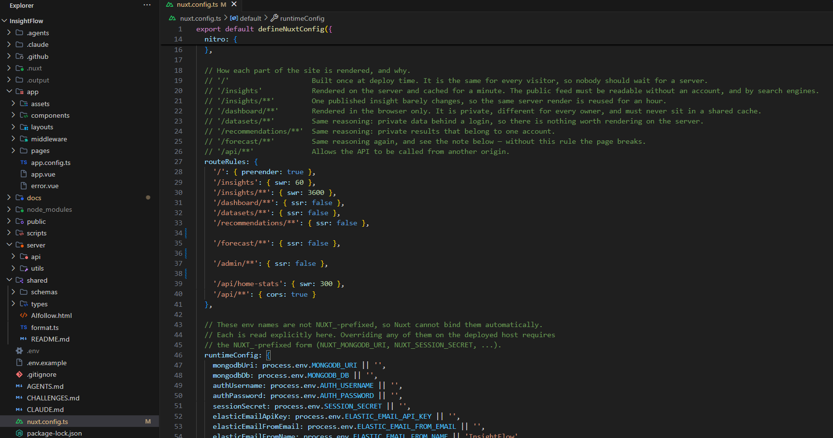
INSIGHTFLOW · NUXT / VUE
One Nuxt app can use different rendering strategies
CODE SCREENSHOT
PRERENDER
build once
Landing page
CACHED SSR
HTML + SWR
Public insights
CSR
private + personal
Owner workspace
Malik
InsightFlow · sources in notes
03
Notes:
Walk the routes, not abstract definitions: the landing page is prerendered, the public insight feed is server-rendered and cached, and private owner surfaces are client-rendered.
The choice follows the boundary: public content benefits from HTML and caching; private account-specific content must not enter a shared cache.
The screenshot shows the final routeRules beside the Nuxt 4 app, server and shared folder tree.
[Sources]
- Project source: nuxt.config.ts
- https://nuxt.com/docs/4.x/guide/concepts/rendering
- https://nuxt.com/docs/4.x/guide/concepts/rendering#hybrid-rendering

Slide 4
INSIGHTFLOW · NUXT / VUE
In Nuxt, the file tree becomes application behavior
A path is not just storage. It predicts what Nuxt will do.
app/
server/
shared/
browser code
Nitro endpoints
one contract, both sides
app/pages/datasets/[id]/history.vue
server/api/datasets/[id]/versions.get.ts
shared/schemas/dataset.ts
→ /datasets/:id/history
→ GET /api/datasets/:id/versions
→ importable on both sides
Nuxt 4: Sumayya's data-set routes live in app/ and server/, with shared contracts at the repository root.
Sumayya
InsightFlow · sources in notes
04
Notes:
This is the most visible Nuxt 4 convention in the project. Most older tutorials show Nuxt 3 paths without app/.
Use the examples to let the audience predict both a page route and an API verb from filenames.
The shared folder is deliberately outside app/ because the same Zod schemas are imported by browser and server code.
[Sources]
- Project source: docs/HANDOFF.md
- https://nuxt.com/docs/4.x/directory-structure/app
- https://nuxt.com/docs/4.x/guide/directory-structure/server
- https://nuxt.com/docs/4.x/guide/directory-structure/shared

Slide 5
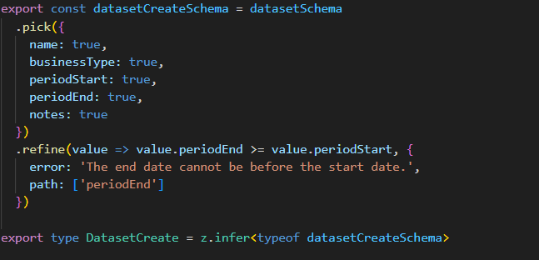

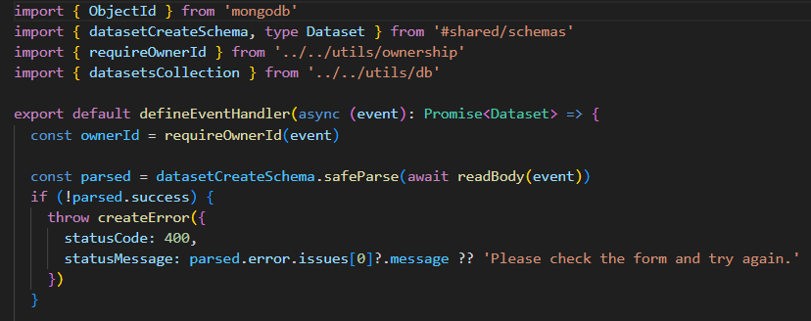
INSIGHTFLOW · NUXT / VUE
One validation contract serves the form and server
Write the rule once.
Enforce it twice.
CODE SCREENSHOT
Vue form
UForm binds to the create schema
Nitro handler
safeParse before persistence
Shared Zod schema
datasetCreateSchema
IDs, owner IDs and timestamps stay server-assigned.
Sumayya
InsightFlow · sources in notes
05
Notes:
The browser form and server route import the same create schema, so validation language cannot drift.
The create schema intentionally omits ownerId, id, rowCount, version pointer and timestamps. Those fields come from the signed session or server.
The screenshot combines three focused code crops: the schema definition, UForm binding and safeParse in the endpoint.
[Sources]
- Project source: shared/schemas/dataset.ts
- Project source: docs/DESIGN-SYSTEM.md
- https://zod.dev/
- https://ui.nuxt.com/components/form

Slide 6
INSIGHTFLOW · NUXT / VUE
Live flow: one upload crosses the full Nuxt stack
The feature is the round trip—not any single file.
1
2
3
4
5
OWNER
VUE
NITRO
MONGODB
UI
chooses CSV
$fetch on submit
auth + Zod + CSV
data set + rows + version
refreshes the owner view
Why this proves full-stack understanding
Every boundary preserves ownership, validation and a typed response back to the interface.
Sumayya
InsightFlow · sources in notes
06
Notes:
Trace the user action all the way through the stack. A button-triggered request uses $fetch, not useFetch.
The server checks the session, validates metadata and sales rows, writes MongoDB records, records a version, then the interface refreshes.
Emphasize the return path: the feature is complete only when the owner sees a useful result or a useful error.
[Sources]
- Project source: docs/HANDOFF.md
- https://nuxt.com/docs/4.x/api/utils/dollarfetch
- https://nuxt.com/docs/4.x/guide/directory-structure/server
- https://www.mongodb.com/docs/drivers/node/current/

Slide 7
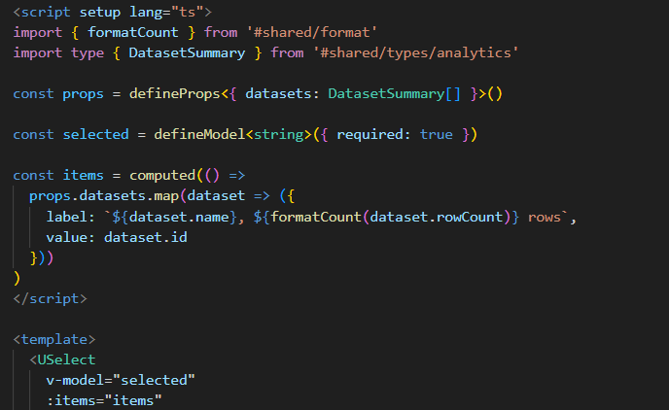
INSIGHTFLOW · NUXT / VUE
Vue tracks dependencies instead of rerunning everything
change
→
dependency
→
update
CODE SCREENSHOT
props.datasets
input from parent
computed(items)
derived select options
defineModel
selected data set
Yasser
InsightFlow · sources in notes
07
Notes:
Contrast the mental models carefully: Vue tracks which reactive values a computation or template reads, then updates the dependent work when those values change.
Use DatasetSelector as the project evidence: props provide data, defineModel carries selection, and computed derives display items.
Do not claim that Vue never re-renders a component; the point is dependency-tracked reactive updates rather than manually replacing state.
[Sources]
- Project source: app/components/dashboard/DatasetSelector.vue
- https://vuejs.org/guide/essentials/reactivity-fundamentals.html
- https://vuejs.org/guide/essentials/computed.html
- https://vuejs.org/guide/components/v-model.html

Slide 8
INSIGHTFLOW · NUXT / VUE
Components turn analytics data into explainable UI
A reusable component should make the meaning clearer—not hide it.
Typed response
Vue components
Owner meaning
summary · trend · forecast
metric card · table · chart
what changed · where · what next
Browser-only boundary
Chart or window-dependent code sits inside <ClientOnly> with a skeleton fallback.
Yasser
InsightFlow · sources in notes
08
Notes:
Components are valuable when they encode a stable explanation: formatting, labels, change direction and empty/loading states.
InsightFlow passes typed analytics into reusable components instead of letting each page reinterpret the same response.
Any component that touches a chart library or window must be inside ClientOnly with a skeleton fallback so server rendering remains safe.
[Sources]
- Project source: docs/DESIGN-SYSTEM.md
- Project source: AGENTS.md
- https://vuejs.org/guide/essentials/component-basics.html
- https://nuxt.com/docs/4.x/api/components/client-only

Slide 9
INSIGHTFLOW · NUXT / VUE
Use the smallest state mechanism that works
State should grow only when its sharing boundary grows.
useState
computed
defineModel
across Nuxt
ref
derived value
shared + hydration-safe
parent ↔ child
no duplicate source of truth
one component
two-way component contract
local interaction
narrow
shared
Yasser
InsightFlow · sources in notes
09
Notes:
Start narrow. A local ref is easier to reason about than a shared store; computed avoids copying derived state.
defineModel is a component contract for two-way binding, not a global state store.
Nuxt useState is for state shared across components and serialized through SSR hydration. It is not React's local useState hook despite the name.
[Sources]
- https://vuejs.org/api/reactivity-core.html#ref
- https://vuejs.org/api/reactivity-core.html#computed
- https://vuejs.org/guide/components/v-model.html
- https://nuxt.com/docs/4.x/api/composables/use-state

Slide 10
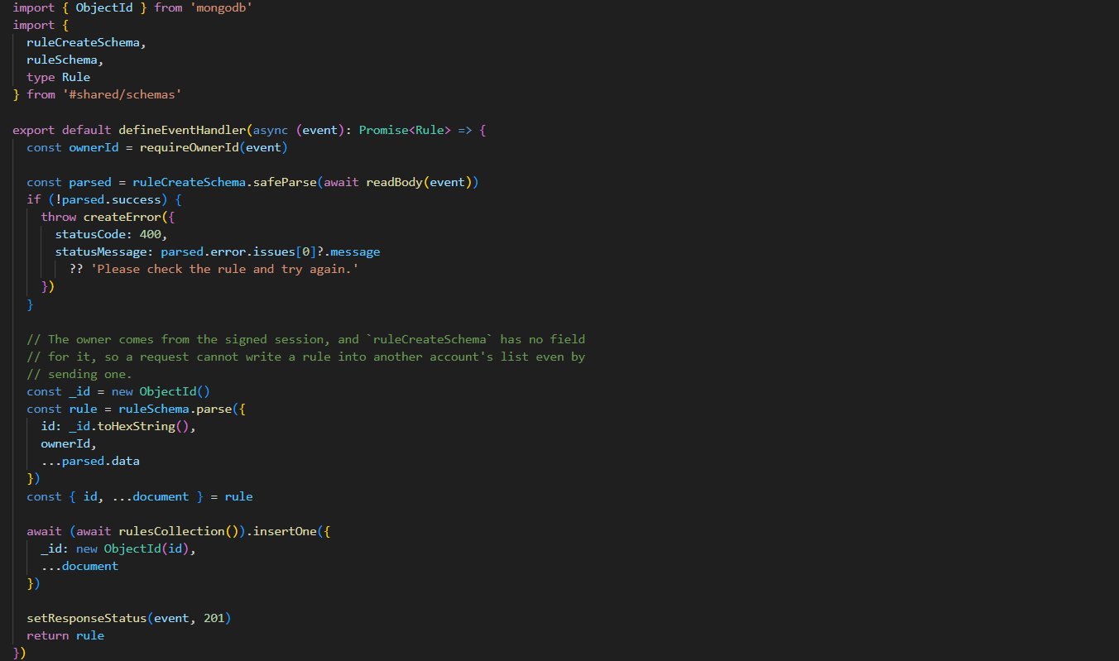
INSIGHTFLOW · NUXT / VUE
A server filename can become a validated CRUD endpoint
CODE SCREENSHOT
server/api/recommendations/rules.post.ts
01
requireOwnerId
scope the request
02
safeParse
reject invalid input
03
ruleSchema.parse
build the record
04
insertOne
persist with official driver
POST /api/recommendations/rules
Dalaa
InsightFlow · sources in notes
10
Notes:
The filename establishes the method and route; the handler still has to enforce every security and data boundary.
The endpoint takes owner identity from the signed session, parses the request with the shared create schema, creates a complete record, then writes through the official MongoDB driver.
The screenshot shows the final rules.post code crop. Use the four lines on the right to explain the request lifecycle.
[Sources]
- Project source: server/api/recommendations/rules.post.ts
- https://nuxt.com/docs/4.x/guide/directory-structure/server
- https://www.mongodb.com/docs/drivers/node/current/usage-examples/insertOne/
- https://zod.dev/

Slide 11
INSIGHTFLOW · NUXT / VUE
Full-stack features are flows, not isolated endpoints
InsightFlow extends one Nuxt architecture across the owner journey.
Owner action
Shared contract
Server logic
Explainable result
create rule · follow advice · publish finding
recommendation · outcome · insight
validate · measure · protect
next action · verdict · public finding
RECOMMENDATIONS
FOLLOW-UP
OUTCOMES
PUBLISH
what to do
what happened next
what changed
what can be shared
Dalaa
InsightFlow · sources in notes
11
Notes:
This slide stays on Dalaa's ownership: recommendation action, outcome measurement, and publishing.
The recommendation flow crosses a shared outcome contract, runs measurement on the server, and returns an explainable verdict.
Publishing hands the next public boundary to Mohammad; this slide stops at the private recommendation outcome.
[Sources]
- Project source: docs/HANDOFF.md
- Project source: docs/HANDOFF.md
- Project source: server/utils/forecast.ts
- Project source: server/utils/outcomes.ts

Slide 12
INSIGHTFLOW · NUXT / VUE
One recommendation crosses three Nuxt boundaries
Dalaa's flow keeps the action, measurement, and explanation connected.
VUE ACTION
NITRO ENDPOINT
OUTCOME VIEW
I followed this
POST /api/outcomes
/recommendations/:id/outcome
Input
followed date + note
validated owner action
equal comparison windows
Measurement
fourteen-day windows
freeze recommendation snapshot
server-owned readiness
Evidence
upload references + row counts
typed outcome response
visible observed comparison
Claim
Vue renders the verdict
Nitro calculates the verdict
the UI never claims causation
Dalaa
InsightFlow · sources in notes
12
Notes:
Keep this comparison balanced. Nuxt and Next.js both provide integrated application frameworks; their biggest practical difference here is the Vue versus React ecosystem and conventions.
A separated SPA and API can be the right choice when services need independent ownership or deployment, but it adds coordination across the boundary.
InsightFlow benefited from one team owning the browser, server endpoints and rendering policy in one Nuxt repository.
[Sources]
- https://nuxt.com/docs/4.x/getting-started/introduction
- https://nextjs.org/docs
- https://vuejs.org/guide/introduction.html
- https://react.dev/learn

Slide 13
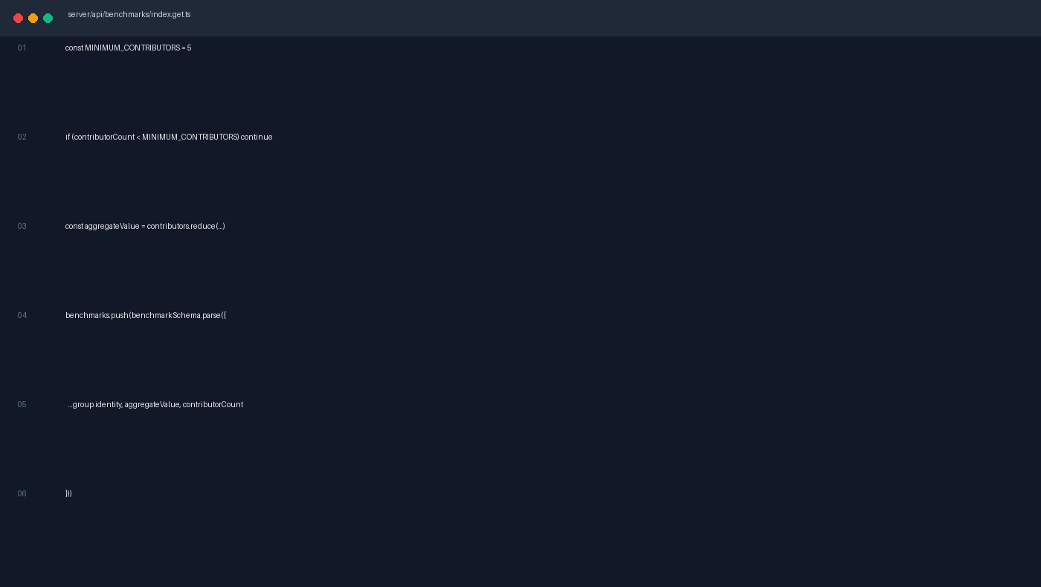
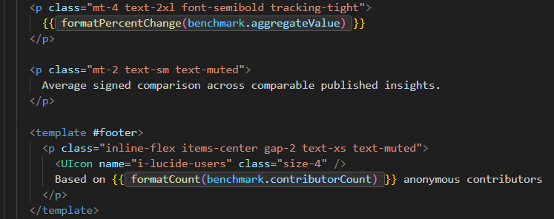
INSIGHTFLOW · NUXT / VUE
Mohammad's public route keeps rendering, caching and privacy together
CODE SCREENSHOT
A public page is a product boundary
1
PUBLISH
only selected findings
2
AGGREGATE
no raw private rows
3
SUPPRESS
fewer than 5 contributors
4
CACHE + SSR
public HTML, controlled freshness
Privacy is enforced in the endpoint—not left to the interface.
Mohammad
InsightFlow · sources in notes
13
Notes:
Public data is not simply private data with the login removed. The endpoint must expose only published fields and enforce aggregation and suppression.
The benchmark rule is a minimum of five contributors. Enforce it before returning data so the interface cannot bypass privacy.
The screenshot shows the completed benchmark endpoint: the five-contributor threshold, aggregate calculation and public anonymous result.
[Sources]
- Project source: shared/schemas/benchmark.ts
- Project source: docs/HANDOFF.md
- Project source: nuxt.config.ts
- https://nuxt.com/docs/4.x/guide/concepts/rendering#hybrid-rendering

Slide 14
INSIGHTFLOW · NUXT / VUE
A public InsightFlow route keeps its contract narrow
PUBLISHED FIELDS
BENCHMARK FLOOR
caption + percentage
5 contributors
PUBLIC PAGE
server-rendered feed
NITRO ENDPOINT
VUE CARD
no raw rows
anonymous aggregate
CACHE POLICY
PUBLIC CONTRACT
reusable HTML
selected findings only
Public by choice · private by default · one Nuxt boundary
Mohammad
InsightFlow · sources in notes
14
Notes:
Use the public route map to connect the feed, benchmark endpoint, and privacy floor.
The public contract stays visible: selected fields can leave the owner workspace, raw rows cannot.
Point to cache and SSR as the Nuxt choice for reusable public HTML.
[Sources]
- Project source: nuxt.config.ts
- Project source: docs/HANDOFF.md
- https://nuxt.com/docs/4.x/getting-started/introduction
- https://nitro.build/guide
- https://www.mongodb.com/docs/drivers/node/current/

Slide 15
THE TRANSFERABLE LESSON
Reason about
boundaries
The public route proves the boundary.
Framework knowledge becomes useful when it changes where code runs, who owns data, and how a user action returns as a trustworthy result.
InsightFlow: publish selected findings, preserve private sales data.
RENDER
VALIDATE
CONNECT
EXPLAIN
Mohammad
InsightFlow · sources in notes
15
Notes:
Resolve the opening claim: the team did not merely learn syntax; it learned to reason about boundaries.
Rendering decides where the page is built. Validation decides what may cross a boundary. Full-stack flows decide whether a feature is complete. Explainability decides whether the result is useful.
Close with the project evidence across this build, then invite questions about any boundary rather than ending with a generic thank-you.
[Sources]
- Project source: docs/HANDOFF.md
- Project source: docs/HANDOFF.md
- https://nuxt.com/docs/4.x/getting-started/introduction
- https://vuejs.org/guide/introduction.html

