Slide 1

Note: The data and information in this document is reflective of a hypothetical situation and client. This document is to be used for KPMG Virtual Internship purposes only.

Slide 2
Note: The data and information in this document is reflective of a hypothetical situation and client. This document is to be used for KPMG Virtual Internship purposes only.
Agenda
1. To find the significant data patterns in existing customer data
2. To find the new customers that fits in the patterns seen in 1 to boost the sales

Slide 3
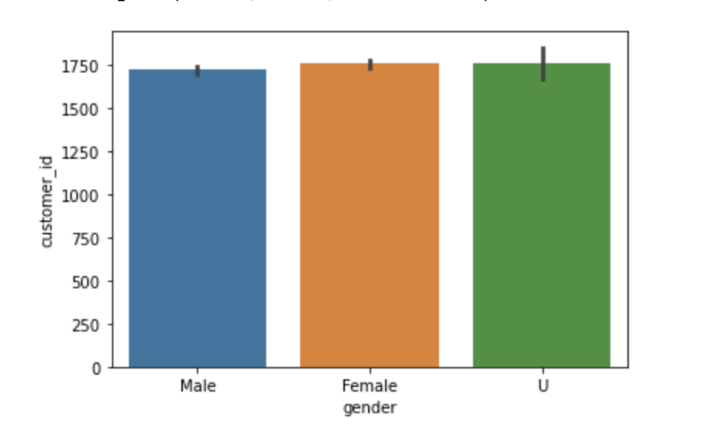
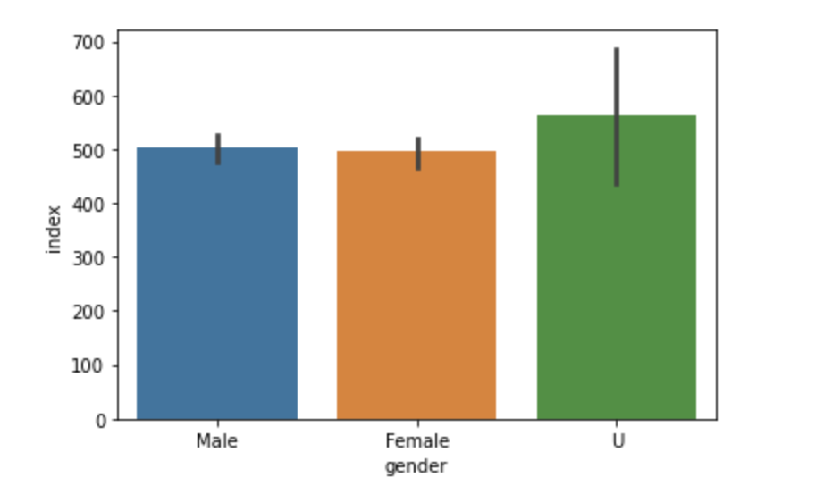
Note: The data and information in this document is reflective of a hypothetical situation and client. This document is to be used for KPMG Virtual Internship purposes only.
Introduction
Existing Customer data distribution based on Gender factor.
As per first bar plot, almost all genders have equal percentage in purchasing the products.
Though, the Female and Unknown genders customers are slightly more than Male customers. It is marginally more only.
Place any supporting images, graphs, data or extra text here.
From new customer dataset, we have Female and unknown customers more and both should be focused to get new customers.

Slide 4
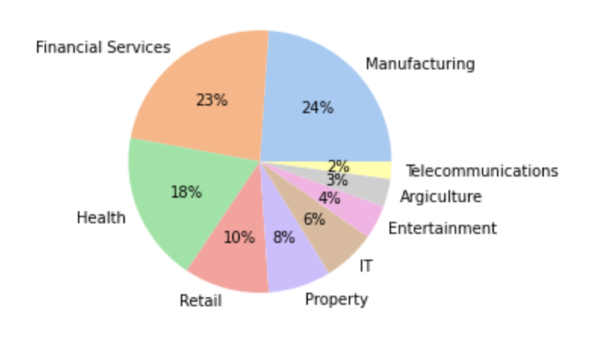
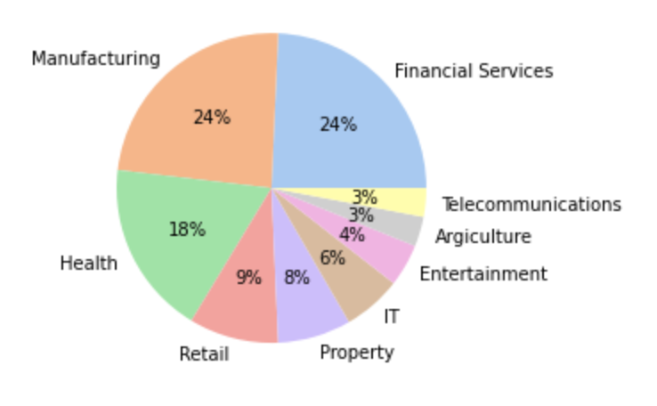
Note: The data and information in this document is reflective of a hypothetical situation and client. This document is to be used for KPMG Virtual Internship purposes only.
Data Exploration
customer distribution based on industry
Old Customer data presents that customers mostly belong from manufacture, financial, health, retail and property industries.
Place any supporting images, graphs, data or extra text here.
In new customer dataset, we have many potential customers belonging to these industries and that’s where we should focus to increase sale.

Slide 5
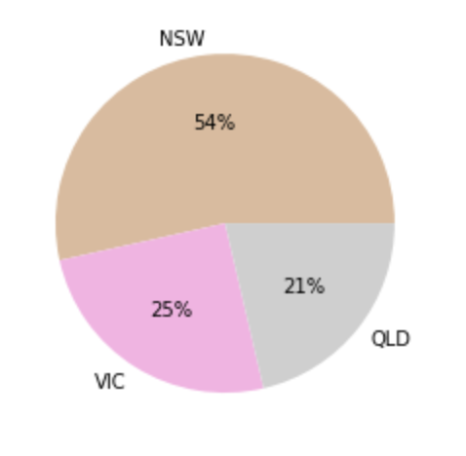
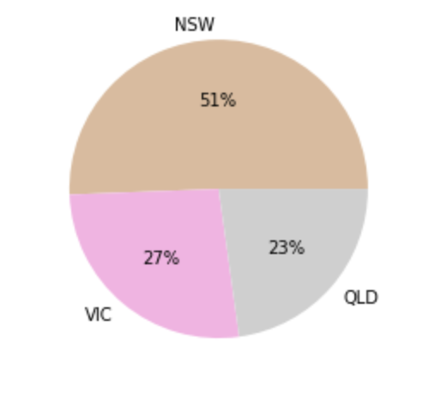
Note: The data and information in this document is reflective of a hypothetical situation and client. This document is to be used for KPMG Virtual Internship purposes only.
Model Development
The client should focus more on NSW customers to increase sales
Old customer Data
Place any supporting images, graphs, data or extra text here.
New Customer data

Slide 6
Note: The data and information in this document is reflective of a hypothetical situation and client. This document is to be used for KPMG Virtual Internship purposes only.
Interpretation
Customers should be selected based on the location they live (NSW), gender(Mostly females and unknown customer), and the field they work in like from manufacture, financial, health, retail and property industries.
Place any supporting images, graphs, data or extra text here.

Slide 7
Note: The data and information in this document is reflective of a hypothetical situation and client. This document is to be used for KPMG Virtual Internship purposes only.

Slide 8
Note: The data and information in this document is reflective of a hypothetical situation and client. This document is to be used for KPMG Virtual Internship purposes only.
Appendix

