Slide 1

A low latency Tor client
Muhammad Abdullah Malik & Zain Imran

Slide 2
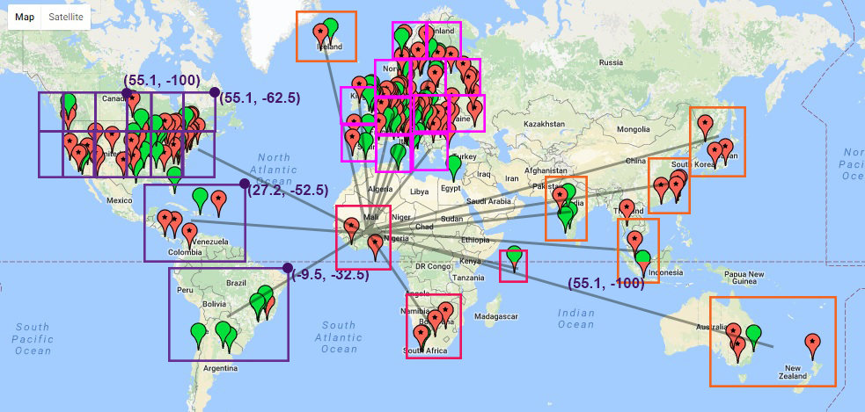
Introduction and Overview
The Problem Statement
Our Implementation
Initial Tests on Stem
Scripting Phase
Testing Phase

Slide 3
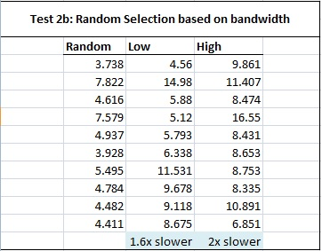
Evaluation & Results

Slide 4
Discussion and Future Work
Key Takeaways
Limitations
Future Work
Machine Learning

Slide 5
Thank you!

