Slide 1
AICP Internship Task Week 1

Slide 2
What is NumPy?
NumPy is a tool in Python that helps us work with numbers easily. It's like a magic box that lets us do math faster and simpler. We use it a lot for big number jobs like in science, data, and machines that learn.

Slide 3
QUESTION#1
Write a NumPy program to create an array of all even integers from 30 to 70.

Slide 4
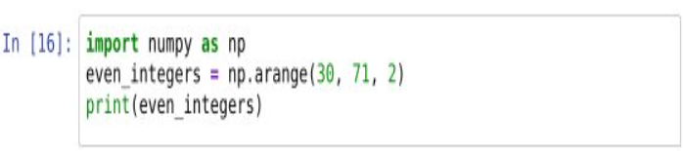
SOURCE CODE

Slide 5
HOW THE CODE WORKS
We start by telling our computer to get ready to use NumPy. We do this by writing "import numpy as np".
Then, we tell the computer to make a list of numbers for us. We want even numbers starting from 30 and ending at 70. We write "np.arange(30, 71, 2)" to do this.
After that, we ask the computer to remember this list of numbers. We give it a name "even numbers" to remember.
Finally, we ask the computer to show us the list of numbers it made. It does this by printing "even numbers" for us.

Slide 6
WHAT THE COMPUTER SHOW US
RUNTIME SCREEN
EXPLANATION
Here, we see what our computer made for us. It's a list of even numbers from 30 to 70. Each number is 2 more than the previous one. This list is what we asked for using the code.

Slide 7
QUESTION#2
Write a NumPy program to generate an array of 15 random numbers from a standard normal distribution.

Slide 8

SOURCE CODE

Slide 9
HOW THE CODE WORKS
First, we tell our computer to get ready to use NumPy. We do this by writing "import numpy as np".
Then, we ask NumPy to make a list of random numbers for us. We want 15 random numbers, and we write "np.random.randn(15)" to do this.
We give a name "random_numbers" to remember this list of random numbers.
Finally, we ask the computer to show us the list of random numbers it made by printing "random_numbers".

Slide 10

WHAT THE COMPUTER SHOW US
RUNTIME SCREEN
EXPLANATION
Here, we see what our computer made for us. It's a list of 15 random numbers. These numbers can be any real number and are chosen randomly by the computer. This list is what we asked for using the code.

Slide 11
QUESTION#3
How to compute the cross-product of two matrices in NumPy?

Slide 12
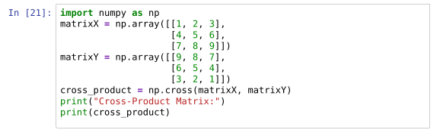
SOURCE CODE

Slide 13
HOW THE CODE WORKS
First, we import the NumPy library and give it the alias "np". This allows us to use NumPy's functions and tools in our code.
Then, we create two matrices named matrixX and matrixY. Each matrix is made of rows and columns of numbers. Here, we have two matrices each with 3 rows and 3 columns.
We use np.array() to create these matrices. The numbers inside the square brackets represent the rows, and the rows are separated by commas. The whole thing is inside another set of square brackets, which tells NumPy that it's an array.
After creating the matrices, we calculate their cross-product using np.cross(matrixX, matrixY). The cross-product of two matrices is a mathematical operation that gives us a new matrix.
Finally, we print the result, which is the cross-product matrix.

Slide 14
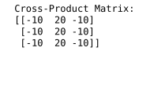
WHAT THE COMPUTER SHOW US
EXPLANATION
RUNTIME SCREEN
This is the cross-product matrix that our code produced. Each number in the matrix is calculated using a specific mathematical formula involving the numbers from the original matrices. The cross-product helps us understand relationships between the matrices.

Slide 15
QUESTION#4
How to compute the determinant of an array using NumPy?

Slide 16
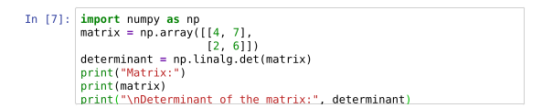
SOURCE CODE

Slide 17
HOW THE CODE WORKS
First, we import the NumPy library and give it the alias "np". This allows us to use NumPy's functions and tools in our code.
Then, we create a matrix named "matrix". This matrix has 2 rows and 2 columns, filled with specific numbers. We use np.array() to create the matrix.
Next, we calculate the determinant of the matrix using np.linalg.det(matrix). The determinant is a special number that helps us understand properties of the matrix.
Finally, we print both the matrix and its determinant using print() statements.

Slide 18

WHAT THE COMPUTER SHOW US
RUNTIME SCREEN
EXPLANATION
This is the matrix that our code produced. Each number in the matrix is part of a mathematical calculation to find its determinant. The determinant is a single number calculated from the matrix. In this case, the determinant is also shown here.

Slide 19
QUESTION#5
How to create a 3x3x3 array with random values using NumPy?

Slide 20

SOURCE CODE

Slide 21
HOW THE CODE WORKS
First, we import the NumPy library and give it the alias "np". This allows us to use NumPy's functions and tools in our code.
Then, we create a random array named "random_array" with a shape of (3, 3, 3). This means it's a 3-dimensional array with 3 elements along each dimension. We use np.random.rand() to generate random numbers and arrange them into this array shape.
Finally, we print the random array using print().

Slide 22
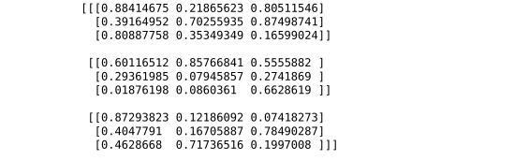
WHAT THE COMPUTER SHOW US
RUNTIME SCREEN
EXPLANATION
This is the 3D random array that our code produced. It consists of three layers, each containing three rows and three columns of random numbers. These numbers are chosen randomly by the computer.

Slide 23
QUESTION#6
How to create a 5x5 array with random values and find the minimum and maximum values using NumPy?

Slide 24
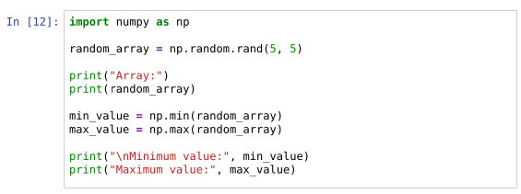
SOURCE CODE

Slide 25
HOW THE CODE WORKS
First, we import the NumPy library and give it the alias "np". This allows us to use NumPy's functions and tools in our code.
Then, we create a random array named "random_array" with a shape of (5, 5). This means it's a 2-dimensional array with 5 rows and 5 columns. We use np.random.rand() to generate random numbers and arrange them into this array shape.
Next, we print the random array using print() to show the numbers.
After that, we find the minimum and maximum values in the random array using np.min() and np.max() functions, respectively.
Finally, we print the minimum and maximum values using print().

Slide 26
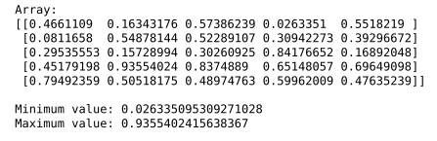
WHAT THE COMPUTER SHOW US
RUNTIME SCREEN
EXPLANATION
This is the random array that our code produced. It consists of 5 rows and 5 columns of random numbers. We also found the minimum and maximum values in this array, which are shown here.

Slide 27
QUESTION#7
How to compute the mean, standard deviation, and variance of a given array along the second axis in NumPy?

Slide 28
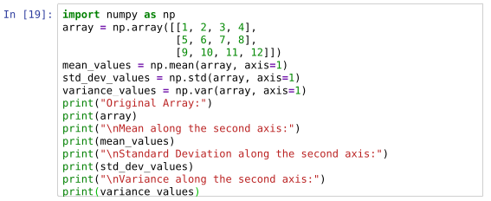
SOURCE CODE

Slide 29
HOW THE CODE WORKS
First, we import the NumPy library and give it the alias "np". This allows us to use NumPy's functions and tools in our code.
Then, we create a 2-dimensional array named "array". This array has 3 rows and 4 columns filled with specific numbers. We use np.array() to create the array.
Next, we calculate the mean, standard deviation, and variance along the second axis of the array using np.mean(), np.std(), and np.var() functions respectively. The second axis represents the rows in our 2D array.
Finally, we print the original array along with the calculated mean, standard deviation, and variance values.

Slide 30
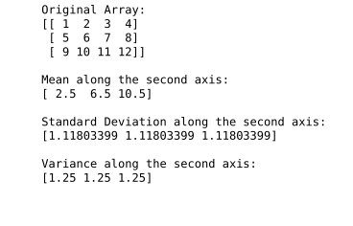
WHAT THE COMPUTER SHOW US
RUNTIME SCREEN
EXPLANATION
This is the original array that our code produced. Each row represents a set of numbers. We also calculated the mean, standard deviation, and variance for each row, and the results are shown here.

Slide 31
Summary
NumPy is a powerful library for numerical computing in Python.
It provides a wide range of functions for creating, manipulating, and analyzing arrays and matrices.
With NumPy, you can efficiently perform complex mathematical operations, handle large datasets, and conduct statistical analysis with ease.
Mastering NumPy opens up opportunities to work on a diverse range of projects, from scientific research to machine learning and data analysis.

Slide 32

Thank you
Malik M Shahmeer Rashid
malikmshahmeerrashid@gmail.com

