Slide 1
AICP INTERNSHIP
Task Week 2

Slide 2
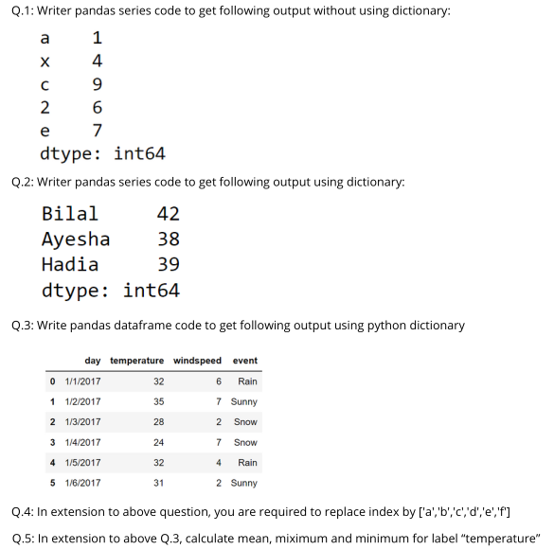
Agenda

Slide 3
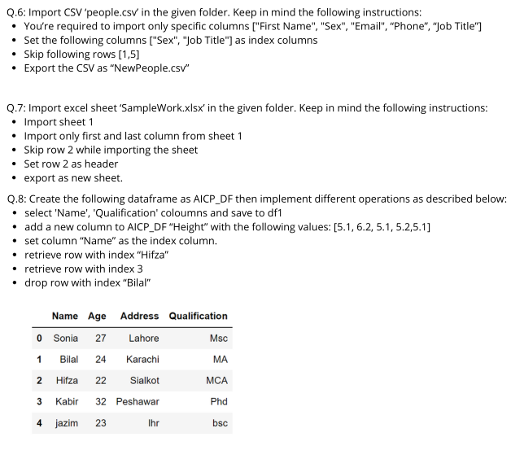
Agenda

Slide 4
What is Pandas?
Python Library for Data Manipulation & Analysis
DataFrame: 2D labeled data structure, akin to a spreadsheet or SQL table.
Series: 1D labeled array, representing a single column of data.
Data manipulation: Functions for indexing, slicing, merging, joining, reshaping, and aggregating.
Missing data handling: Tools for filling, dropping, and interpolating missing values.
Grouping & aggregation: Support for grouping data and performing operations like sum, mean, count.
Time series analysis: Features for date range generation, time zone handling, resampling, frequency conversion.
Input/output: Capabilities to read/write data from/to various formats like CSV, Excel, SQL, JSON, HDF5.

Slide 5
QUESTION#1
Writer pandas series code to get following output without using dictionary:
a 1
x 4
c 9
2 6
e 7
dtype: int 64

Slide 6
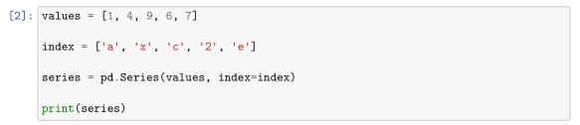
SOURCE CODE

Slide 7
HOW THE CODE WORKS
This code creates a Pandas Series object, which is like a labeled array or a column in a table. Let's break down what each part of the code does:
values = [1, 4, 9, 6, 7]: This line creates a list called values containing some numbers: 1, 4, 9, 6, and 7.
index = ['a', 'x', 'c', '2', 'e']: This line creates another list called index, which contains labels ('a', 'x', 'c', '2', 'e') corresponding to each value in the values list. These labels will be used to identify each value in the series.
series = pd.Series(values, index=index): This line creates a Pandas Series object named series. It takes two arguments:
values: The list of values to be stored in the series.
index: The list of labels to be used as indices for the values in the series.
The function pd.Series() from the Pandas library is used to create the series.
4. print(series): This line prints out the series created in the previous step.

Slide 8
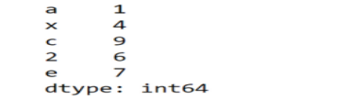
WHAT THE COMPUTER SHOW US
RUNTIME SCREEN
EXPLANATION
This code creates a series of numbers (1, 4, 9, 6, 7) and assigns labels ('a', 'x', 'c', '2', 'e') to each number. Then it prints out the series, which shows each number along with its corresponding label.

Slide 9
QUESTION#2
Writer pandas series code to get following output using dictionary:
Bilal 42
Ayesha 38
Hadia 30
dtype: int64

Slide 10

SOURCE CODE

Slide 11
HOW THE CODE WORKS
This code creates a Pandas Series object from a Python dictionary.
Let's break it down:
data = {'Bilal': 42, 'Ayesha': 38, 'Hadia': 30}: This line creates a Python dictionary called data. Each key-value pair in the dictionary represents a label-value pair for the series. For example, 'Bilal': 42 means that 'Bilal' is a label associated with the value 42.
series = pd.Series(data): This line creates a Pandas Series object named series using the dictionary data. The keys of the dictionary become the index labels of the series, and the corresponding values become the values in the series. The function pd.Series() from the Pandas library is used to create the series.
print(series): This line prints out the series created in the previous step.

Slide 12

WHAT THE COMPUTER SHOW US
RUNTIME SCREEN
EXPLANATION
This code creates a series with three items, where 'Bilal' is associated with the number 42, 'Ayesha' is associated with 38, and 'Hadia' is associated with 30. Then it prints out the series, which shows each name along with their corresponding age.

Slide 13
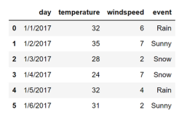
QUESTION#3
Write pandas dataframe code to get following output using python dictionary

Slide 14
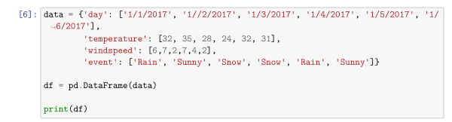
SOURCE CODE

Slide 15
HOW THE CODE WORKS
This code creates a Pandas DataFrame from a dictionary where the keys are column names and the values are lists of data.
Let's break it down:
data: This dictionary contains four keys: 'day', 'temperature', 'windspeed', and 'event'. Each key corresponds to a column in the DataFrame.
df = pd.DataFrame(data): This line creates a Pandas DataFrame named df using the dictionary data. The keys become column names, and the corresponding lists become the values in those columns. The function pd.DataFrame() from the Pandas library is used to create the DataFrame.
print(df): This line prints out the DataFrame created in the previous step.

Slide 16
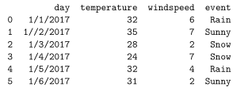
WHAT THE COMPUTER SHOW US
RUNTIME SCREEN
EXPLANATION
This code organizes data about the weather for different days into a table. Each row represents a different day, and the columns contain information about the date, temperature, wind speed, and weather event for that day. Then it prints out the DataFrame, displaying this tabular data.

Slide 17
QUESTION#4
In extension to above question, you are required to replace index by ['a','b','c','d','e','f']

Slide 18
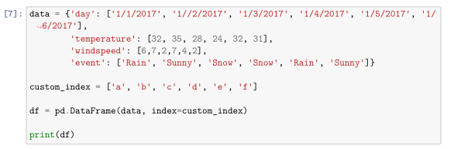
SOURCE CODE

Slide 19
HOW THE CODE WORKS
This code is very similar to the previous one, but it allows for custom index labels to be assigned to each row of the DataFrame.
Let's break it down:
data: This dictionary contains four keys: 'day', 'temperature', 'windspeed', and 'event'. Each key corresponds to a column in the DataFrame, just like before.
custom_index = ['a', 'b', 'c', 'd', 'e', 'f']: This line creates a list called custom_index, which contains custom labels for each row of the DataFrame. These labels will replace the default numeric index labels (0, 1, 2, ...) with the specified labels ('a', 'b', 'c', 'd', 'e', 'f').
df = pd.DataFrame(data, index=custom_index): This line creates a Pandas DataFrame named df using the dictionary data. Additionally, it specifies the index parameter to use the custom index labels provided in the custom_index list. So each row of the DataFrame will be labeled with the corresponding label from the custom_index list.
print(df): This line prints out the DataFrame created in the previous step.

Slide 20
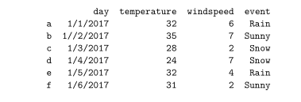
WHAT THE COMPUTER SHOW US
EXPLANATION
RUNTIME SCREEN
This code organizes weather data into a table, just like before, but this time, it assigns custom labels ('a', 'b', 'c', 'd', 'e', 'f') to each row of the DataFrame. Then it prints out the DataFrame, displaying this tabular data with custom row labels.

Slide 21
QUESTION#5
In extension to above Q.3, calculate mean, miximum and minimum for label “temperature”.

Slide 22
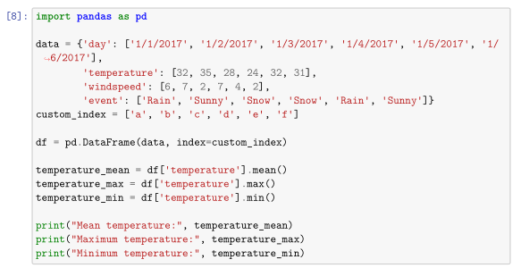
SOURCE CODE

Slide 23
HOW THE CODE WORKS
Creating the DataFrame:
This block of code creates a DataFrame named df using the pd.DataFrame() function from Pandas.
The DataFrame is created from the data dictionary, with custom row indices provided by the custom_index list.
Calculating statistics:
temperature_mean = df['temperature'].mean()
temperature_max = df['temperature'].max()
temperature_min = df['temperature'].min()
The mean(), max(), and min() methods are applied to the 'temperature' column using DataFrame indexing (df['temperature']).
Printing the results:
print("Mean temperature:", temperature_mean)
print("Maximum temperature:", temperature_max)
print("Minimum temperature:", temperature_min)

Slide 24

WHAT THE COMPUTER SHOW US
RUNTIME SCREEN
EXPLANATION
This code creates a table of weather data with custom row labels. Then it calculates and prints out the mean, maximum, and minimum temperatures from that data.

Slide 25
QUESTION#6
Import CSV ‘people.csv’ in the given folder. Keep in mind the following instructions:
You’re required to import only specific columns ["First Name", "Sex", "Email", “Phone”, “Job Title”]
Set the following columns ["Sex", "Job Title"] as index columns
Skip following rows [1,5]
Export the CSV as “NewPeople.csv”

Slide 26
SOURCE CODE

Slide 27
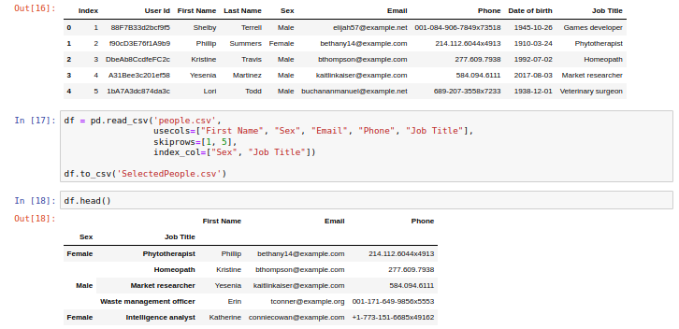
WHAT THE COMPUTER SHOW US
RUNTIME SCREEN

Slide 28
QUESTION#7
Import excel sheet ‘SampleWork.xlsx’ in the given folder. Keep in mind the following instructions:
Import sheet 1
Import only first and last column from sheet 1
Skip row 2 while importing the sheet
Set row 2 as header
export as new sheet.

Slide 29
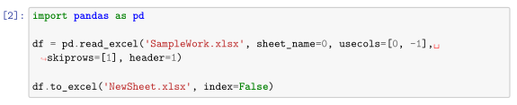
SOURCE CODE

Slide 30
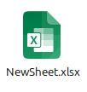
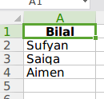
WHAT THE COMPUTER SHOW US
RUNTIME SCREEN
EXPLANATION

Slide 31
QUESTION#8
Create the following dataframe as AICP_DF then implement different operations as described below:
select 'Name', 'Qualification' coloumns and save to df1
add a new column to AICP_DF “Height” with the following values: [5.1, 6.2, 5.1, 5.2,5.1]
set column “Name” as the index column.
retrieve row with index “Hifza”
retrieve row with index 3
drop row with index “Bilal”

Slide 32
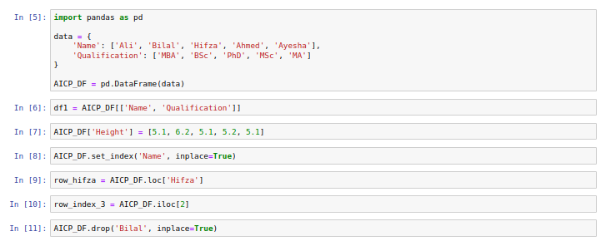
SOURCE CODE

Slide 33
Summary
- Demonstrates use of Pandas library in Python for data manipulation and analysis.
- Starts with importing Pandas and creating a DataFrame from a dictionary of weather data.
- DataFrame organizes data into rows and columns with custom row labels.
- Calculates descriptive statistics (mean, max, min temperatures) using Pandas' statistical methods.
- Utilizes `mean()`, `max()`, and `min()` functions for statistical analysis.
- Stores calculated statistics in separate variables for later use.
- Prints results to the console for easy interpretation.
- Provides foundational understanding of DataFrame creation, indexing, and basic operations.

Slide 34

Thank you
Malik M Shahmeer Rashid
malikmshahmeerrashid@gmail.com

