Slide 1
AICP INTERNSHIP
WEEK#3:
TASK(Data visualizations)

Slide 2
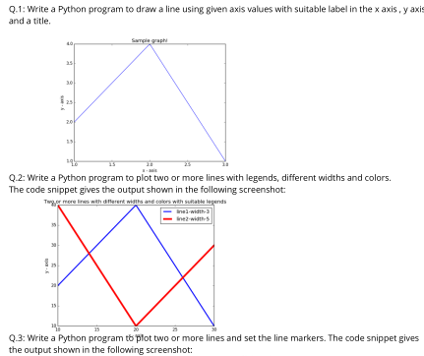
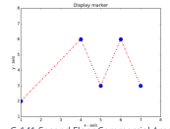
Agenda

Slide 3
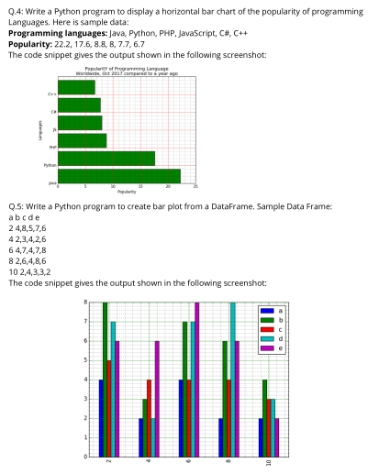
Agenda

Slide 4
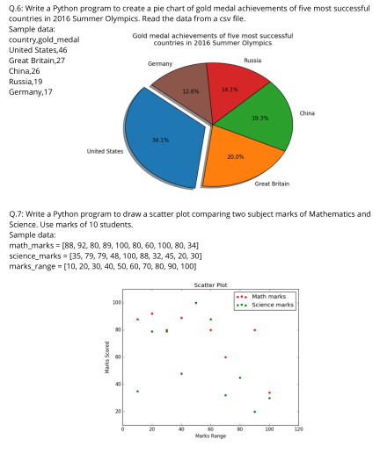
Agenda

Slide 5
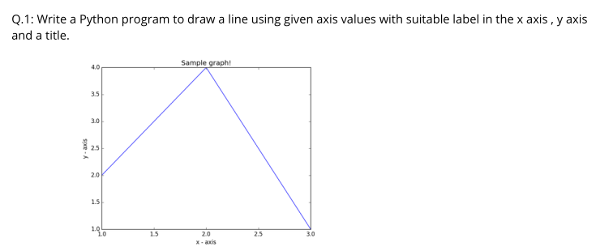
QUESTION#1

Slide 6
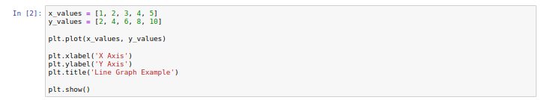
SOURCE CODE

Slide 7
HOW THE CODE WORKS
Initialize lists `x_values` and `y_values` with data points for the x and y axes respectively.
Use `plt.plot(x_values, y_values)` to create a line plot with the specified data points.
Set the label for the x-axis using `plt.xlabel('X Axis')`.
Set the label for the y-axis using `plt.ylabel('Y Axis')`.
Set the title of the plot using `plt.title('Line Graph Example')`.
Use `plt.show()` to display the plot.

Slide 8
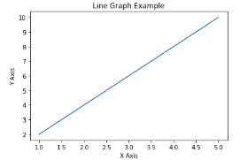
WHAT THE COMPUTER SHOW US
RUNTIME SCREEN

Slide 9
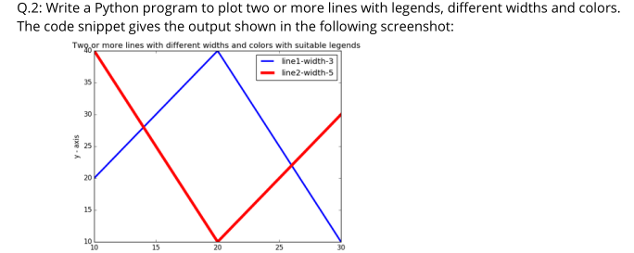
QUESTION#2

Slide 10
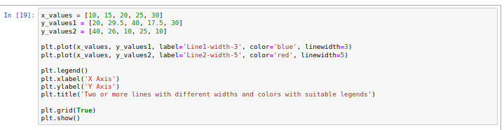
SOURCE CODE

Slide 11
HOW THE CODE WORKS
- Define the x-axis values in the list `x_values`.
- Define two sets of y-axis values in lists `y_values1` and `y_values2`.
- Use `plt.plot(x_values, y_values1, label='Line1-width-3', color='blue', linewidth=3)` to plot the first line with specified attributes:
- Label it as "Line1-width-3" for the legend.
- Set the line color to blue.
- Set the line width to 3.
- Use `plt.plot(x_values, y_values2, label='Line2-width-5', color='red', linewidth=5)` to plot the second line with specified attributes:
- Label it as "Line2-width-5" for the legend.
- Set the line color to red.
- Set the line width to 5.
- Add a legend to the plot using `plt.legend()` to differentiate between the lines.
- Set the label for the x-axis using `plt.xlabel('X Axis')`.
- Set the label for the y-axis using `plt.ylabel('Y Axis')`.
- Set the title of the plot using `plt.title('Two or more lines with different widths and colors with suitable legends')`.
- Enable grid lines on the plot using `plt.grid(True)`.
- Display the plot using `plt.show()`.

Slide 12
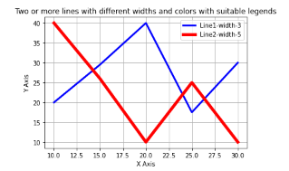
WHAT THE COMPUTER SHOW US
RUNTIME SCREEN

Slide 13
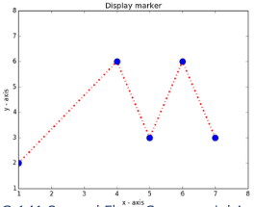
QUESTION#3

Slide 14
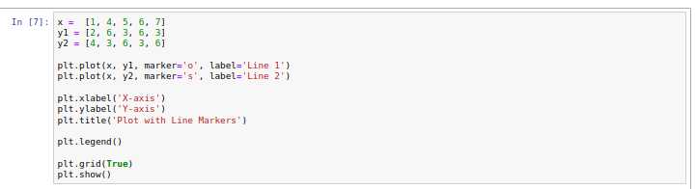
SOURCE CODE

Slide 15
HOW THE CODE WORKS
- Define the x-axis values in the list `x`.
- Define two sets of y-axis values in lists `y1` and `y2`.
- Use `plt.plot(x, y1, marker='o', label='Line 1')` to plot the first line with circular markers:
- Specify markers as circles with `marker='o'`.
- Label it as "Line 1" for the legend.
- Use `plt.plot(x, y2, marker='s', label='Line 2')` to plot the second line with square markers:
- Specify markers as squares with `marker='s'`.
- Label it as "Line 2" for the legend.
- Add a legend to the plot using `plt.legend()` to differentiate between the lines.
- Set the label for the x-axis using `plt.xlabel('X-axis')`.
- Set the label for the y-axis using `plt.ylabel('Y-axis')`.
- Set the title of the plot using `plt.title('Plot with Line Markers')`.
- Enable grid lines on the plot using `plt.grid(True)`.
- Display the plot using `plt.show()`.

Slide 16
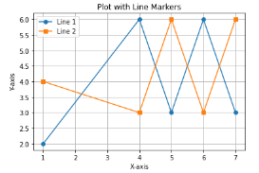
WHAT THE COMPUTER SHOW US
RUNTIME SCREEN

Slide 17
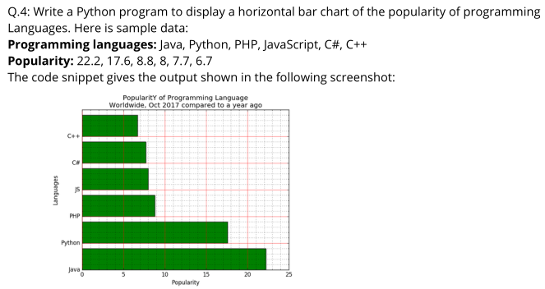
QUESTION#4

Slide 18
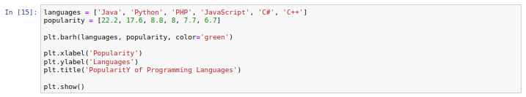
SOURCE CODE

Slide 19
HOW THE CODE WORKS
- Define a list `languages` containing the names of programming languages.
- Define a list `popularity` containing the popularity scores of corresponding programming languages.
- Use `plt.barh(languages, popularity, color='green')` to create a horizontal bar chart:
- `languages` is used as the y-axis values.
- `popularity` is used as the width of the bars.
- Set the color of the bars to green.
- Set the label for the x-axis using `plt.xlabel('Popularity')`.
- Set the label for the y-axis using `plt.ylabel('Languages')`.
- Set the title of the plot using `plt.title('Popularity of Programming Languages')`.
- Display the plot using `plt.show()`.

Slide 20
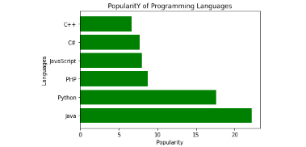
WHAT THE COMPUTER SHOW US
RUNTIME SCREEN

Slide 21
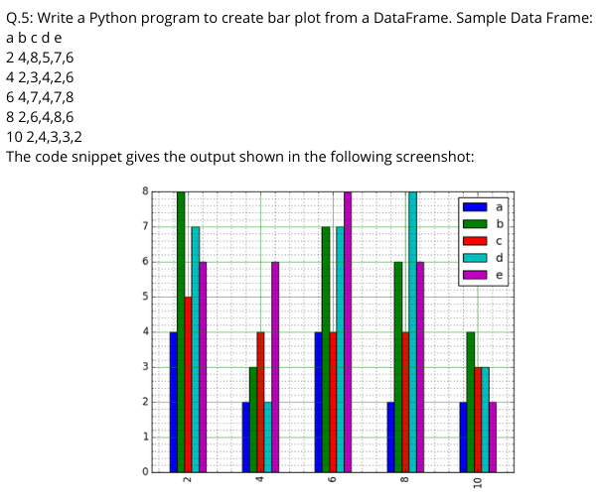
QUESTION#5

Slide 22
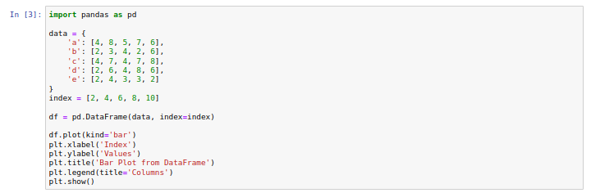
SOURCE CODE

Slide 23
HOW THE CODE WORKS
- Import the pandas library as `pd`.
- Create a dictionary `data` containing data for columns 'a' to 'e'.
- Create a list `index` containing index values.
- Use `pd.DataFrame(data, index=index)` to create a DataFrame `df` with the given data and index.
- Use `df.plot(kind='bar')` to create a bar plot from the DataFrame:
- Each column in the DataFrame will be represented as a set of bars.
- Set the label for the x-axis using `plt.xlabel('Index')`.
- Set the label for the y-axis using `plt.ylabel('Values')`.
- Set the title of the plot using `plt.title('Bar Plot from DataFrame')`.
- Add a legend to the plot using `plt.legend(title='Columns')` to specify the titles of the legend.
- Display the plot using `plt.show()`.

Slide 24
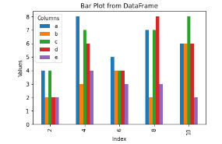
WHAT THE COMPUTER SHOW US
RUNTIME SCREEN

Slide 25
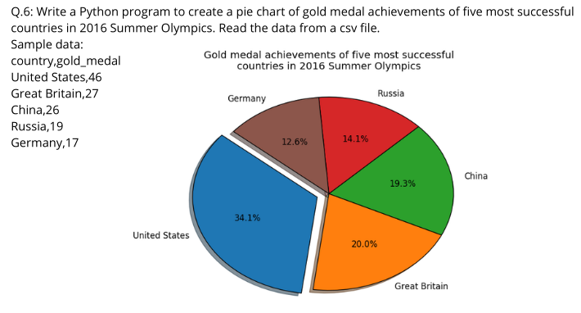
QUESTION#6

Slide 26
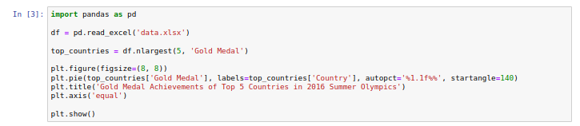
SOURCE CODE

Slide 27
HOW THE CODE WORKS
- Import the pandas library as `pd`.
- Use `pd.read_excel('data.xlsx')` to read data from an Excel file into a DataFrame `df`.
- Select the top 5 countries with the most gold medals using `df.nlargest(5, 'Gold Medal')`.
- Set the figure size for the pie chart using `plt.figure(figsize=(8, 8))`.
- Use `plt.pie()` to create a pie chart:
- Pass the gold medal counts as the data to be plotted.
- Set country names as labels using `labels=top_countries['Country']`.
- Use `autopct='%1.1f%%'` to display percentages with one decimal place.
- Set the starting angle of the pie chart to 140 degrees using `startangle=140`.
- Set the title of the plot using `plt.title('Gold Medal Achievements of Top 5 Countries in 2016 Summer Olympics')`.
- Set the aspect ratio of the plot to be equal using `plt.axis('equal')` to ensure a circular shape.
- Display the plot using `plt.show()`.

Slide 28
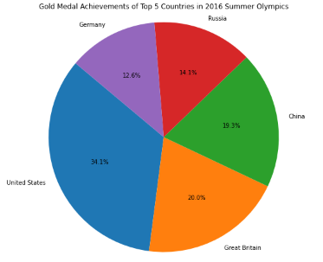
WHAT THE COMPUTER SHOW US
RUNTIME SCREEN

Slide 29
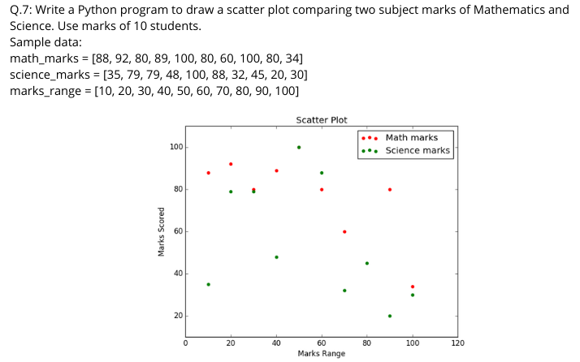
QUESTION#7

Slide 30
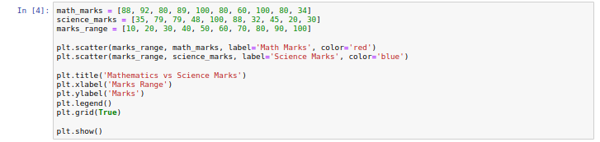
SOURCE CODE

Slide 31
HOW THE CODE WORKS
- Define three lists:
- `math_marks` containing marks for Mathematics.
- `science_marks` containing marks for Science.
- `marks_range` containing the range of marks.
- Use `plt.scatter(marks_range, math_marks, label='Math Marks', color='red')` to create a scatter plot for Mathematics marks:
- Plot Mathematics marks against the marks range.
- Use `plt.scatter(marks_range, science_marks, label='Science Marks', color='blue')` to create a scatter plot for Science marks:
- Plot Science marks against the marks range.
- Set the title of the plot using `plt.title('Mathematics vs Science Marks')`.
- Set the label for the x-axis using `plt.xlabel('Marks Range')`.
- Set the label for the y-axis using `plt.ylabel('Marks')`.
- Add a legend to the plot using `plt.legend()` to differentiate between Mathematics and Science marks.
- Enable grid lines on the plot using `plt.grid(True)`.
- Display the plot using `plt.show()`.

Slide 32
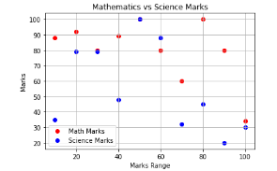
WHAT THE COMPUTER SHOW US
RUNTIME SCREEN

Slide 33
Summary
Draw a line using given axis values, label the x and y axes, and add a title to the plot.
Plot two or more lines on a graph with legends, different widths, and colors.
Plot two or more lines and set markers on the lines.
Display a horizontal bar chart showing the popularity of different programming languages.
Create a bar plot from a DataFrame containing sample data.
Create a pie chart showing the gold medal achievements of the top five countries in the 2016 Summer Olympics, using data from a CSV file.
Draw a scatter plot comparing the marks of Mathematics and Science subjects for 10 students.

Slide 34

THANK YOU
Malik M Shahmeer Rashid
malikmshahmeerrashid@gmail.com

