Slide 1
AICP INTERNSHIP
WEEK#4:
TASK(Data Visualization)

Slide 2
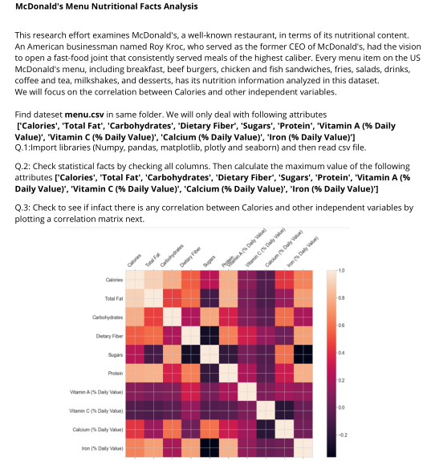
Agenda

Slide 3
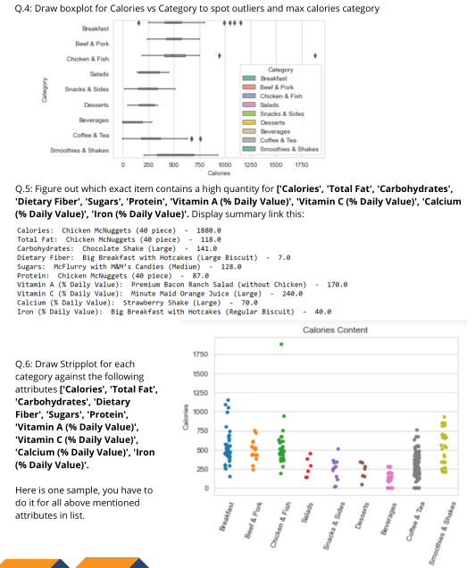
Agenda

Slide 4
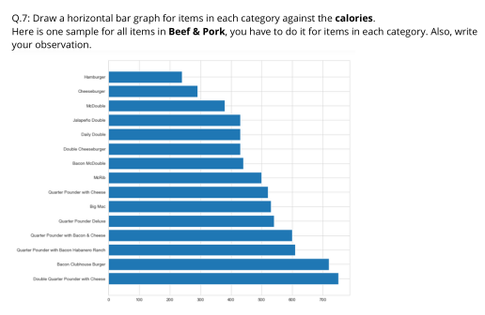
Agenda

Slide 5

QUESTION#1

Slide 6
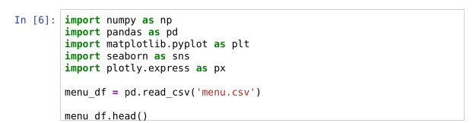
SOURCE CODE

Slide 7
HOW THE CODE WORKS
We start by importing necessary libraries like NumPy, Pandas, Matplotlib, Seaborn, and Plotly Express.
These libraries help us with data manipulation, visualization, and analysis.
We read a dataset called 'menu.csv' using Pandas.
This dataset likely contains information about McDonald's menu items, such as their nutritional content.
After reading the data, we display the first few rows using the `head()` function.
This allows us to understand the structure of the dataset and see what kind of information it contains.
By looking at the first few rows of the dataset, we can see various columns like Calories, Total Fat, Carbohydrates, etc.
Each row represents a different menu item, and each column contains specific information about that item, such as its nutritional values.
With the dataset loaded, we're ready to analyze it further.
We can explore things like the distribution of calories, correlation between different attributes, and comparisons between menu categories.

Slide 8
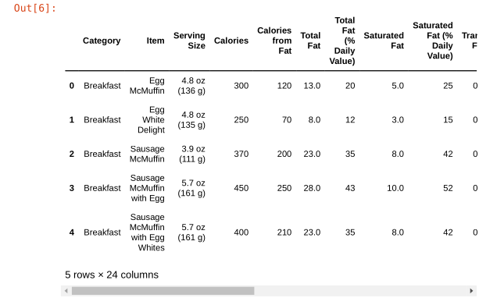
WHAT THE COMPUTER SHOW US
RUNTIME SCREEN

Slide 9

QUESTION#2

Slide 10
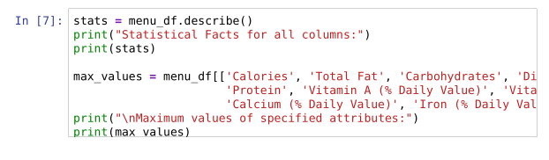
SOURCE CODE

Slide 11
HOW THE CODE WORKS
We use the `describe()` method on the `menu_df` DataFrame to compute statistical facts for all columns.
Statistical facts include count, mean, standard deviation, minimum value, 25th percentile, median (50th percentile), 75th percentile, and maximum value for each numeric column.
This helps us understand the central tendency, dispersion, and shape of the distribution of each attribute.
After calculating statistical facts, we print them out to the console for easy viewing.
This allows us to quickly grasp the overall summary statistics of the dataset, including measures like the mean calorie count, maximum sugar content, etc.
We extract specific attributes (Calories, Total Fat, Carbohydrates, etc.) from the `menu_df` DataFrame.
Then, we use the `max()` method to find the maximum value for each of these attributes across all menu items.
This helps us identify which menu item has the highest calorie count, fat content, carbohydrate level, etc.
Finally, we print out the maximum values of the specified attributes to the console.
This provides us with insights into the most calorie-dense, fat-rich, or nutrient-packed menu items.

Slide 12
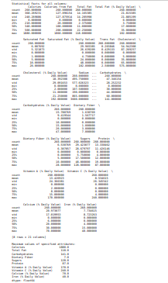
WHAT THE COMPUTER SHOW US
RUNTIME SCREEN

Slide 13
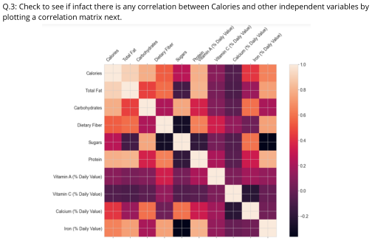
QUESTION#3

Slide 14
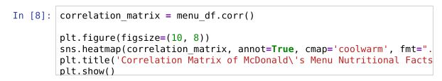
SOURCE CODE

Slide 15
HOW THE CODE WORKS
We use the `corr()` method on the `menu_df` DataFrame to compute the correlation matrix.
The correlation matrix shows how each pair of attributes in the dataset is related to each other.
Correlation values range from -1 to 1, where:
1 indicates a perfect positive correlation, -1 indicates a perfect negative correlation, and 0 indicates no correlation.
After calculating the correlation matrix, we create a heatmap using Matplotlib and Seaborn.
The heatmap visualizes the correlation matrix, with each cell color-coded based on the correlation value.
We set annotations to True to display correlation values inside each cell for easy interpretation.
The 'coolwarm' colormap is used to represent positive and negative correlations with different colors, enhancing visualization.
The `fmt=".2f"` parameter formats the annotation text to two decimal places.
Adjustments like setting the figure size and linewidths help improve the aesthetics of the heatmap.
Finally, we display the correlation matrix heatmap in the plot window.
This visualization allows us to quickly identify patterns of association between different nutritional attributes in the McDonald's menu dataset.

Slide 16
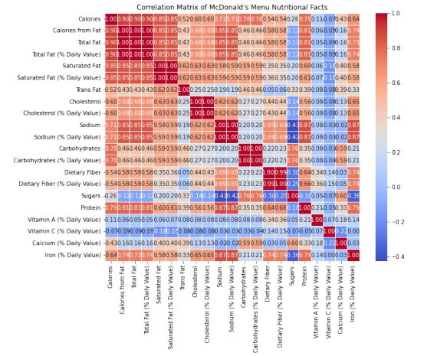
WHAT THE COMPUTER SHOW US
RUNTIME SCREEN

Slide 17
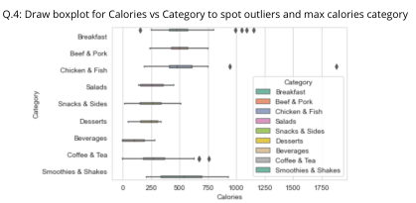
QUESTION#4

Slide 18
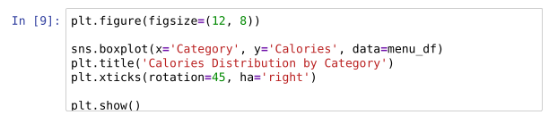
SOURCE CODE

Slide 19
HOW THE CODE WORKS
We set the figure size to make sure the plot is clear and visible.
Then, we use Seaborn's `boxplot()` function to create a boxplot.
The `x` parameter specifies the categorical variable ('Category') to be plotted on the x-axis, and the `y` parameter specifies the numerical variable ('Calories') to be plotted on the y-axis.
We provide the `menu_df` DataFrame as the data source for the plot.
We set the title of the plot to 'Calories Distribution by Category' to provide context for the reader.
The `plt.xticks()` function is used to rotate the category labels on the x-axis for better readability.
A rotation of 45 degrees is applied to the category labels, and the `ha='right'` parameter ensures that the labels are aligned properly.
Finally, we use `plt.show()` to display the boxplot.
The boxplot allows us to visually compare the distribution of calorie values across different categories of menu items.

Slide 20
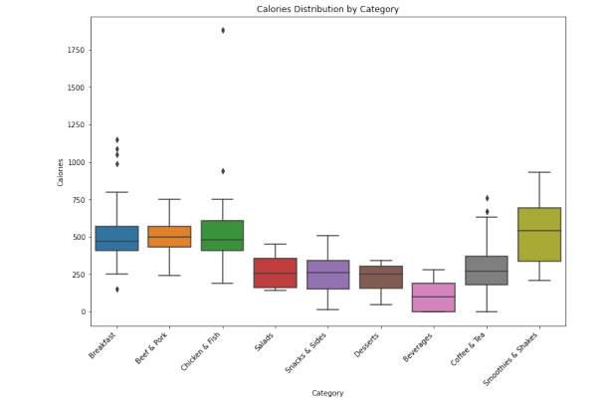
WHAT THE COMPUTER SHOW US
RUNTIME SCREEN

Slide 21
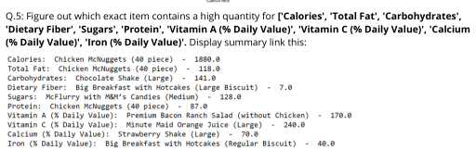
QUESTION#5

Slide 22
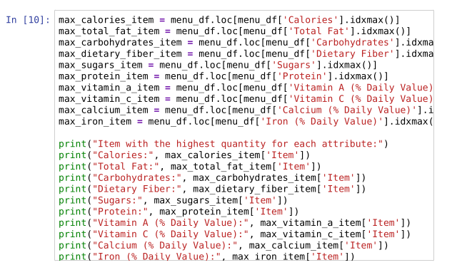
SOURCE CODE

Slide 23
HOW THE CODE WORKS
We use the `idxmax()` function to find the index of the row with the maximum value for each attribute.
Then, we use the `loc[]` function to locate the row in the DataFrame based on the index found.
This allows us to extract the entire row corresponding to the item with the highest quantity for each attribute.
We print out the item with the highest quantity for each attribute to the console.
This helps us identify which menu item has the highest value for each nutritional attribute.
For example, the item with the highest calories is printed as "Calories: Big Breakfast with Hotcakes (Large Biscuit)".
Similarly, the items with the highest values for total fat, carbohydrates, dietary fiber, sugars, protein, vitamin A, vitamin C, calcium, and iron are printed accordingly.
These findings provide insights into which menu items are particularly high in certain nutrients or attributes.
It helps in understanding the nutritional composition of the menu and identifying items that may be of interest to customers based on their dietary preferences or requirements.

Slide 24
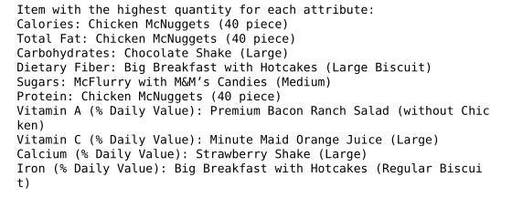
WHAT THE COMPUTER SHOW US
RUNTIME SCREEN

Slide 25
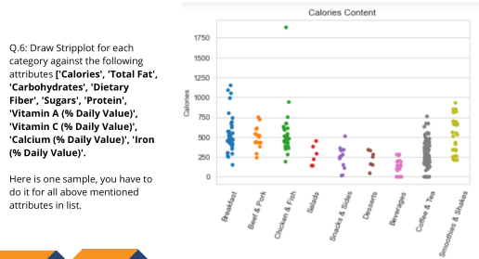
QUESTION#6

Slide 26
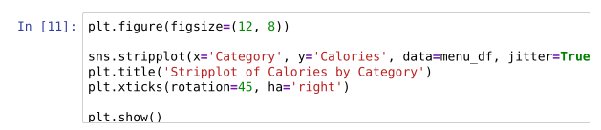
SOURCE CODE

Slide 27
HOW THE CODE WORKS
We set the figure size to ensure the plot is clear and visible.
Then, we use Seaborn's `stripplot()` function to create a stripplot.
The `x` parameter specifies the categorical variable ('Category') to be plotted on the x-axis, and the `y` parameter specifies the numerical variable ('Calories') to be plotted on the y-axis.
We provide the `menu_df` DataFrame as the data source for the plot.
We set the title of the plot to 'Stripplot of Calories by Category' to provide context for the reader.
The `plt.xticks()` function is used to rotate the category labels on the x-axis for better readability.
A rotation of 45 degrees is applied to the category labels, and the `ha='right'` parameter ensures that the labels are aligned properly.
Finally, we use `plt.show()` to display the stripplot.
The stripplot allows us to visualize the distribution of calorie values across different categories of menu items.

Slide 28
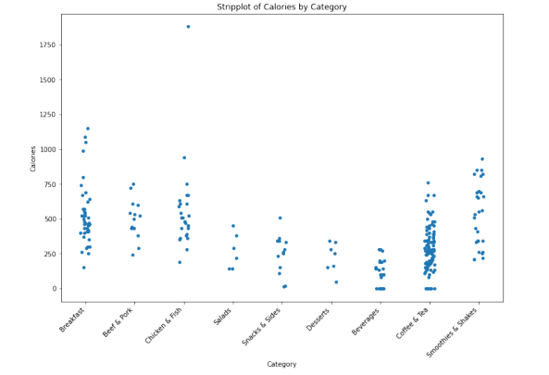
WHAT THE COMPUTER SHOW US
RUNTIME SCREEN

Slide 29
QUESTION#7

Slide 30
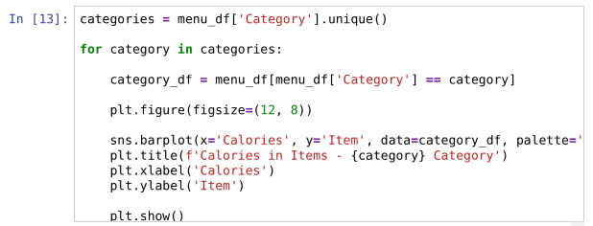
SOURCE CODE

Slide 31
HOW THE CODE WORKS
We start by getting the unique categories from the 'Category' column of the `menu_df` DataFrame.
Then, we iterate over each unique category in a loop to create separate visualizations for each category.
Within each iteration, we filter the `menu_df` DataFrame to include only the rows corresponding to the current category using boolean indexing.
This creates a subset DataFrame (`category_df`) containing only the data for the current category.
We set the figure size to ensure clear visualization.
We use Seaborn's `barplot()` function to create a bar plot.
The `x` parameter specifies the numerical variable ('Calories') to be plotted on the x-axis, and the `y` parameter specifies the categorical variable ('Item') to be plotted on the y-axis.
We provide the `category_df` DataFrame as the data source for the plot.
We set the title of the plot dynamically based on the current category using f-strings.
The x-axis label is set to 'Calories', and the y-axis label is set to 'Item' for clarity.
Finally, we use `plt.show()` to display the bar plot for the current category.
This loop repeats for each unique category, generating separate bar plots for the calorie distribution of items within each category.

Slide 32
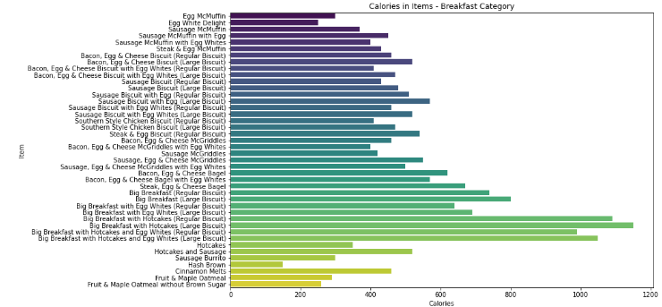
WHAT THE COMPUTER SHOW US
RUNTIME SCREEN
[Calories, Item]

Slide 33
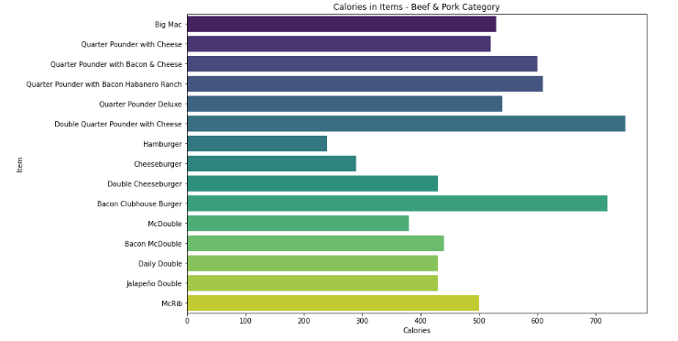
WHAT THE COMPUTER SHOW US
RUNTIME SCREEN
[Calories, Item] (Beef & pork)

Slide 34
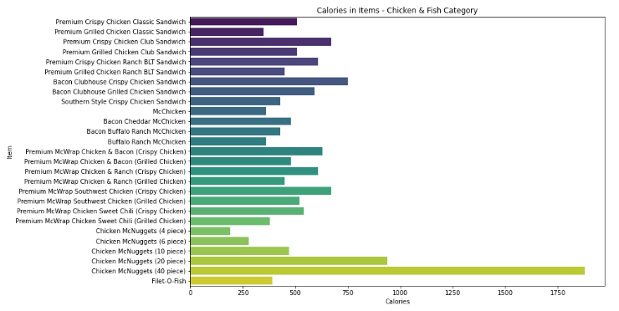
WHAT THE COMPUTER SHOW US
RUNTIME SCREEN
[Calories, Item] (Chicken & Fish)

Slide 35
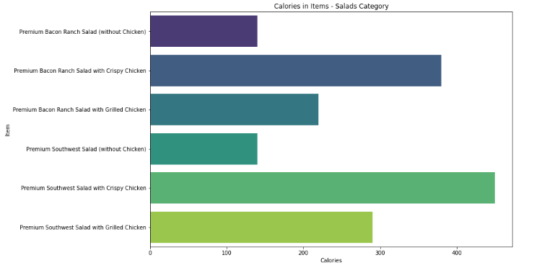
WHAT THE COMPUTER SHOW US
RUNTIME SCREEN
[Calories, Item] (Salads)

Slide 36
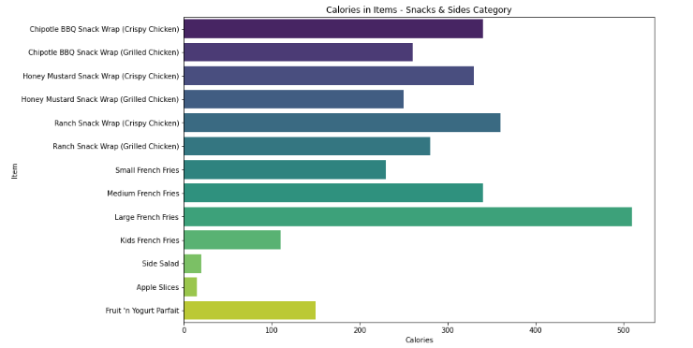
WHAT THE COMPUTER SHOW US
RUNTIME SCREEN
[Calories, Item] (Snacks & Sides)

Slide 37
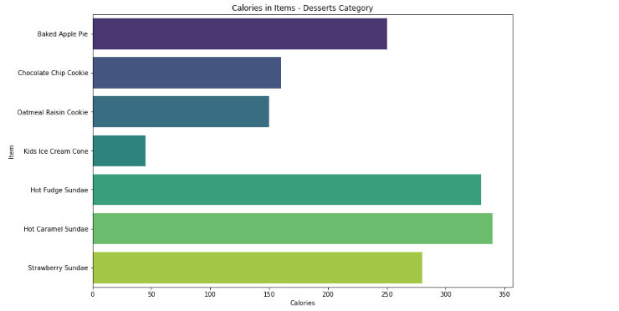
WHAT THE COMPUTER SHOW US
RUNTIME SCREEN
[Calories, Item] (Desserts)

Slide 38
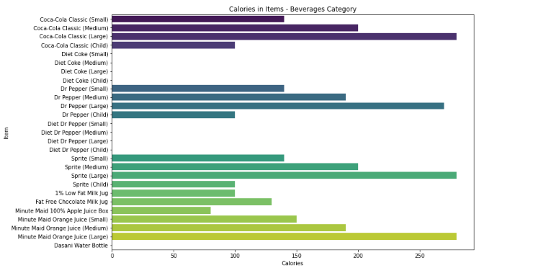
WHAT THE COMPUTER SHOW US
RUNTIME SCREEN
[Calories, Item] (Beverages)

Slide 39
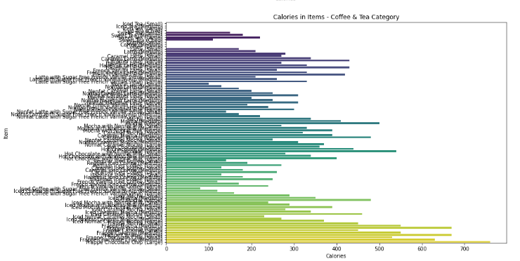
WHAT THE COMPUTER SHOW US
RUNTIME SCREEN
[Calories, Item] (Coffee & Tea)

Slide 40
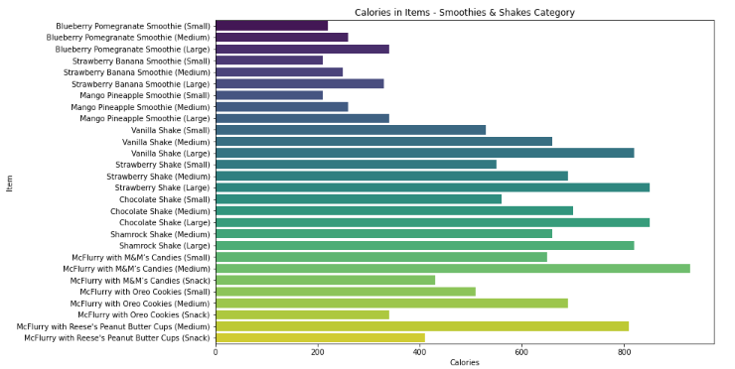
WHAT THE COMPUTER SHOW US
RUNTIME SCREEN
[Calories, Item] (Smoothies & Shakes)

Slide 41
Summary
Sure, here's a summary of the ab
- Utilized McDonald's menu dataset to analyze nutritional information of various menu items.
- Explored attributes including Calories, Total Fat, Carbohydrates, Dietary Fiber, Sugars, Protein, and Daily Vitamin and Mineral percentages.
- Conducted statistical analysis to identify maximum values for each attribute.
- Investigated correlation between Calories and other independent variables using a correlation matrix.
- Visualized calories distribution across menu categories using boxplots to identify outliers and max calorie categories.
- Identified menu items with high quantities of specific attributes such as Calories, Total Fat, Carbohydrates, etc.
- Drew stripplots to visualize the distribution of various attributes across menu categories.
- Created horizontal bar graphs to compare calorie content of items within each menu category.
- Observations included insights into calorie distribution, outliers, and category-wise comparisons of nutritional attributes.

Slide 42

THANK YOU
Malik M Shahmeer Rashid
malikmshahmeerrashid@gmail.com

