Slide 1

FloodGuard AI
From Initial-Round Model to a Deployed, AI-Powered MLOps Product
ML Opsidian: Genesis — Final Round Submission
Team: [Add team name] | June 2026

Slide 2

1. Team Introduction
• "We are API4— we turned our Initial Round flood-risk model
into a deployed, AI-powered product (web + mobile) with full MLOps."
 | Member
 | Gehiru Damnidu
 | Malika Nishnatha
 | Senash Adeesha
 | Nimssith Senevirathna
.
1 / 9

Slide 3
2. Problem Understanding
• Predict a continuous flood_risk_score in [0, 1] for locations across Sri Lanka's 25 districts
• Dataset: 20,886 training rows · 5,300 test rows · 47 columns
score = (0.5 × MAE + 0.5 × RMSE) × (1 + max(0, 1 − explained_variance))
• Lower is better — rewards both accuracy AND calibration (matching the variance, not just the mean)
Category | Example columns
Geography | latitude, longitude, district, elevation, distance to river
Climate | 7-day & monthly rainfall, drainage index, seasonal index
Land | land cover, soil type, NDVI / NDWI, built-up %
Infrastructure & Socioeconomics | population density, infrastructure score, distance to hospital
Event context | flood occurrence, inundated area, historical flood count
• Key insight: district dominates feature importance — district_te is the #1 feature by gain in every model version. The data is synthetic/noisy → ensembling + district-level aggregates win.
2 / 9

Slide 4
3. Initial Round Approach — solution_v10.py
5-Model Ensemble
LightGBM · LightGBM-DART
CatBoost · XGBoost
ExtraTrees (Optuna-tuned)
Ridge Meta-Learner
Stacks 10-fold × 3-seed
OOF predictions
Calibration Shift
Shift mean to match
train target mean
Custom Metric
≈ 0.383
→
→
→
• ~150 engineered features: district stats/quantiles/ranks, KMeans clusters (k = 5, 10, 20), haversine-KNN target stats, target encoding, interaction features
• 10-fold × 3-seed cross-validation
• 10 rounds of pseudo-labeling on the test set to squeeze out additional signal
• Post-processing: shift the final prediction mean to exactly match the training target mean (the calibration insight that carries through to the Final Round)
3 / 9

Slide 5
4. Improvements Made: v10 → FloodGuard AI
v10 (batch) | FloodGuard AI (FeatureEngineer)
District stats via groupby over all rows | Precomputed per-district lookup table, joined onto new rows
KMeans fit and .predict() on the same data | KMeans models fit once, saved, .predict() on the new row
KNN target stats via BallTree over all rows | Same BallTree, built once at fit time, queried per new row
Target encoding via K-fold OOF means | OOF means for training; full-train means for new rows
*_qmap columns (no raw counterpart) | Empirical monotonic map learned at fit time, np.interp at transform time
Composite indices (seasonal_index, etc.) assumed present | Default to the district mean (or global mean) if the user omits them
• Reduced to a 3-model ensemble (LightGBM + CatBoost + XGBoost), 5-fold CV, fixed hyperparameters, no pseudo-labeling → ~45-second, fully reproducible training run — 223 features, 14 MB of artifacts
• Kept the two highest-leverage ideas: Ridge meta-stacking (weights: lgb=0.229, cat=0.713, xgb=0.134) and mean-calibration shift (shift ≈ 0 — stacked mean already matches the train mean of 0.4780)
• Result: OOF custom metric 0.4071 (vs 0.383 for the heavier Initial Round search) — a documented trade-off of leaderboard score for deployability
• NEW: an AI Risk Advisor (Claude claude-haiku-4-5, with a deterministic template fallback) turns the score + top contributing features into a plain-language report and recommendations
4 / 9

Slide 6
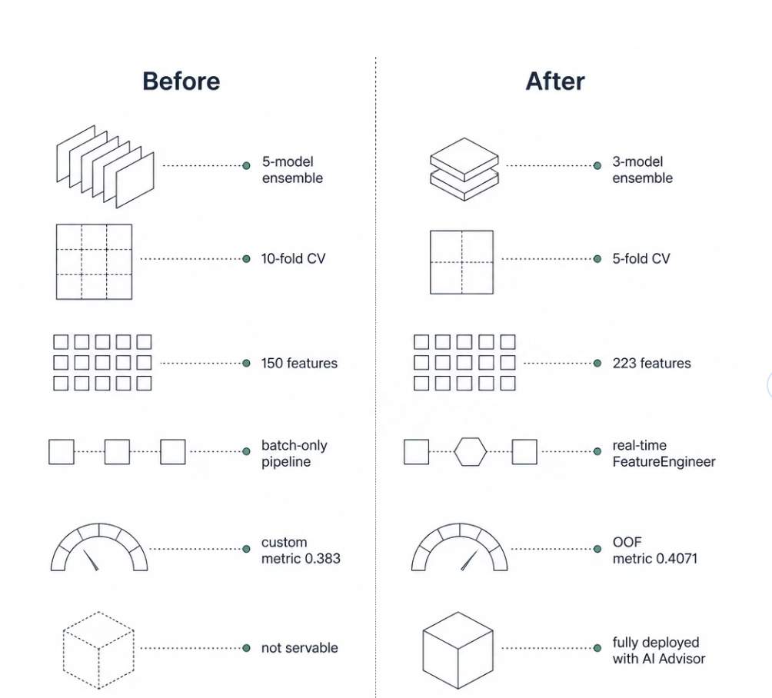

Slide 7
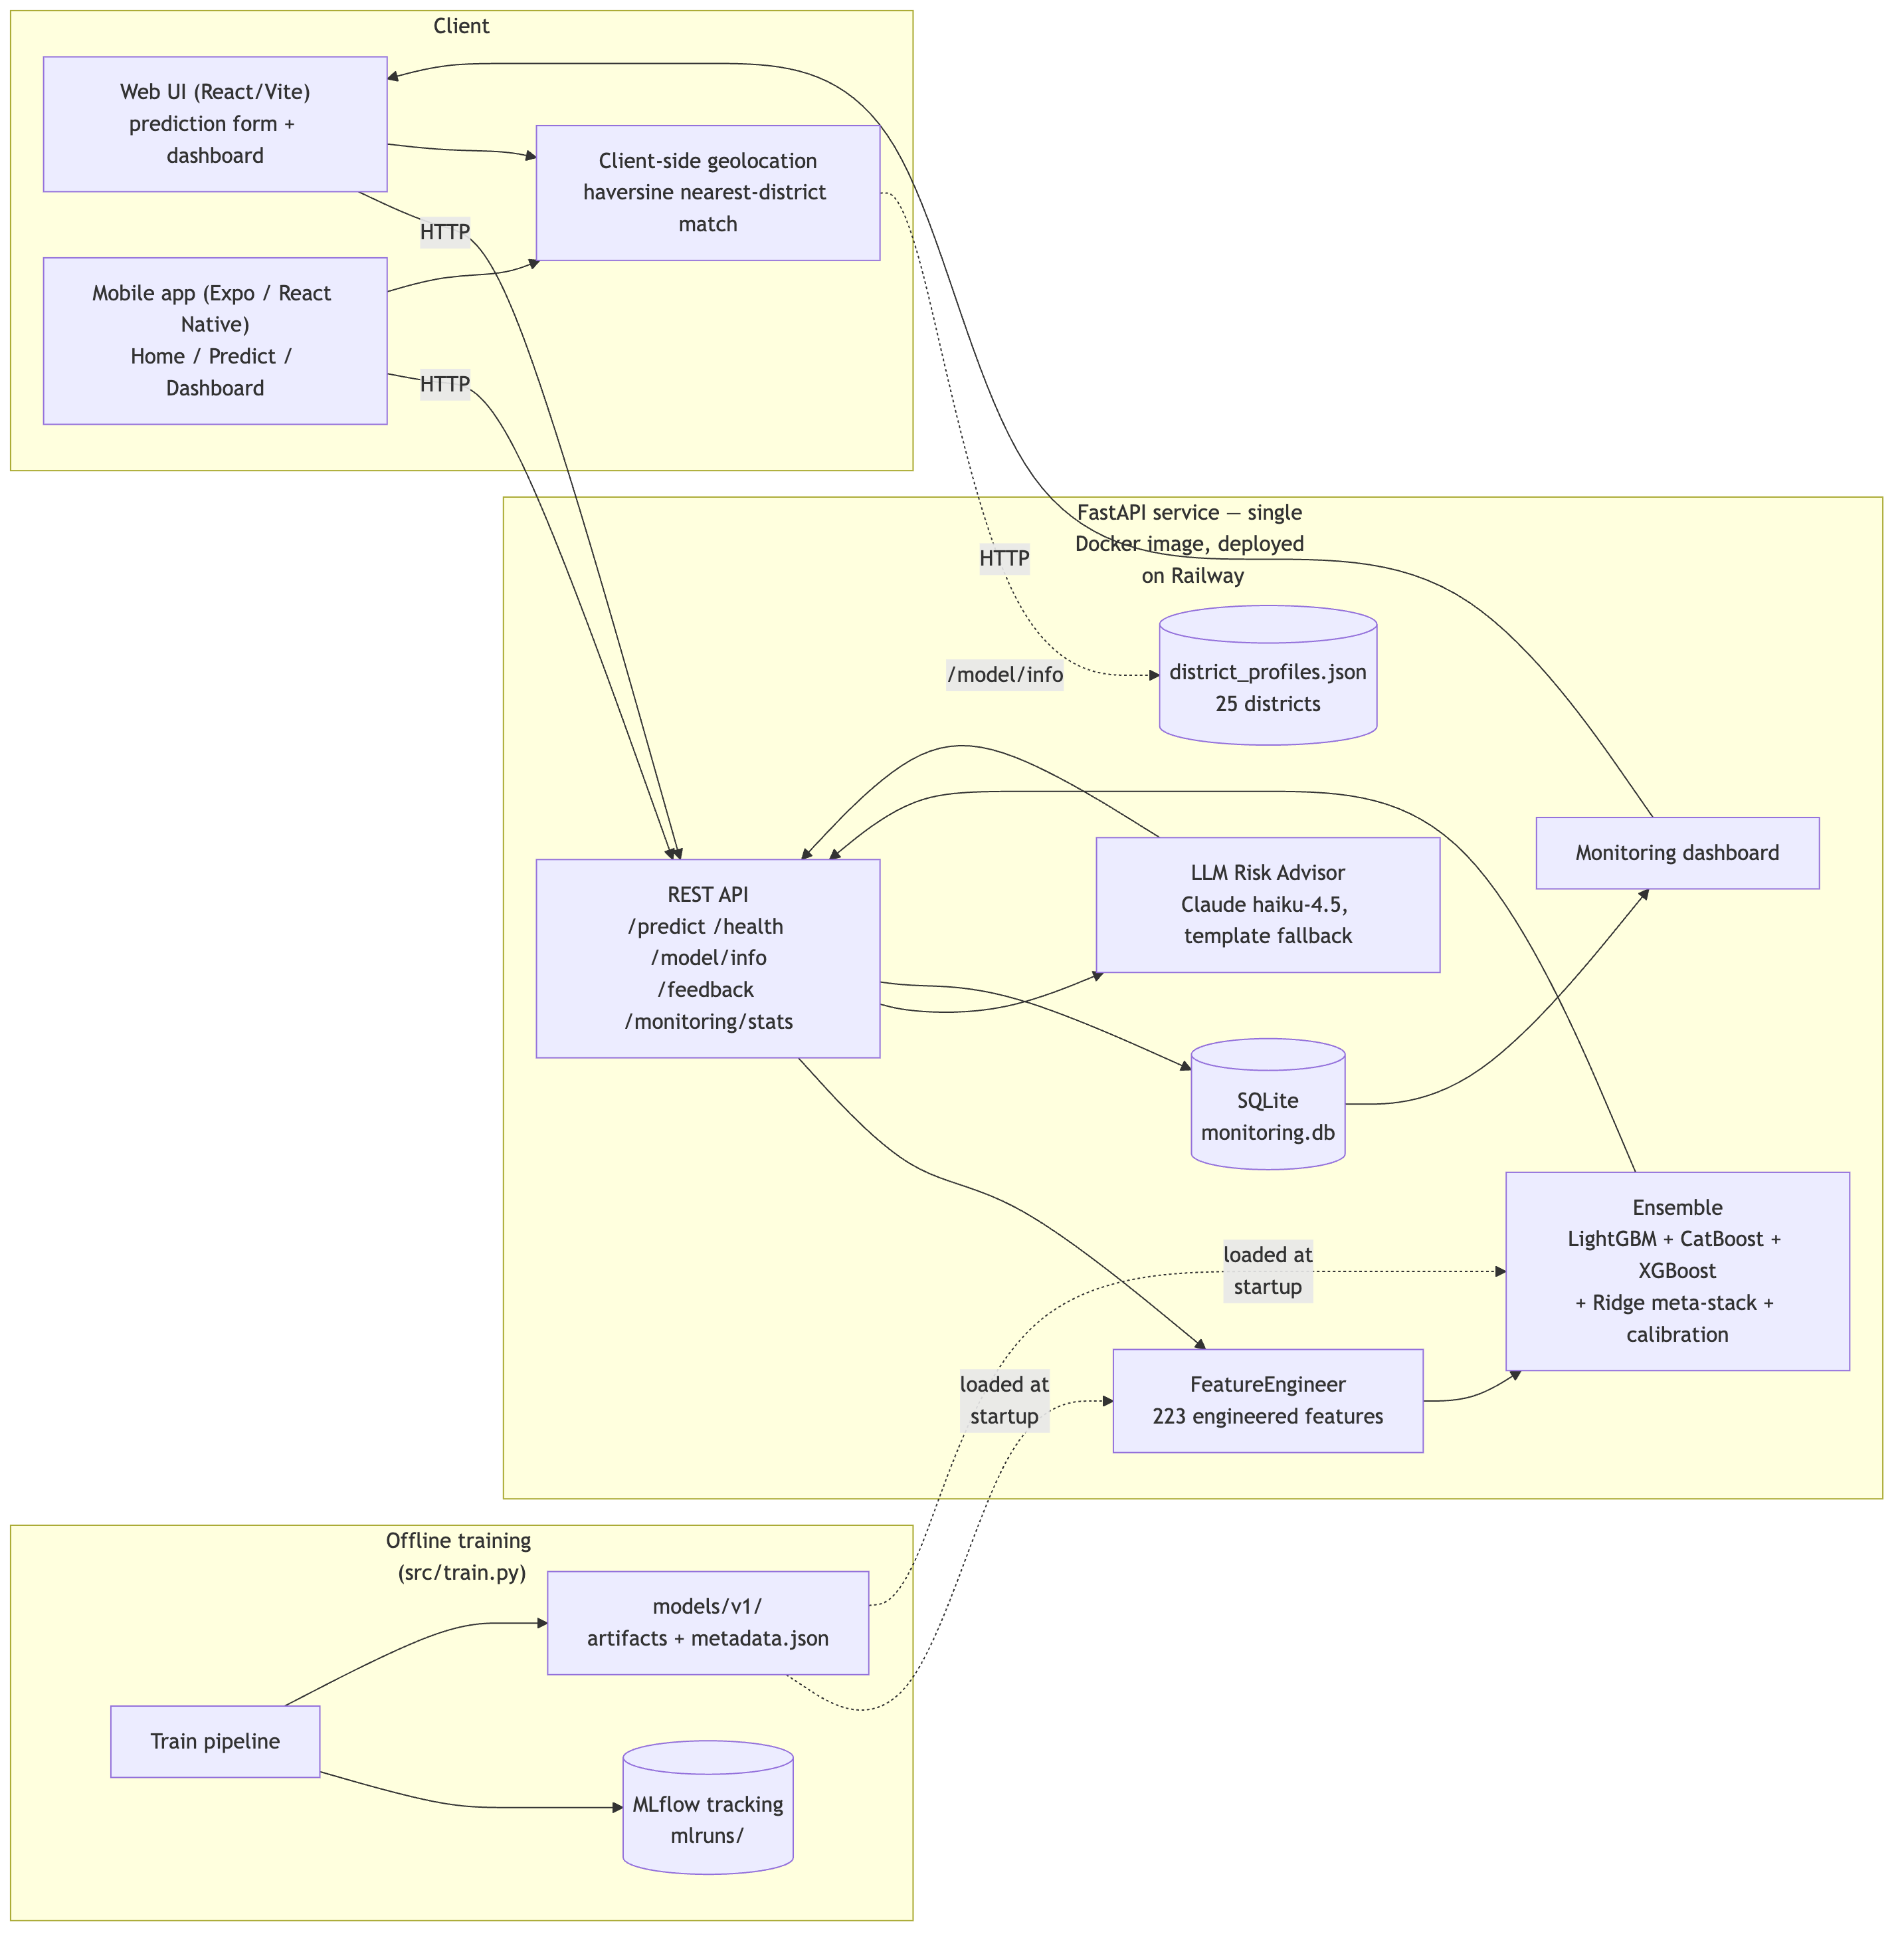
5. System Architecture
• One Docker image, one Railway URL serves the REST API, the prediction form, and the monitoring dashboard — judges don't need to set up anything
• A companion Expo / React Native mobile app (Android APK + Expo Go) talks to the same live backend and adds a geolocation-based Live Risk Preview on both clients
• Offline path: src/train.py → MLflow (mlruns/) → models/v1/ artifacts loaded at API startup
5 / 9

Slide 8
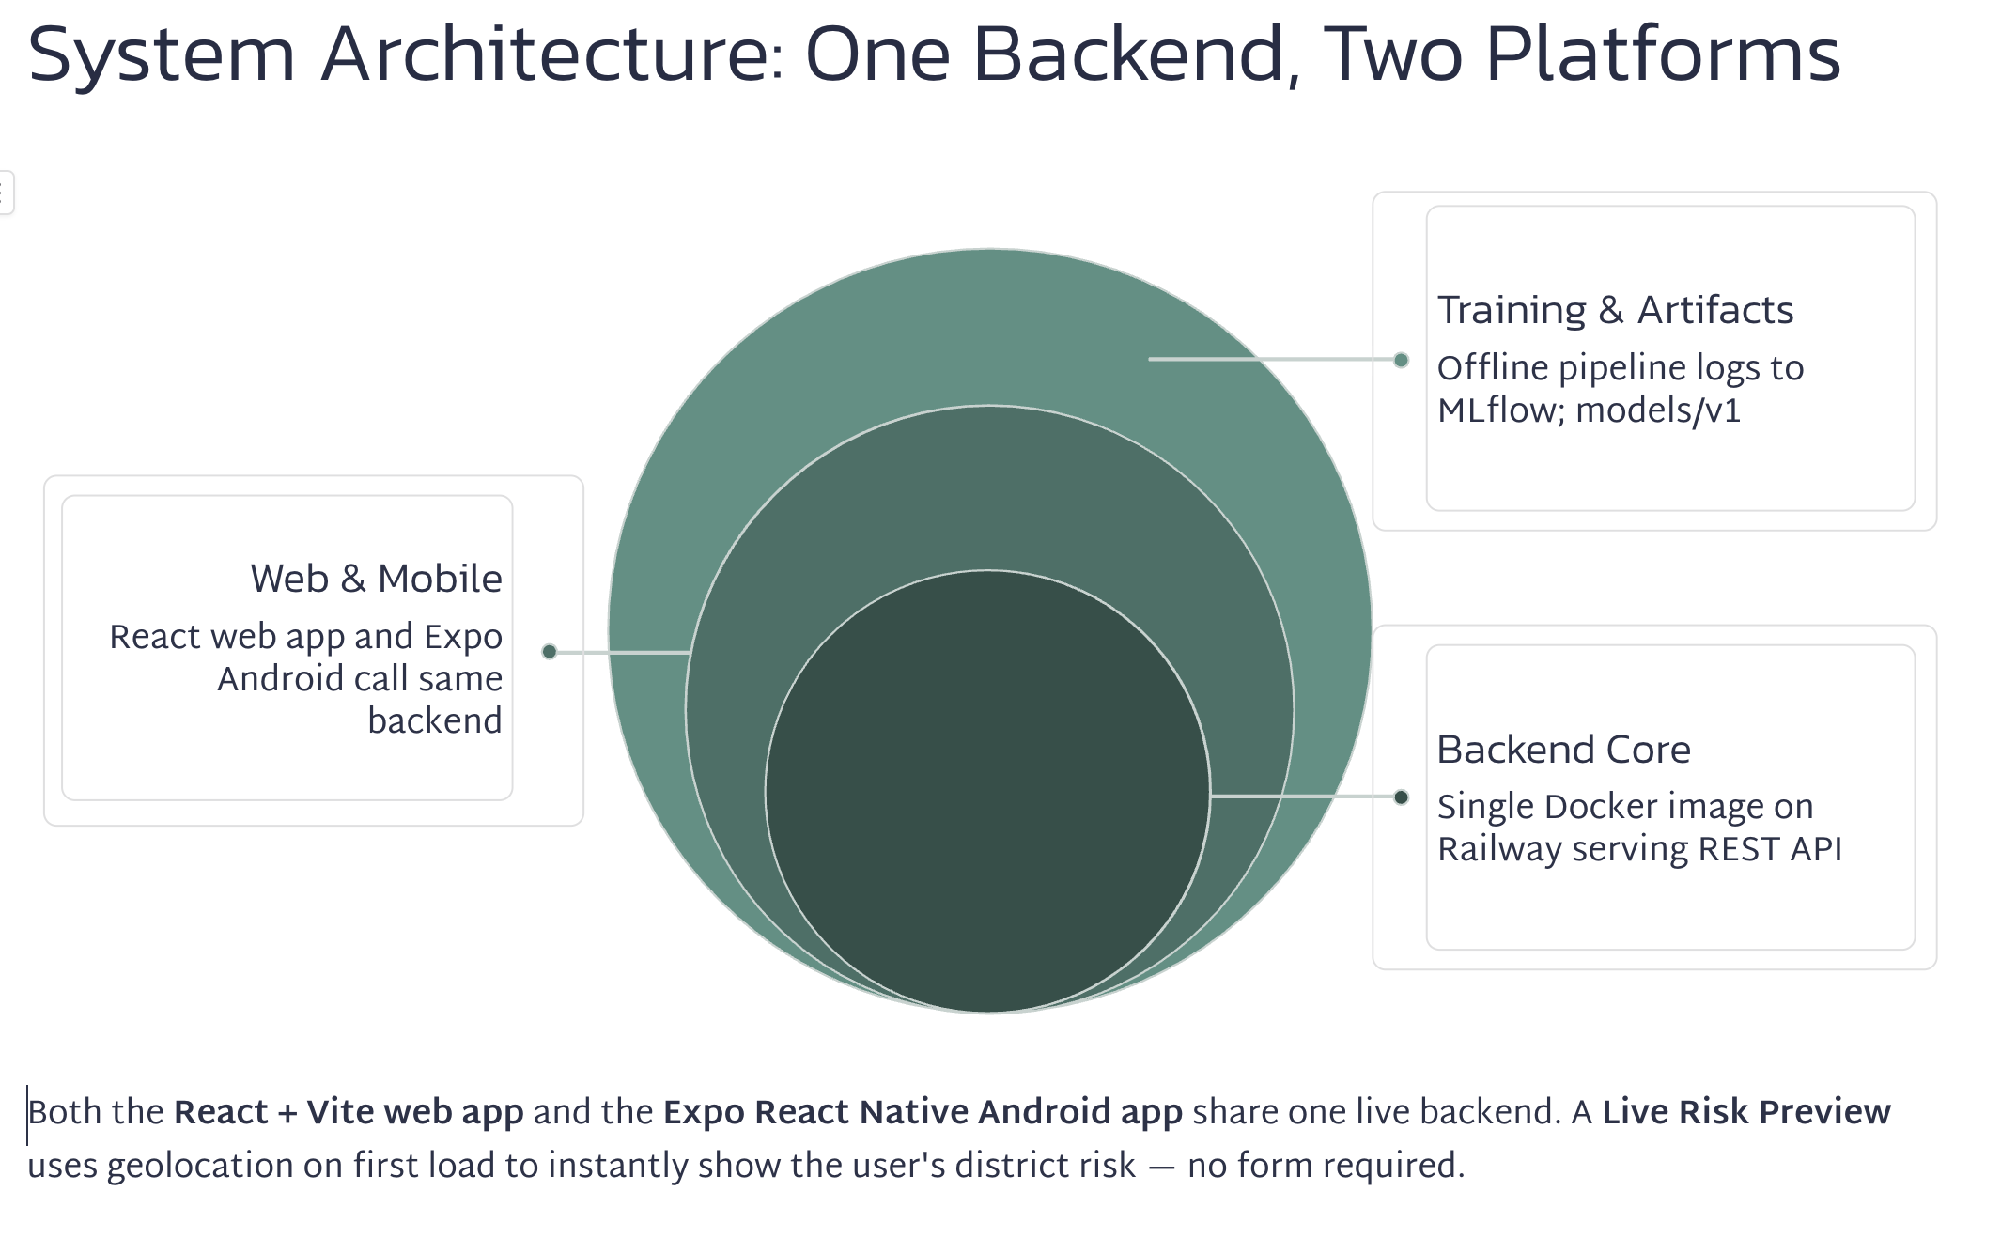

Slide 9
6. MLOps Workflow
Pillar | What We Built
Data Pipeline | src/data_validation.py runs schema/null/range checks before training, plus per-request out-of-distribution flags
Model Management | MLflow experiment tracking (mlruns/) logs every run's hyperparameters and metrics; models/v1/metadata.json records feature count, CV metrics, Ridge weights — versioned for v2, v3, …
Deployment | Dockerfile → Railway (railway up), /health readiness check, optional ANTHROPIC_API_KEY; Render documented as an alternative; Android APK via EAS Build
Monitoring | Every prediction logged to SQLite (score, category, latency, OOD flags); /monitoring/stats + /dashboard (Chart.js) auto-refresh every 15s
CI/CD (bonus) | GitHub Actions runs the full pytest suite (feature pipeline, inference, API) and builds the Docker image on every push/PR
6 / 9

Slide 10
7. Demonstration (Live + Backup Recording)
• Landing page (/) — hero, "how it works", live model snapshot from /model/info; the geolocation-based Live Risk Preview shows the risk for the user's own district instantly, no form needed
• Prediction flow — fill the form for a flood-prone location → risk gauge, risk category, model breakdown (lgb / cat / xgb), top contributing factors, AI-generated risk report with recommendations
• Edge case — submit an out-of-range value (e.g. negative rainfall) → the OOD flag appears in the response
• Feedback — rate the prediction with the star widget → POST /feedback → SQLite
• Dashboard (/dashboard) — prediction volume, score histogram, category/district breakdowns, latency, and the feedback just submitted, all live
• Mobile app (optional) — the same flow on the Android APK / Expo Go, including the geolocation Live Risk Preview on the Home screen
• Rehearse this end-to-end against the live Railway URL, not just localhost — and have a screen-recording ready as a fallback if the live demo or network fails.
7 / 9

Slide 11
8. Challenges Faced
• Making a batch feature pipeline servable for one record — v10's district stats, KMeans, KNN, and target encodings were all computed over the entire training set at once; redesigning each as a fit-once / apply-to-one-row component (FeatureEngineer) was the single biggest engineering effort of the Final Round.
• Trading leaderboard score for deployability — dropping pseudo-labeling, 2 of 5 base models, and going from 10-fold × 3-seed to 5-fold cost ~0.024 on the custom metric (0.383 → 0.407) — a deliberate, documented trade-off rather than an oversight.
• Handling "expected" data noise without over-engineering — negative rainfall/distance values produce NaN after log1p(); rather than imputing or dropping rows, we leaned on LightGBM/CatBoost/XGBoost's native NaN handling and added flag_out_of_distribution() so these cases are visible in production rather than silently handled.
8 / 9

Slide 12
9. Future Improvements
• Periodic retraining as new labeled flood events become available, versioned as models/v2/, v3/, … and compared via the MLflow run history
• Lightweight, request-time-feasible pseudo-labeling using accumulated predictions + user feedback as a weak-label source
• A model-drift alert (rolling flag_out_of_distribution rate vs. a baseline) surfaced on the dashboard
• Expanding the AI Risk Advisor to support Sinhala / Tamil for end users in the regions the model covers
• Publishing the mobile app to the Play Store / TestFlight, plus background location + push notifications when a user's district risk crosses a threshold
"FloodGuard AI shows the Initial Round model didn’t just survive the transition to production — its core ideas (ensembling, stacking, calibration) are exactly what made that transition work."
9 / 9

Slide 13


Thank You

Slide 14
Thank You — Questions?
GitHub: github.com/malika1234m/flood-guard-ai
Live Demo: floodguard-production.up.railway.app
Mobile: Android APK (EAS internal build) — link in README

