Slide 1

PREDICTING DIESEL
PRICES IN FRANCE
Tina •Malika |
Notes:
Tina
Hello everyone. We are Malika and Tina. Our project focuses on predicting diesel prices in France using Machine Learning. Our flagship model is XGBoost.
We use historical station data, location, time patterns and external market indicators to predict future diesel prices.

Slide 2

PREDICTING
DIESEL PRICES
IN FRANCE
Can machine learning anticipate
future diesel prices?
Tina & Malika
MACHINE LEARNING PROJECT • 2026
Notes:
Tina —
“The idea is simple: using what we know today to predict diesel prices tomorrow.”

Slide 3
WHY THIS PROJECT?
FROM OBSERVING PRICES
TO ANTICIPATING THEM
OUR QUESTION
Can station characteristics, location, seasonality and recent market data help predict future diesel prices in France?
Fuel prices affect everyday mobility and business operating costs. Most tools tell us what fuel costs now, not what it may cost next.
POTENTIAL USE CASES
Drivers • Fleet management
Delivery • Mobility services
Notes:
Tina —
Our main question is: can station characteristics, location, seasonality and recent market data help us predict diesel prices? This is a regression problem, because our target is a price in euros per liter. One important point is time. We cannot mix past and future data. So we train the model on earlier months and test it on later months. November and December 2025 are kept completely unseen until the final test. This helps us simulate a real prediction of future prices.
To answer this question, we first needed to prepare our data. Malika will explain this part.

Slide 4

2. Data Pipeline & Data Quality
We combined French fuel data with station information and two external market signals
FUEL PRICES
2025 French station prices
5.3M price records
BRENT
Daily crude-oil market signal
STATION METADATA
Latitude • Longitude
Highway • 24/7 payment
GPR
Geopolitical Risk Index
Daily risk score
QUALITY CHECKS
Missing essentials removed • dates/postal codes standardized • duplicates/anomalies checked • external data aligned
FINAL MODELING DATASET ≈ 1.5M diesel observations
Notes:
Malika
We combined three sources: 5.3 million fuel price records for 2025, metadata for over 14,000 stations, and two external indicators — Brent crude oil and the Geopolitical Risk Index. We first focused on data quality: missing essential values, data types, duplicates and suspicious observations. Importantly, we investigated anomalies before removing them — a conflicting duplicate reading and an isolated €3.00 outlier were only removed after we confirmed them as genuine errors by checking each station's price history and same-day national prices. That left us with about 1.5 million clean diesel observations.

Slide 5
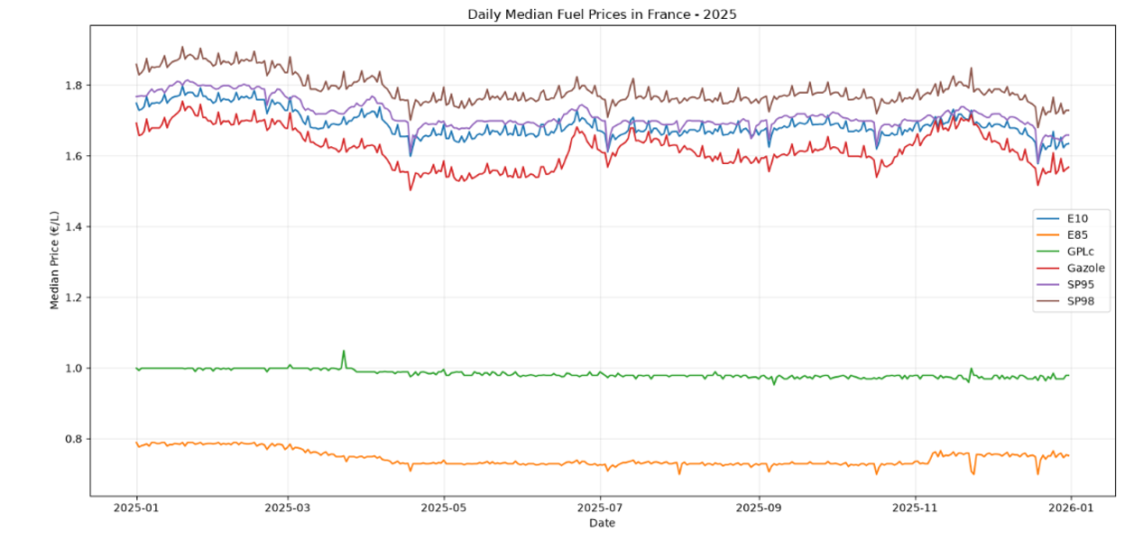
3. EDA → What drives diesel prices?
The exploratory analysis revealed clear station-type, geographic and cross-fuel relationships.
MEDIAN
€1.636/L
HIGHWAY
€1.809/L
vs €1.629/L roads
GEO RANGE
≈ €0.20/L
EDA TAKEAWAY
Diesel prices showed clear temporal and station level patterns.
Notes:
Malika
Our EDA guided the model design. Diesel had a median price of 1.636 euros per liter. One of the clearest patterns was the difference between highway and road stations: 1.809 versus 1.629 euros per liter. We also observed substantial geographic variation — about 20 cents between areas — and strong relationships between diesel and other fuels, suggesting shared market dynamics. This told us that time, geography and station characteristics all belonged in the model.

Slide 6
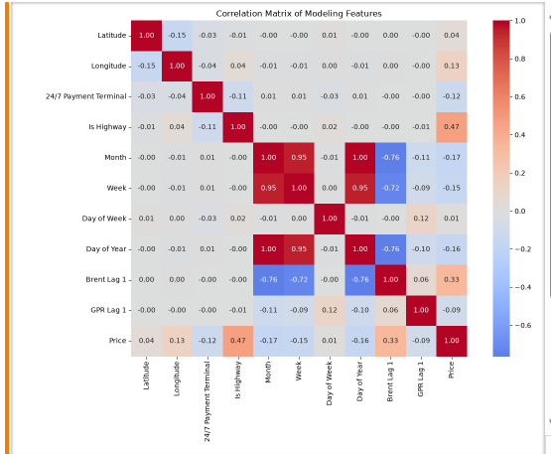
4. Feature Engineering & Temporal Design
Eight predictors were retained after redundancy and leakage checks.
FROM RAW DATA TO MODEL FEATURES
Date
→
Day of Week • Day of Year
Station location
→
Latitude • Longitude • Is Highway
Station services
→
24/7 Payment Terminal
Brent Price
→
Brent Lag 1
GPR
→
GPR Lag 1
KEY DECISIONS
Month and Week removed for redundancy.
Brent and GPR shifted by one day to limit future information leakage.
Notes:
Malika
We engineered eight final predictors covering geography, station characteristics, time and lagged external signals. Month and Week were removed because they were highly redundant with Day of Year. We also excluded same-day Brent and GPR and created one-day lags. This is important because it reduces temporal leakage and better represents the information available before a prediction is made.

Slide 7
5. Modeling Strategy & Validation
A chronological split was used instead of a random split.
JAN TO SEP
OCT
NOV TO DEC
Development
Train
Validation
Tune and select
Final test
Unseen future
WHY NOT RANDOM?
RANDOM FOREST BASELINE
XGBOOST
Fuel prices evolve over time. A random split could let the model learn from future observations while predicting the past.
MAE 0.0487 €/L
MAE 0.0380 €/L
≈ 22% lower validation error
XGBoost becomes our flagship model.
Notes:
Tina
Because fuel prices change over time, we decided not to use a random split. We used a chronological split instead. January to September is used for development, October for validation and tuning, and November and December for the final test. We first used a basic Random Forest as our baseline. Its MAE was 0.0487. Then, our first XGBoost model reached 0.0380, which is about 22 percent better. So we selected XGBoost as our flagship model.

Slide 8
6. XGBoost Tuning & Performance
Broad exploration → focused search → final refinement.
RANDOM SEARCH
BEST CONFIGURATION
10 combinations tested
1,200 trees
Learning rate 0.1
Subsample 0.9
Column sample 0.6
L2 3
MAE ≈ 0.0383 €/L
→
GRID SEARCH
16 refined combinations
MAE ≈ 0.0380 €/L
→
MANUAL SEARCH
Final adjustments
MAE ≈ 0.0374 €/L
The validation gain was modest. The real question was whether it would hold on genuinely unseen future data.
Notes:
Tina
For XGBoost tuning, we used three steps.First, Random Search explored different combinations. Then, Grid Search focused on the most promising ones. Finally, Manual Search helped us refine the model.Our final configuration used 1,200 trees, with the other hyperparameters shown on the slide. Our best validation MAE was about 0.0374 euros per liter.

Slide 9
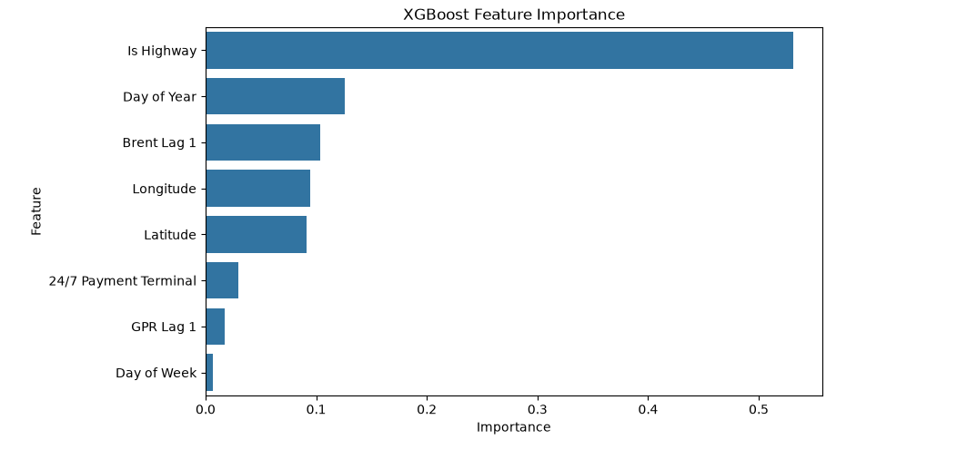
7. Final Test Results & Feature Importance
The unseen future period reveals both model performance and its main predictive signals.
MAE
RMSE
R²
TRAIN R²
0.0507 €/L
0.0639
0.5957
0.8347
FEATURE IMPORTANCE
WHAT STANDS OUT
Is Highway is the strongest predictor
53.1% importance
Test MAE rose to about 5.1 cents/L.
Performance dropped compared with training, so generalization remains a challenge.
Notes:
Malika
On the completely unseen November-December test period, the final model achieved an MAE of 0.05 euros per liter, an RMSE of 0.064 and an R-squared of 0.59 — so it explains about 60 percent of the variation in the test period. The train R-squared was 0.83, notably higher, which suggests some overfitting. Feature importance shows why the model predicts what it does: Is Highway alone accounts for 53 percent of total importance, followed by Day of Year, Brent Lag 1 and geographic coordinates. There may also be a temporal effect : November and December can exhibit different price dynamics compared with October validation period. So the model is facing a genuinely new market situation. This is an important limitation of our current approach.

Slide 10
8. Key Findings
A useful model, with clear limits to generalization.
01
KEY SIGNALS
02
MODEL RESULT
03
LIMITATION
Station context was the strongest signal. Time, Brent and geography also contributed.
XGBoost clearly outperformed the Random Forest baseline during validation.
Performance decreased on the unseen future period. Predicting future prices remains challenging.
Machine learning can provide useful forward looking information on diesel prices, but robust prediction requires models that can adapt to changing market conditions.
Notes:
Malika
Three things stood out. First, station context — especially whether a station sits on a highway — was by far the strongest predictive signal, with time, Brent prices and geography adding smaller but meaningful contributions. Second, XGBoost consistently and clearly outperformed the Random Forest baseline throughout validation. Third, and just as important: performance dropped on the unseen future period, which is a real limitation, not a footnote. Our takeaway is that machine learning can give useful forward-looking signal on diesel prices, but turning that into a robust forecast requires models that can adapt as market conditions change.

Slide 11
9. Challenges, Lessons Learned & Future Work
What the project taught us beyond the final score.
CHALLENGES AND LESSONS LEARNED
FUTURE WORK
Large scale data
More historical data
Around 1.5M diesel observations made training and tuning computationally demanding.
Extend the analysis beyond one year.
Station price history
Temporal leakage
Explore station level lag and rolling price features.
Validation and external features had to respect what would actually be known at prediction time.
Stronger temporal validation
Validation is not the future
Test across several successive future periods.
Strong October performance did not fully translate to November and December.
Richer market signals
Explore additional external variables.
Notes:
Malika
Beyond the final score, this project taught us a few practical lessons. Working with around 1.5 million observations made training and tuning genuinely demanding, which shaped how much search we could afford to run. Respecting temporal leakage took real discipline — every feature had to reflect only what would actually be known at prediction time. And maybe the most humbling lesson: strong October validation performance didn't fully translate to November and December — validation is not the future. Looking ahead, we'd extend the analysis across multiple years, add station-level price history and rolling features, test across several successive future periods instead of just one, and bring in richer external market signals.

Slide 12
THANK YOU
From observing diesel prices
to understanding what helps anticipate them.
Questions?
Tina & Malika
MACHINE LEARNING PROJECT • 2026
Notes:
Tina
We started by asking if Machine Learning could help us anticipate diesel prices instead of just observing them. Our results show that XGBoost can use information from stations, time and market data to predict diesel prices. But there is still room for improvement, with more historical data, better temporal validation and more market information.
Thank you for listening.

