Slide 1

SMART CAMPUS
MANAGEMENT SYSTEM
SCMS software project showcase for HITEC University Taxila
Abdul Saboor (25-CS-156) | Abdullah Sajjid (25-CS-026)
Course: Object Oriented Programming
Instructor: Mohsin Shahzad
HITEC University Taxila
SCMS | HITEC University Taxila
01

Slide 2
PROJECT INTRODUCTION
SCMS turns campus operations into an OOP demonstration.
A complete C++17 system organized into six academic modules.
1
Purpose
2
Objectives
3
Scope
Show how a university can manage people, courses, library items, finance records, hostel rooms, and reports through one console application.
Demonstrate inheritance, polymorphism, templates, exceptions, persistence, smart pointers, lambdas, and STL algorithms.
Six integrated modules plus CSV/TXT persistence, documentation, UML artifacts, executable build, and submission packaging.
6
25+
C++17
CSV
PROJECT MODULES
OOP CHECKPOINTS
COMPILER TARGET
PERSISTENCE
SCMS | HITEC University Taxila
02

Slide 3






SYSTEM ARCHITECTURE
A menu-driven console app coordinates six independent modules.
Each module owns its domain while shared utilities handle reports and persistence.
Course
Person
src/course
Library
src/person
src/library
main.cpp
Menu + Demo Runner
data/*.csv
TXT report
Finance
Reports
src/finance
Hostel
src/utils
src/hostel
SCMS | HITEC University Taxila
03

Slide 4
FOLDER STRUCTURE
The repository is organized by module, artifacts, and persisted data.
The structure mirrors the project checklist and keeps implementation boundaries clear.
src/
docs/
data/
├── person
├── project docs
├── students.csv
├── course
├── UML diagrams
├── courses.csv
├── library
├── logo + branding
├── library_items.csv
├── finance
├── finance_summary.csv
├── cover page
├── hostel
├── hostel_rooms.csv
├── presentation
├── scms_report.txt
├── utils
SCMS | HITEC University Taxila
04

Slide 5
MODULE 1: PERSON HIERARCHY
Runtime polymorphism starts from the abstract Person base class.
UndergradStudent preserves multilevel inheritance while keeping the student model accurate.
Person
abstract + displayInfo()
Student
Faculty
Staff
UndergradStudent
projectTitle + advisor
Person* / unique_ptr<Person>
Virtual dispatch calls the correct displayInfo() at runtime.
SCMS | HITEC University Taxila
05

Slide 6
MODULE 2: COURSE & ENROLLMENT
Enrollment rules are enforced through operators and custom exceptions.
Course capacity, credit hours, and enrollment data are validated before state changes.
Student
rollNo
Enrollment
semester + grade
Course
capacity + credits
Faculty
instructor
+
operator+=
=
operator==
<<
operator<<
Enrolls a student into a course and increments enrolledStudents safely.
Compares Course objects by courseCode for identity checks.
Formats course details for clean console output.
SCMS | HITEC University Taxila
06

Slide 7
MODULE 3: LIBRARY MANAGEMENT
The library module combines abstraction, templates, and borrowing workflows.
Book and Journal objects are stored through LibraryItem polymorphism.
LibraryItem
abstract
Library<T>
*
LibraryManager owns items
Class template + searchByTitle<T>() function template
Uses vector<unique_ptr<LibraryItem>> for clean memory management.
Book
Journal
Register member
Search item
Issue item
Return item
SCMS | HITEC University Taxila
07

Slide 8
MODULE 4: FINANCE & PAYROLL
Financial records are validated, summarized, and persisted as CSV.
FinanceManager composes salary, fee, and invoice records.
FinancialRecord
#
Static members
SalaryRecord and FeeRecord maintain total record counters.
f
Friend summary
SalaryRecord
FeeRecord
Invoice
generateFinanceSummary() accesses private financial data for reports.
CSV
Persistence
Finance CSV and invoice CSV save/load data through fstream RAII.
SCMS | HITEC University Taxila
08

Slide 9
MODULE 5: HOSTEL MANAGEMENT
Virtual inheritance resolves the diamond problem cleanly.
HostelManager inherits behavior from Accommodation and Reportable while BaseEntity appears once.
BaseEntity
abstract
Accommodation
virtual public
Reportable
virtual public
*
Composition
HostelManager
o
Aggregation
HostelBlock owns Room objects through vector<Room>.
Rooms store student roll numbers only; Student objects remain outside hostel ownership.
SCMS | HITEC University Taxila
09

Slide 10
MODULE 6: REPORTS & UTILITIES
Modern C++ features power campus-wide reporting.
Nested namespaces, smart pointers, lambdas, and STL algorithms organize shared functionality.
Reports
ReportGenerator
ptr
Smart pointers
unique_ptr<ReportGenerator> and shared_ptr<UtilityManager> demonstrate safe ownership.
SCMS
λ
Lambdas
Utils
UtilityManager
Sorting students, finding overdue library records, and filtering unpaid fees.
STL
STL algorithms
sort, find_if, count_if, for_each, and copy_if are used meaningfully.
SCMS | HITEC University Taxila
10

Slide 11
PERSISTENCE SYSTEM
Every module saves and reloads data through structured files.
CSV files support module data; TXT output stores the generated campus report.
CampusPersistence
CsvUtils + fstream
Module objects
data/
CSV + TXT files
Reloaded objects
students.csv
undergrad_students.csv
✓
Safety rule
courses.csv
library_items.csv
Bad CSV rows are skipped safely; numeric parsing validates before object creation.
finance_summary.csv
hostel_allocations.csv
scms_report.txt
SCMS | HITEC University Taxila
11

Slide 12
OOP CONCEPTS IMPLEMENTED
The project covers the full instructor checklist with concrete classes.
Concepts are distributed across modules instead of being isolated examples.
Inheritance
Polymorphism
Operators
Person, LibraryItem, FinancialRecord, Hostel
displayInfo(), displayRecord(), LibraryItem*
+=, +, ==, <<, -=
Templates
Exceptions
Smart pointers
Library<T>, searchByTitle<T>()
Enrollment, capacity, overdue
unique_ptr, shared_ptr
Namespaces
Persistence
Composition
SCMS::Reports, SCMS::Utils
fstream CSV/TXT save/load
FinanceManager, HostelBlock, LibraryManager
SCMS | HITEC University Taxila
12

Slide 13
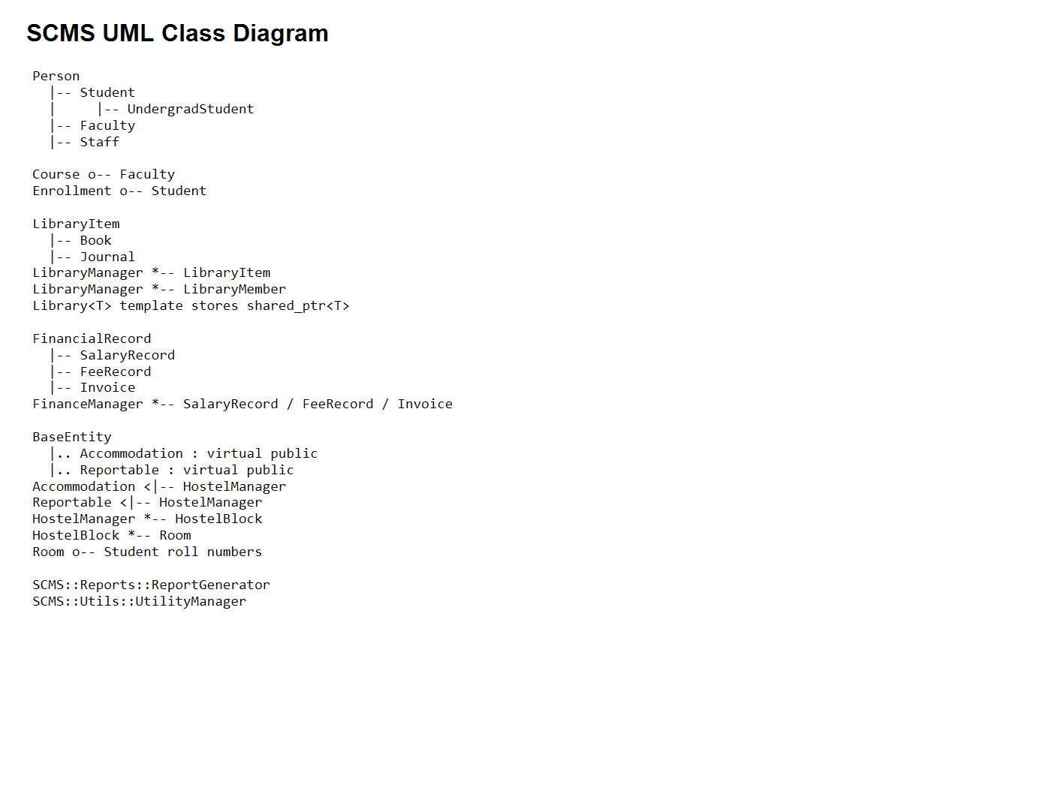
UML OVERVIEW
The class model shows inheritance, composition, aggregation, and templates.
The full UML artifact is maintained in docs/UML and reused here for presentation.
I
Inheritance
Person, LibraryItem, FinancialRecord, and BaseEntity hierarchies.
*
Composition
Manager classes own their records, items, blocks, and rooms.
o
Aggregation
Courses, rooms, and enrollments reference external student/faculty data.
SCMS | HITEC University Taxila
13

Slide 14
BUILD & VERIFICATION
The final project compiles cleanly and runs through the integrated menu.
Verification confirms executable generation, runtime startup, and module smoke paths.
PASS
PASS
$sources = Get-ChildItem src -Recurse -Filter *.cpp
g++ -std=c++17 -Wall -Wextra -Werror $sources.FullName -o scms.exe
ZERO WARNINGS
RUNTIME MENU
YES
17
Smoke test path
SCMS.EXE
SLIDES
✓
Startup splash -> main menu -> selected modules -> return menu -> exit code 0.
SCMS | HITEC University Taxila
14

Slide 15
PROJECT ACHIEVEMENTS
SCMS is submission-ready as a complete C++ OOP showcase.
The implementation combines academic requirements with practical campus workflows.
1
Complete modules
2
Strong OOP coverage
Person, Course, Library, Finance, Hostel, Reports
25+ concepts demonstrated in real classes
3
Persistence
4
Documentation
CSV/TXT data files generated and reloaded
Overview, architecture, UML, viva prep, testing
5
Branding
6
Packaging
Logo, cover page, presentation, assets
Executable and ZIP submission artifacts
SCMS | HITEC University Taxila
15

Slide 16
CONCLUSION
A modular campus system that proves OOP through working software.
SCMS connects class design, runtime behavior, persistence, reporting, and polished submission assets.
A
Academic value
T
Technical value
P
Presentation value
Every major concept is tied to a visible project feature and viva-ready explanation.
C++17, STL, RAII, validation, exceptions, and clean module boundaries.
Professional documentation, UML, branding, and verified build output.
Ready for instructor evaluation and viva discussion.
SCMS | HITEC University Taxila
16

Slide 17
Questions & Answers
Smart Campus Management System (SCMS) | HITEC University Taxila
SCMS | HITEC University Taxila
17

