Slide 1
DenialIQ
AI-Powered Medical Claim Denial Intelligence
Smart • Short • Actionable

Slide 2
The Problem
Claim denials are hard to interpret
277 responses are complex & technical
CARC/RARC codes lack clear explanations
Billing teams lose time and revenue

Slide 3
What is a 277 Claim Response?
ANSI X12 277 = Claim Status Response
Sent by payer after claim submission
Indicates Accepted, Rejected, or Denied
Uses CARC & RARC denial codes

Slide 4
Denial Codes Explained
CARC: Claim Adjustment Reason Code
RARC: Remittance Advice Remark Code
Machine-readable, not human-friendly
Example: CARC 50 – Not medically necessary

Slide 5
What is DenialIQ?
AI system to explain claim denials
Reads 277 responses & denial codes
Explains why claim failed
Provides actionable fix steps

Slide 6
Data Preparation
Collected all CARC & RARC codes
Cleaned & normalized descriptions
Downloaded official 277 Claim Status Guide
Converted PDFs & CSVs into text chunks

Slide 7
Vector Database – Pinecone
Embedded denial codes & 277 guidelines
Stored as vectors using embeddings
Enables semantic search via cosine similarity
Foundation for RAG pipeline

Slide 8
RAG (Retrieval-Augmented Generation)
User Query → Embed → Pinecone Retrieval
→ Relevant denial context
→ LLM generates explanation
→ Plain English output

Slide 9
LangGraph Agent Router
User query analyzed
Structured query → SQLite
Explanation query → Pinecone (RAG)
Correct tool selected automatically

Slide 10
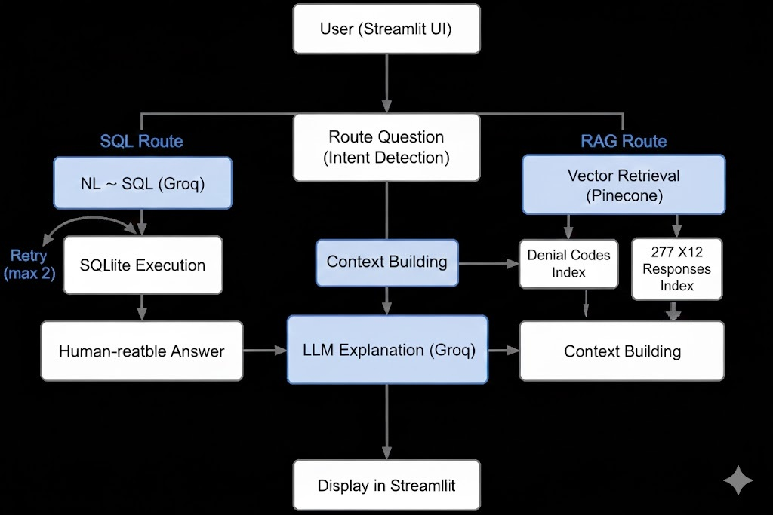
System Architecture

Slide 11
Live Demo Flow
User asks: Why was claim denied?
Denial codes extracted
Context retrieved from Pinecone
Explanation generated
Fix steps suggested

Slide 12
Example Output
Reason for denial
Which code caused rejection
What documentation is missing
How to resubmit successfully

Slide 13
Business Impact
Faster denial resolution
Reduced AR days
Less manual research
Higher first-pass acceptance rate

Slide 14
DenialIQ – See Clearly Why Claims Fail
AI-powered clarity for medical billing teams
From codes → context → correction

