Slide 1
Automated Repair of Asymmetric Web Pages during Resolution of Mobile Friendly Problems
The 16th International Conference on Evaluation of Novel Approaches to Software Engineering
(ENASE 2021)
Authors:
Md. Aquib Azmain
Kishan Kumar Ganguly
Institute of Information Technology, University of Dhaka
Bangladesh
Notes:
Hello everyone. Wishing you a very good day. I am going to present our paper Automated Repair of Asymmetric Web Pages during Resolution of Mobile Friendly Problems. I am Md. Aquib Azmain, the first author of this paper. And Kishan Kumar Ganguly, the second author of this paper who also supervised me in this work. We are from institute of information technology, University of Dhaka. And it is located in Bangladesh. If you are not familiar it’s a small country in south asia having 180 millions people.

Slide 2

Mobile Friendly Problems
The viewport varies with the device, and will be smaller on a mobile phone than on a computer screen.
Notes:
Mobiles have become a common medium of accessing the internet. Designing websites to be mobile friendly ensures that the pages of that website is readable and usable on all devices. The websites which are developed for desktop viewport might be difficult to view and use on a mobile device.

Slide 3
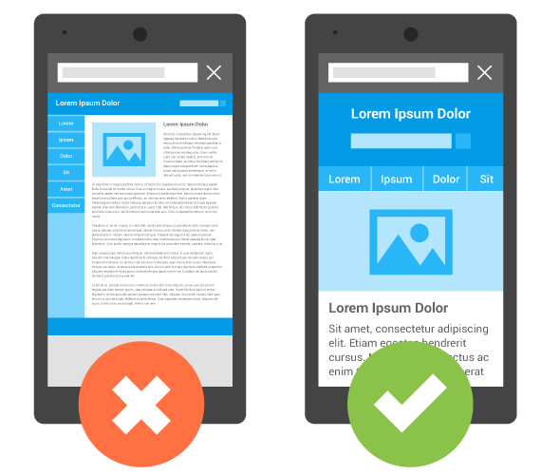
Why Mobile Friendly?
Users abandon mobile unfriendly websites
Google has incorporated mobile-friendliness as part of its ranking criteria when returning search results
Notes:
Now the qusn is why we need mobile friendly websites. Google has updated its ranking criteria and included mobile-friendliness as a criteria while returning search results for mobile devices in April 2015. This concludes that if a website is not mobile friendly, the probability of getting higher rank in the search results will be less.

Slide 4
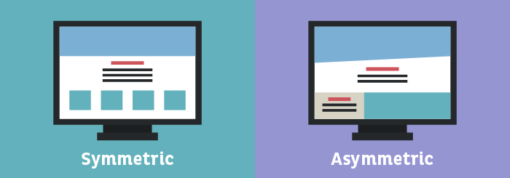
Problem: Ensuring Symmetric Structure
Relies on proportion to create a style with mirroring sides
Composition of design is distributed evenly around a central point or axis of a website
Significantly correlated with users’ subjective ratings
Notes:
The main problem of existing approaches is the violation of symmetric structure of the website. Symmetrical design relies on proportion to create a style with mirroring sides. Symmetry happens when the composition of design is distributed evenly around a central point or axis of a website

Slide 5
Research Question
RQ: How to improve symmetric structure during resolution of mobile friendly problems of a web page?
SQ1: How to identify CSS properties and values of the HTML elements that cause asymmetry of a web page?
SQ2: How to generate patches that improve symmetric structure maintaining trade-off between symmetry and layout distortion in different viewports?
Notes:
The goal of this research is to deliver a technique to improve symmetric structure of a website during resolution of mobile friendly problems. This proposed method has been compared with the existing works. This methodology helps to develop mobile friendly websites with a symmetric structure. Moreover, this approach has decreased development time and cost as it automatically fixes a web page according to the viewports of the mobile devices.

Slide 6
Overview of the Solution
Mobile friendly score
Layout distortion
Page under test (PUT)
Web page segmentation
Apply patches to fix mobile friendly problem
Evaluate symmetric structure of PUT
Repaired PUT
Generate the symmetric mobile friendly patch
Compute Candidate Patches
Identify problematic CSS properties
Balance Score
Proportion Score
Notes:
First, the approach parses the document object model (DOM) tree of the target web page to identify the segments.
After that, the approach incorporates the existing mobile friendly fix (Mahajan et al., 2018). This applies patches to fix mobile friendly problems of the target patch. This step uses two metrics named mobile friendly score and layout distortion for evaluation.
Then, the approach evaluates symmetric structure of the web page based on symmetry based metrics. It also finds the faulty HTML elements that cause asymmetry. To detect the asymmetry, the approach checks the balance between the two sides of a web page according to the centralized vertical axis.
After that, the approach generates patches that modifies some CSS properties like position, height, width, padding etc. so that the whole page can be symmetrically structured
The approach updates the position property value (static, relative or sticky) to achieve the most symmetric structure possible for that web page. This step uses two metrics named proportion score and balance score to generate the symmetry mobile friendly patch.
New values are made into CSS style declarations by converting it into a CSS selector. A CSS media query is formed by these updated CSS style values.

Slide 7

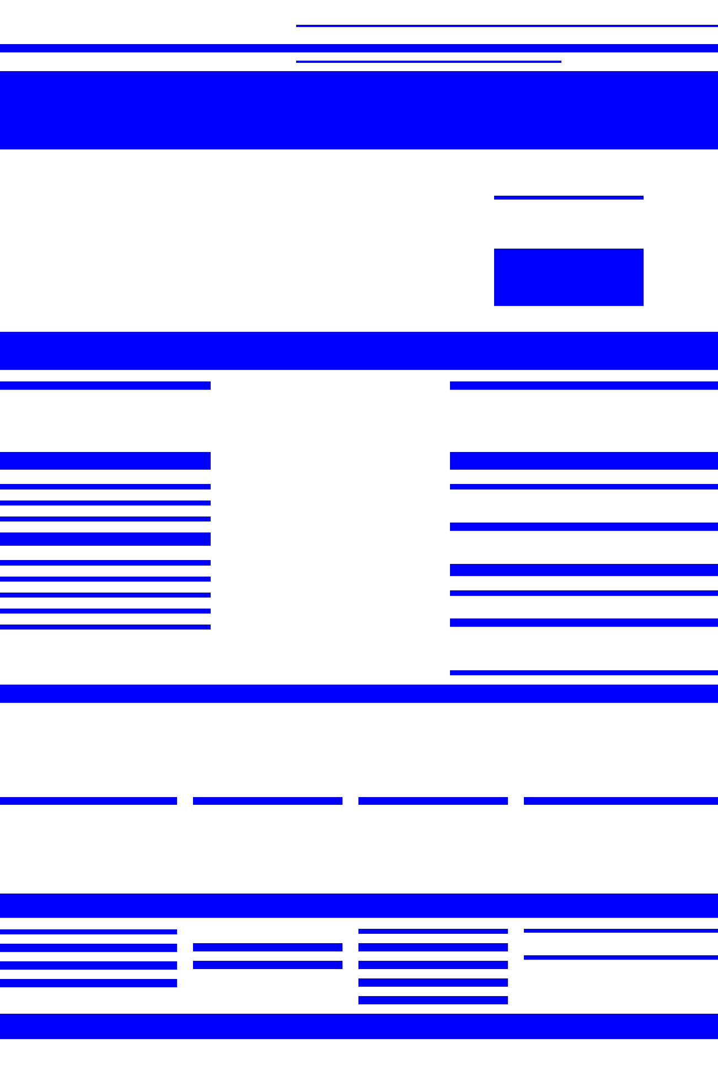
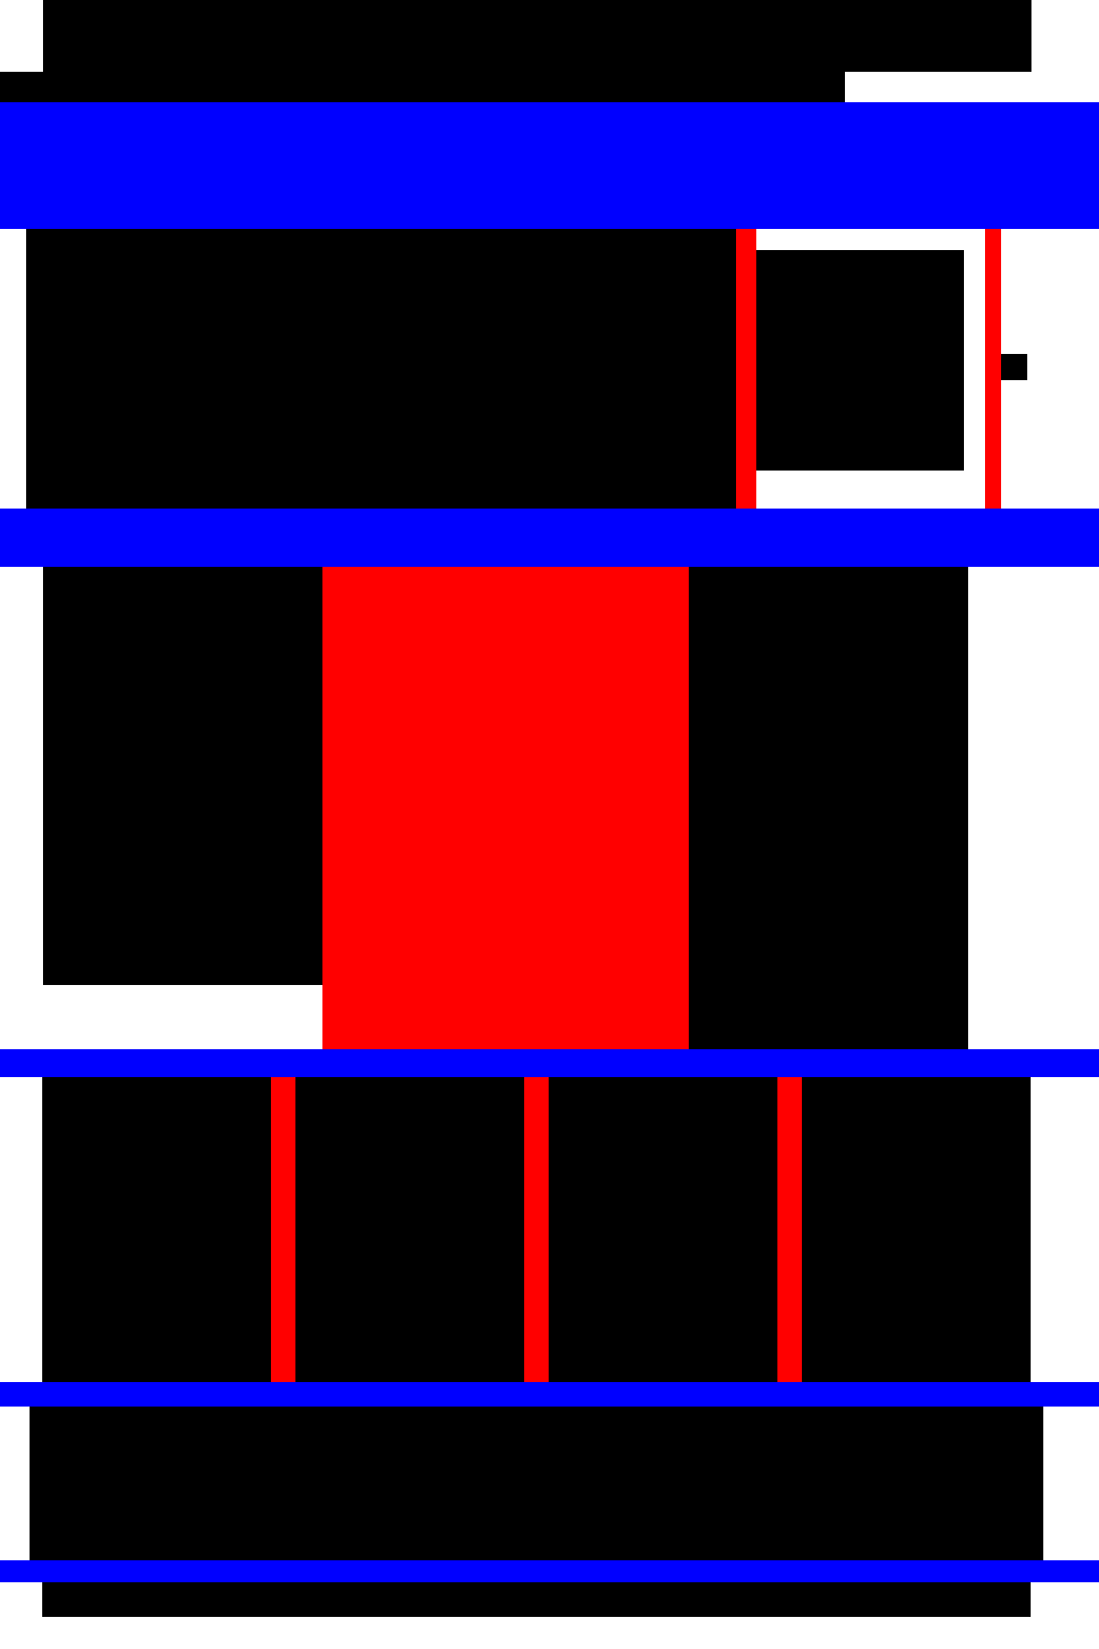
Segmentation of the web page
Notes:
Now we will see the approach in detail. First step is the segmentaion of the web page.
To get the segments , The document object model (DOM) tree of the target web page needs to be parsed
We have used Visual representation based segmentation process called VIPS
Extract visual blocks
Separator detection
Content structure construction
This approach Uses visual information, such as position, background color, font size, font weight

Slide 8

Detecting Faulty Elements
Balance Score
$N_{i}$ The number of odd elements in each segments on both sides.
$H_{i}$ The distance from the closest headline and sub-headline on both sides.
$C_{i}$ The distance from the closest call to action button according to the center.
$E_{i}$ The number of odd elements under the heading on both sides
Notes:
Now we will see how this approach detect faulty elements that cause asymmetry of the web page. The symmetric evaluation of the HTML elements is concluded by two metrics.
Balance Score is The equal distribution of visual weight in a design is defined as balance. This is a metric for measuring equilibrium along a vertical axis in the layout.

Slide 9



Detecting Faulty Elements
Proportion Score:
If the height of an HTML element, $e$ is $H_{e}$ and width is $W_{e}$, the proportion score of that element is $P_{e}$.
If the proportion score of left set is $P_{L}s$ and right set is $P_{R}s$
where the number of elements in left side is $n_{L}$ and
Notes:
The second metirc we have used to evaluate symmetry is proportion score. It is the ratio between the dimensions of elements. The ratio is calculated by dividing the height of any element by its length. The proportion of every elements in a web page needs to be similar to maintain symmetric structure. The proportion score of a web page is calculated by the difference of individual mean proportion score of each mirror side of that web page. The solution is looking for a proportion score close to zero.

Slide 10



Detecting Faulty Elements
Proportion Score:
where the number of elements in left side is $n_{R}$
Final proportion score of a page $W$ is $P_{W}$,
Notes:
So we get the proportion score of both the left side and right side of the web page. we need to substract them to get the final proportion score of that target web page.

Slide 11
Generate Symmetric Mobile Friendly Patch
Search based technique has been used to generate candidate patches by updating CSS values
Gain highest balance score (close to 1)
Gain lowest proportion score (close to 0).
Iterates over each of the elements to get optimum result
CSS media query is formed by these updated CSS style values
Notes:
Now we will discuss how we achieve the Symmetric Mobile Friendly Patch. Search based technique has been used to generate candidate patches to get symmetric mobile friendly web page. The value of balance score and proportion score has been changed dynamically to gain highest balance score (close to 1) and lowest proportion score (close to 0). Search-based strategies start by choosing a sample set from the solution space. For this, the method iterates over each of the elements in the site.
New values are made into CSS style declarations by converting it into a CSS selector. A CSS media query is formed by these updated CSS style values. When an user access the page in a mobile viewport, this media query cause it to be rendered with the updated CSS patch.

Slide 12
Subjects
54 real world Websites
(MOZ top 500 websites)
ID | URL | Category | Rank | #HTML
1 | http://aamc.org | Health | 23 | 598
2 | https://arxiv.org | Science | 21 | 381
3 | http://us.battle.net | Kids and teens | 2 | 615
4 | https://bitcointalk.org | Science | 25 | 1302
5 | http://blizzard.com | Kids and teens | 33 | 313
6 | https://boardgamegeek.com | Games | 31 | 4474
7 | https://bulbagarden.net | Kids and teens | 26 | 151
8 | http://coinmarketcap.com | Science | 8 | 1964
9 | http://correios.com.br/para-voce | Society | 14 | 769
10 | http://dict.cc | Reference | 20 | 633
11 | https://www.discogs.com | Arts | 26 | 5738
Notes:
For result analysis, 54 websites were selected from the most popular websites list across all categories listed by MOZ top 500 websites of 2020. We selected MOZ website list as the source because it gives the popularity based ranking and a mix of different layouts. We have used HTTrack (HTT, 2020) to download all the HTML files, images, CSS and javascript files from the website.

Slide 13
Proportion Score Loss
Notes:
The figure shows the distribution of proportion score of 54 websites.
The light blue portion indicates the proportion score of the mobile friendly version. The dark portion indicates the improvement of proportion score of the symmetric mobile friendly version.
52 out of 54 subjects have lost proportion value. The effectiveness on the basis of proportion score is 96.2%.

Slide 14
Balance Score Gain
Notes:
The figure shows the distribution of balance score of 54 websites
49 out of 54 subjects have gained balance score. Therefore, the effectiveness of the approach on the basis of balance is 90.7%.

Slide 15
Summary of Evaluation Metrics
 | Max | Min | Average
Balance Gain | 0.253 | -0.361 | 0.202
Proportion Loss | 0.851 | -0.658 | 0.253
Notes:
If we summarize the evaluation metrics, we can see that, the mean value of balance gain is 0.20 and the mean value of proportion loss is 0.25 which are greater than 0. It confirms that the repaired versions have performed better than the previous mobile friendly technique.

Slide 16
User Based Study
Which version between two screenshots (One is mobile friendly, other one is symmetric mobile friendly) is more visually attractive?
Which version would you prefer more to use in a mobile device?
Rate the each version of the target page on a scale of 10.
Notes:
A user based case study has been conducted by doing a survey. The purpose of this survey is to evaluate the visual appeal of the updated web page that is incorporated with symmetric mobile friendly patch. The participants were asked to compare the previous and updated versions of the subjects in that survey. For each subject, the survey included a screenshot of the original and updated pages when viewed in a viewport of the mobile device. The questions of the survey were:

Slide 17
User Based Study
25 Professional Software Developer (Front-end)
88.89% subjects, 48 out of 54, have been considered as more preferable than the previous version by the users.
The average rating (out of 10) given by the participants is 8.17
Notes:
For the survey, we had 25 participants who are currently working as software developers in different multi-national software companies of Bangladesh.
Based on the result of the survey, the participants preferred using symmetric version 48 out of 54 subjects. On average, the rating of updated symmetric mobile friendly version had a 21% improvement than the mobile friendly version.

Slide 18
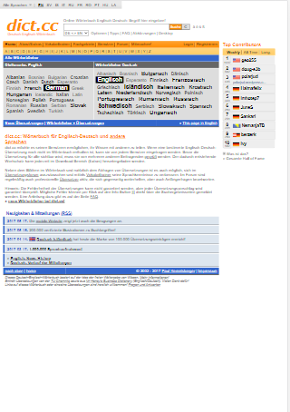
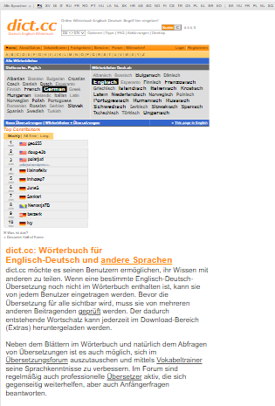
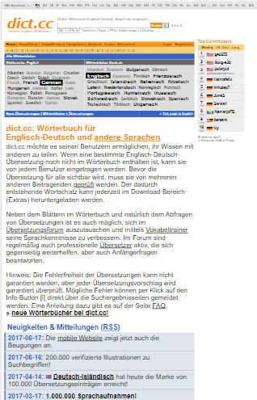
Example
Notes:
We have an example here. The 1st image shows a website with various mobile friendly problems.
After applying the solution for mobile friendly problems, the website has asymmetric structure .
The last image is the final result that shows how the website looks after fixing the structural problem.

Slide 19
Future Work
Handle the dynamic changes along with the symmetric mobile friendliness of a web page
Analyze the relation between symmetry, mobile friendliness and complexity of a web page to quantify this relation
Notes:
Our future work is to handle the dynamic changes along with the symmetric mobile friendliness of a web page. This solution needs to introduce fixing the online version of a web site.
Another possible future work is to analyze the relation between symmetry, mobile friendliness and complexity of a web page to quantify this relation. As the complexity of a web page depends on the elements, contents and layout, symmetry analysis on different types of website can extract valuable insights.

Slide 20


Thank You
Notes:
Thank you everyone for hearing. If you have any question, you can ask.

