Slide 1
CASE STUDY · NETWORK SECURITY CAPSTONE
Fortifying B2B Network Security
for Regulatory Compliance
A FinSecure Technologies Inc. Case Study
Group 3
Case Studies, Issues & Capstone Project in Network Security
University of Winnipeg · Prof. Victor Balogun · Fall 2024
Notes:
Welcome the audience and frame the story before any slide detail: this is a real-shaped consulting engagement, not a generic slideshow — a client (FinSecure) had a breach, was non-compliant with three separate financial regulations, and we rebuilt their network and access model in response. Set the tone that every design decision from here on is a direct answer to that starting problem, not a checklist of buzzwords.

Slide 2
AGENDA
What We'll Cover
01
Client Background
05
Zero Trust
Who FinSecure is and why the stakes are high
Why and how we rebuilt access control
02
The Breach
06
Risk & Policy
What happened on October 3, 2024
What governs the network now
03
Methodology
07
Incident Response
How we investigated it
How we responded, and what we learned
04
Network Redesign
08
Results
Before vs. after architecture
Compliance achieved & what's next
FinSecure Technologies Inc. — Network Security Capstone
1
Notes:
Walk through the agenda quickly — the key thing to land here is the arc: we start from a concrete incident, use it to justify a technical redesign, then show the governance (risk + policy) that makes the redesign durable rather than a one-time fix. That arc is what separates this from a generic 'here are some security controls' presentation.

Slide 3
CLIENT BACKGROUND
FinSecure Technologies Inc.
A New York City-headquartered financial services firm hosting financial services and software-based web applications for a diverse B2B client base.
3
Regulations to satisfy
(SOX · PCI DSS · GLBA)
Flagship client: GlobalTech Industries, a publicly traded multinational conglomerate
Serves finance firms, e-commerce companies, government agencies, and publicly traded companies
Explicitly does not serve the health sector — HIPAA is out of scope
Infrastructure: Active Directory, public web servers, PostgreSQL, Redis cache, SFTP file transfer
0
Health-sector clients
(HIPAA out of scope)
1
Confirmed breach that
triggered this engagement
FinSecure Technologies Inc. — Network Security Capstone
2
Notes:
The point of this slide is scope-setting: FinSecure is a B2B financial platform, not a consumer bank, so the compliance burden is SOX + PCI DSS + GLBA together, not any single framework in isolation. Flag explicitly that health-sector rules like HIPAA never applied — that boundary matters later when we talk about what's in vs. out of scope for the policy document.

Slide 4
THE PROBLEM
A Confirmed Breach — and a Compliance Gap
Not compliant with SOX, PCI DSS, or GLBA at the start of this engagement
Attack entry point: SQL injection against an internally-built web application
Escalated via weak, default SFTP credentials into lateral movement across the network
Placed FinSecure in direct violation of SOX's data-protection requirements
October 3
2024
Web application server compromised — cardholder data and client PII exposed.
FinSecure Technologies Inc. — Network Security Capstone
3
Notes:
This is the emotional and technical center of the whole deck — everything downstream (redesign, Zero Trust, policy) exists because of this single incident. Be specific about the mechanism: it wasn't a sophisticated zero-day, it was SQL injection plus default credentials — an entirely preventable chain, which is exactly why the fix is architectural (segmentation, MFA, no default creds) rather than a single patch.

Slide 5
OBJECTIVES & SCOPE
What This Engagement Set Out to Do
1
2
3
Achieve Compliance
Implement Zero Trust
Formalize Governance
Bring FinSecure into alignment with SOX, PCI DSS, and GLBA
“Never trust, always verify” across users, devices, and segments
A network security policy covering access, monitoring, and incident response
IN SCOPE
OUT OF SCOPE
Network redesign · security technology · risk assessment · Zero Trust · staff training
Health-sector compliance (HIPAA) · physical office relocation / facilities work
FinSecure Technologies Inc. — Network Security Capstone
4
Notes:
Three objectives, deliberately in this order: compliance is the business driver, Zero Trust is the technical mechanism, and the policy document is what makes it stick after the consultants leave. The in/out-of-scope box exists because scope creep is the most common way capstone-style engagements lose focus — call out explicitly that HIPAA was never relevant here.

Slide 6
NETWORK SECURITY ANALYSIS
Methodology: Three Complementary Approaches
Automated
Scanning
Manual
Penetration Testing
Security
Audits
Nmap + OWASP ZAP
Metasploit
Policy & config review
Broad, repeatable coverage of open ports, exposed services, and known-vulnerable software across every server and device.
Targeted exploitation of the specific weaknesses scanning flagged — confirming they were actually exploitable, not theoretical.
A compliance-focused review of access controls, encryption, and segmentation against SOX, PCI DSS, and GLBA.
FinSecure Technologies Inc. — Network Security Capstone
5
Notes:
Emphasize why all three methods were used together rather than just one: automated scanning is fast but shallow, manual pentesting is slow but proves real exploitability, and the compliance audit catches process/policy gaps neither tool can see (like improper segmentation). Findings from each method corroborated the others — e.g. the WAF log pattern (audit/monitoring) matched exactly the endpoint Metasploit confirmed was exploitable.

Slide 7
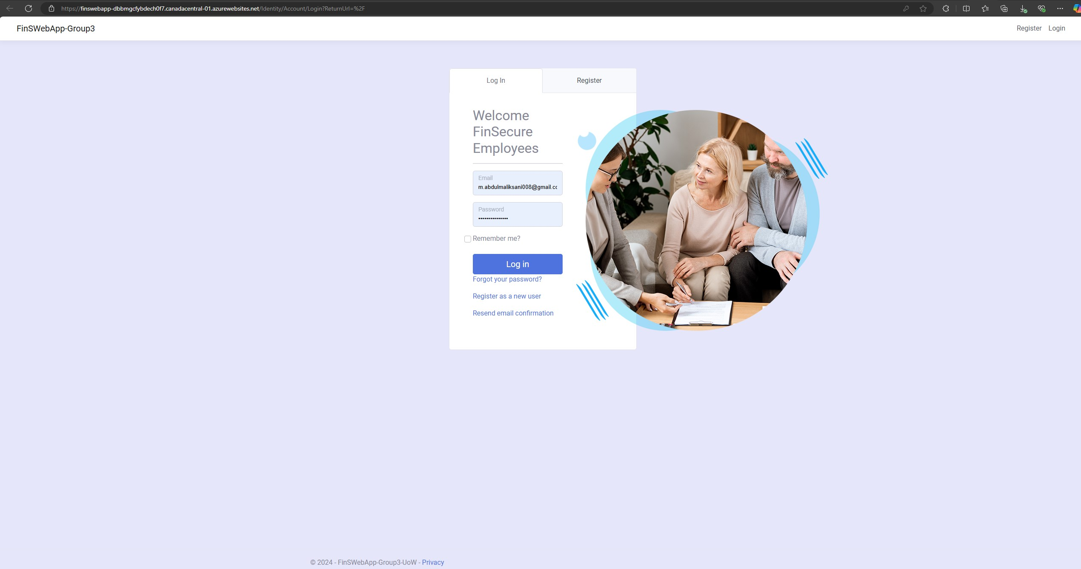
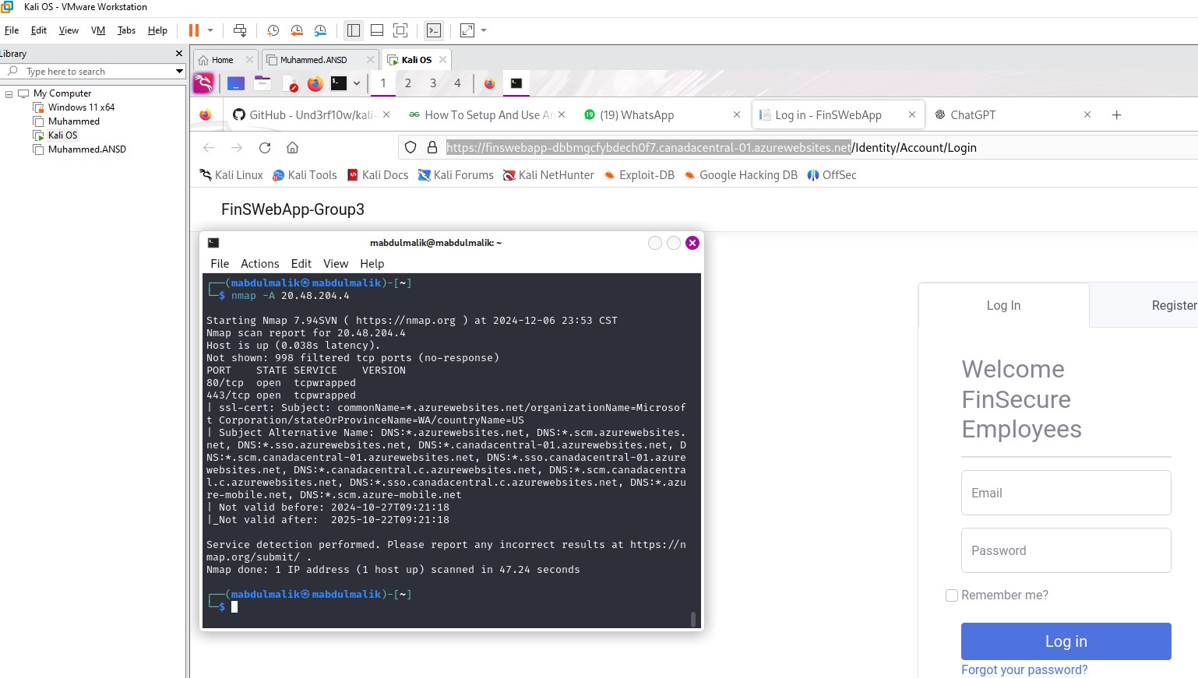
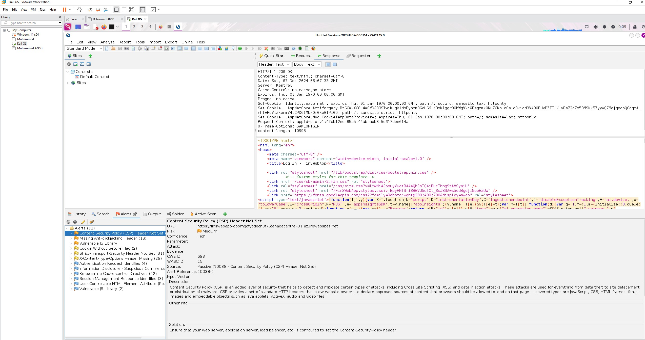
NETWORK SECURITY ANALYSIS
Live Evidence: Scanning FinSWebApp
The actual FinSWebApp login page — the application under test.
Nmap: only ports 80/443 exposed externally, with a valid TLS cert.
OWASP ZAP: 12 alerts, including a missing CSP header.
FinSecure Technologies Inc. — Network Security Capstone
6
Notes:
These are not mockups — this is the group's own Kali Linux workstation scanning the group's own deployed FinSWebApp instance on Azure App Service. Left to right: the actual application under test, then Nmap confirming the external attack surface is small (just 80/443) with a valid cert, then OWASP ZAP's automated scan — which is what actually caught the missing security headers and outdated JS library, lower-severity than the SQL injection in the incident narrative but the same 'hardening skipped under deadline pressure' pattern. This slide exists to show the audience the methodology wasn't just described — it was actually run.

Slide 8
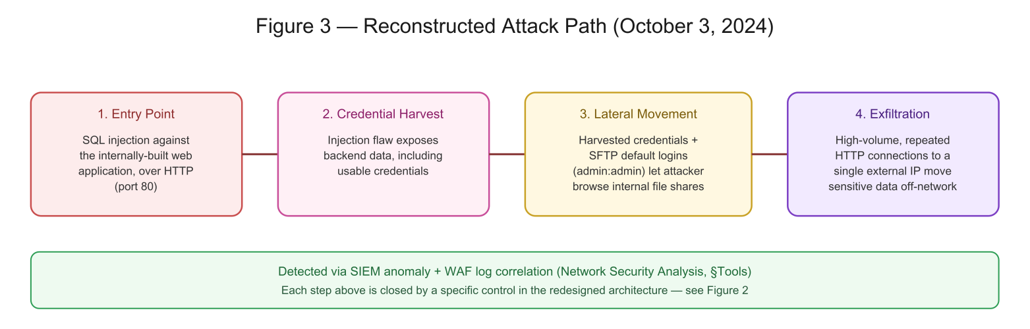
FINDINGS
The Attack Path, Reconstructed
SQL Injection
Cross-Site Scripting
Weak Authentication
Internally-built web app
Same web application
SFTP default credentials
FinSecure Technologies Inc. — Network Security Capstone
7
Notes:
Walk left to right across the diagram — this reconstructed path is built directly from SIEM anomalies, WAF log correlation, and Wireshark traffic analysis, not assumption. The three vulnerability tags below map one-to-one onto the four path stages: SQL injection is the entry, XSS is a related web-app weakness found in the same testing pass, and the weak SFTP auth is what turned a single compromised endpoint into full lateral movement.

Slide 9
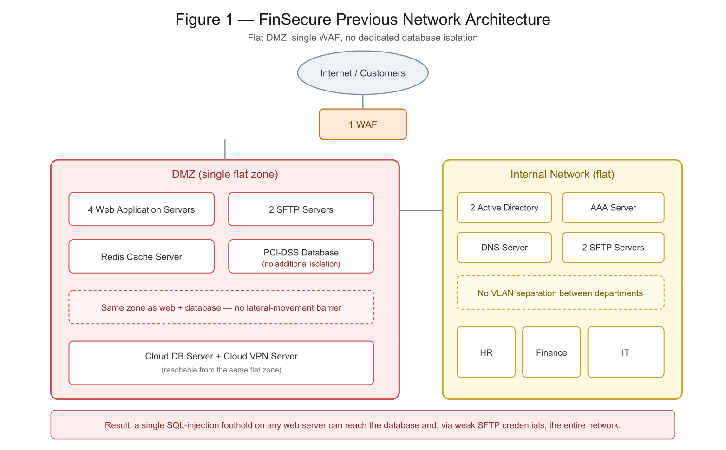
NETWORK REDESIGN
Before: A Flat, Under-Segmented Network
Single WAF in front of one flat DMZ
Web servers, SFTP, cache, and the PCI-DSS database all share one zone
No barrier between the compromised web tier and the database
Internal VLANs not separated by department
This is exactly what let a single SQL-injection foothold reach the database and, from there, the entire network.
FinSecure Technologies Inc. — Network Security Capstone
8
Notes:
This is the 'before' half of the before/after pair — don't over-explain the diagram, just point out there is exactly one firewall between the internet and the cardholder database. That single fact is the through-line to the next slide: everything in the redesign is aimed at replacing this one choke point with multiple independent boundaries.

Slide 10
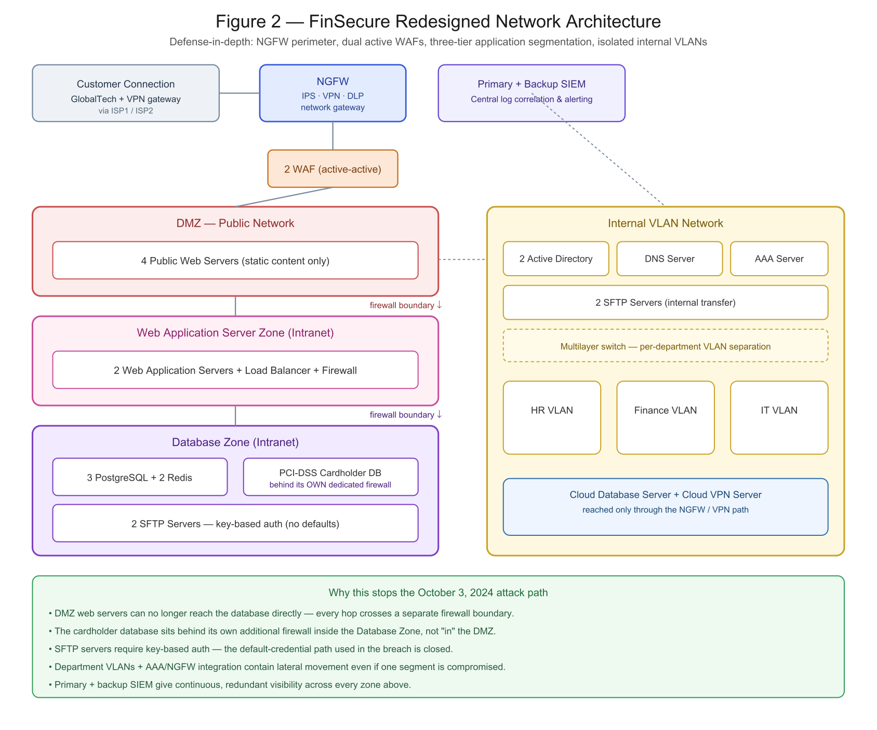
NETWORK REDESIGN
After: Defense-in-Depth Segmentation
NGFW + Dual WAF
IPS, VPN, DLP at the perimeter; active-active WAF pair
3-Tier Isolation
DMZ → App Zone → Database Zone, each behind its own firewall
Dedicated CDE Firewall
Cardholder data isolated with an additional boundary
Per-Department VLANs
HR, Finance, IT segmented to contain lateral movement
FinSecure Technologies Inc. — Network Security Capstone
9
Notes:
The improvements list on the left isn't decorative — each line is a direct fix for one of the four 'before' weaknesses on the previous slide. Point out specifically that the cardholder database now sits behind an *additional* dedicated firewall inside the Database Zone — that's the fix for the PCI-DSS wording issue in the original report, where the database was incorrectly described as being 'within the DMZ.'

Slide 11
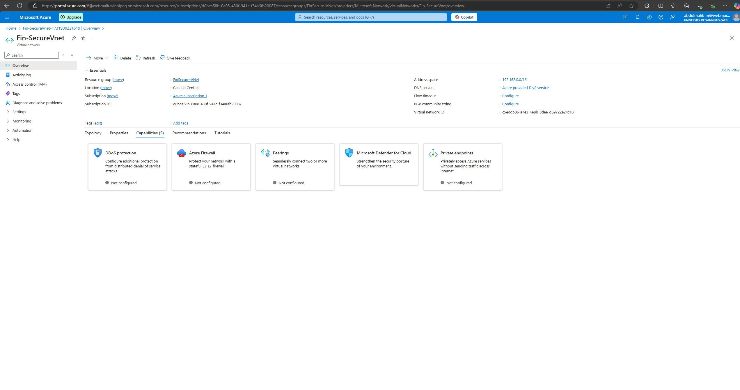
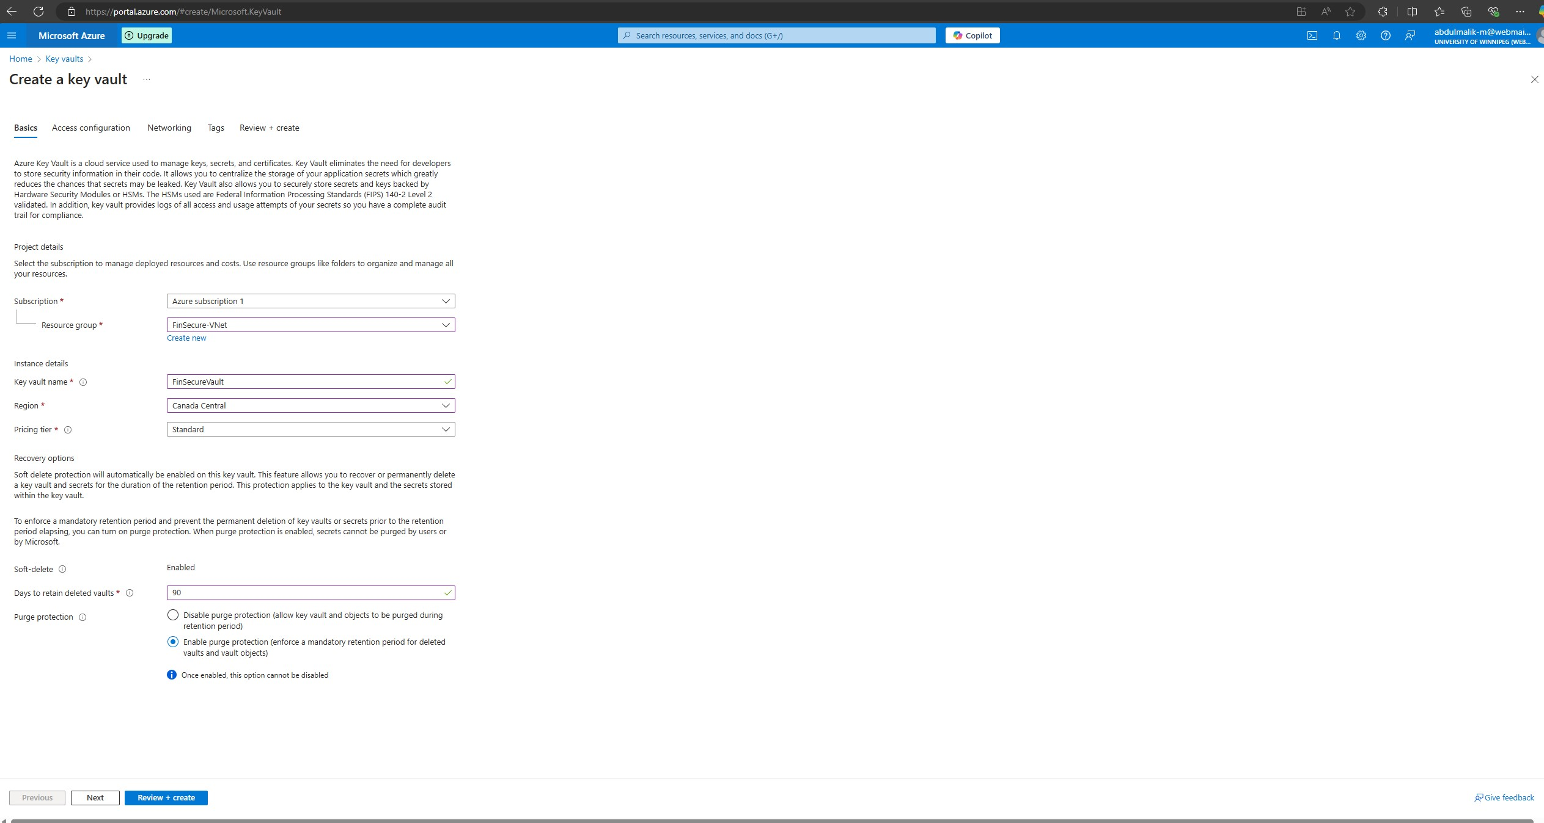
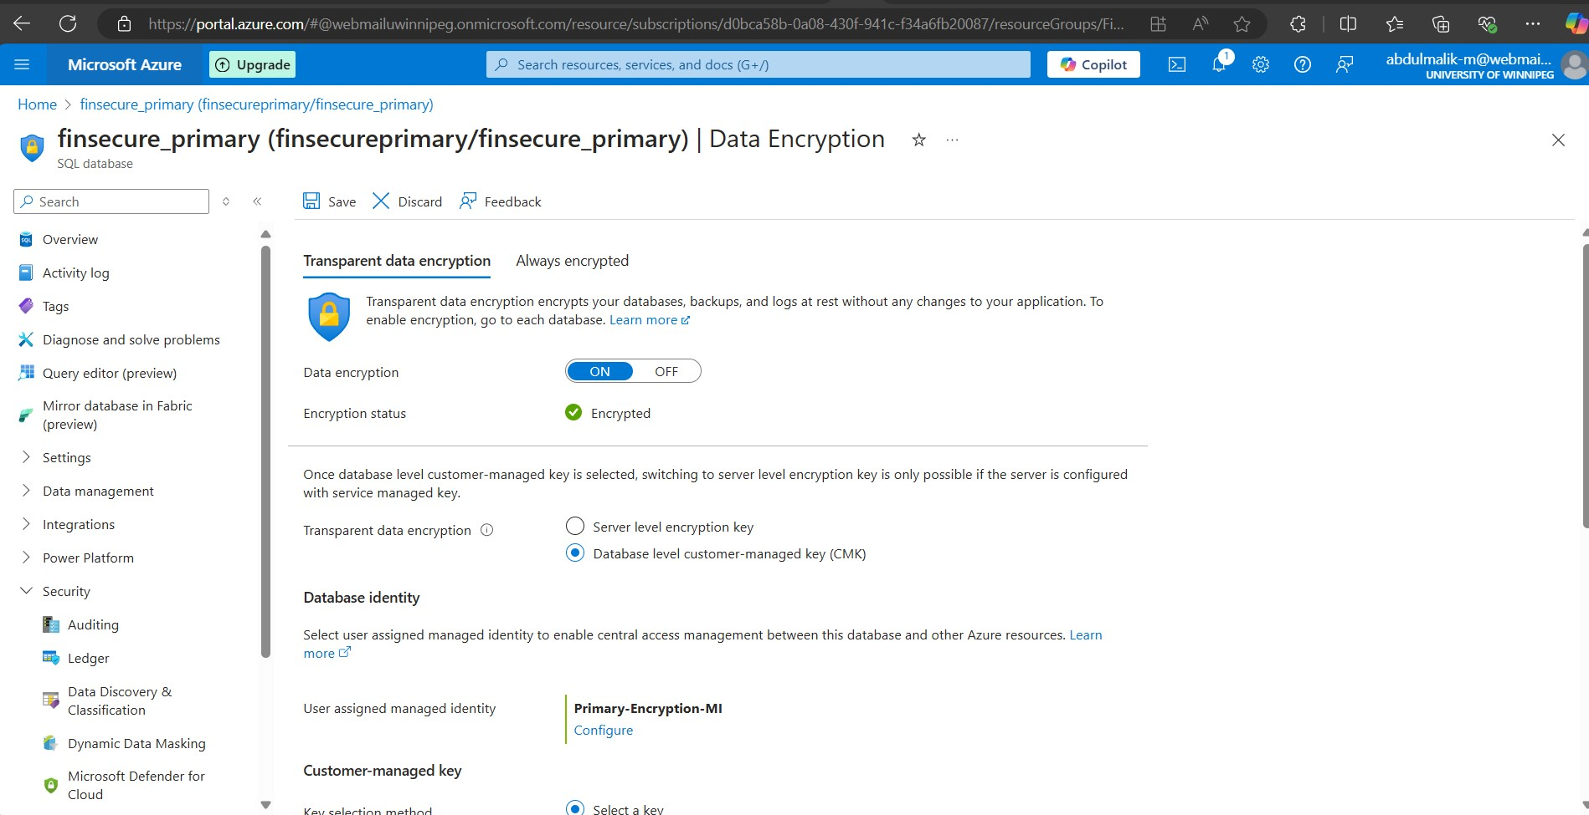
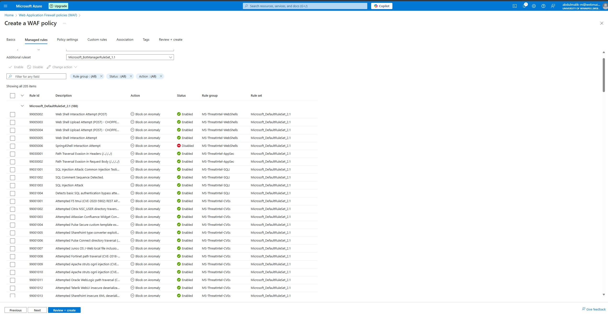
NETWORK REDESIGN
Cloud Migration Evidence: The Actual Azure Deployment
Fin-SecureVnet — the deployed virtual network, DDoS/Firewall-ready.
FinSecureVault — centralized secrets and key management.
Transparent Data Encryption enabled on the primary SQL database.
Azure WAF: 205 managed rules blocking SQLi, path traversal, known CVEs.
FinSecure Technologies Inc. — Network Security Capstone
10
Notes:
Same principle as the earlier live-evidence slide: these are screenshots of the group's own Azure subscription, not mockups — the resource names (Fin-SecureVnet, FinSecureVault, finsecure_primary) are the actual deployed resources built for the Cloud Migration module of this project. Point out that each one maps directly onto a control already shown in the on-prem redesign: the VNet is the cloud-side network segmentation, Key Vault and TDE are the encryption/secrets layer, and the WAF policy is the cloud counterpart to the dual on-prem WAFs. This is the bridge between the network diagrams and the actual infrastructure work the group did in Azure.

Slide 12
ZERO TRUST ARCHITECTURE
Why Zero Trust, Specifically for FinSecure
PCI DSS
Least privilege, MFA, network segmentation
→ Identity verification + micro-segmentation
SOX
Strong internal controls over financial data
→ Continuous verification, minimized trust boundaries
GLBA
Strong protection of nonpublic personal information
→ Least-privilege access model
FinSecure Technologies Inc. — Network Security Capstone
11
Notes:
The key point of this slide: none of SOX, PCI DSS, or GLBA say the words 'Zero Trust' anywhere in their text — but read literally, each one's actual requirement points straight at it. This reframes Zero Trust from 'a trendy architecture we picked' to 'the natural consequence of taking these three regulations seriously at the same time.'

Slide 13
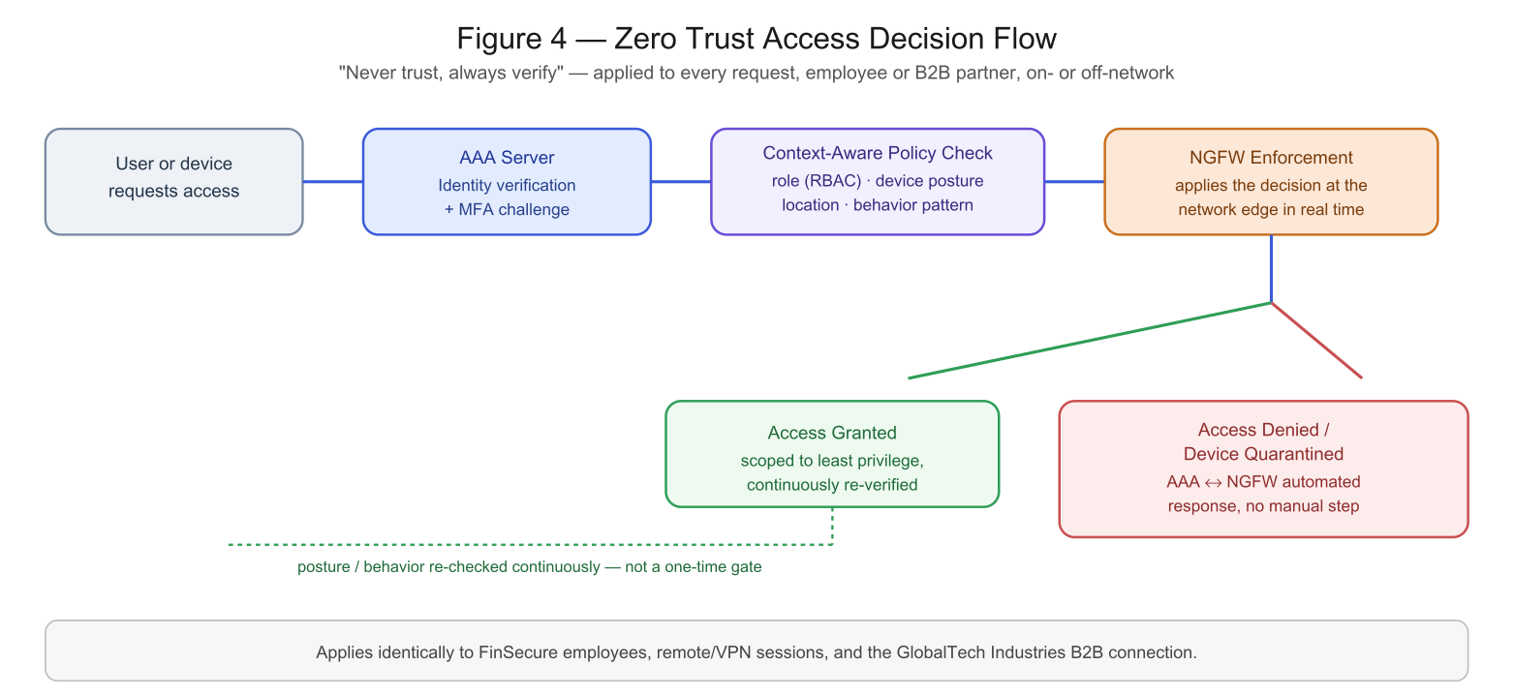
ZERO TRUST ARCHITECTURE
How It Works: Never Trust, Always Verify
1. Inventory users, devices, and data flow
2. Define the protected surface (CDE + core servers)
3. Deploy AAA + Active Directory: SSO, MFA, least privilege
4. Continuous monitoring + automated NGFW response
FinSecure Technologies Inc. — Network Security Capstone
12
Notes:
Trace the diagram left to right: every single request — employee, remote VPN session, or the GlobalTech B2B connection — goes through the same four gates. The critical detail is the dashed feedback loop at the bottom: posture and behavior are re-checked continuously, so a device that was fine at login but starts behaving oddly an hour later gets caught, not just trusted until the next login.

Slide 14
RISK ASSESSMENT
Highest-Priority Risks (Rated Extreme)
Asset | Threat | Top Control
Customer / financial data | Data breach via SQL injection | Encryption at rest & in transit, RBAC, DAM, admin MFA
Security event data (SIEM) | Log tampering, delayed detection | Full log coverage, real-time alerts, IDS/IPS integration
User credentials / AD | Privilege escalation, account hijacking | MFA, least-privilege review, login auditing
Authentication (AAA) | Credential theft, denial of service | Strong password policy, MFA, RADIUS in backbone
Banking service availability | Partial / total service loss | IR plan, BC/DR plans, GlobalTech comms matrix
Full asset-by-asset register (18 risks) maintained in risk-assessment/risk-register.md
FinSecure Technologies Inc. — Network Security Capstone
13
Notes:
These are the five risks rated Extreme out of the full eighteen-item register — don't read the table line by line, instead point out the pattern: every single one of these five is directly addressed by a control we already showed in the redesign or the Zero Trust rollout. The risk register isn't a separate compliance exercise bolted on afterward — it's the scoring system that justified the architecture decisions.

Slide 15
NETWORK SECURITY POLICY
What Now Governs the Network
Access Control
RBAC, least privilege, 12-char password minimum, AES-256 / TLS 1.2+
Monitoring & Logging
Real-time SIEM, IDS/IPS, scheduled log audits
Remote Access & Removable Media
VPN + MFA for every session; USB disabled on regulated-data endpoints
Third-Party / Vendor (B2B)
GlobalTech and future partners onboarded under the same RBAC & segmentation rules
Compliance & Auditing
SOX, PCI DSS, and GLBA controls verified on a recurring schedule
FinSecure Technologies Inc. — Network Security Capstone
14
Notes:
Two of these five rows — Remote Access & Removable Media, and Third-Party/Vendor Risk Management — were things the original report described in prose elsewhere but never actually wrote down as governing policy sections. Closing that gap matters practically: 'we do this' in a narrative report doesn't survive an audit the way a numbered, versioned policy section does.

Slide 16
INCIDENT RESPONSE
How We Responded to the Breach
1
2
3
4
5
Contain
→
Investigate
→
Notify
→
Recover
→
Review
Disconnected the compromised server immediately
Cross-functional IR team, forensic investigation
Affected clients, including GlobalTech, informed promptly
Restored from backup; deployed WAF, dedicated CDE, new AAA+MFA
Independent third-party compliance audit
Lessons learned: stronger vulnerability management, a documented IR plan, retuned SIEM alerting, and specialized IT training on distinguishing false positives from real incidents.
FinSecure Technologies Inc. — Network Security Capstone
15
Notes:
Walk through this as a timeline, not a list — the order matters: contain first to stop ongoing exfiltration, then investigate, and notification happens in parallel with recovery, not after it, because GLBA and client trust both demand speed. The lessons-learned line at the bottom is the bridge back to everything earlier in the deck — this incident is the reason the redesign, Zero Trust rollout, and policy exist.

Slide 17
RESULTS
Compliance Achieved — What's Next
COMPLIANCE STATUS
FUTURE RECOMMENDATIONS
✓
SOX — access controls & audit trail
Recurring in-house + third-party security audits
Ongoing, role-specific security training
Every new asset joins the Zero Trust model on day one
Regular incident-response drills
Close the remaining non-SSO application gap
✓
PCI DSS — cardholder data isolated & encrypted
✓
GLBA — NPI protected, access classified
✓
NIST CSF — Identify/Protect/Detect/Respond/Recover mapped
FinSecure Technologies Inc. — Network Security Capstone
16
Notes:
Left side is where we ended up, right side is where FinSecure needs to keep going — make clear that compliance here is a status achieved through this project, not a permanent state; the right column exists because Zero Trust and regulatory alignment both degrade if nobody keeps maintaining them. The 'close the non-SSO gap' item is a specific, honest loose end we flagged rather than papering over.

Slide 18
Thank You
Questions & Discussion
Group 3
Case Studies, Issues & Capstone Project in Network Security
University of Winnipeg · Prof. Victor Balogun · Fall 2024
Network Security Analysis section & this rebuild: Muhammed Abdulmalik
Notes:
Close by reiterating the single sentence that ties the whole deck together: a preventable breach exposed both a technical gap and a compliance gap, and this project closed both at once by rebuilding the network around Zero Trust rather than patching the original flaw in isolation. Open the floor for questions.

