Slide 1
CSC271 Database Systems
Lecture # 20

Slide 2
Summary: Previous Lecture
Phases of database SDLC
  Requirements collection and analysis
  Database design
  DBMS selection (optional)
  Application design

Slide 3
Prototyping
Building working model of a database system
Purpose of prototyping includes:
  To identify features of a system that work well, or are inadequate
  To suggest improvements or even new features
  To clarify the users’ requirements
  To evaluate feasibility of a particular system design
Types of prototyping
  Requirements prototyping
  Evolutionary prototyping

Slide 4
Implementation
Physical realization of the database and application designs
  Use DDL to create database schemas and empty database files
  Use DDL to create any specified user views
  Use 3GL or 4GL to create the application programs, this will include the database transactions implemented using the DML, possibly embedded in a host programming language

Slide 5
Data Conversion and Loading
Transferring any existing data into new database and converting any existing applications to run on new database
  Only required when new database system is replacing an old system
  DBMS normally has utility that loads existing files into new database
  May be possible to convert and use application programs from old system for use by new system

Slide 6
Testing
Process of running the database system with intent of finding errors
  Use carefully planned test strategies and realistic data
  Testing cannot show absence of faults; it can show only that software faults are present
  Demonstrates that database and application programs appear to be working according to requirements
  Should also test usability of system
  Evaluation conducted against a usability specification

Slide 7
Evaluation Criteria
Examples of the criteria that can be used to conduct the evaluation include:
  Learnability
  Performance
  Robustness
  Recoverability
  Adaptability

Slide 8
Operational Maintenance
Process of monitoring and maintaining database system following installation
  Monitoring performance of system
  If performance falls, may require tuning or reorganization of the database
  Maintaining and upgrading database application (when required)
  Incorporating new requirements into database application

Slide 9
CASE Tools
Support provided by CASE tools include:
  Data dictionary to store information about database system’s data
  Design tools to support data analysis;
  Tools to permit development of corporate data model, and conceptual and logical data models
  Tools to enable prototyping of applications

Slide 10
CASE Tools
CASE tools provide following benefits:
  Standards
  Integration
  Support for standard methods
  Consistency
  Automation

Slide 11
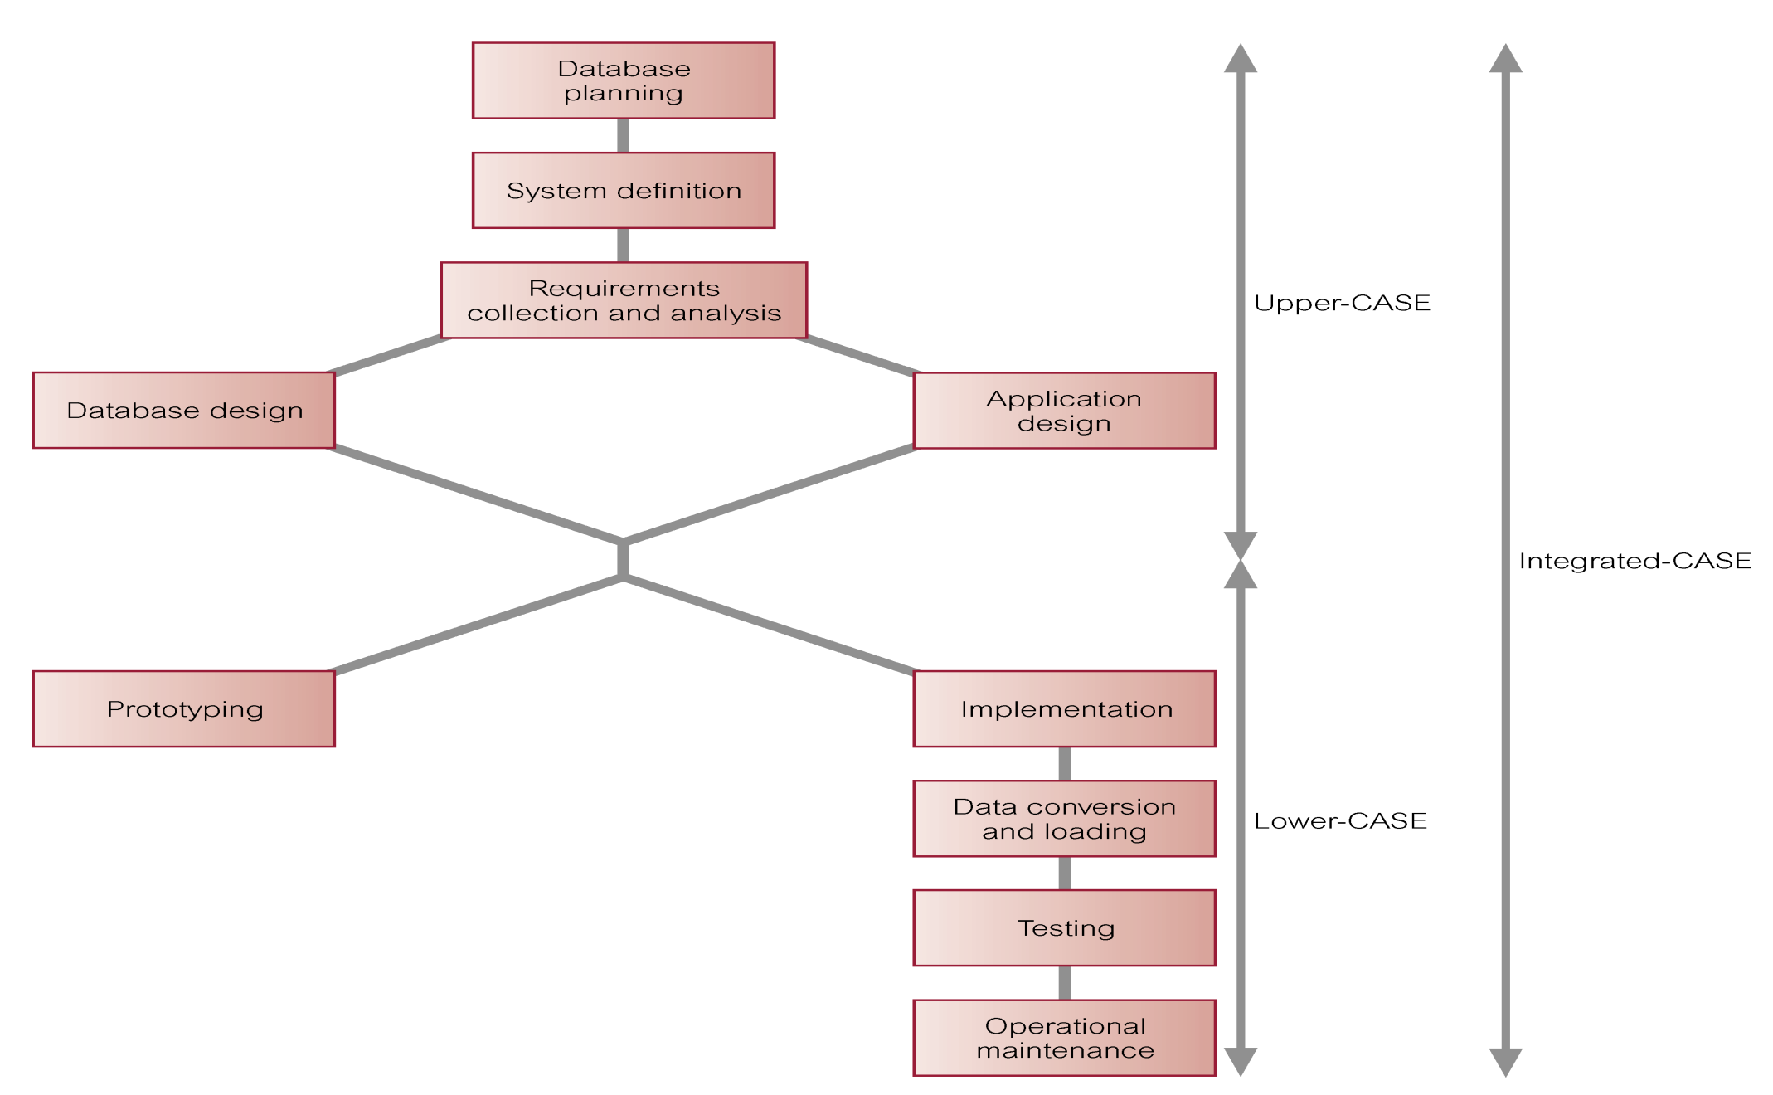
CASE Tools and DB SDLC

Slide 12
Data/Database Administration
The Data Administrator (DA) and Database Administrator (DBA) are responsible for managing and controlling the corporate data and corporate database, respectively
  DA (Data Administrator) is more concerned with early stages of database system development lifecycle
  DBA (Database Administrator) is more concerned with later stages

Slide 13
Data Administration
Management of data resource including:
  Database planning
  Development and maintenance of standards, policies and procedures, and conceptual and logical database design

Slide 14
Database Administration
Management of physical realization of a database system including:
  Physical database design and implementation
  Setting security and integrity controls
  Monitoring system performance, and reorganizing the database

Slide 15
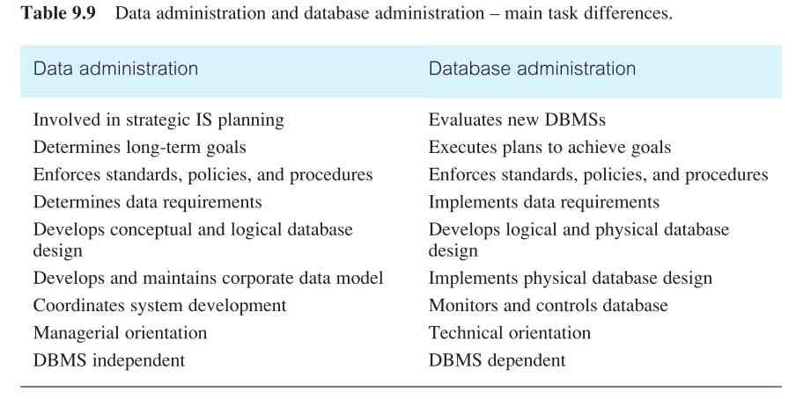
DA Vs. DBA

Slide 16
Fact-Finding Techniques
Chapter 10

Slide 17
Fact-Finding
It is critical to capture the necessary facts to build the required database application
These facts are captured using fact-finding techniques
  The formal process of using techniques such as interviews and questionnaires to collect facts about systems, requirements, and preferences

Slide 18
When Are Techniques Used?
Fact-Finding used throughout the database application lifecycle, crucial to the early stages including database planning, system definition, and requirements collection and analysis stages
  Enables developer to learn about the terminology, problems, opportunities, constraints, requirements, and priorities of the organization and the users of the system

Slide 19
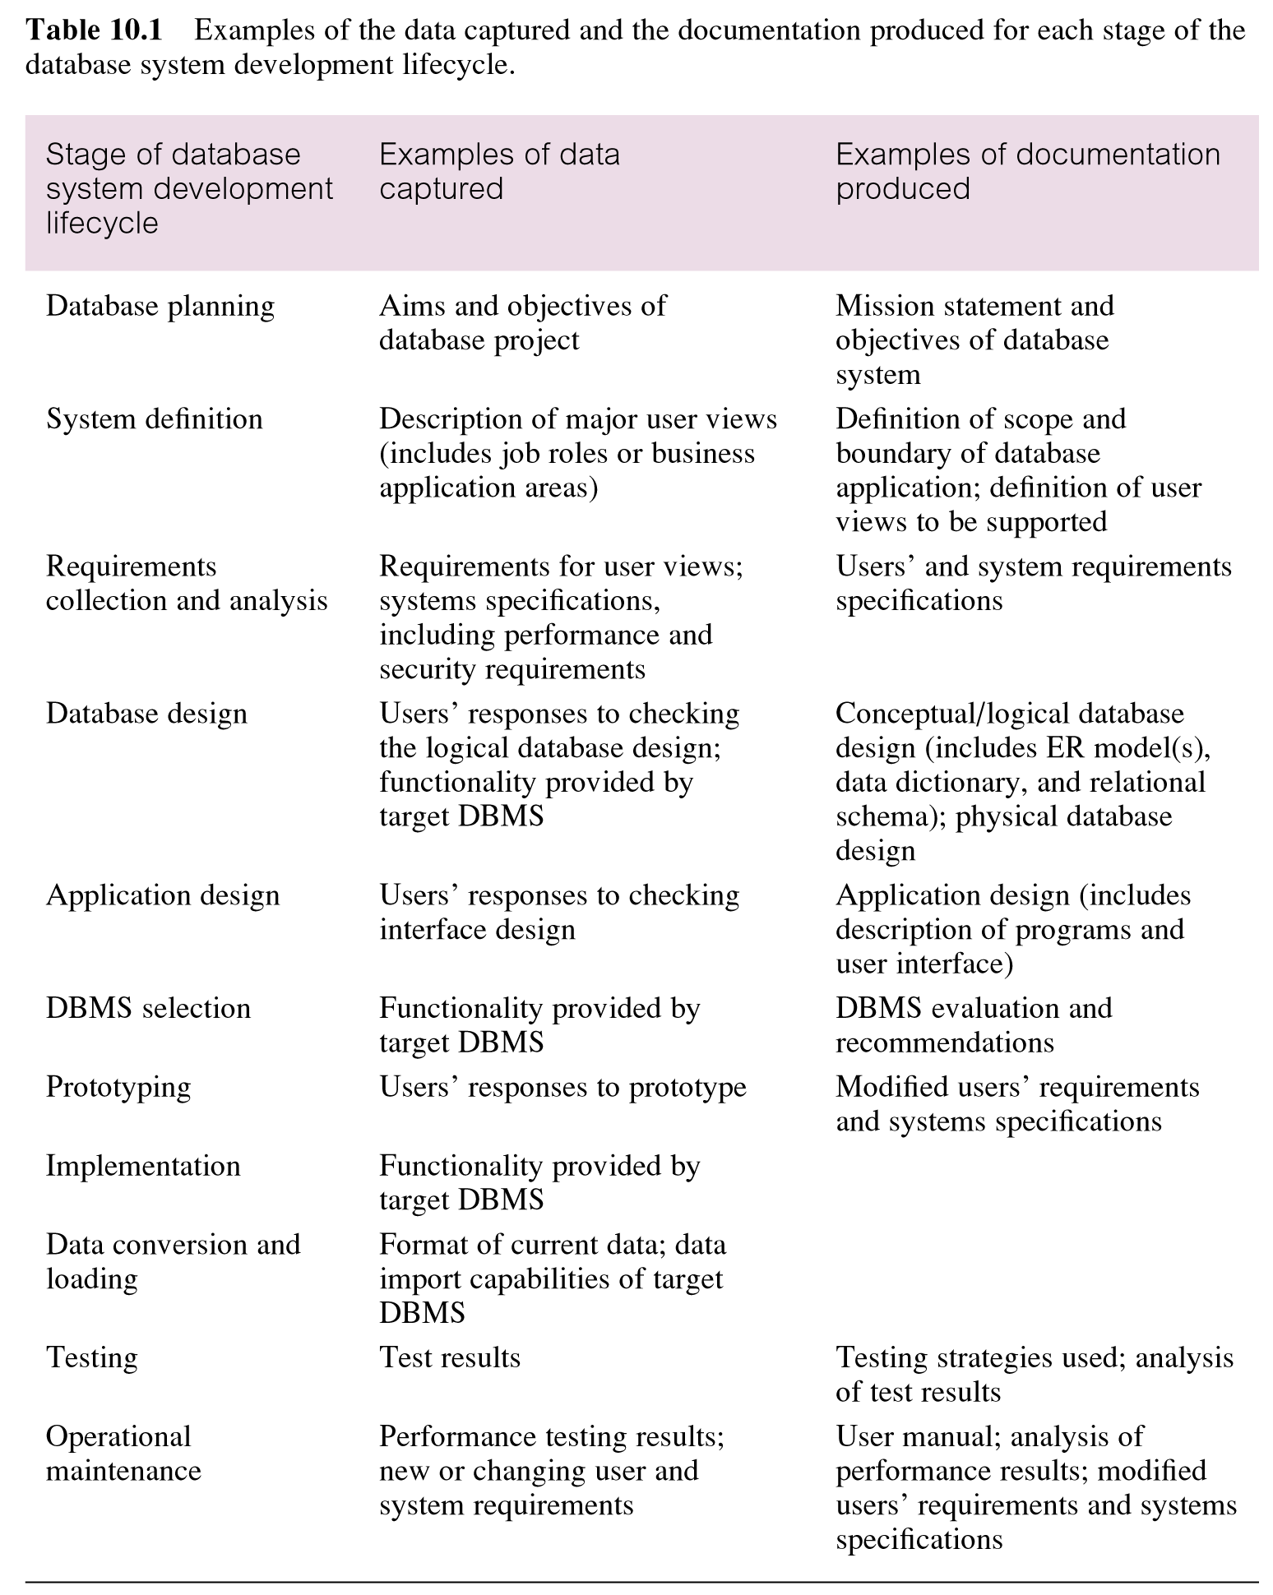

Slide 20
Fact-Finding Techniques
A database developer normally uses several fact-finding techniques during a single database project including:
  Examining documentation
  Interviewing
  Observing the organization in operation
  Research
  Questionnaires

Slide 21
  Examining Documentation
Can be useful
  To gain some insight as to how the need for a database arose
  To identify the part of the organization associated with the problem
  To understand the current system

Slide 22
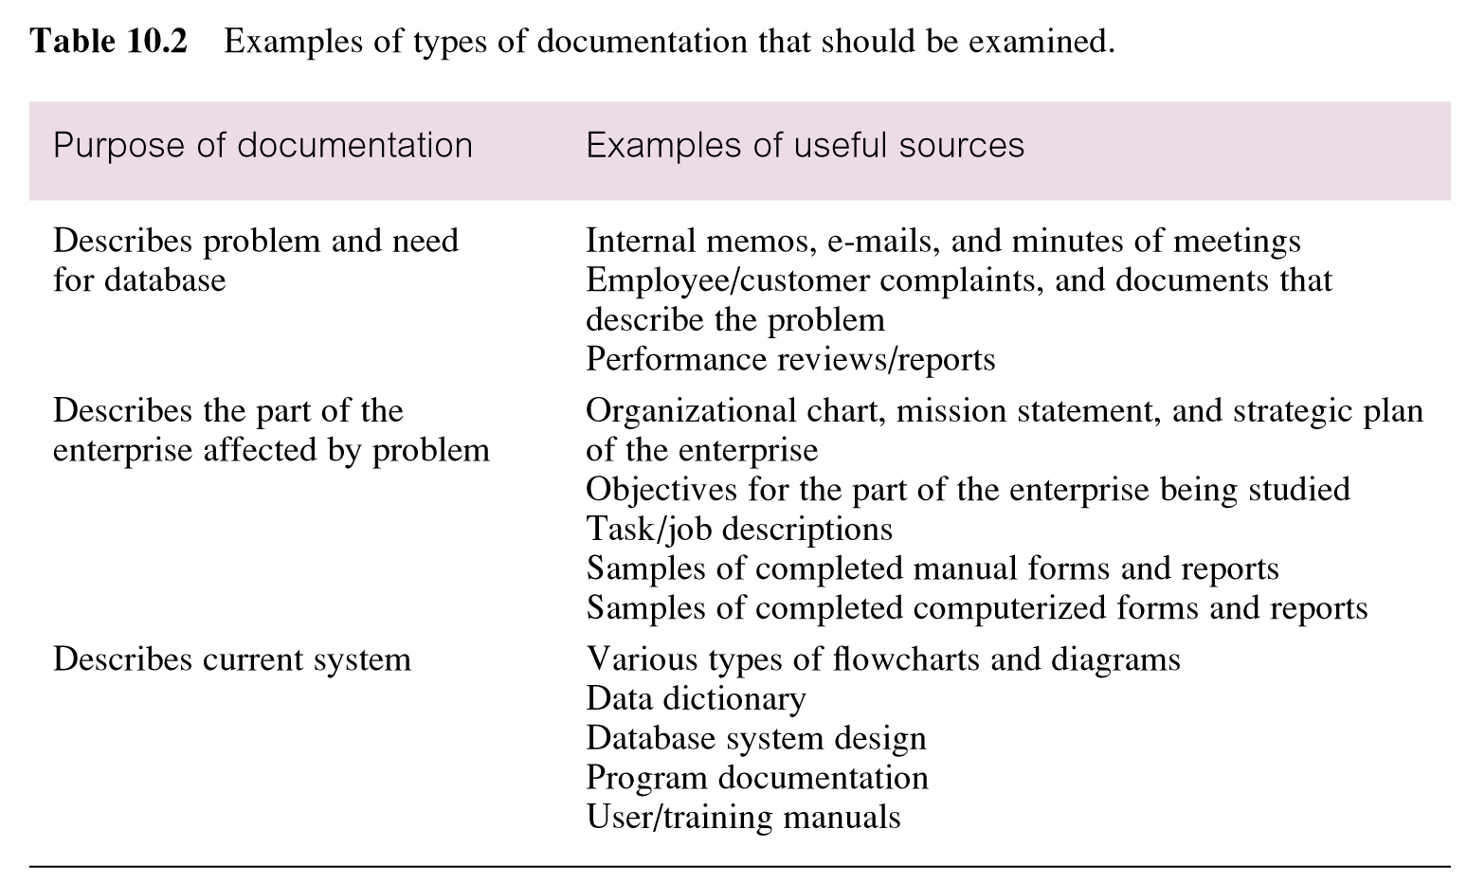
  Examples: Documentation

Slide 23
Interviewing
Most commonly used, and normally most useful, fact-finding technique
  Enables collection of information from individuals face-to-face
  Objectives include finding out facts, verifying facts, clarifying facts, generating enthusiasm, getting the end-user involved, identifying requirements, and gathering ideas and opinions

Slide 24
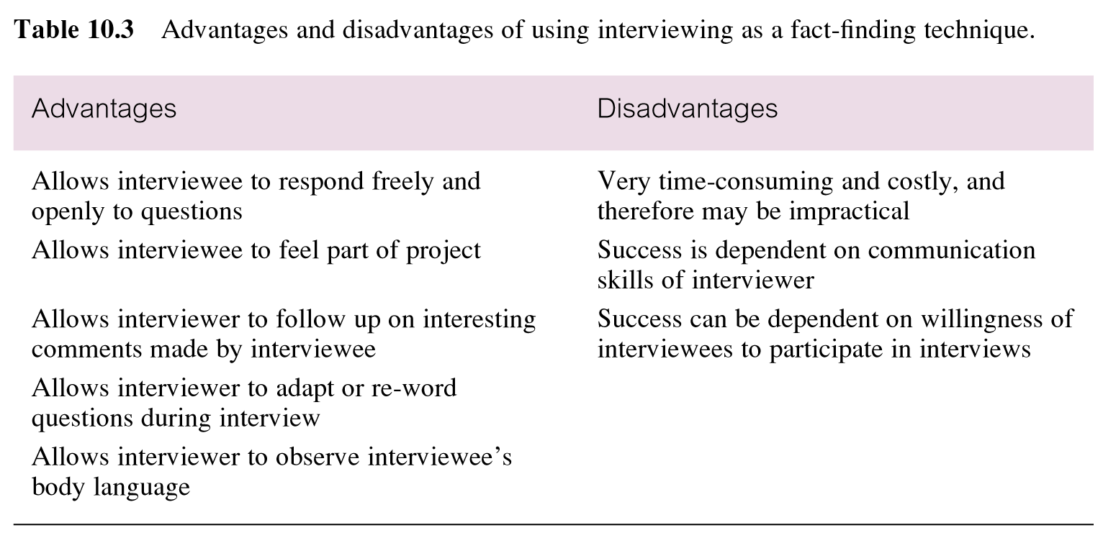
Pros/Cons: Interviewing

Slide 25
Types of Interviewing
There are two types of interviews unstructured and structured
  Open-ended questions allow the interviewee to respond in any way that seems appropriate
  Closed-ended questions restrict answers to either specific choices or short, direct responses

Slide 26
Observing the Organization in Operation
An effective technique for understanding a system
  Possible to either participate in, or watch, a person perform activities to learn about the system
  Useful when validity of data collected is in question or when the complexity of certain aspects of the system prevents a clear explanation by the end-users

Slide 27
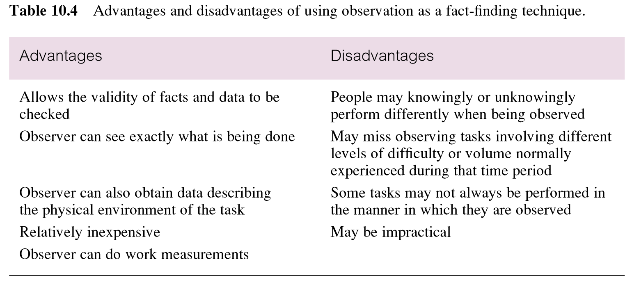
Pros/Cons: Observation

Slide 28
Research
Useful to research the application and problem
  Use computer trade journals, reference books, and the Internet (including user groups and bulletin boards)
  Provide information on how others have solved similar problems, plus whether or not software packages exist to solve or even partially solve the problem

Slide 29
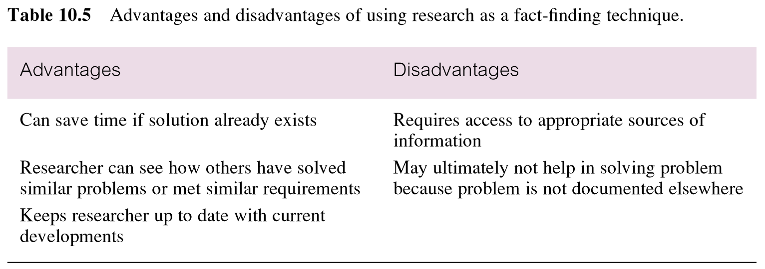
Pros/Cons: Research

Slide 30
Questionnaires
Conduct surveys through questionnaires, which are special-purpose documents that allow facts to be gathered from a large number of people while maintaining some control over their responses
There are two types of questions, namely
  Free-format
  Fixed-format

Slide 31
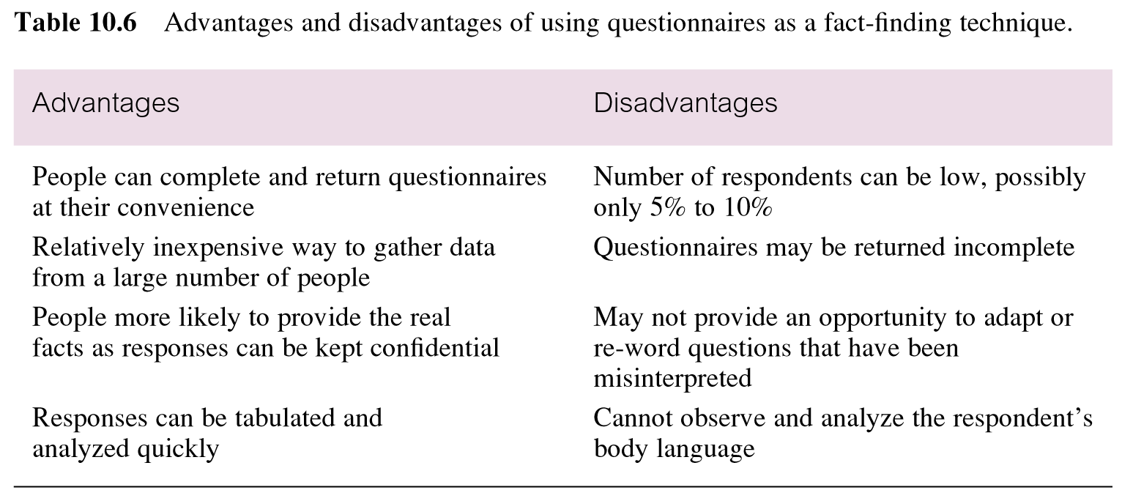
Pros/Cons: Questionnaires

Slide 32
Summary
Phases of database SDLC
  Prototyping (optional)
  Implementation
  Data conversion and loading
  Testing
  Operational maintenance
Fact-finding techniques
  Examining documentation
  Interviewing
  Observing the organization in operation
  Research
  Questionnaires

Slide 33
References
All the material (slides, diagrams etc.) presented in this lecture is taken (with modifications) from the Pearson Education website :
  http://www.booksites.net/connbegg

