Slide 1

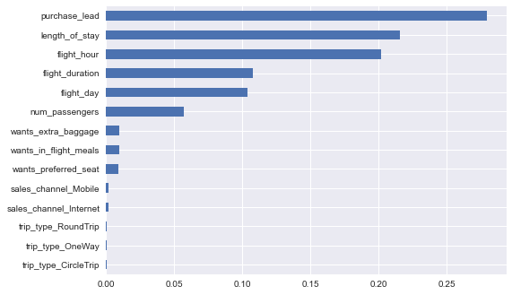
PREDICTIVE MODELING
ACCURACY
85%
PRECISION
86%
RECALL
98%
IMPORTANT FEATURES
Out of 50000 booking entries only 14.96 % bookings were successfully or complete.
Number of bookings done through internet: 88.764 %
Number of Bookings done through phone call: 11.236 %
Percentage of round trips: 98.994 %
Percentage of One way trips: 0.774 %
Percentage of circle trips: 0.232 %

