Slide 1

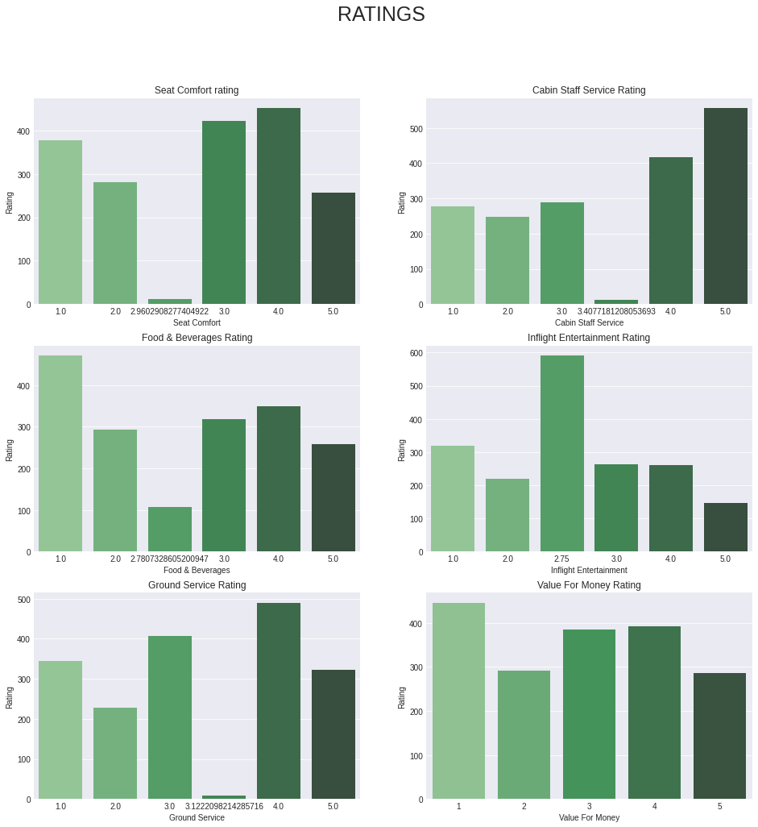
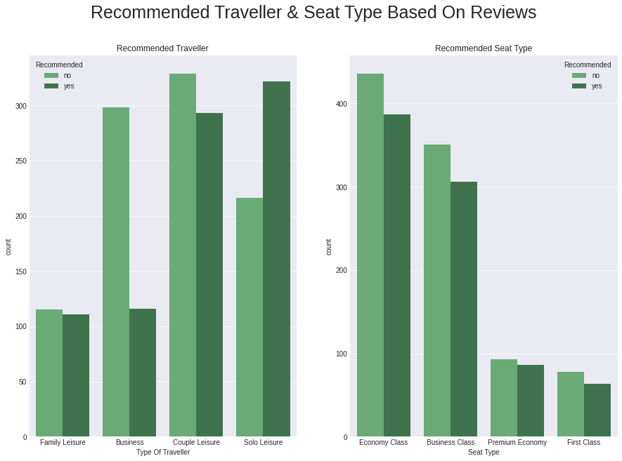
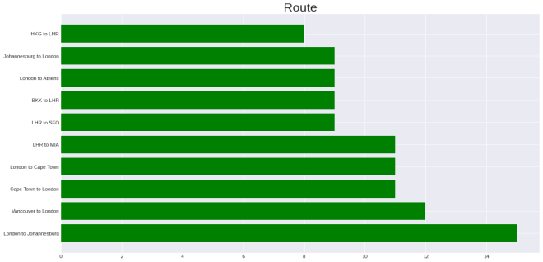
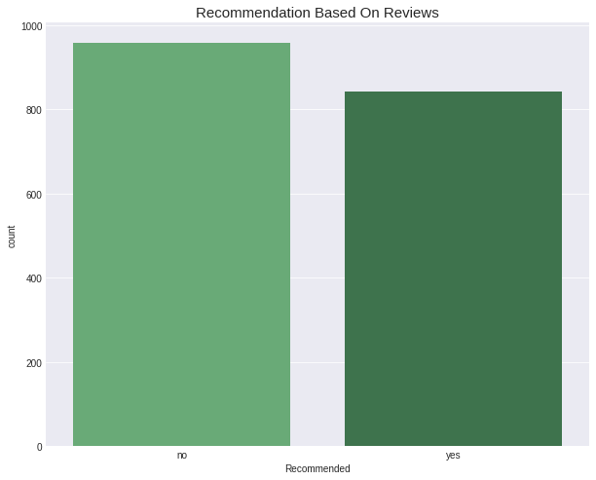
KEY METRICS AND INSIGHTS
RATINGS
Seat Comfort 2.9/5
Cabin Staff Service 3.4/5
Food & Beverages 2.8/5
In flight Entertainment 2.7/5
Ground Service 3.2/5
Value For Money 2.8/5

Slide 2
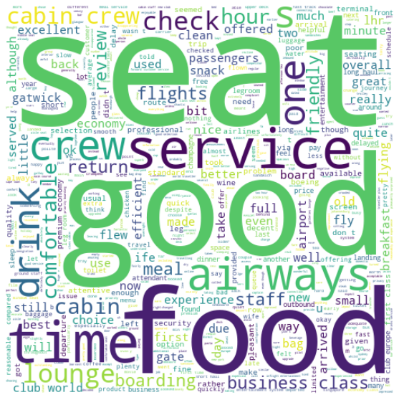
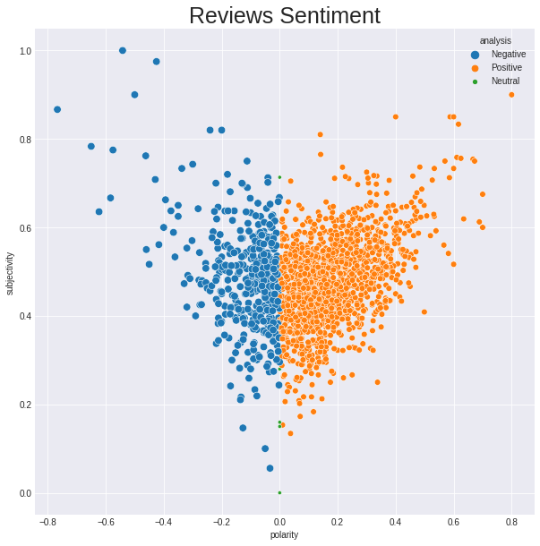
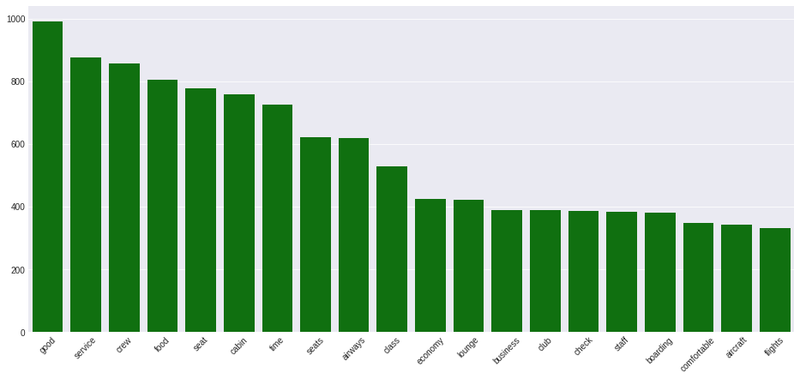
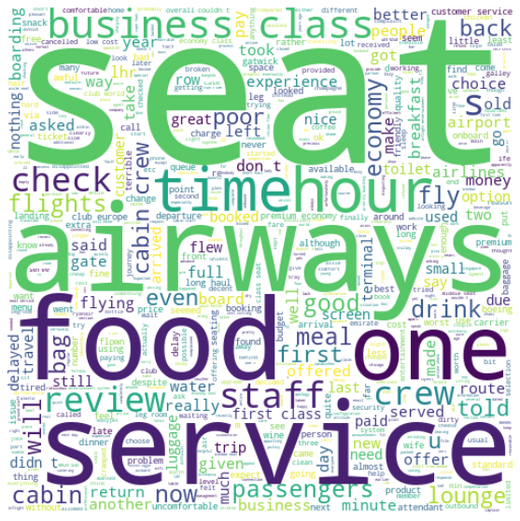
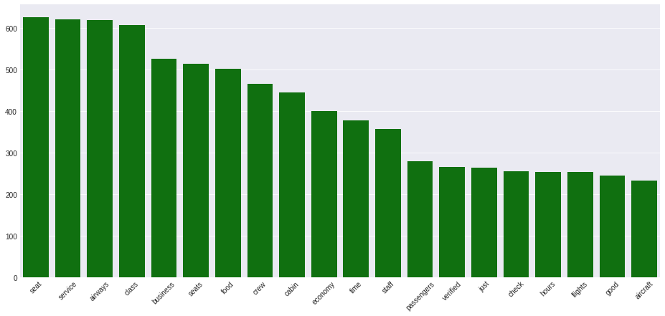
SENTEMENT ANALYSIS
POSITIVE WORDS
NEGATIVE WORDS

Slide 3
INSIGHTS FROM DATA
Around 55% of customer are not recommending the service
there for we need to improve that number
Area's that need to be improved based on reviews rating
Seat Comfort
Food and Beverages
In flight Entertainment
Traveller (Business & Couple Leisure)
Seat Type (Economy class & Business class)
SENTIMENS:
The sentiments are positive in most of the reviews
Customers are talking positively about seat , good food , service , time etc
Customers are talking negatively about airways , business , hours , staff etc

