Slide 1
SQL
SQL-Powered Insights for The Restaurant Industry
An Analysis of Top 250, Future 50, and Independence 100 Datasets
Malik Mohammad Junaid Majeed

Slide 2
Abstract
This report presents a structured SQL-based analysis of three major datasets: Top 250, Future 50, and Independence 100. The project focuses on data cleaning, query optimization, and extracting meaningful business insights. Key findings include identification of high-performing restaurants, growth trends, and regional distributions. The study demonstrates SQL as a powerful tool for industry benchmarking and strategic decision-making.
Introduction
The restaurant industry is highly dynamic, and data-driven analysis is essential for competitive advantage. Structured Query Language (SQL) enables analysts to clean, organize, and interpret datasets effectively. This report explores SQL methodologies applied to three datasets: Independence100 (independent restaurants), Future50 (emerging chains), and Top250 (established leaders). The analysis highlights sales performance, growth metrics, and operational efficiency.

Slide 3
Methodology
The analysis was conducted in MySQL. Initial steps included creating temporary cleaned tables for each dataset, ensuring removal of duplicates, NULL values, and invalid entries. Safe updates were disabled to allow for data modifications. Columns such as YOY_Sales and YOY_Units were standardized into numeric formats. Once cleaned, advanced queries involving aggregation, window functions, CTEs, and CASE statements were applied to generate insights.
Advanced SQL Concepts Applied
The project also applied advanced SQL techniques: - Stored Procedures: For automating transaction insertion. - Triggers: For automatic updates of balances after inserts. - Window Functions: For ranking, rolling totals, and partitioned analysis. - CTEs: For segmenting data such as 'High Check' vs 'Low Check'. - CASE Statements: For categorizing restaurants by growth. - UNION: For combining top sales performers across datasets.

Slide 4
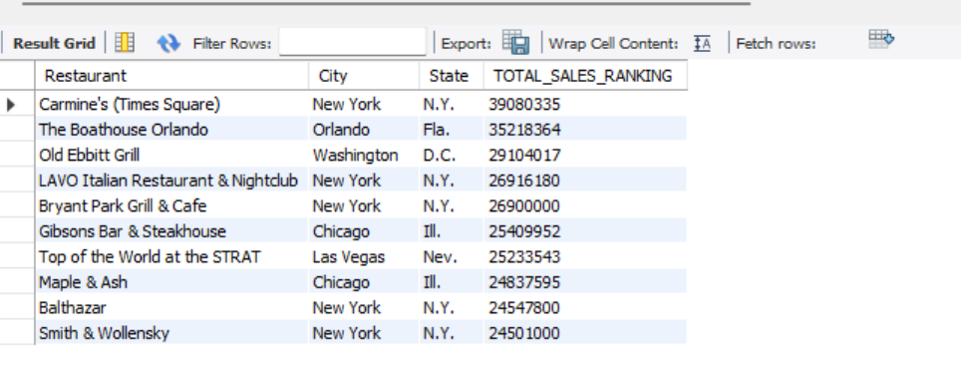
SQL Queries and Insights:
Top Sales Performers in Independents
SQL:
SELECT Restaurant, City, State, SUM (Sales) AS TOTAL_SALES_RANKING FROM Cleaned_independence100 GROUP BY Restaurant, City, State ORDER BY TOTAL_SALES_RANKING DESC LIMIT 10;

Slide 5
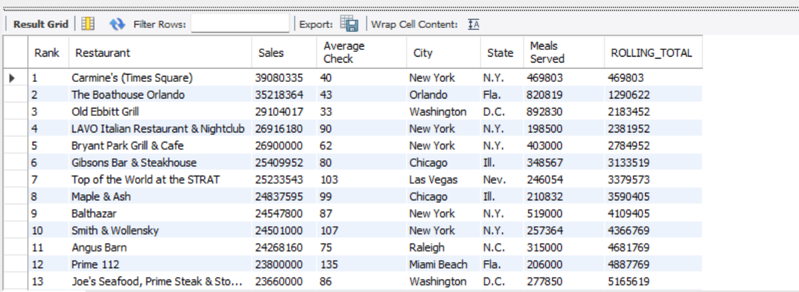
Rolling Total of Meals Served (Window Function)
SQL:
SELECT *, SUM(`Meals Served`) OVER(ORDER BY `Rank` ) AS ROLLING_TOTAL FROM independence100 ORDER BY `Rank`;

Slide 6
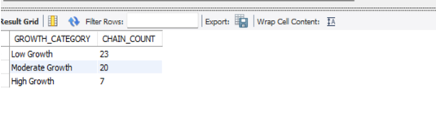
Growth Segmentation in Future50
SQL:
SELECT CASE WHEN YOY_Sales > 50 THEN 'High Growth' WHEN YOY_Sales BETWEEN 20 AND 30 THEN 'Moderate Growth' ELSE 'Low Growth' END AS GROWTH_CATEGORY, COUNT(*) AS CHAIN_COUNT FROM future50 GROUP BY GROWTH_CATEGORY ORDER BY COUNT(*) DESC;

Slide 7
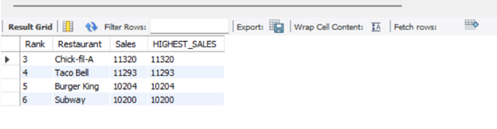
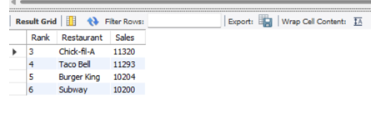
Restaurants Ranked 3rd–6th in Sales (Top250)
SQL:
SELECT `Rank`, Restaurant, Sales, MAX(Sales) AS HIGHEST_SALES FROM Cleaned_top250 GROUP BY `Rank`, Restaurant, Sales ORDER BY HIGHEST_SALES DESC LIMIT 4 OFFSET 2; -- Alternative (Window Function) SELECT `Rank`, Restaurant, Sales FROM ( SELECT *, DENSE_RANK() OVER(ORDER BY Sales DESC) AS rnk FROM Cleaned_top250 ) AS RANKING WHERE rnk > 2 AND rnk < 7;

Slide 8
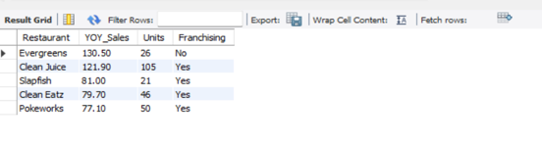
Top 5 Emerging Chains by YOY Sales Growth (Future50)
SQL:
SELECT Restaurant, YOY_Sales, Units, Franchising FROM Cleaned_future50 ORDER BY YOY_Sales DESC LIMIT 5;

Slide 9
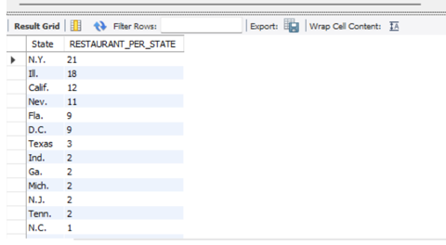
Geographic Distribution of Independent Restaurants
SQL:
SELECT DISTINCT State, COUNT(Restaurant) AS RESTAURANT_PER_STATE FROM Cleaned_independence100 GROUP BY State
ORDER BY COUNT(Restaurant) DESC;

Slide 10
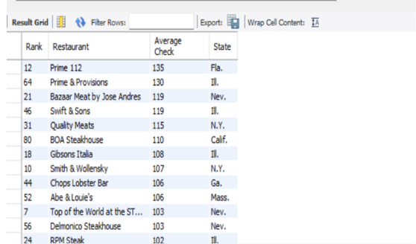
Outliers in Check Value
SQL:
SELECT `Rank`, Restaurant, `Average Check`, State FROM Cleaned_independence100 WHERE `Average Check` > 100 ORDER BY `Average Check` DESC;

Slide 11
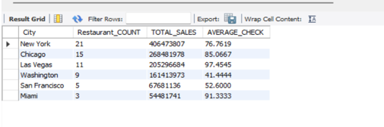
Sales by City (Independents)
SQL:
SELECT City, COUNT(Restaurant) AS Restaurant_COUNT, SUM(Sales) AS TOTAL_SALES, AVG(`Average Check`) AS AVERAGE_CHECK FROM Cleaned_independence100 GROUP BY City HAVING Restaurant_COUNT > 2 ORDER BY TOTAL_SALES DESC;

Slide 12
Results and Discussion
Analysis of the datasets revealed several key insights: - Independent restaurants with high sales-to-meals ratios indicate operational efficiency. - Franchised Future50 chains show higher average unit volumes compared to non-franchised. - Certain states dominate the independent restaurant scene, highlighting regional market strengths. - Top 250 segmentation analysis demonstrates competitive pressures in Quick Service categories.
Conclusion and Future Work
This project demonstrates the power of SQL for handling large-scale datasets in the restaurant industry. Through data cleaning, aggregation, and advanced analysis, meaningful insights were extracted. Future work can include integrating SQL with BI tools such as Power BI or Tableau for visualization, or extending the analysis with predictive modeling using Python and SQL integration.

