Slide 1

COVID-19
Global Health Data Analytics Using MySQL
Prepared By: Malik Mohammad Junaid Majeed

Slide 2

INTRODUCTION
This presentation showcases a series of advanced SQL queries performed to analyze global health data, with a focus on identifying key trends, high-risk regions, and critical performance metrics. The analysis leverages MySQL’s aggregation, filtering, and analytical capabilities to transform raw data into actionable insights.
Global Total Cases, Deaths, and Recovery Rate – Summarizing overall impact on a global scale.
Top 10 Countries with Highest Active Cases – Identifying regions with the most ongoing infections.
Daily New Cases Globally – Tracking the daily growth and spread of infections.
Case Fatality Rate by Country – Evaluating the severity of the outbreak across nations.
Top 10 Countries by Highest Deaths – Highlighting the most affected countries by fatalities.
Daily Growth Rate per Country – Analyzing the trend of infections in each country.
Peak Cases Date per Country – Identifying when the outbreak peaked regionally.
Mortality vs Recovery Correlation per Country – Exploring the relationship between deaths and recoveries.
This comprehensive analysis provides a data-driven understanding of the global situation, enabling better forecasting, risk assessment, and strategic decision-making.

Slide 3
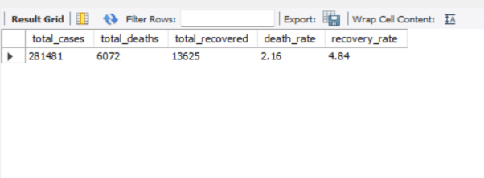
1. Global Total Cases, Deaths, and Recovery Rate
SELECT
SUM(confirmed) AS total_cases,
SUM(deaths) AS total_deaths,
SUM(recovered) AS total_recovered,
ROUND(SUM(deaths) * 100.0 / NULLIF(SUM(confirmed), 0), 2) AS death_rate,
ROUND(SUM(recovered) * 100.0 / NULLIF(SUM(confirmed), 0), 2) AS recovery_rate
FROM covid_19_data;
Shows overall impact and key percentages globally.

Slide 4
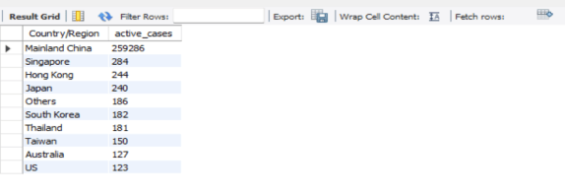
2. Top 10 Countries with Highest Active Cases
SELECT
`Country/Region`,
(SUM(confirmed) - SUM(recovered) - SUM(deaths)) AS active_cases
FROM covid_19_data
GROUP BY `Country/Region`
ORDER BY active_cases DESC
LIMIT 10;
Identifies countries with the most ongoing cases.

Slide 5
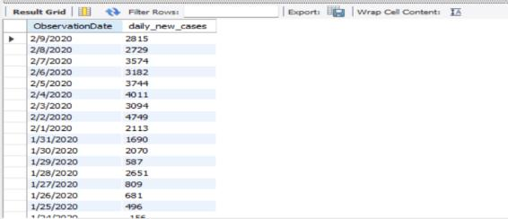
3. Daily New Cases Globally
SELECT
ObservationDate,
SUM(confirmed) - LAG(SUM(confirmed)) OVER (ORDER BY ObservationDate) AS daily_new_cases
FROM covid_19_data
GROUP BY ObservationDate
ORDER BY ObservationDate;
Shows how cases evolved daily.

Slide 6
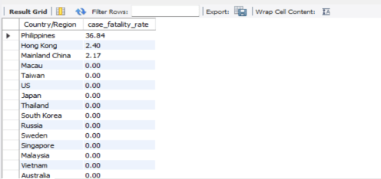
4. Case Fatality Rate by Country
SELECT
`Country/Region`,
ROUND(SUM(Deaths) * 100.0 / NULLIF(SUM(Confirmed), 0), 2) AS case_fatality_rate
FROM covid_19_data
GROUP BY `Country/Region`
ORDER BY case_fatality_rate DESC;
Measures severity across countries.

Slide 7
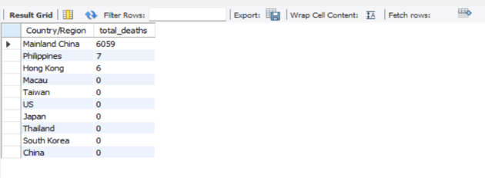
5. Top 10 Countries by Highest Deaths
SELECT
`Country/Region`,
SUM(Deaths) AS total_deaths
FROM covid_19_data
GROUP BY `Country/Region`
ORDER BY total_deaths DESC
LIMIT 10;
Normalizes cases based on population size.

Slide 8
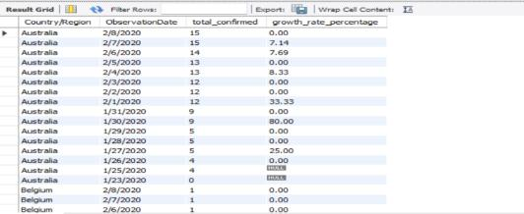
6. Daily Growth Rate per Country
SELECT
`Country/Region`,
ObservationDate,
SUM(confirmed) AS total_confirmed,
ROUND ((SUM(confirmed) - LAG(SUM(Confirmed)) OVER (PARTITION BY `Country/Region`
ORDER BY ObservationDate)) * 100.0 / NULLIF(LAG(SUM(Confirmed)) OVER (PARTITION BY `Country/Region`
ORDER BY ObservationDate), 0), 2) AS growth_rate_percentage
FROM covid_19_data
GROUP BY `Country/Region`, ObservationDate
ORDER BY `Country/Region`, ObservationDate DESC;
Detects acceleration or slowdown of the outbreak.

Slide 9
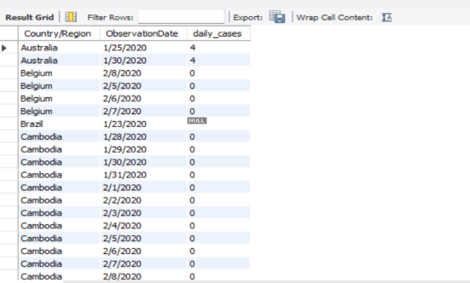
7. Peak Cases Date per Country
WITH daily_data AS
(SELECT `Country/Region`, ObservationDate,
SUM(Confirmed) - LAG(SUM(Confirmed)) OVER (PARTITION BY `Country/Region` ORDER BY ObservationDate ) AS daily_cases
FROM covid_19_data
GROUP BY `Country/Region`, ObservationDate)
SELECT `Country/Region`, ObservationDate, daily_cases
FROM (
SELECT *, RANK() OVER (PARTITION BY `Country/Region`
ORDER BY daily_cases DESC ) AS rnk
FROM daily_data) ranked
WHERE rnk = 1;
Finds the date when each country had its highest surge.

Slide 10
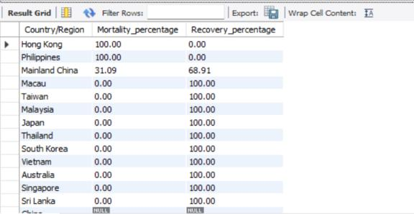
8. Mortality vs. Recovery Correlation per Country
SELECT
`Country/Region`,
ROUND(SUM(Deaths) * 100.0 / NULLIF(SUM(Deaths) + SUM(Recovered), 0), 2) AS Mortality_percentage,
ROUND(SUM(Recovered) * 100.0 / NULLIF(SUM(Deaths) + SUM(Recovered), 0), 2) AS Recovery_percentage
FROM covid_19_data
GROUP BY `Country/Region`
ORDER BY Mortality_percentage DESC;
Compares how each country fared in terms of survival vs. mortality.

Slide 11

Conclusion and Future Work
This project demonstrates the effective use of advanced SQL analytics to extract, process, and analyze large-scale global health data. By employing structured queries in MySQL, it delivers accurate, scalable, and reproducible insights into key metrics such as cases, deaths, recovery rates, and country-wise trends. The work establishes a robust analytical framework that supports real-time monitoring and can be adapted for future applications in infectious disease surveillance, healthcare planning, and risk assessment.
Building upon this foundation, future enhancements will focus on:
Advanced Analytical Queries: Incorporating predictive modeling using SQL with machine learning integration.
Dynamic Dashboards: Connecting the database to visualization tools such as Power BI or Tableau for interactive, real-time insights.
Data Enrichment: Integrating additional datasets (vaccination rates, demographic information, healthcare infrastructure).
Automated ETL Pipelines: Enabling seamless data ingestion and periodic updates for continuous analysis.
Scalability and Cloud Deployment: Migrating the database to cloud-based platforms for global accessibility and higher processing capabilities.
This forward-looking approach ensures the project remains relevant, extensible, and impactful, serving as a foundation for evidence-based research and decision-making in public health and beyond.

