Slide 1

UAJK AIS • BRIEF A
YOUR PROMPT
STARTS HERE
"No Code. No Limits. Just Build."
Campaign: PROMPTX Challenge Launch Audience: Students who have never joined a hackathon Date: 25 May 2026 | UAJK | AIS
8 FRAMES
AI-GENERATED

Slide 2
CAMPAIGN CONCEPT
"YOUR PROMPT STARTS HERE"
CORE MESSAGE
TARGET EMOTION
PROMPTX Challenge is for every student who ever wanted to build with AI but thought they needed to code first. You don't need code — you need curiosity, creativity, and a team. PROMPTX is that door.
Replace FOMO with excitement. The campaign starts with the fear of not belonging, then dismantles it frame by frame — showing real students, real moments, and a celebration waiting at the finish line.
DESIRED ACTION
VISUAL STYLE
Register for PROMPTX Challenge before 25 May 2026. Form a team of 2–4 students. Show up, build an AI solution in 8 hours, and compete. The ask is simple: just show up.
Dark cinematic tech aesthetic — deep navy, electric blue, neon accents. Contrast between intimate (single student at desk) and epic (full venue at launch). Blue screen glow as a consistent visual motif.

Slide 3
1
THE SPARK
Campaign Hook
SCENE DESCRIPTION
The screen opens on the bold, electric PROMPTX CHALLENGE poster. The AI chip glows. The date is locked in: 25 May 2026. This is the moment the campaign announces itself to the university.
VOICEOVER / NARRATION
"UAJK AIS presents the PROMPTX Challenge — Build AI Solutions. Shape the Future."
CAPTION / OVERLAY TEXT
PROMPTX CHALLENGE · 25 MAY 2026 · REGISTER NOW
MOOD: Electric · Ambitious · Bold
AI Tool: Canva AI

Slide 4

2
THE FEAR
Audience Hook — Relatable Tension
SCENE DESCRIPTION
Close-up of a student's face lit only by a glowing screen. She looks curious but unsure — exactly how most students feel about hackathons. This captures 'I want to try but I'm scared.'
VOICEOVER / NARRATION
"Ever wanted to build something real with AI… but didn't know where to start?"
CAPTION / OVERLAY TEXT
You don't need to be an expert. You just need to show up.
MOOD: Intimate · Relatable · Tension
AI Tool: DALL-E (ChatGPT)

Slide 5
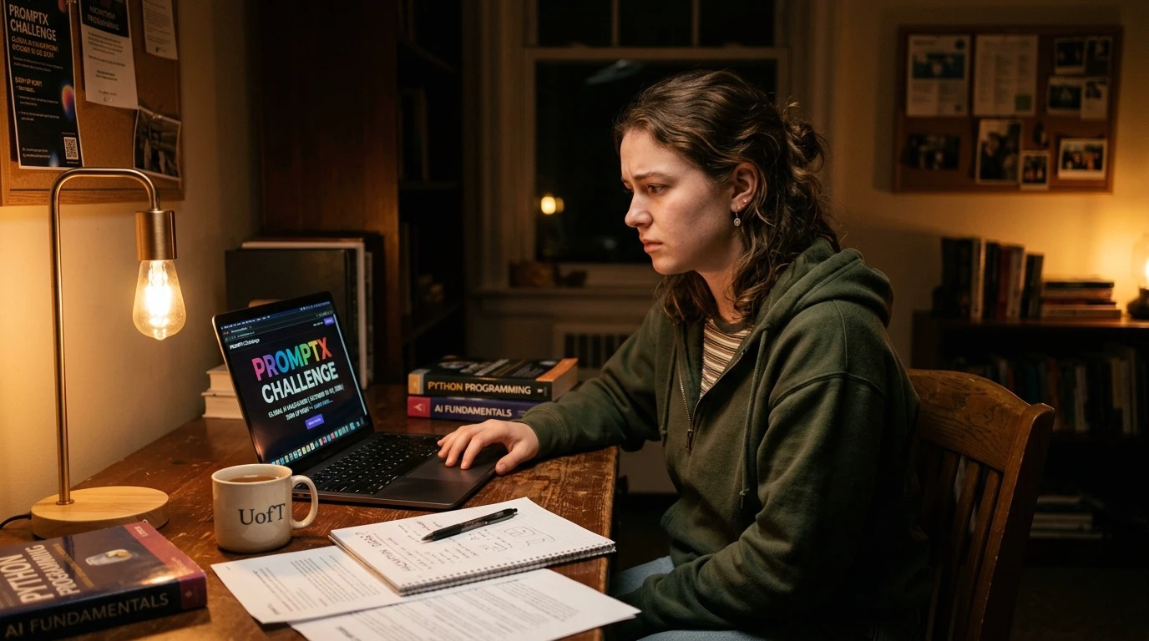
3
THE DISCOVERY
Awareness Moment
SCENE DESCRIPTION
A student in her dorm room stumbles across the PROMPTX Challenge registration page late at night. Warm lamp light contrasts with the colorful screen — a moment of discovery and possibility opening up.
VOICEOVER / NARRATION
"What is this? A hackathon… no coding needed? That's for me."
CAPTION / OVERLAY TEXT
PROMPTX Challenge — Open to ALL students. No experience needed.
MOOD: Warm · Curious · Hopeful
AI Tool: DALL-E (ChatGPT)

Slide 6
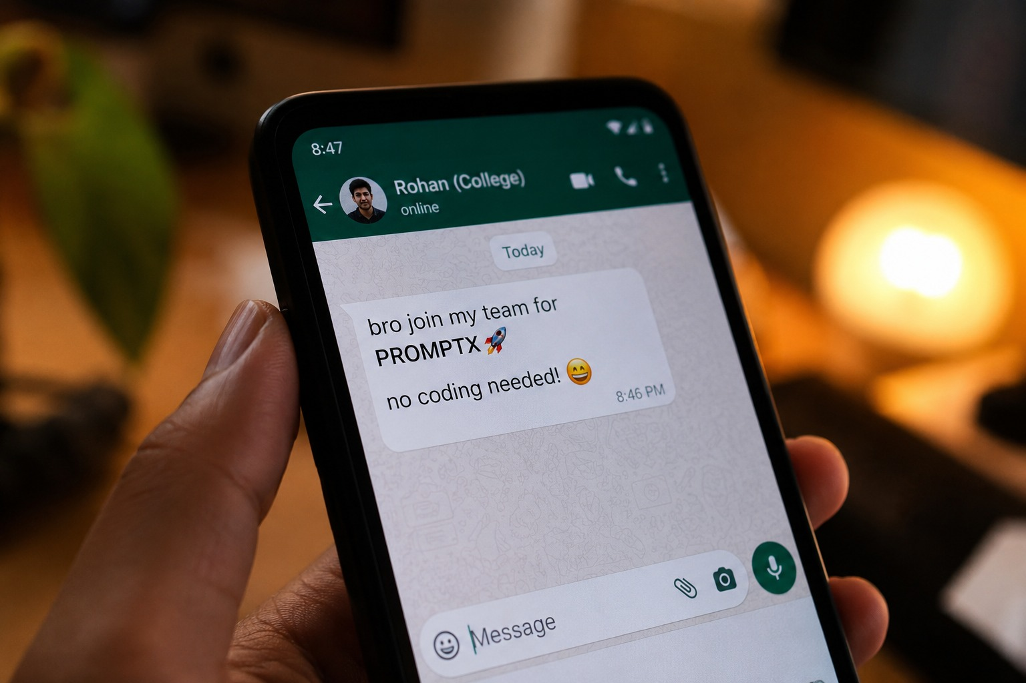
4
THE INVITE
Social Proof — Peer FOMO
SCENE DESCRIPTION
A phone screen shows a WhatsApp message from a friend: 'bro join my team for PROMPTX 🚀 no coding needed! 😁'. The message is casual, relatable, and removes the biggest barrier instantly.
VOICEOVER / NARRATION
"Your friend already signed up. What are you waiting for?"
CAPTION / OVERLAY TEXT
Form your team. Register now. No coding needed.
MOOD: Casual · Energetic · FOMO
AI Tool: Bing Image Creator

Slide 7

5
THE TEAM
Team Formation
SCENE DESCRIPTION
Four diverse students huddle around laptops covered in hackathon stickers, laughing and building ideas together. A whiteboard behind them reads 'PROMPTX — IDEA · APPROACH · IMPACT.'
VOICEOVER / NARRATION
"Find your people. Build your idea. Every great project starts with a team."
CAPTION / OVERLAY TEXT
Teams of 2–4. Bring your ideas. AIS brings the platform.
MOOD: Collaborative · Bright · Energetic
AI Tool: Adobe Firefly

Slide 8
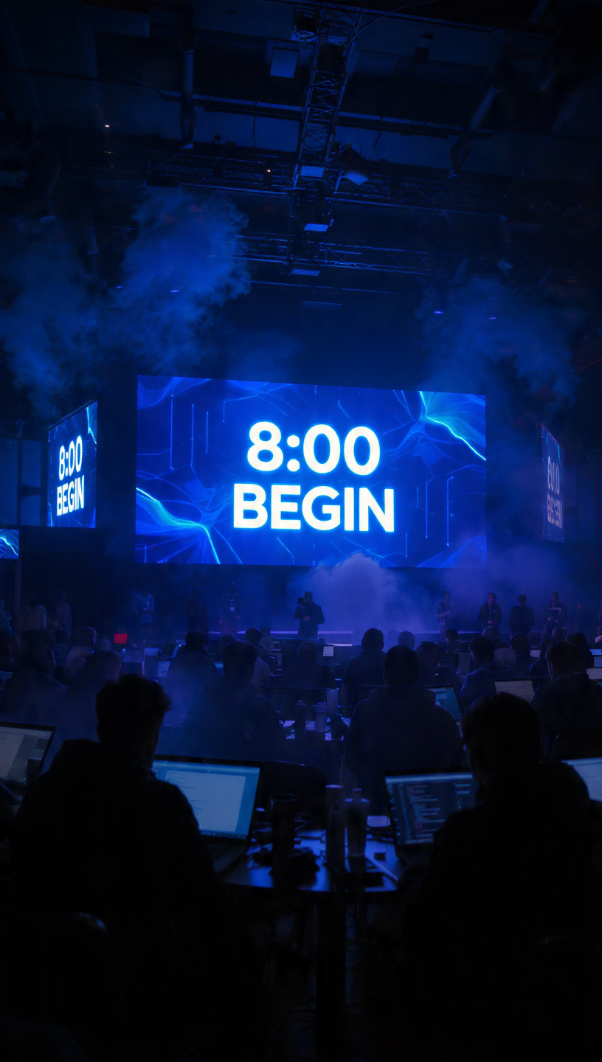
6
THE COUNTDOWN
The Big Day Begins
SCENE DESCRIPTION
The hackathon venue comes alive. Fog rises, the massive LED screen blazes '8:00 BEGIN', and hundreds of students sit ready at their stations. The energy is cinematic.
VOICEOVER / NARRATION
"8 hours. One challenge. Unlimited potential. BEGIN."
CAPTION / OVERLAY TEXT
PROMPTX Challenge · 8 Hours of Innovation · 25 May 2026
MOOD: Epic · Cinematic · Adrenaline
AI Tool: Adobe Firefly

Slide 9
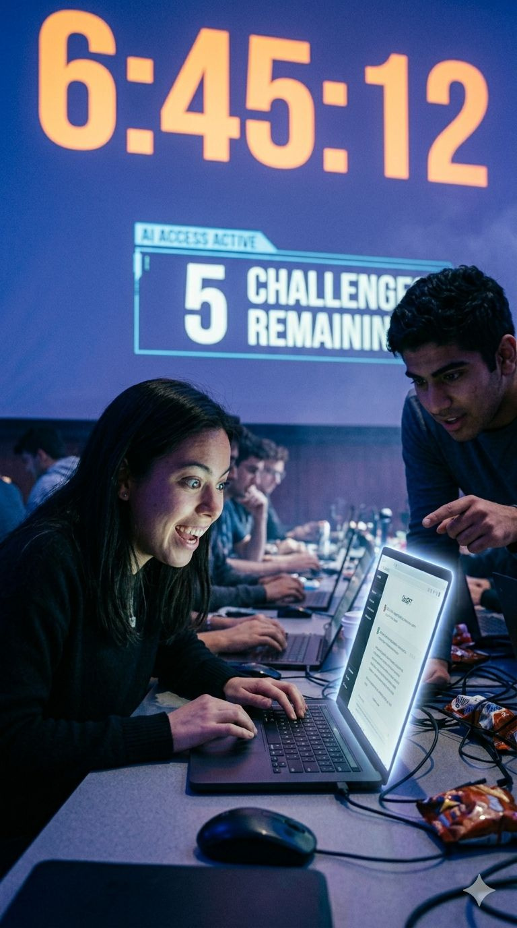
7
IN THE ZONE
Peak Hackathon Moment
SCENE DESCRIPTION
A student beams with excitement mid-hackathon. The countdown clock shows 6:45:12. Her teammate leans in pointing at the screen. Behind them, 5 challenges still remain.
VOICEOVER / NARRATION
"6 hours in. 5 challenges to go. Zero regrets for showing up."
CAPTION / OVERLAY TEXT
This could be you. PROMPTX Challenge — Register before seats fill.
MOOD: Thrilling · Joyful · Competitive
AI Tool: DALL-E (ChatGPT)

Slide 10
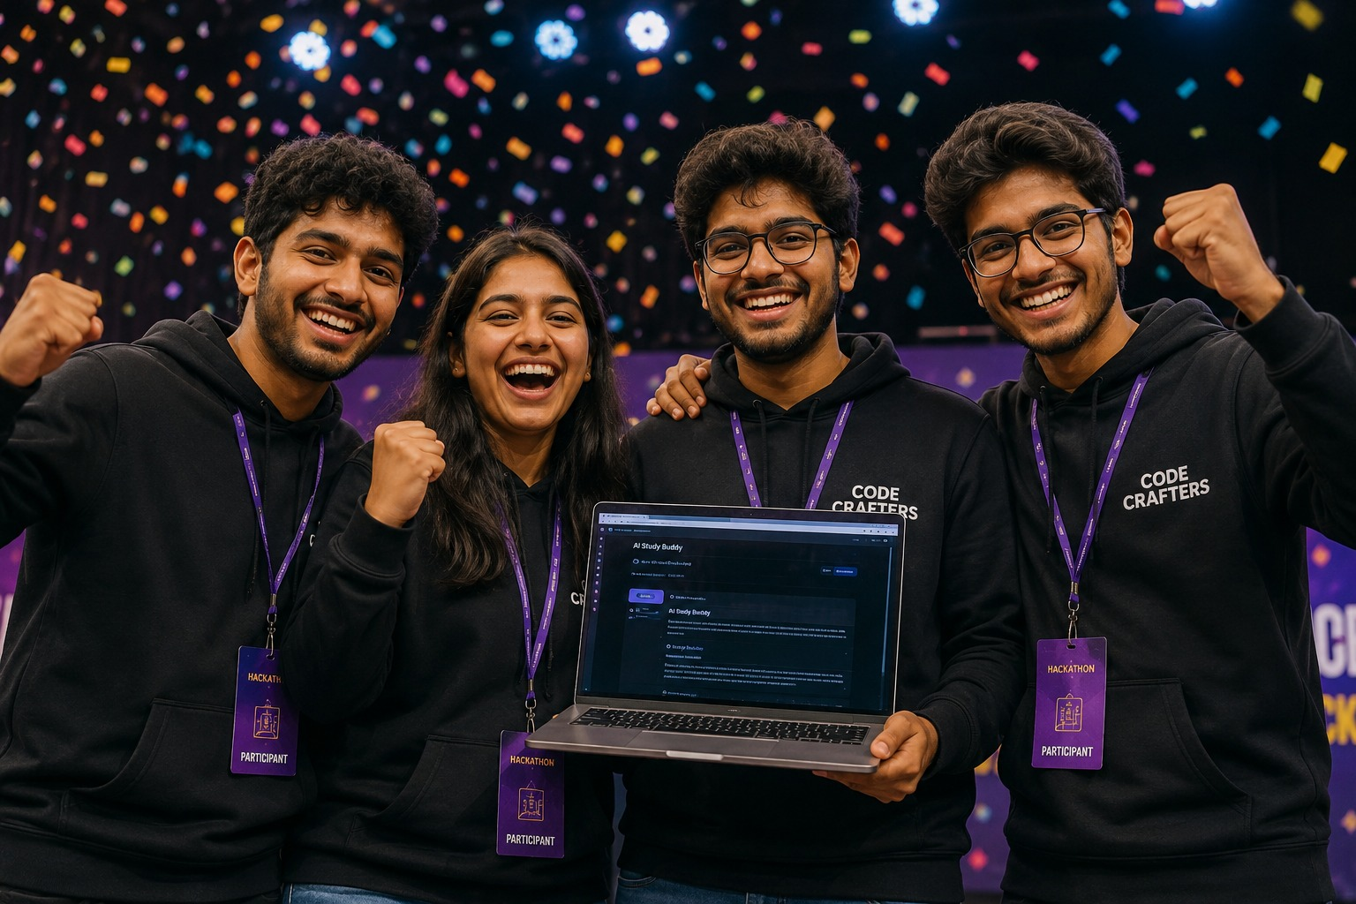
8
THE WIN
Victory + Call To Action
SCENE DESCRIPTION
Four students erupt in celebration, fists raised, holding up their laptop showing their finished AI project. Confetti rains down. HACKATHON PARTICIPANT badges glow. This is the payoff — and your invitation.
VOICEOVER / NARRATION
"They built an AI project in 8 hours. Now it's your turn. Register for PROMPTX."
CAPTION / OVERLAY TEXT
🏆 Build. Win. Make Impact. · PROMPTX · 25 May 2026 · UAJK AIS · REGISTER NOW
MOOD: Triumphant · Inspiring · Celebratory
AI Tool: Adobe Firefly

Slide 11
AI WORKFLOW LOG
Tool documentation — which AI tool was used and the exact prompt for each frame
Frame | Title | AI Tool Used | Content Type | AI Prompt (Summary)
1 | THE SPARK | Canva AI | Image + Caption | Dark blue tech poster with glowing AI circuit chip, bold white title PROMPTX CHALLENGE, …
2 | THE FEAR | DALL-E (ChatGPT) | Image + Caption | Cinematic close-up portrait of a university student's face illuminated by blue laptop sc…
3 | THE DISCOVERY | DALL-E (ChatGPT) | Image + Caption | Photorealistic: female university student at wooden desk at night, warm Edison bulb lamp…
4 | THE INVITE | Bing Image Creator | Image + Caption | Realistic close-up photo of a hand holding an Android phone showing a WhatsApp conversat…
5 | THE TEAM | Adobe Firefly | Image + Caption | Bright natural light photo of four diverse university students collaborating around tabl…
6 | THE COUNTDOWN | Adobe Firefly | Image + Caption | Wide-angle cinematic shot of large darkened hackathon venue with giant LED screen displa…
7 | IN THE ZONE | DALL-E (ChatGPT) | Image + Caption | Dramatic hackathon scene: female student smiling excitedly at laptop, male teammate poin…
8 | THE WIN | Adobe Firefly | Image + Caption | Euphoric celebration of four South Asian university students in black hoodies with hacka…
W1 | All Frames | Claude (Anthropic) | Copy / Text | Voiceovers, captions, frame descriptions, tagline, campaign concept
W2 | All Frames | ChatGPT (OpenAI) | Copy / Text | Campaign name brainstorming, pitch script outline, idea refinement

Slide 12
2-MINUTE PITCH SCRIPT
Deliver this to judges — frame by frame, confident, sell the idea
0:00–0:20
"Every student at UAJK has an idea. But most never act — because they think they need to code first. The PROMPTX Challenge says otherwise."
Hook
0:20–0:40
"Our campaign follows a student who discovers PROMPTX, forms a team, and walks in with nothing but an idea. Eight hours later — a built AI project and a certificate."
The Story
0:40–1:10
"Frame 1 is the hook — the poster. Frame 2 is the emotion — the hesitation. By Frame 8, that hesitation becomes a fist raised in victory. Walk frame by frame."
Walk the Frames
1:10–1:45
"This campaign doesn't sell a hackathon — it sells a feeling. The feeling that: yes, I belong here too. No Code. No Limits. Just Build."
Why It Works
1:45–2:00
"We're asking AIS leadership to approve this for PROMPTX 2026. Every frame is ready. Every image generated. Every caption written. We just need your green light."
Close

