Slide 1
Ravens HTML && CSS
Zulifqar Ahmad
12-20-2019

Slide 2
HTML BASIC
<title style="color:red">Welcome back Ravens!</title>
Closing tag
</title>
Element
<title ...>...</title>
<title style="color: red">
Opening Tag

Slide 3
HTML BASIC
<h2> Hello Ravens, welcome back </h2>
opening tag
closing tag
content
element

Slide 4
HTML BASIC
key
value
<h2 style="color: blue">
attribute
Key word for css
<h2 style="color: blue; text-decoration: underline">
Tag with multiple attribute
</h2>

Slide 5
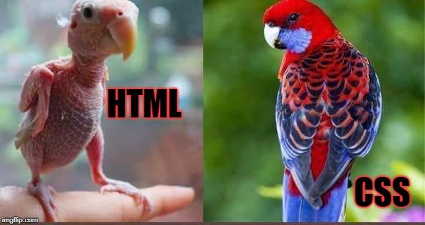
CSS !!

Slide 6
CSS TYPES
<body>
<p style="color:red;">This is red</p>
<p style="font-size:20px;">This is thick</p>
<p style="color:green;">This is green</p>
<p style="color:green;font-size:20px;">Thick and green!</p>
</body>
1-Inside start tag
2-After tag name
multi style
style1;style2
syntax

Slide 7


Bootstrap why ??
adoptive
Responsive

Slide 8
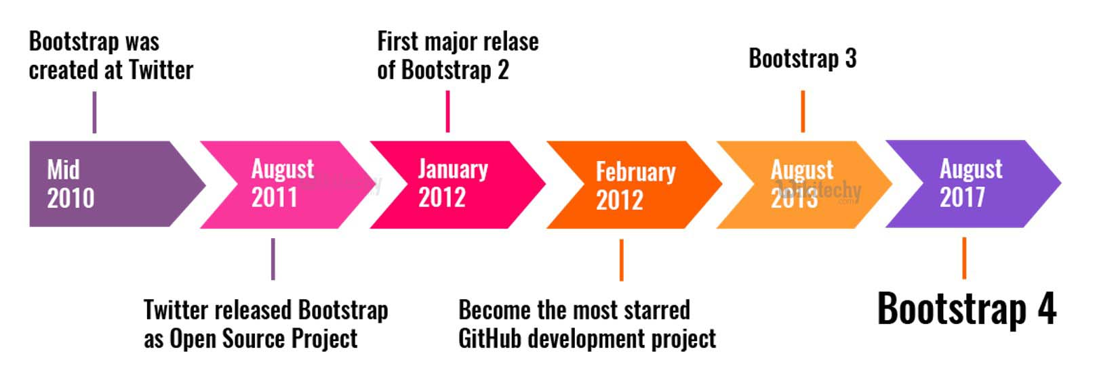
Bootstrap4 .. HOW/WHEN ?

Slide 9


Slide 10
Bootstrap – HOW ? ➔ Set UP
https://getbootstrap.com/
<head>
<link rel=stylesheet” href=www.ravens.com>
</head>
<link
rel="stylesheet" href="https://stackpath.bootstrapcdn.com/bootstrap/4.4.1/css/bootstrap.min.css" integrity="sha384-Vkoo8x4CGsO3+Hhxv8T/Q5PaXtkKtu6ug5TOeNV6gBiFeWPGFN9MuhOf23Q9Ifjh”
>

Slide 11
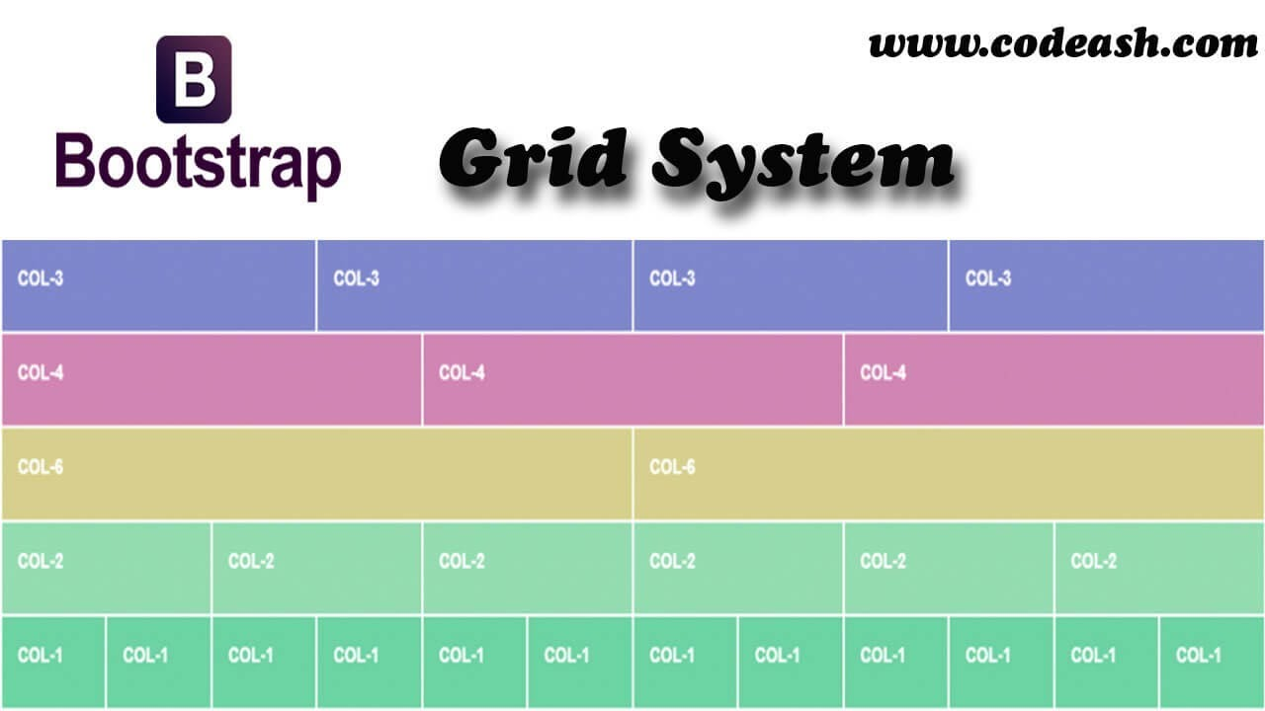

Slide 12
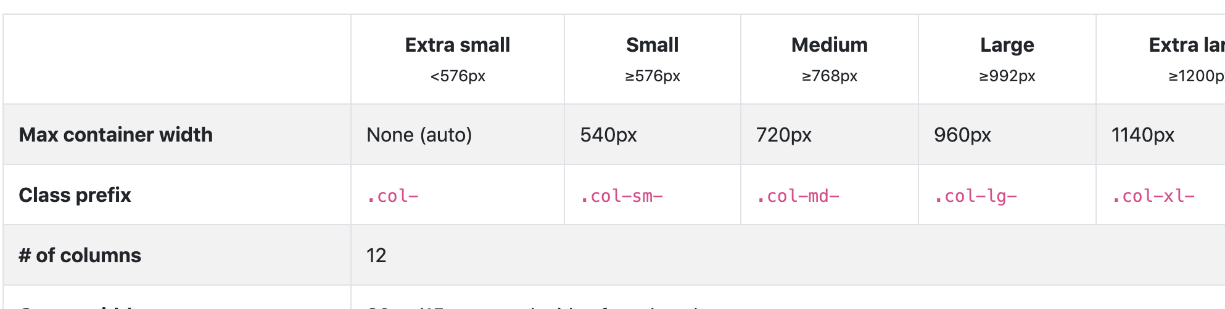
Grid Options

Slide 13
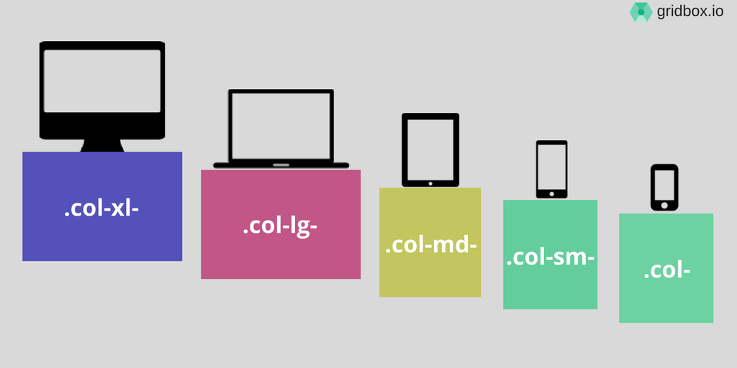
Grid Options

Slide 14
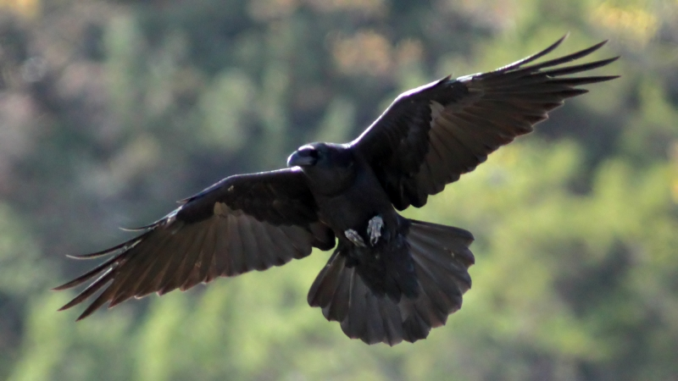

Slide 15

CSS
Cascading Style Sheets
12-27-2019

Slide 16
CSS TYPES – INLINE – as attribute
<body>
<p >This is red</p>
</body>
<body>
<p>This is red</p>
</body>
style="color:red;"

Slide 17
CSS TYPES - INLINE
by style attribute inside tags
<body>
<p style="color:red;">This is red</p>
<p style="font-size:20px;">This is thick</p>
<p style="color:green;">This is green</p>
<p style="color:green;font-size:20px;">Thick and green!</p>
</body>
1-Inside start tag
2-After tag name
multi style
style1;style2
syntax/rule

Slide 18
CSS TYPES – Internal – Inside Head
<head>
<style>
p{ color:red; }
</style>
</head>
<body>
<p>This is red</p>
</body>

Slide 19
CSS TYPES-INTERNAL
<head>
<style>
h1 {
color: red;
}
h2 {
color: blue;
}
h3 {
color: green;
}
h2,
h3 {
background-color: blueviolet;
}
</style>
</head>
<body>
<h1>h1 is red</h1>
<h2>h2 is thick</h2>
<h3>h3 is green</h3>
</body>
by using a <style> element in the <head> section
1-Inside head tag (best)
2- style tag => style{key:value}
syntax/rule
multi style
style1;style2

Slide 20
CSS TYPES – EXternal – IN separate file
<head>
<link
rel="stylesheet"
type="text/css”
href="styles.css”
/>
</head>
styles.css
p {
color: red;
}
h2 {
color: blue;
}
h3 {
color: green;
}
<body>
<p>This is red</p>
</body>

Slide 21
CSS TYPES-EXTERNAL
by using an external CSS file
styles.css
h1 {
color: red;
}
h2 {
color: blue;
}
h3 {
color: green;
}
<head>
<link rel="stylesheet" type="text/css" href="styles.css"/>
<title>This is CSS external type!</title>
</head>
<body>
<h1>h1 is red</h1>
<h2>h2 is blue</h2>
<h3>h3 is green</h3>
</body>
1-Link tag inside head tag (best)
2-Link tag’s [rel => relation ;href => css file path]
syntax/rule
multi style
style1;style2
CSS file = > selector{key:value}

Slide 22
CSS .... Style selectors
tag
<h2>
Hello Ravens, you are super!
</h2>
h1 {
color: red;
}
id
<h2 id=”ravens">
Hello Ravens, you are the best!
</h2>
#ravens {
color: yellow;
}
class
<h2 class=”friday”>
Hello Ravens, You fly && you fly well!
</h2>
.friday {
color: blue;
}

Slide 23
CSS Basic
selector
#ravens {
color: red;
}
selector
h1 {
color: red;
font-size: 1cm;
background-color: yellowgreen;
}
declarations
declarations
.friday {
color: red;
}
color
value
red
key

Slide 24

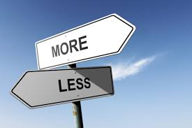

CSS

Slide 25

It's CSS, with just a little more.
<link rel="stylesheet/less" type="text/css" href="styles.less" /> <script
src="//cdnjs.cloudflare.com/ajax/libs/less.js/3.9.0/less.min.js" >
</script>

Slide 26
Variables
@width: 10px;
@height: @width + 10px;
#header {
width: @width;
height: @height;
}
#main {
width: @width + 100; height: @height;
color: red;
}
CSS
#header { width: 10px; height: 20px; }

Slide 27
Mixins
.bordered {
border-top: dotted 1px black;
border-bottom: solid 2px black;
}
#header {
width: 20px;
.bordered();
}
#menu {
color: yellow;
.bordered();
}

Slide 28
Nesting
#main { color: black; }
#main .success { height: 20px; }
#main .failure { width: 300px; }
#main
{
color: black;
.success { font-size: 12px; }
.failure { width: 300px; }
}

Slide 29
