Slide 1

EDA of IMDB’s Top 1000 Movies
Wahaj Alam – 2021696
Sabeer Faisal – 2021447
Ali Murtaza – 2021082
Malik Mobeen Karim - 2021283

Slide 2
Introduction
In this EDA project, we aim to delve into the IMDB top 1000 movies dataset and uncover interesting insights about these films. By performing a thorough analysis, we hope to gain a deeper understanding of the factors that contribute to a movie's success and popularity.
Problem Statement
What is the count Of successful movies in both Metascore and Gross?
What is the correlation between Metascore and IMDb rating on artistically successful movies?
How many movies will be successful for the next 10 years?

Slide 3
Methodology
Data Collection
Data Cleaning
Descriptive Statistics
Data Visualization
Rating Analysis
Interpretation of Findings

Slide 4
Brief Details of Dataset
IMDB (also known as the Internet Movie Database) is an online database of information related to movies.
It combines movie plot description, Metascore ratings, critic ratings, user ratings, user reviews, release dates, and many more aspects.
Most data in the database is provided by volunteer contributors.

Slide 5
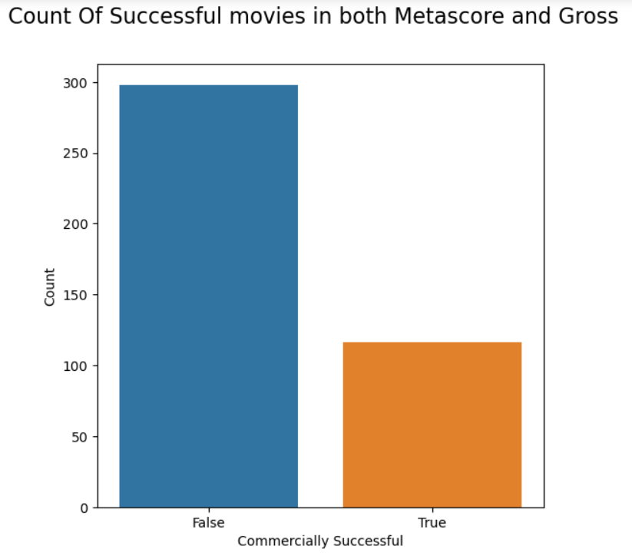
Results & Discussion
This bar graph represents the count of movies that were successful in both Metascore and Gross.
It compared the Metascore and Gross.
If Metascore was >= than 77 AND the gross was >= mean gross THEN it was a successful movie.

Slide 6
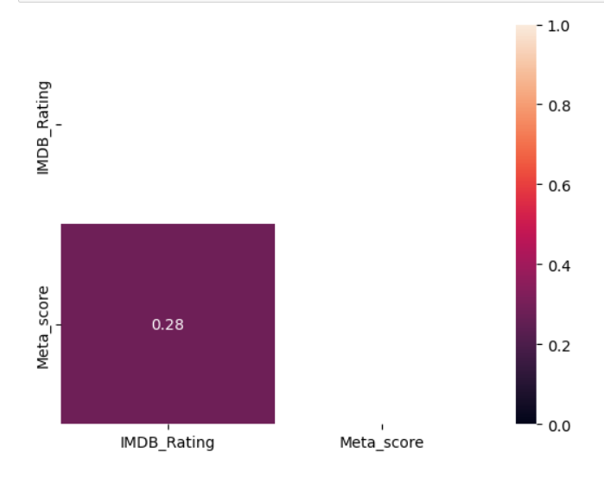
Results and Discussion
This heatmap was created to check if there is a strong correlation between the IMDB rating and Metascore rating.
We got a correlation of 0.28 which is absolutely not a strong correlation.
This proves that the professional reviewers don’t see always eye to eye with the audience.

Slide 7
References
Dataset from Kaggle

