Slide 1
Final Course Project
Nandini Malik
Columbia University

Slide 2
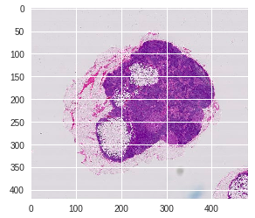
Problem:
Detecting cancer in gigapixel pathology images
Human reading prone to error
Assist and not replace

Slide 3
Approach
Pull all data
Pre-process images
Extract patches
Assign labels to patches
Divide into train and test
Make data balanced
Train Model
Visualise the results

Slide 4
Approaches that did not work
Just using one slide: Insufficient data
Using all slides: not much information
Using a shallow model
Using all patches from the slides: corner patches are mostly useless
Using just recall or accuracy as the success metric
Deep and complex architecture with pre-defined weights (ImageNet in InceptionV3)

Slide 5
Approaches that did work
Removing blank slides
Removing patches with very few tissue pixels
Upsampling the minority class
Using decently small sized patches (80x80) as supposed to 128x128 or 299x299
A deeper and more complex model (InceptionV3) but with no pre-defined weights

Slide 6
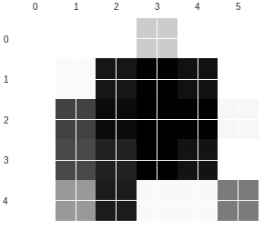
Final Results
High Probability areas

Slide 7
Challenges and Further Improvements
Oversampling is just duplication
Different architecture
Different patch sizes
Possibly making the tumor regions in the slides much lighter, so that the convolutional layers are able to distinguish between tumor and non-tumor
Getting more data

Slide 8
Video uploaded on the following link:
https://youtu.be/8QrkNKpMl9o
Please leave any suggestions/feedback that you might have for me!
Thanks,
Nandini

