Slide 1
Final Course Project
Nandini Malik
nm3007

Slide 2
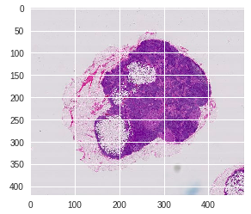
Problem:
Detecting cancer in gigapixel pathology images
Assist and not replace

Slide 3
Approach
Read in all slides and masks from drive
Pre-process images: apply monotone mask, compute percentage tissue, etc.
Extract patches from images
Assign labels to patches based on the presence of tumor (in ground truth)
Divide data into train and test
Data imbalanced: try balancing the train data by oversampling or downsampling
Train model
Visualise results through a heatmap
Compare against ground truth

Slide 4
Approaches that did not work
Just using one slide: this gives very inconsistent results due to insufficient amount of data
Using all slides: Some slides are blank, or have no tumors at all.
Using a shallow model: using a model with 2 or 3 convolutional layers was not able to detect the subtle differences between tumor and healthy tissue
Using all patches from the slides: some patches had no tissue pixels at all, because they were corner patches or around the edge
Using just recall or accuracy as the success metric: the model either predicted all samples as 1 or all as 0.
Deep and complex architecture with pre-defined weights (ImageNet in InceptionV3)

Slide 5
Approaches that did work
A deeper and more complex model (InceptionV3) but with no pre-defined weights
Upsampling the minority class
Removing blank slides
Removing patches with very few tissue pixels
Using decently small sized patches (80x80) as supposed to 128x128 or 299x299

Slide 6
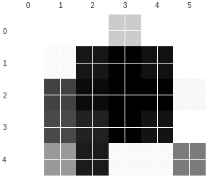
Final Results
High Probability areas

Slide 7
Further Improvements
Different architecture
Different patch sizes
Possibly making the tumor regions in the slides much lighter, so that the convolutional layers are able to distinguish between tumor and non-tumor
Getting more data

