Slide 1
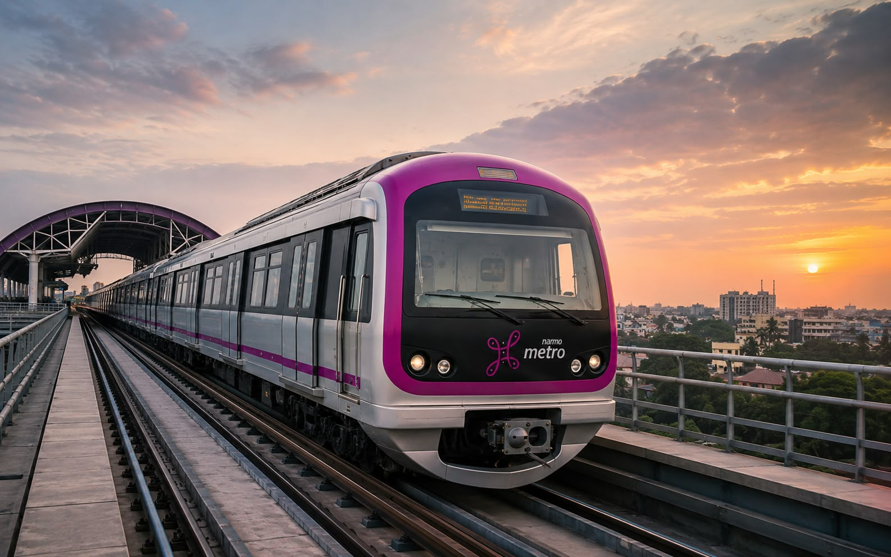
METROPULSE
Bengaluru Metro Ticketing & Transaction Analytics
SQL Data Analyst Project | 2024–2026
Prepared by
Nivedita Malik

Slide 2
PROJECT OVERVIEW
MetroPulse is a SQL-based metro transaction analytics project designed to analyze daily ticketing and payment transactions across multiple channels.
The project uses transaction data from October 2024 to August 2026 and organizes the data into related tables covering smart cards, passes, tickets, QR transactions, QR channels, dates, and daily summaries.
The analysis focuses on identifying transaction patterns, comparing payment channels, understanding daily and yearly trends, and generating meaningful business insights using SQL.

Slide 3
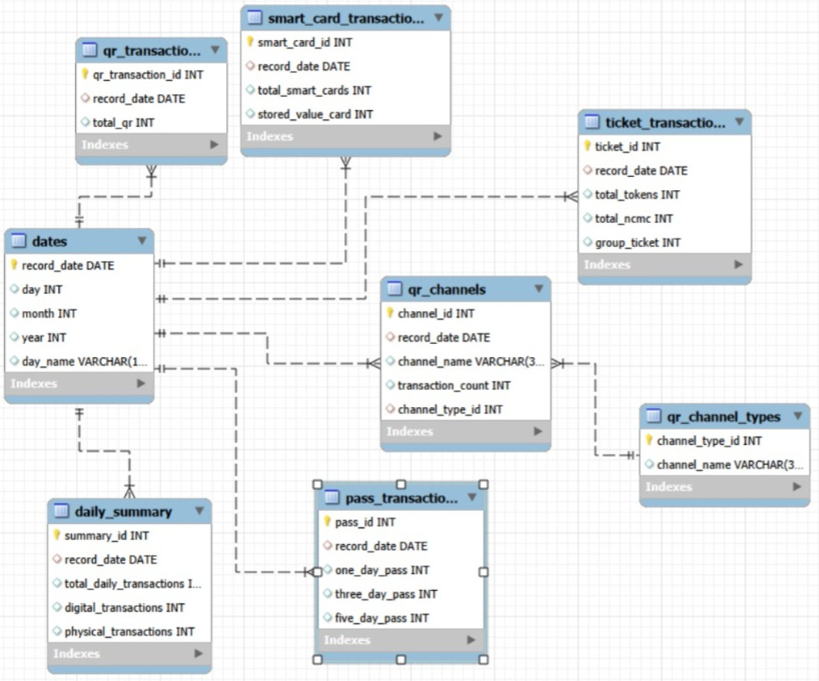

DATABASE STRUCTURE
ER Diagram of MetroPluse Database (8 Tables)
Core Relationship | Type | Foreign Key Used
Dates → Smart Card Transactions | 1:N | record_date
Dates → Pass Transactions | 1:N | record_date
Dates → Ticket Transactions | 1:N | record_date
Dates → QR Transactions | 1:N | record_date
Dates → QR Channels | 1:N | record_date
QR Channel Types → QR Channels | 1:N | channel_type_id
Dates → Daily Summary | 1:1 | record_date

Slide 4
CREATE TABLES
1.Create dates
CREATE TABLE dates
(record_date DATE PRIMARY KEY,
day INT, month INT, year INT,
day_name VARCHAR(10));
2. Create smart_card_transactions
CREATE TABLE smart_card_transactions (
smart_card_id INT AUTO_INCREMENT PRIMARY KEY,
record_date DATE,
total_smart_cards INT,
stored_value_card INT,
FOREIGN KEY (record_date)
REFERENCES dates(record_date));

Slide 5
CREATE TABLES
3. Create pass_transactions
CREATE TABLE pass_transactions (
pass_id INT AUTO_INCREMENT PRIMARY KEY,
record_date DATE, one_day_pass INT,
three_day_pass INT, five_day_pass INT,
FOREIGN KEY (record_date)
REFERENCES dates(record_date));
4. Create ticket_transactions
CREATE TABLE ticket_transactions (
ticket_id INT AUTO_INCREMENT PRIMARY KEY,
record_date DATE,
total_tokens INT,
total_ncmc INT, group_ticket INT,
FOREIGN KEY (record_date)
REFERENCES dates(record_date));

Slide 6
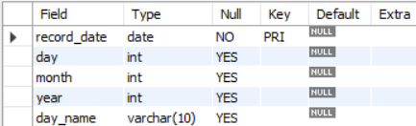
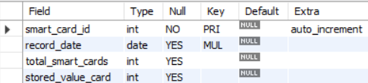
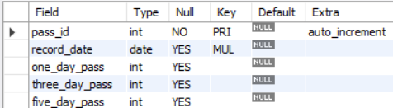
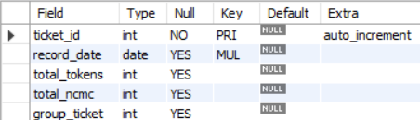
TABLE STRUCTURE
MySQL Table Definitions Using DESC Command
1. DESC dates; 2. DESC smart_card_transactions;
3. DESC pass_transactions; 4. DESC ticket_transactions;

Slide 7
TABLE STRUCTURE
MySQL Table Definitions Using DESC Command
1. DESC dates; 2. DESC smart_card_transactions;
3. DESC pass_transactions; 4. DESC ticket_transactions;

Slide 8
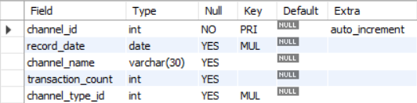

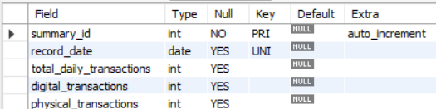

TABLE STRUCTURE
MySQL Table Definitions Using DESC Command
5. DESC qr_transactions; 6. DESC qr_channels;
7. DESC qr_channel_types; 8. DESC daily_summary;

Slide 9
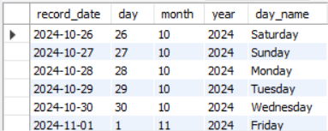
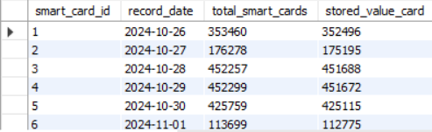
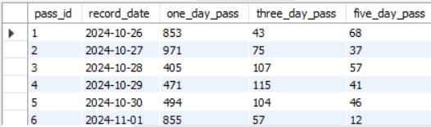
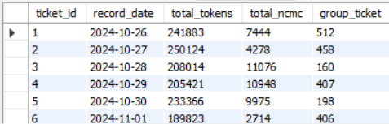
CONTENTS OF TABLES
Sample Records From The MetroPulse Database
1. SELECT * FROM dates; 2. SELECT * FROM smart_card_transactions;
3. SELECT * FROM pass_transactions 4. SELECT * FROM ticket_transactions;

Slide 10
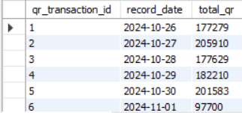
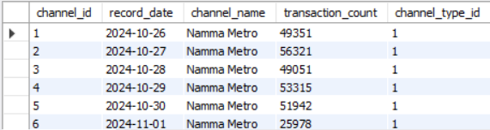
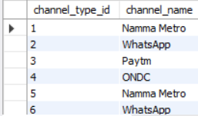
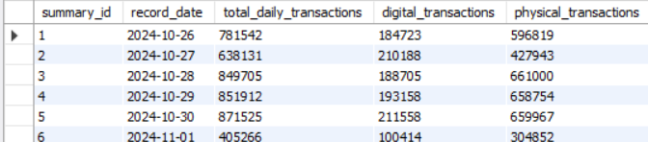
CONTENTS OF TABLES
Sample Records From The MetroPulse Database Using SELECT *
SELECT * FROM qr_transactions; 2. SELECT * FROM qr_channels;
3. SELECT * FROM qr_channel_types; 4. SELECT * FROM daily_summary;

Slide 11
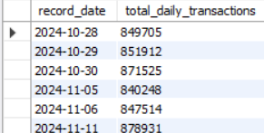

SUBQUERIES
Business questions solved using nested SQL queries
Above Average Daily Transactions Question:
Which dates had transactions above the average daily total?
SELECT record_date, total_daily_transactions
FROM daily_summary
WHERE total_daily_transactions >
(SELECT AVG(total_daily_transactions)
FROM daily_summary);
Highest Smart Card Usage Question:
Which date recorded the highest smart card transactions?
SELECT record_date, total_smart_cards
FROM smart_card_transactions
WHERE total_smart_cards = (SELECT MAX(total_smart_cards)
FROM smart_card_transactions);

Slide 12

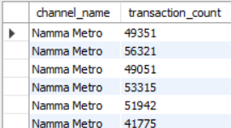
SUBQUERIES
Business questions solved using nested SQL queries
Highest QR Transactions Question:
Which date had the highest QR transactions?
SELECT record_date, total_qr
FROM qr_transactions WHERE total_qr =
(SELECT MAX(total_qr)
FROM qr_transactions);
Above Average QR Channel Usage Question:
Which QR channels performed above the average channel usage?
SELECT channel_name, transaction_count
FROM qr_channels
WHERE transaction_count >
(SELECT AVG(transaction_count)
FROM qr_channels);

Slide 13
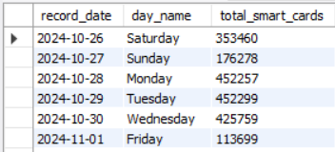
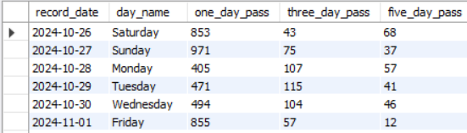
JOINS
Combining related tables to analyze Metro transaction data
Dates + Smart Cards Question:
Show the date, day name and smart card transactions.
SELECT d.record_date, d.day_name,
s.total_smart_cards FROM dates d
JOIN smart_card_transactions s
ON d.record_date = s.record_date;
Type: INNER JOIN
Dates + Passes Question:
Show daily pass transactions along with the day.
SELECT d.record_date, d.day_name,
p.one_day_pass, p.three_day_pass,
p.five_day_pass FROM dates d
JOIN pass_transactions p
ON d.record_date = p.record_date;
Type: INNER JOIN

Slide 14
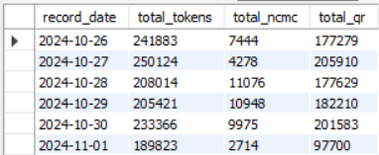
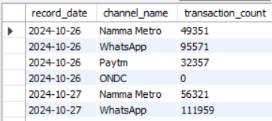
JOINS
Combining related tables to analyze Metro transaction data
Dates + Tickets + QR Question:
Compare ticket and QR transactions by date.
SELECT d.record_date, t.total_tokens, t.total_ncmc, q.total_qr
FROM dates d JOIN ticket_transactions
t ON d.record_date = t.record_date JOIN qr_transactions
q ON d.record_date = q.record_date;
Type: Multiple INNER JOIN
Dates + QR Channels Question:
Show QR channel-wise transactions by date.
SELECT d.record_date, q.channel_name, q.transaction_count
FROM dates d JOIN qr_channels q
ON d.record_date = q.record_date;
Type: INNER JOIN

Slide 15
INSIGHTS
📊 Smart cards were the most used transaction category, contributing the largest share of recorded transactions.
🎟️ Tokens were the second-highest transaction category, showing strong usage of token-based ticketing.
📱 QR transactions showed significant adoption, making QR an important digital ticketing channel.
💬 WhatsApp was the leading QR channel, followed by Namma Metro and Paytm, while ONDC had the lowest QR usage.
🚇 Transaction activity reached its highest daily level on 14 August 2026, indicating a strong peak in overall metro transactions.

Slide 16


