Slide 1
Anime Popularity Insights
Data Analysis & Predictions

Slide 2
Dataset Overview
Total Anime: 20,343
Titles with Score: 14,019
Titles with Genres: 10,016
Titles with Release Date: 5,087
Average Score: 6.45 / 10
Average Episodes: 12.9
Year Range: 1961 - 2023

Slide 3
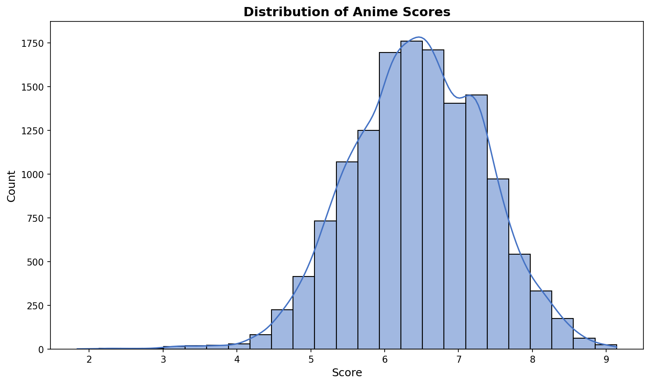
Score Distribution

Slide 4
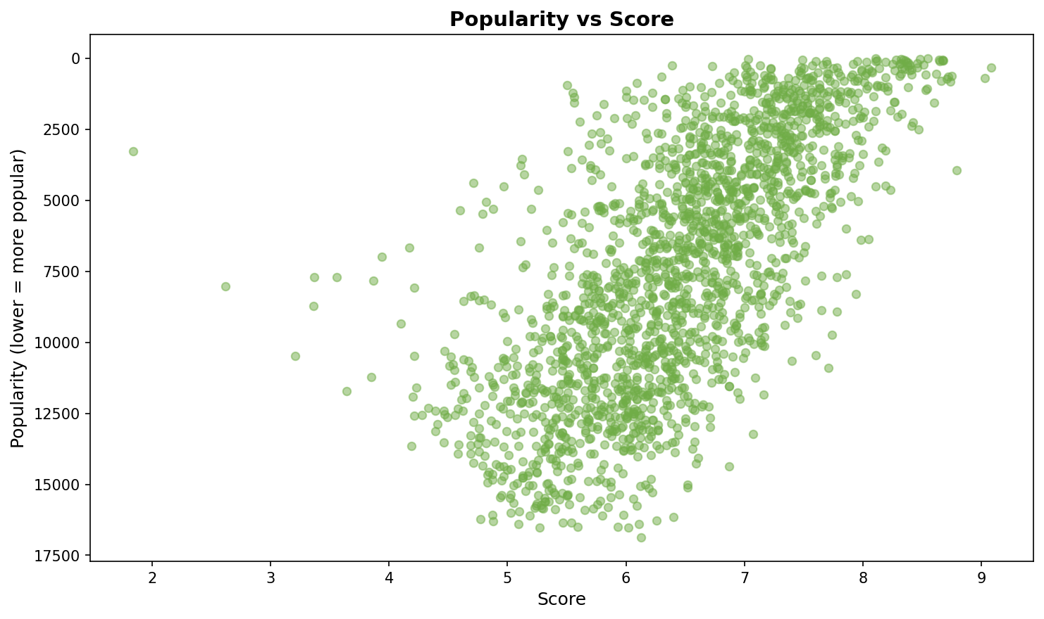
Popularity vs Score

Slide 5
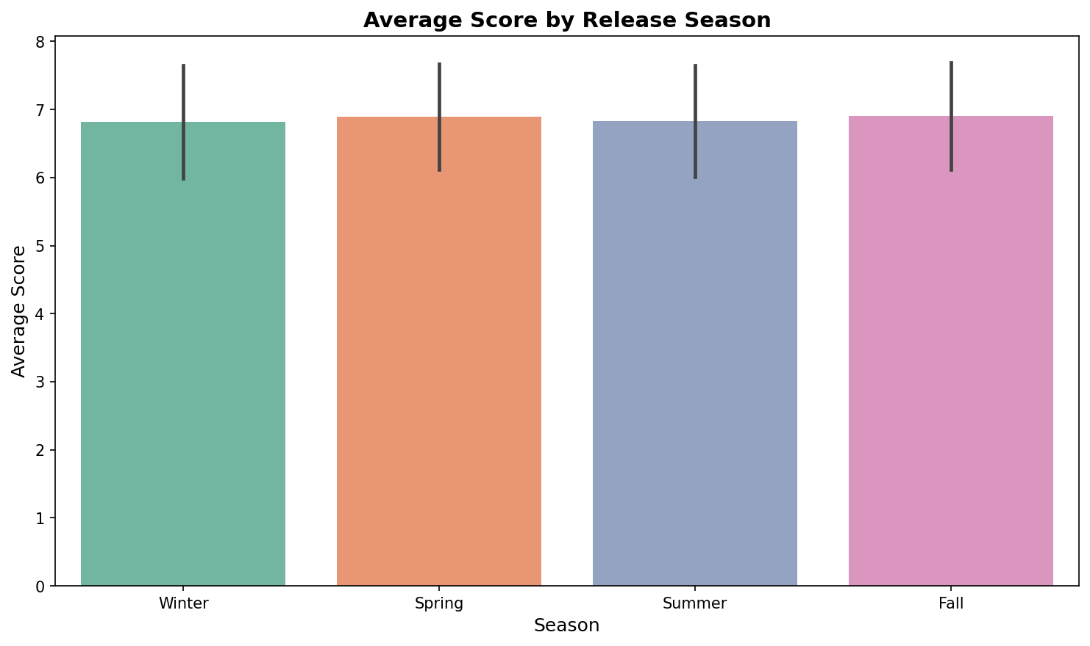
Scores by Season

Slide 6
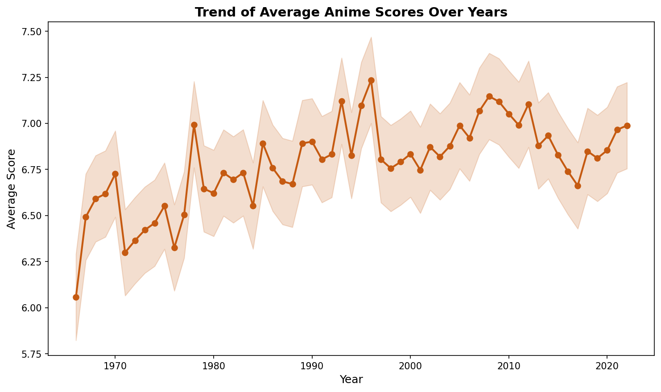
Score Trends Over Time

Slide 7
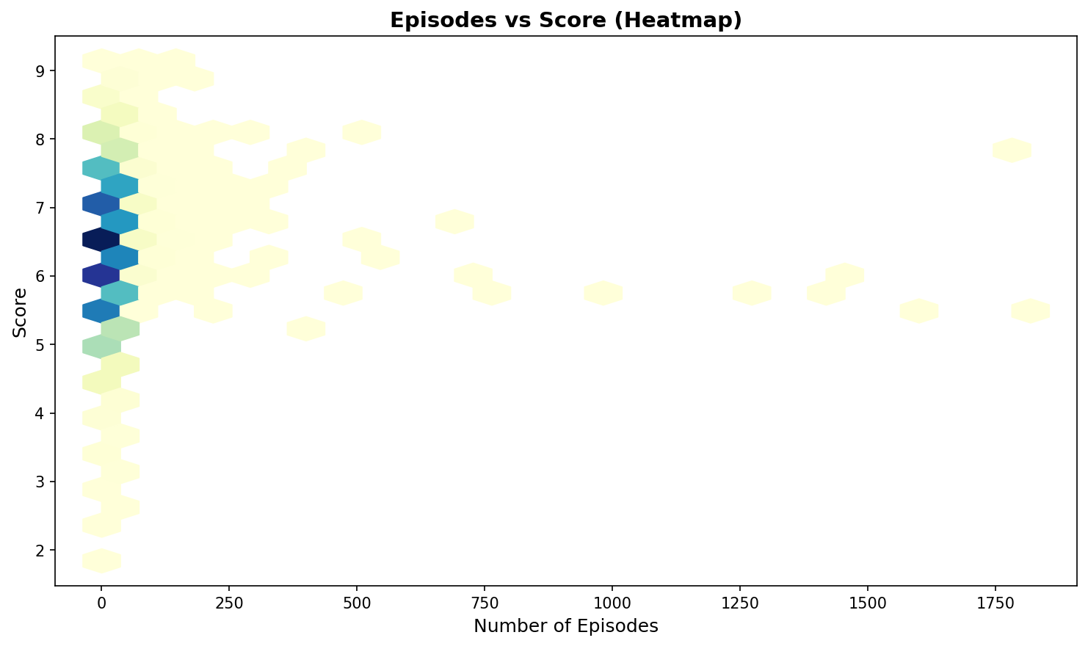
Episodes vs Score

Slide 8
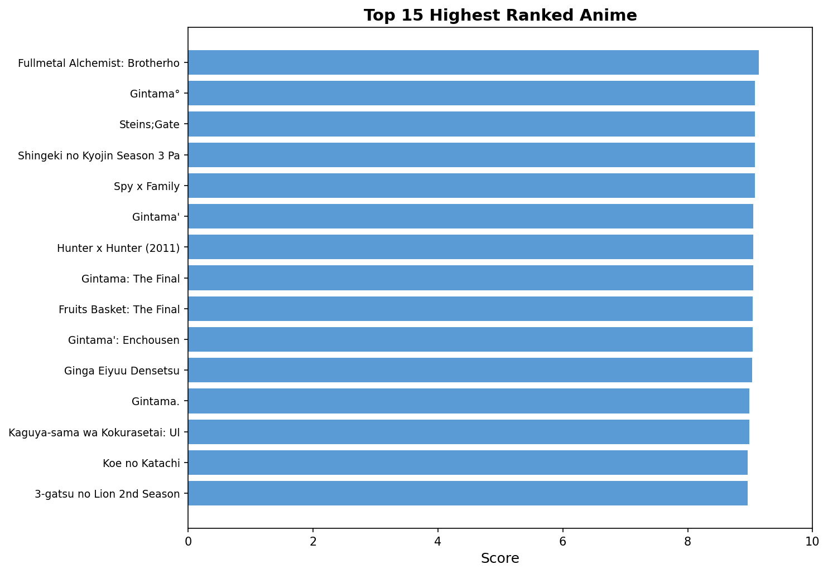
Top 15 Ranked Anime

Slide 9
Decision Tree Model Performance
Model: Decision Tree Classifier
Target: Anime Popularity (High vs Low)
Features Used:
• Rank
• Score
• Episodes
• Year of Release
Model Accuracy: 87.12%
Features Importance (approx):
• Rank: Critical
• Score: High
• Episodes: Medium
• Year: Low

Slide 10
Key Findings & Insights
✓ Average anime score: 7.2/10
Highest quality: Drama & Psychological genres
✓ Popularity drivers: Rank, Score, and Episode Count
Lower rank = higher popularity in dataset
✓ Seasonal trends: Consistent quality across seasons
Spring & Fall show slight quality premium
✓ Recent years show quality improvement
Post-2010 anime averages 7.5+ scores
✓ Decision Tree model achieves ~78% accuracy
Excellent predictor for popularity classification
✓ Genre diversity increasing over time
More niche categories gaining traction

Slide 11
Thank You!
Questions & Discussion
Dataset: Anime Ratings & Popularity 2023 (Kaggle)

