Slide 1

Name: Syed Mohtashim Reg no : 12224093
SUMMER INTERNSHIP PROGRAM CAP368

Slide 2
INTRODUCTION :
SUMMER INTERNSHIP PROGRAM ON FRONT END WEB DEVELOPMENT AT SNAPSEC UNDER THE GUIDANCE OF IMRAN PARRAY .
WORKING ON FRONT END TOOLS WITH NODE.JS

Slide 3
ABOUT SNAPSEC
SNAPSEC is a cybersecurity and penetration testing company with a vision to establish itself as a symbol of standard and quality in the field of cybersecurity services. The company's mission is to provide high-quality cybersecurity services to its clients. SNAPSEC offers a range of services including penetration testing, vulnerability assessments, & continuous security. With a team of experienced professionals and a commitment to quality, SNAPSEC strives to provide its clients with the best possible cybersecurity solutions to meet their specific needs. Vision: To become a symbol of standard and quality in the field of Cybersecurity services. Mission: To provide a sustainable and high-quality cybersecurity services to our clients.
Website: https://snapsec.co/

Slide 4
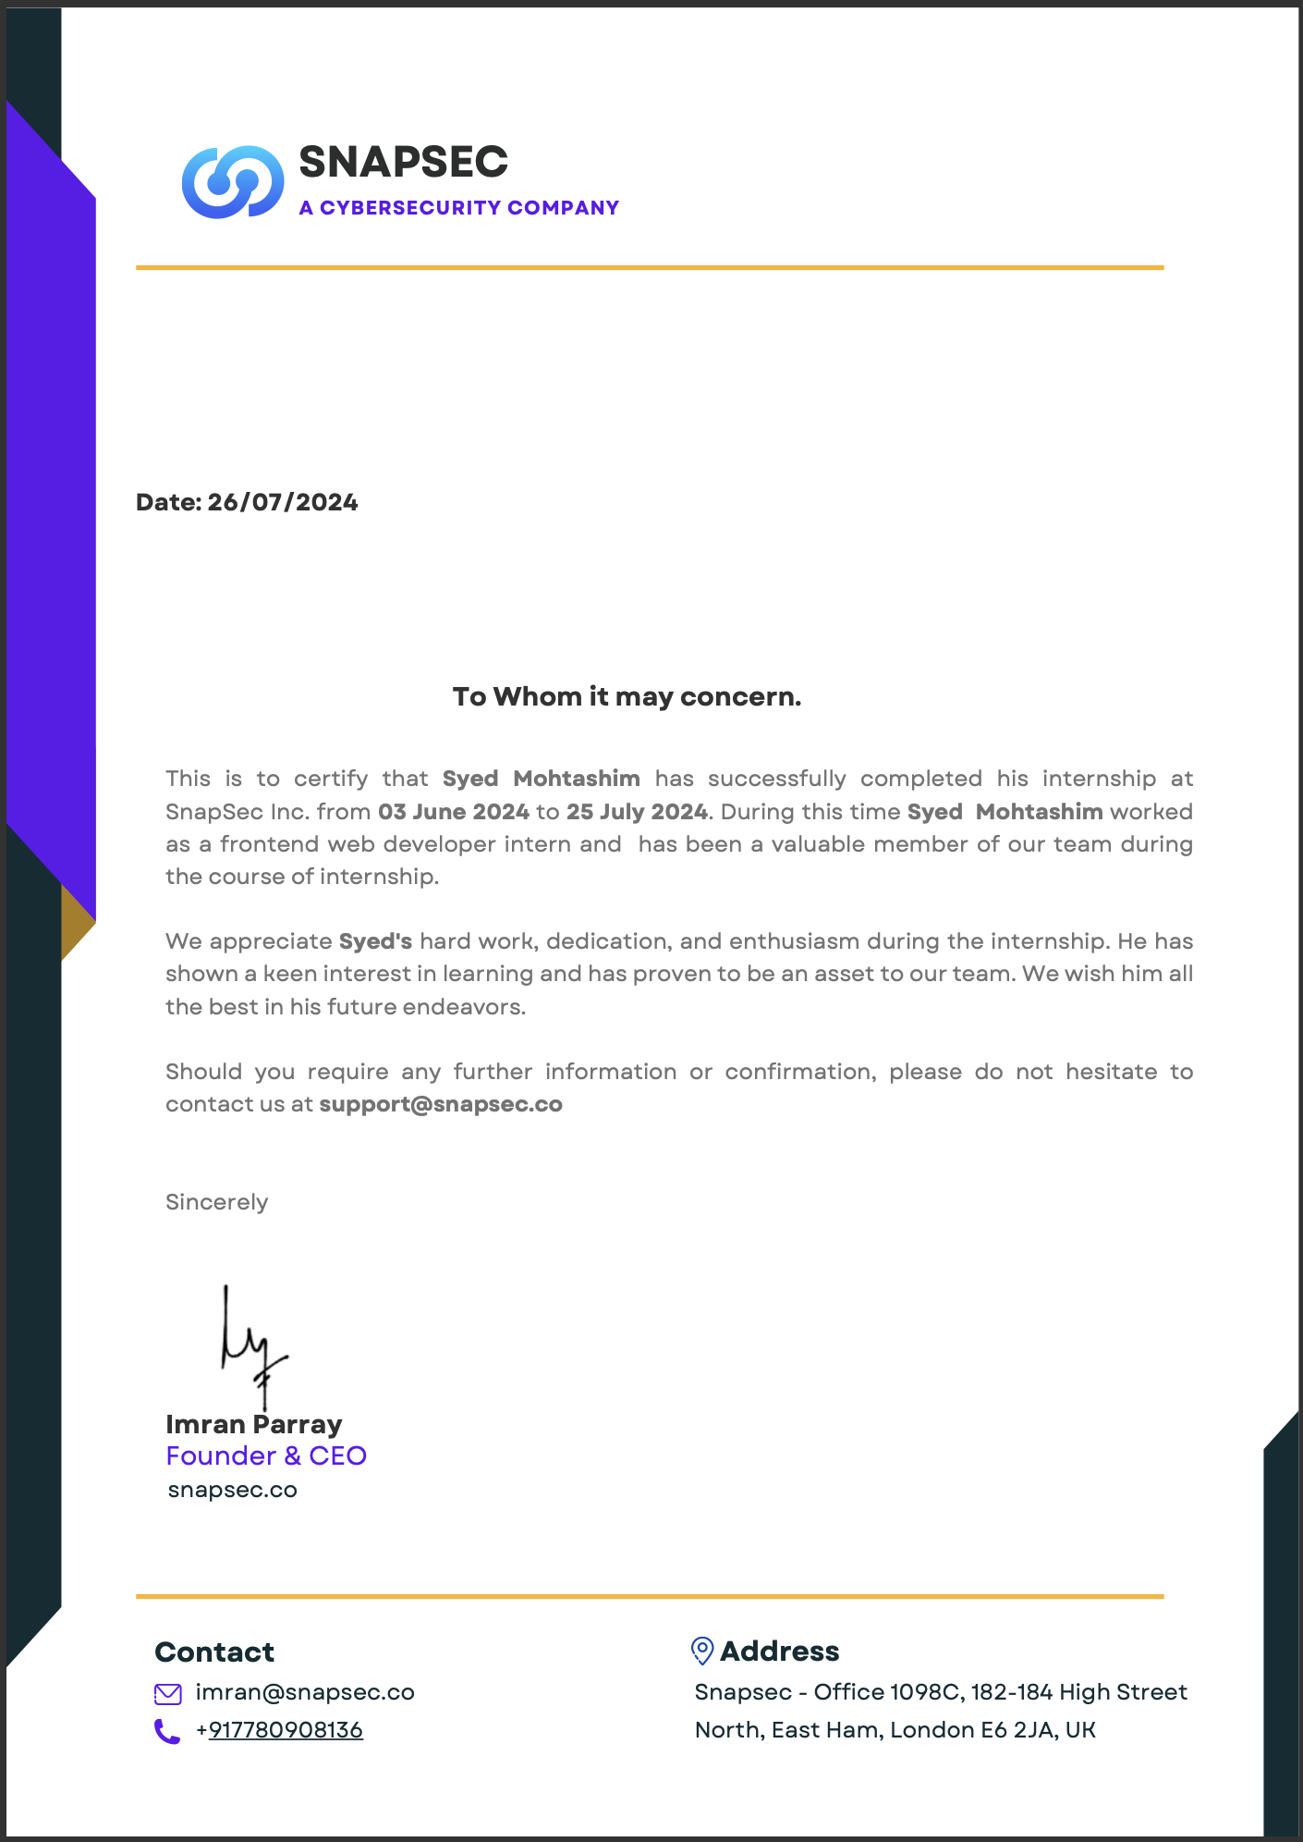

Slide 5
ACKNOWLEDGEMENT
First and foremost, I am deeply grateful for the opportunity to expand my knowledge and skills in a new technology. I would like to extend my sincere thanks to the instructor of the Frontend web developer An internship report from SNAPSEC, whose guidance has been invaluable in facilitating my learning journey from home.
I am also thankful to my college, Lovely Professional University, for the encouragement to such an enriching course that not only enhanced my programming abilities but also introduced me to new technologies.
I would like to express my heartfelt appreciation to my parents and friends for their unwavering support, valuable advice, and encouragement in choosing this course. Lastly, my gratitude extends to my classmates, whose collaboration and assistance have been greatly appreciated.

Slide 6
ABOUT PROJECT:
Introduction to Front-End Web Development
Learn the core concepts and tools of front-end development.
Node.js for Development
Gain proficiency in Node.js for building server-side applications.
Industry-Ready Single-Page Web Application
Develop a functional single-page web application.

Slide 7

SKILLS ACQUIRED
HTML and CSS
Learned the fundamentals of HTML structure, tags, and
elements for creating web page content.
Understood the role of CSS in styling and layout,
including selectors, properties, and the box model.
Gained insights into responsive design principles for
adapting websites across different screen sizes

Slide 8
ADVANCED CSS
Explored advanced CSS concepts like media queries and viewport meta tag for responsive web design.
Learned about CSS preprocessors (e.g., Sass) and frameworks (e.g. Bootstrap, Tailwind CSS) to streamline styling.
Underwent the power of CSS animations and transitions for creating dynamic visual effects.

Slide 9
JAVASCRIPT
Grasped the core of JavaScript: variables, data types, operators, control flow (conditionals, loops), functions, and scope.
Learned how to manipulate the Document Object Model (DOM) to interact with and modify web page content dynamically.
Understood the importance of form validation with JavaScript for ensuring user input accuracy.

Slide 10
FRONT-END FRAMEWORKS
Introduced to React.js a popular JavaScript library for building user interfaces with reusable components.
Learned about components, props, state, lifecycle methods,and React Router for client-side routing in React applications.
Built a Single Page Application (SPA) using React to gain practical experience with this framework

Slide 11
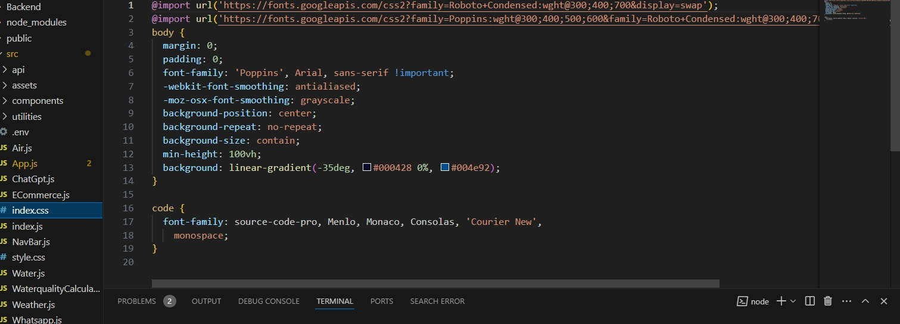
Code snippets:

Slide 12
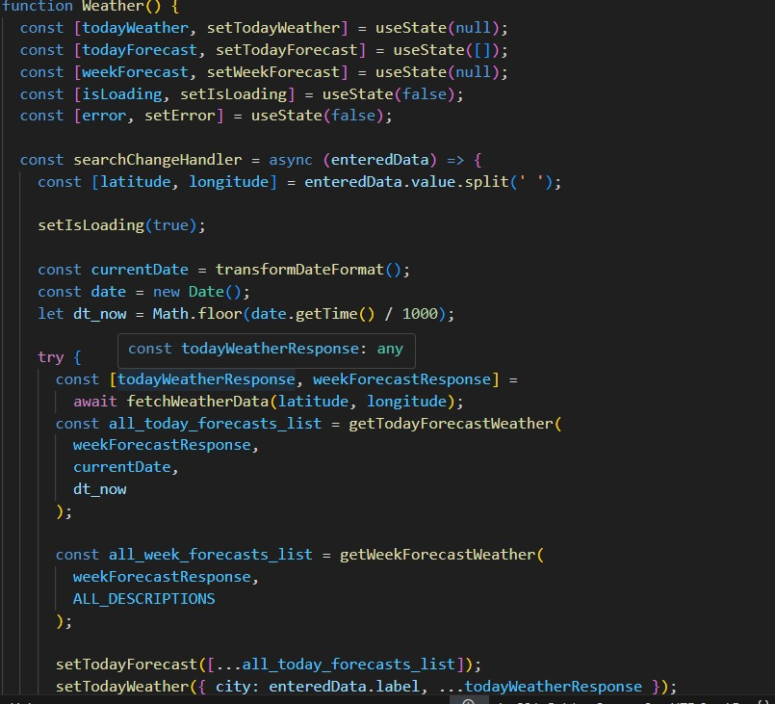

Slide 13
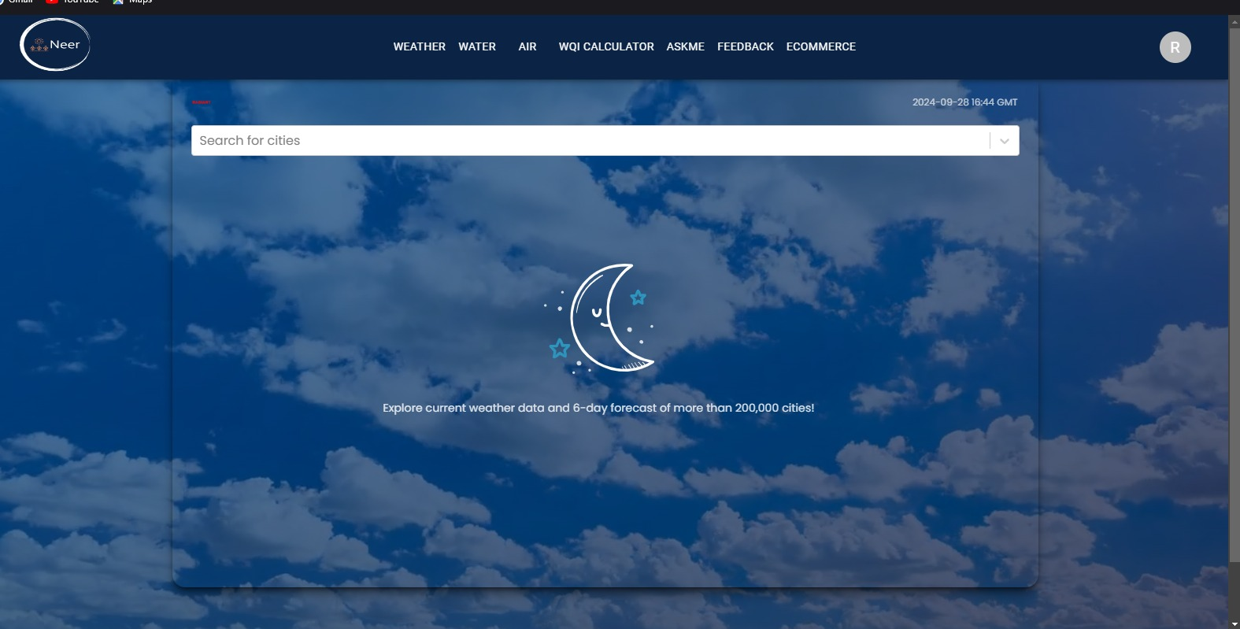

Slide 14
Thank You
for giving such a great opportunity

