Slide 1
My IMS project
By Subhaan Malik

Slide 2
Who am i?
Subhaan Malik - an interest in programming and operating systems
My Approach
Understanding the scope of project
Looking at planning the project with tools like jira
Understanding pre existing code within program

Slide 3
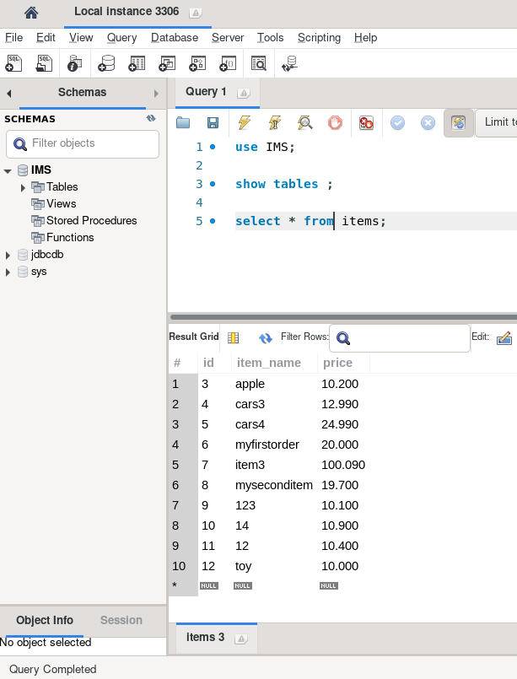
Consultant Journey
Git - Branches, adding, committing, pushing.
Java - deeper understanding of OOP, Abstract classes.
JUnit - How to add tests into programming
SQL / JDBC - Writing SQL queries, injecting SQL queries from java into SQL.

Slide 4
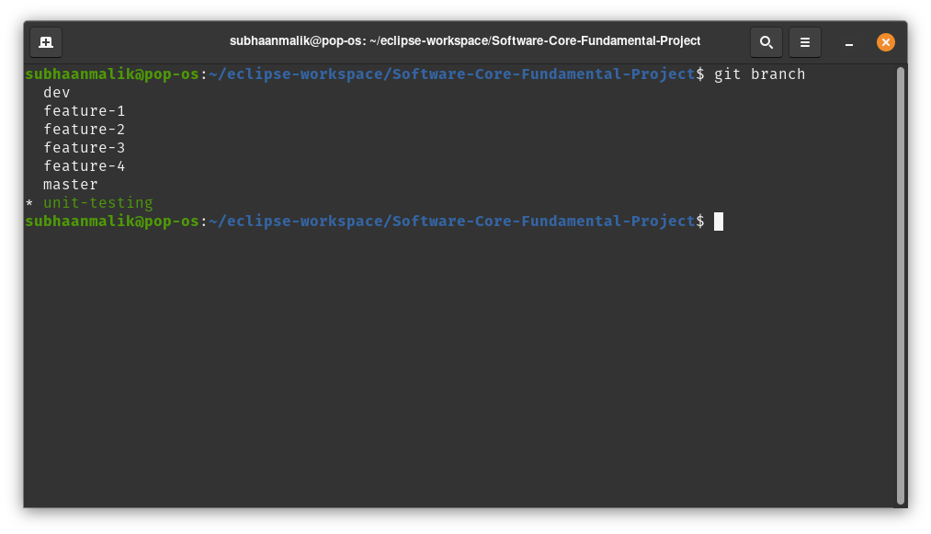
Version Control
Used different branches for different features
Ability to revert back if any changes break the program

Slide 5
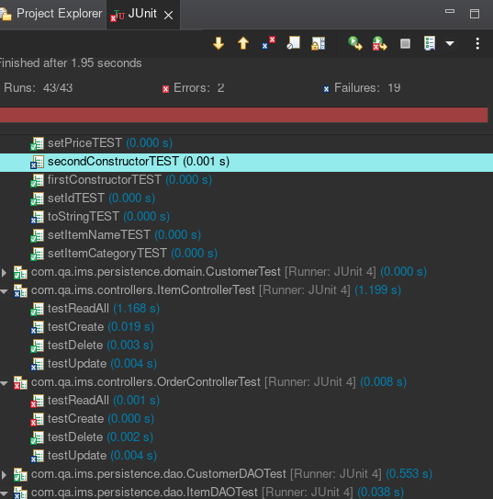
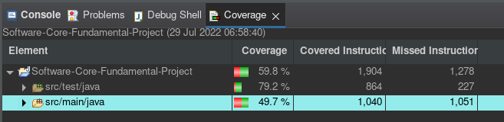
Testing
Testing with JUnit, ran 43 tests, 19 failed.
Some tests fail due to tests written incorrectly, some due to bugs within classes.

Slide 6
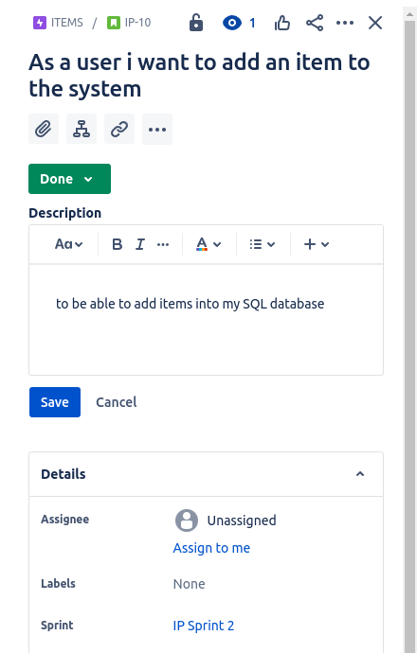
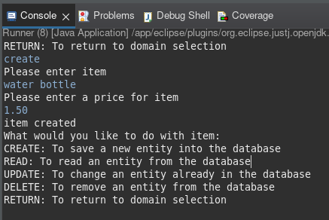
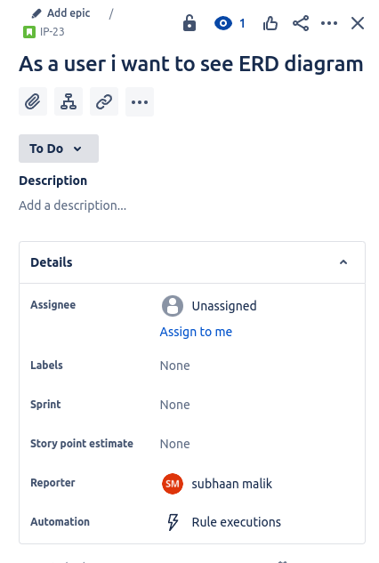
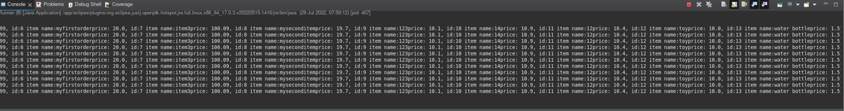
User Stories

Slide 7
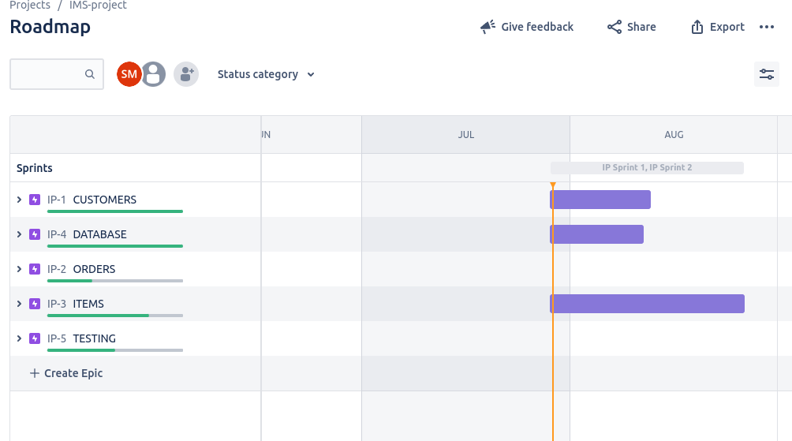
Sprint Review

Slide 8
Sprint Retrospective
Able to connect to SQL
Able insert SQL queries through Java
Better understanding of how Java applications work.
Better understanding of how unit testing works.
What could've went better?
Better understanding of SQL table relationships
Better understanding of abstract classes & OOP practices

Slide 9
Conclusion
What could've went better?
Time management
Asking right people for help
More research and studying on specific subjects within java/JDBC

