Slide 1






Magasiniere
Puzzle Game In Java – OOP Semester Project

Slide 2
Developed by
Abdul Manan
CMS 303323
BSCS 9A, SEECS
NUST Islamabad
Tafheem Ul Islam
CMS 321906
BSCS 9A, SEECS
NUST Islamabad
Hammad Saleem
CMS 306647
BSCS 9A, SEECS
NUST Islamabad

Slide 3
Introduction
Puzzle game developed in Java
Semester project for class of OOP.
Game inspired from Sokoban.
Player pushes crates to keep them in their positions.
Tools : JavaFx and IntelliJ Idea

Slide 4
Background
Challenges faced
Significant portion of time was spent on learning JavaFx.
Portion of time was given to designing of game.
Development took a larger portion as the project was revised multiple times before final product.
New technologies and skills learnt:
OOP concepts
Java
JavaFx
Working with IntelliJ IDE

Slide 5
Game Overview
Four Window
1. Main Menu
2. Levels Menu
3. Instructions
4. Main (Gameplay)
WASD to move.
B,N to go to previous and next level.
R to restart
Esc to Main Menu

Slide 6
Features
Beautiful and simple GUI
15 Levels
Level Menu to select any level
Option to move to next and previous level during gameplay.
Option to move to Main Menu in gameplay.
Option to restart the game.
Background Music
Choice to mute Background Music.

Slide 7
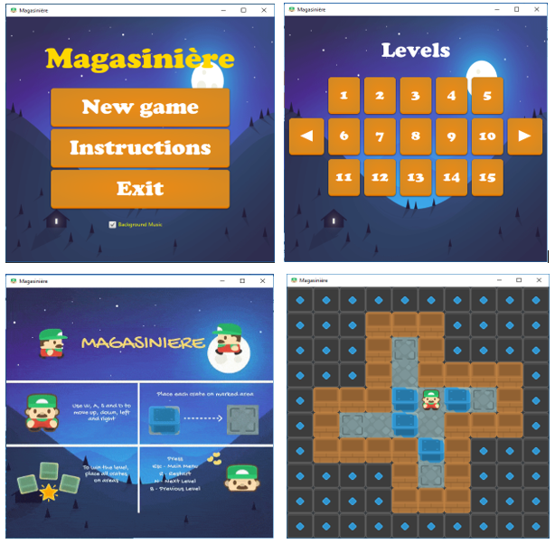
GUI of Game

Slide 8
Back-End Development
Game board designed with arrays.
Images used with ImageView class.
Elements of game given values and used in level array.
Multiple layers laid over each other.

Slide 9
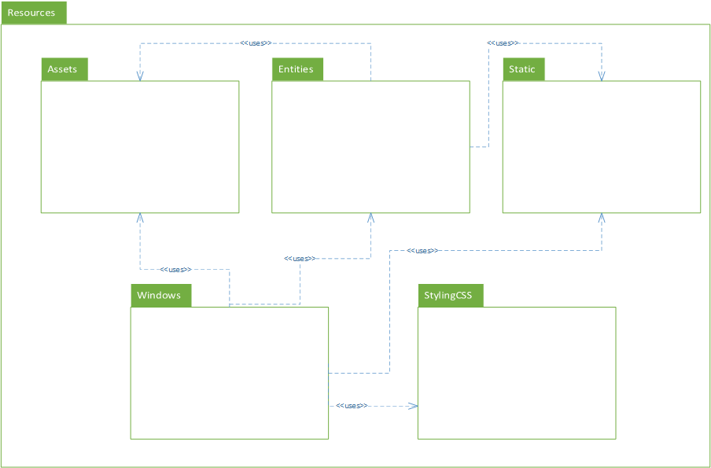
Package UML diagram

Slide 10
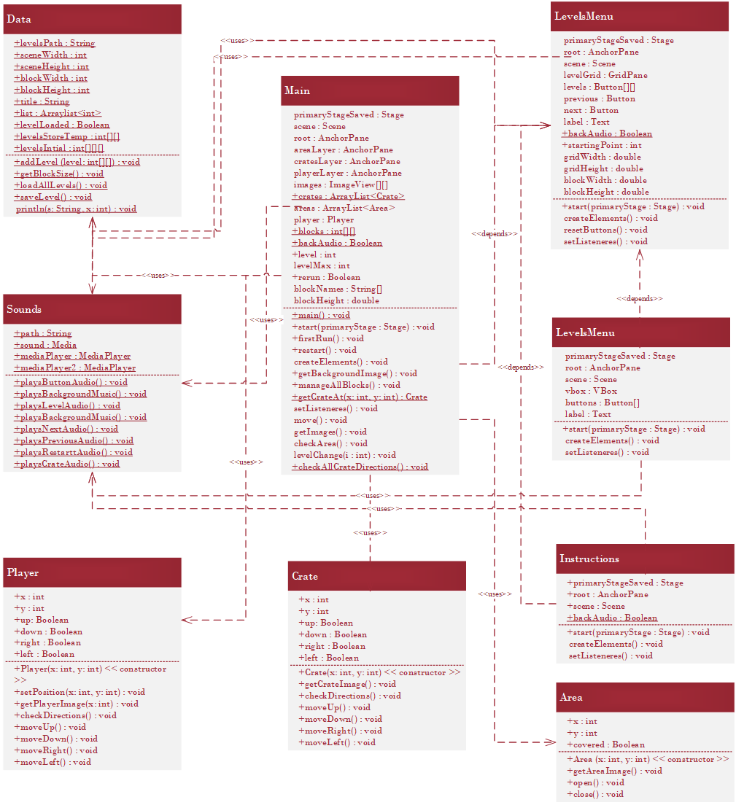
Class UML diagram

Slide 11
Area.java
Package Entities
For creating ‘area’ objects.
Area is location where crate is to be placed.
Uses Image and ImageView class of JavaFx
Inherits ImageView class

Slide 12
Crate.java
Package Entities
For creating ‘crate’ objects.
Crate is element that is pushed.
Uses Image and ImageView class of JavaFx
Inherits ImageView class.
Data encapsulated

Slide 13
Player.java
Package Entities
For creating ‘player’ instance.
Player is the main character in game.
Uses Image and ImageView class of JavaFx.
Inherits ImageView class.
Data encapsulated

Slide 14
Data.java
Package Static
Holds and manages data.
Consists of arrays and lists for levels.
Deals with designing and loading of levels.
Static data fields and methods.
Uses file handling for storing level in txt file.

Slide 15
Sounds.java
Package Static
Loads and plays all audio files in project.
Imports Media and MediaPlayer classes.
Includes static methods and data fields.
Multiple methods, each playing different audio.

Slide 16
MainMenu.java
Package Windows
Primary class, runs the program.
Inherits Application class.
Builds Main Menu window of program.
Uses buttons to let user navigate to play or see instructions.
Uses Data.java and Sounds.java

Slide 17
LevelsMenu.java
Package Windows
Shows up the levels.
Inherits Application class.
15 levels
Buttons for starting any level

Slide 18
Instructions.java
Package Windows
Shows the instructions to play the game.
Inherits Application class.
Builds single page window showing image of instructions.

Slide 19
Main.java
Package Windows
Processes the game play.
Creates UI for game.
Uses other classes to create elements of game.
Core class of the project.

Slide 20
Accomplishments/Results
Learnt and practically implemented OOP concepts using Java.
Built GUI program with JavaFx.
Learnt to use media files in Java.
Used CSS to style our program.
Used file handling.
Used arrays to handle and process data.
Learnt about designing a game.

Slide 21
Thanks
Presentation Ends

