Slide 1
Noon e Tanveen Lecture No. 7
Prepared by: Miss Saboor Fatima
Senior Lecturer
Bahria University, Karachi Campus

Slide 2
Types of Noon e Tanween
When we talk about Tanween and Noon Saakin rules, there are four related ones we should mention:
Izhar
Iqlaab
Idghaam
Ikhfaa

Slide 3
1. Izhar
The word “Izhar” means in the dictionary to explain something or to make something clear. If one of the throat letters we call “Huroof Halaqiyya” comes after Noon Sakinah or Tanween, we are talking about Izhar here.
When we pronounce the letter N clearly, we apply the Izhar rule. The Huroof Halaqiyya are: (ء – هـ – ع – ح – غ – خ)

Slide 4
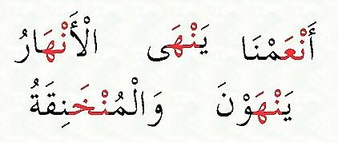
Example of IZHAR

Slide 5
2. Iqlab
If there is a letter Baa (ب) after the Noon Saakin or Tanween, here we have Iqlaab. Changing the sound of a Noon Saakin or Tanween into a Meem is the definition of Iqlaab. All you have to do is to stretch the sound to add Ghunna.
Usually, the letter Meem gives us a sign to recognize this rule. So it is all about turning one letter into another.

Slide 6
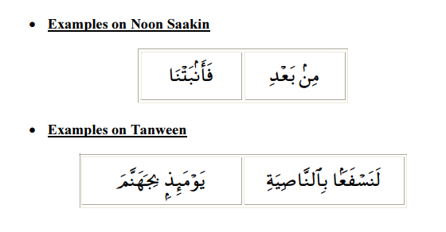
Example of IQLAB

Slide 7
3. Idghaam
The third one of the Noon Saakin rules is called Idghaam. We will analyze it by dividing it into two headings as follows:
Idghaam with Ghunna
Idghaam is called adding one letter to another letter. If one of the letters (ي – م – ن – و) comes after Tanween or Noon Sakinah, it becomes Idghaam with Ghunna (nasal sound) for 2 counts.

Slide 8
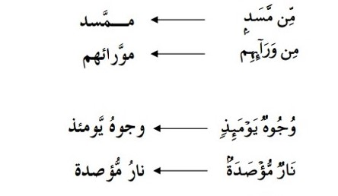
Idghaam with Ghunna

Slide 9
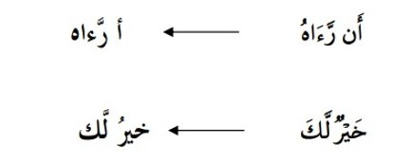
Idghaam without Ghunna
If the letters Lam or Ra come after Tanween or noon Sakiin, it means there is Idgham without Ghunna. You have to pronounce it without stretching while the letter is spoken, it is passed quickly.

Slide 10
4.Ikhfaa
From each of the Noon Saakin rules we listed, there are only fifteen letters left that we didn’t mention. These are the remaining fifteen letters: (ت – ث – ج – د – ذ – ز – س – ش – ص – ض – ط – ظ – ف – ك – ق)
Ikhfaa occurs when one of these fifteen letters comes after tanween or noon Sakinah. While applying this rule, the tongue should not stick to the palate or upper front teeth. There should be a slight gap in between. The sound should come from both the mouth and nasal passages.

Slide 11
Example 1
مِن شَرِّ مَا خَلَقَ (min shari ma khalaq)
This ayah contains a Noon Saakin has the final letter of the first word, which is followed by another letter that causes the Noon Saakin h to be hidden.
Example 2
إِنَّ ٱلۡإِنسَٰانَ لَفِى خُسۡر”ٍ” (‘iina ٱlۡ’iinsaan lafia khusۡr)
The second word in the aforementioned example has a Noon Saakin h in the midst of it, followed by one of the letters of ikhfa.
Example 3
“سَيَصۡلَىٰ نَارًا ذَاتَ لَهَبٍ” (sayasۡlaa naran dhat lahab)
In this example, the second word has a Tanween at the end of it, and the next word’s first letter is one of the Ikhfaa letters that cause the Noon Saakin h and Tanween to be hidden.

Slide 12
Noon Mushaddad and Meem Mushaddad Examples
Noon and Meem are called letters of Ghunna. And as we mentioned before while explaining the Noon Saakin rules, Ghunna is a nasal sound. When we see the letter Noon and Meem having Shaddah on them, we have to hold for a period of time with Ghunna. Briefly, if we come across a Noon or Meem Mushaddad (that has a Shaddah sign on it), we must do Ghunna of 2 beats on it.

Slide 13
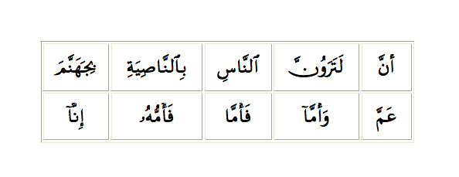
Noon Mushaddad and Meem Mushaddad Examples:

