Slide 1
Huroof e Maddaat and Maddaat Lecture No. 8
Prepared by: Miss Saboor Fatima
Senior Lecturer
Bahria University, Karachi Campus

Slide 2
Definition Of Madd
Tajweed rules Madd can be better understood in light of its linguistic meaning, which is to increase or lengthen.
Madd in Tajweed refers to the stretching or extension of sounds of one of the 3 Madd letters.

Slide 3
Huroof e Maddah
Madd means to stretch a sound and there are 3 Madd letters which are ا – و – ي .
When there is a Damma before wow sakin we stretach it for two counts and it is called wow Madd. When there is a Fatha before alif we stretch it for two counts and it is called Alif Madd.
نو حیھا۔ یقولون۔ الناس
Stretch for 2 counts

Slide 4
Types of Madd in Tajweed:
There are two different types of Madd:
Madd Asli/Tabi’y or Natural Madd
Madd Far’ee or Secondary Madd

Slide 5
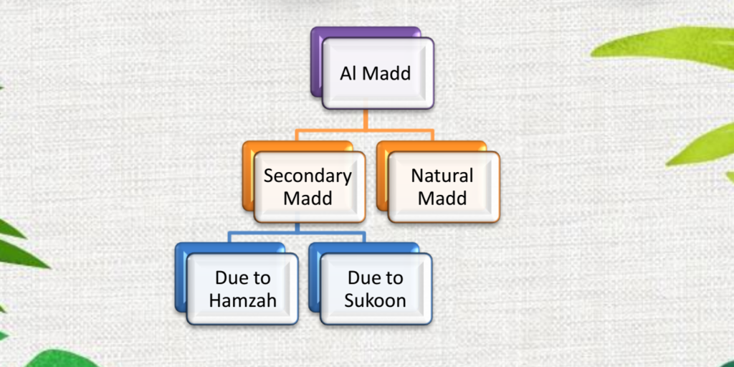

Slide 6
Secondary Madd (Madd Far’ee)
Meanwhile, Secondary Madd or Madd Far’ee is the elongation of vowels but it is dependent on the presence of Hamza or Sukoon
We have multiple types of MADDAT that come under MADDE FAR’EEمد فرعی

Slide 7
Madd ‘Ared Li- Ssukoon
Madd A’red Li- Sskoon is one of the types of madd that can be defined as “temporary Madd for stopping”. If the Maad Tabee’ee (Natural Maad in the letters ا or و or ي) is followed by a letter at the end of a word, which has been made sakin temporary because the reader has to stop at the word, the reader should prolong the Madd Tabee’ee to be Madd ‘Ared Li Ssukoon.
Maad A’red Li Ssukoon is prolonged for 2, 4, or 6 beats.

Slide 8
(Note: Madd A’red Li- Sskoon only exists if the reader stops on that word. If the reader doesn’t stop on it, it should be considered as a Madd Tabee’ee ‘Natural Madd’ 2 beats).
Examples of Madd ‘Ared Li- Ssukoon:
أَخــــــــــيِــــهِ
العَـــظِـــــــيِـمِ
يَتَــــــساءَلُـونَ

Slide 9
Madd Al-Leen (the Madd of Easiness)
Madd Al- Leen is simply can be defined as “Easy”.
What are the Leen Letters?
The Leen letters are: A Waaoo و or Yaa’ ي Sakin preceded by a letter with a fatha.
When should we apply this Madd?
We apply the Madd Al- Leen If one of these Leen letters is followed by a letter at the end of a word, which has been sakin due to stoppage.
The reader, in this case, should prolong the Leen letter. He can prolong it by 2, 4, or 6 beats.

Slide 10
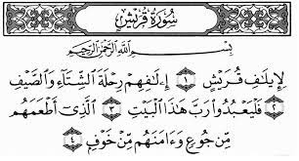

Slide 11
Madd Wajeb Muttasil (Due to Hamzah)
Due to Hamzah)
Madd Wajeb Muttasil simply means “Mandatory Madd” and Muttasil means “Joined”.
If a Madd letter (ا or ي or و ) is followed by a Hamzah (ء) which is present in the same word, the reader should prolong it for 4-5 beats.
أُوْلَٰٓئِكَ
وَٱلسَّمَآءِ
وَجِاْىٓءَ

Slide 12
Madd Ja’ez Munfasil
Madd Ja’ez Munfasil simply means “Ja’iz = Permitted”, and Munfasil means “Separated”. So, Madd Ja’ez Munfasil is a permitted separated madd.
Madd Ja’ez Munfasil happens when a Madd Letter (ا or ي or و ) present at the end of a word is followed by a Hamzah (ء) which is present at the beginning of the next word, the reader should prolong the Madd letter 4-5 beats.
Examples of Madd Ja’ez Munfasil: لا الہ
إِنَّآ أَنزَلْنَٰهُ
ٱلَّذِىٓ أَطْعَمَهُم
ٱلَّذِىٓ أَنقَضَ

Slide 13
Madd Lazem (necessary prolongation)
The Madd Lazem is a necessary prolongation of the letters of Madd. Madd Lazem is considered as one of the longest madd in Tajweed because it is prolonged by 6 beats.
Madd Lazem has two main types and each type of them has another 2 types. So the overall types of Madd Lazem are 4 types of necessary prolongation.

Slide 14
It happens due to HAMZA ء and TASHDEED ّ after HUROOF E MADDAH

Slide 15
Kalimi Muthaqqal (heavy): The first type which occurs within a word is a compulsory Madd that is the outcome of the following combination:
Madd Letter+ a saakin letter with shaddah on it
2. Kalimi Mukhaffaf (light): the second type is caused by a similar combination but it differs that the saakin letter doesn’t have shaddah on it
Madd Letter+ a saakin letter without shaddah on it

Slide 16
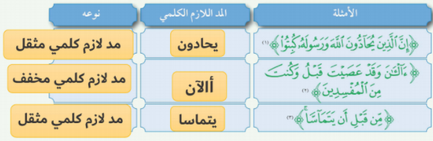

Slide 17
Madd Lazem Harfee Muthaqqal
Madd Lazem Harfee Muthaqqal occurs when the Maad letter is followed by a Mushaddad letter, the reader must prolong the Madd Letter for 6 beats.
Examples of Madd Lazem Harfee Muthaqqal:
الٓمٓصٓ
الٓمٓر
الٓمٓ

Slide 18
Madd Lazem Harfee Mukhafaf
Madd Lazem Harfee Mukhafaf occurs when the Madd letter is followed by a sakin letter, both of them present in the same letter. The reader must prolong the Madd Letter for 6 beats.
Examples of Madd Lazem Harfee Mukhafaf:
كٓهيعٓصٓ
الٓمٓ

