Slide 1
Huroof Leen Lecture No. 9
Prepared by: Miss Saboor Fatima
Senior Lecturer
Bahria University, Karachi Campus

Slide 2
Leen Letters - The Soft Vowels
Leen means to read softly and there are two leen letters which are و and ي.

Slide 3
"و" لین
When there is a wow sukoon and the letter before has a fatha we read the wow softly and it is called wow leen.

Slide 4
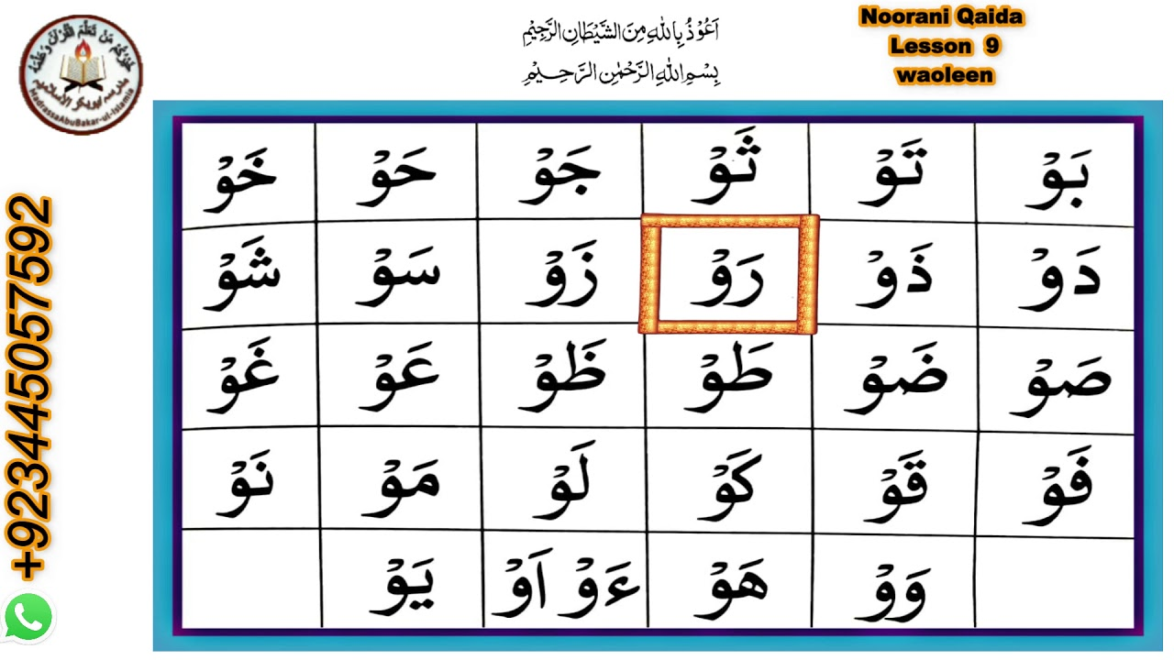

Slide 5
ی لین ya leen
When there is a ya sukoon and the letter before has a fatha we read the ya softly and it is called ya leen.

Slide 6
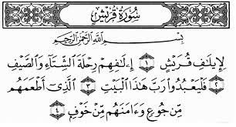

Slide 7
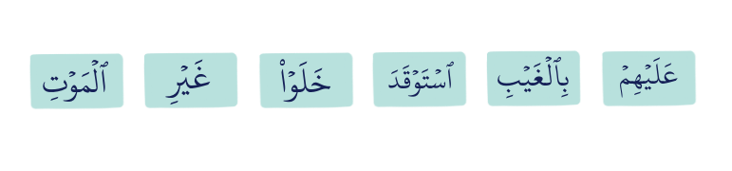
Can you identify the leen letters below?

