Slide 1
Huroof Qalqala Lecture No. 10
Prepared by: Miss Saboor Fatima
Senior Lecturer
Department of Islamic Studies
Bahria University, Karachi Campus

Slide 2
What Is Qalqalah In Tajweed
Qalqalah linguistically: means shaking/disturbance.
Its an echoing sound of pronouncing certain characters with the Sukoon Symbol on them or when one stops at these characters. They require the tones to be strong and create an echoing sound.

Slide 3
5 Qalqalah Letters
Qalqalah letters grouped in the phrase: قُطب جَد (Qutb Jad). That is, Haroof Qalqalah which are:
ق ط ب ج د
Dall Jeem Baa Taa Qaaf

Slide 4
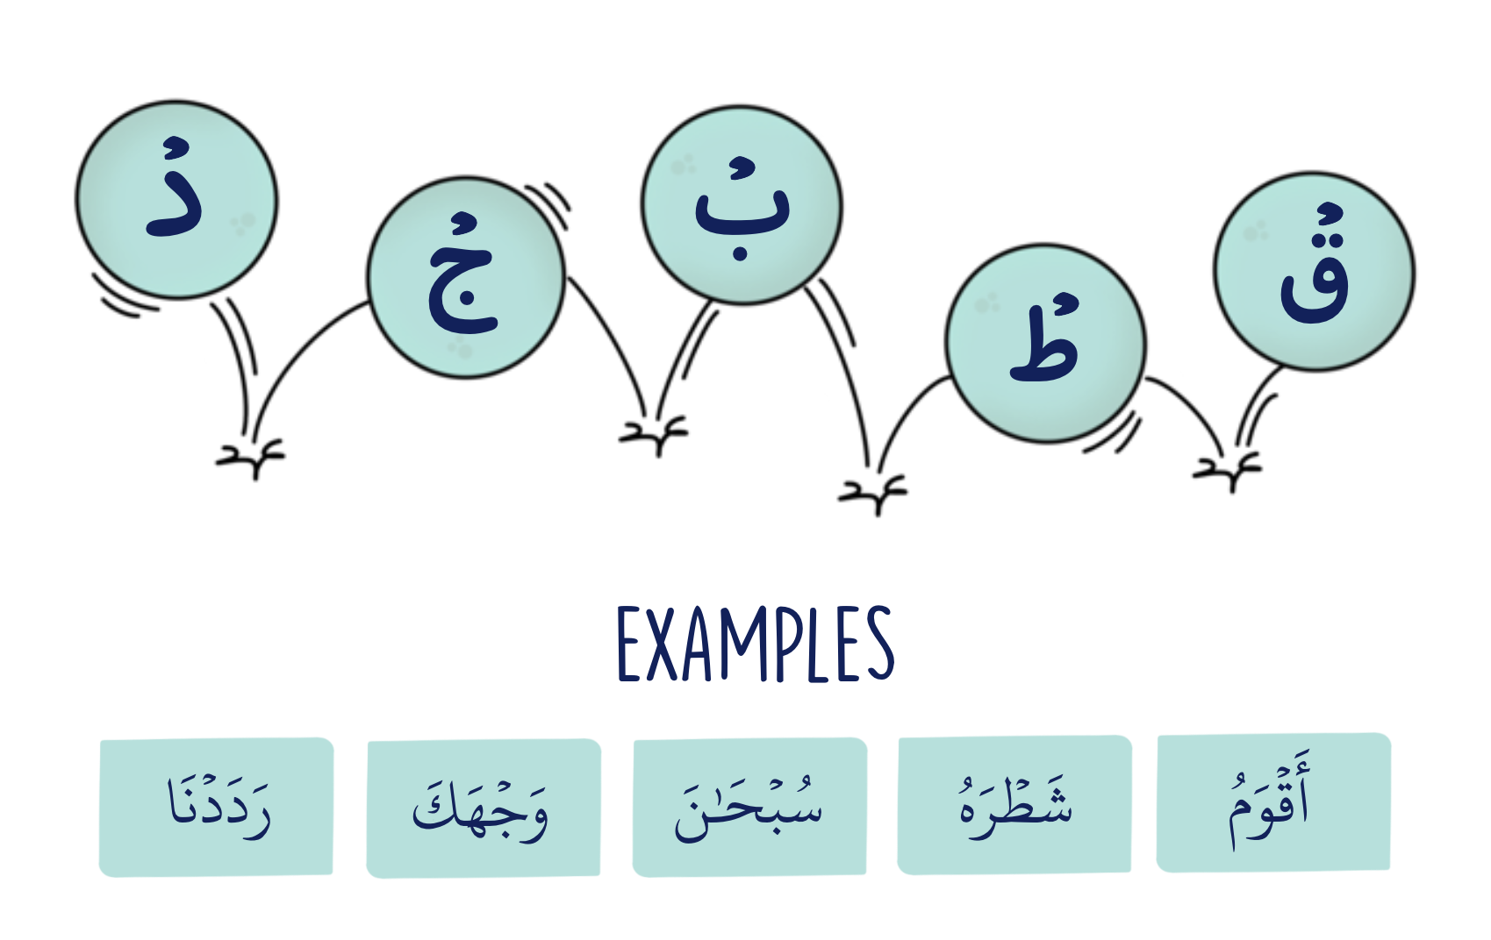

Slide 5
In order to remember the meaning of these letters of Qalqalah, you can recall the constituent phrase Qutb Jad. These five letters have the characteristic of al-Jahr – preventing the flow of air when pronouncing them – and the shid – preventing the flow of sound when pronouncing them.
It is only noticed on Horoof Qalqalah when they have Sukoon. In the case of a vowel, it is pronounced normally without a gurgle or an echo-like sound.

Slide 6
Types of Qalqalah
Qalqalah Kubra (Strong Echoing):
at the end of an Ayah.
2- Qalqalah Wusta (Medium Echoing):
at the end of a word in the middle of an ayah.
3- Qalqalah Sughra (Light Echoing):
in the middle of a word whether at the beginning, middle or end of an ayah

Slide 7
Strong Qalqalah (Kubra)
This type has severity and comes at the end of the verse. Qalqalah becomes strong when the word is at the end, it has a intensity, the last word drops, so you say it with Qalqalah.
You may notice that the last letters that require Qalqalah are not with Sukoon! However, pausing at the end of each verse is preferable, and so in such circumstances you should do a strong Qalqalah.

Slide 8
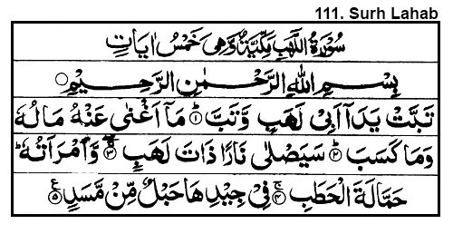

Slide 9
Medium Qalqalah (Wusta)
Qalqalah is intermediate or medium when the letter that appears at the end of the word does not have a Shadda. It does not matter if the letter contains an original Sukoon or not. These words are read in clear voice of Qalqalah.

Slide 10
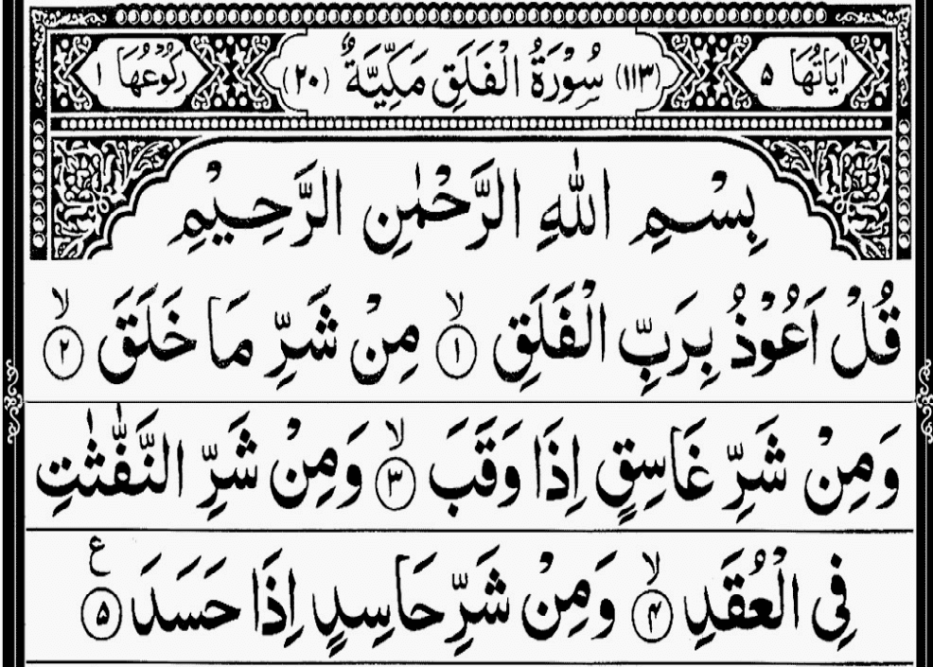

Slide 11
Weak Qalqalah (Sughra)
Qalqalah is weak if it is in the middle of the recitation. Qalqalah letters often appear in the middle of a word or have Sukoon at the top. But, when the reader decides to continue, a weak Qalqalah occurs as the reader quickly moves on to the next letter.

Slide 12
