Slide 1
LEARNDROID
Group 6
Iteration 2

Slide 2
What is Learndroid?
> An upgraded front end to the Moodle Learning Management System.
> Addresses some usability issues for students in Moodle:
- Having to access each course individually to see recent updates.
- No common place which displays grades received in all courses.
- Difficulty in searching a another user.

Slide 3
Use cases
> View Notice Board.
> View Courses.
> View Grades.
> Search User.

Slide 4
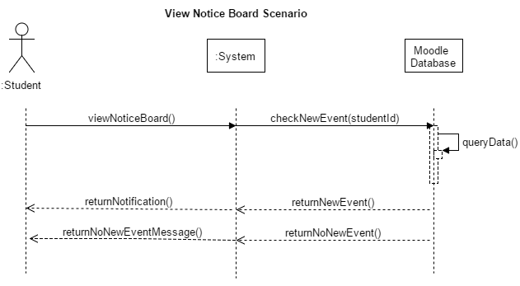
Use case 1: View Notice Board

Slide 5
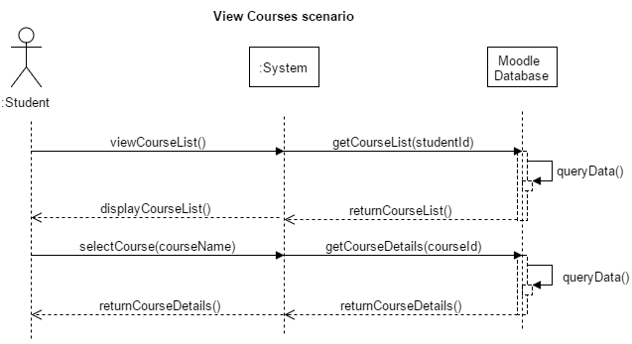
Use case 2: View Courses

Slide 6
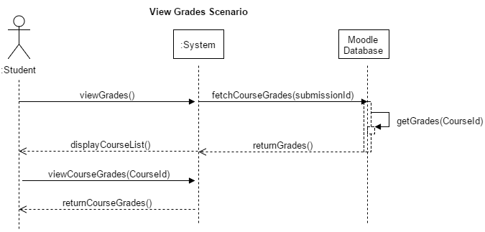
Use case 3: View Grades

Slide 7
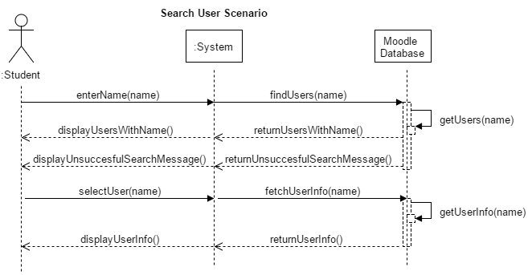
Use case 4: Search User

Slide 8
List of conceptual classes
View Notice Board
User
Course
Forum-Post
Submission
Event
Quiz
URL
File
View Courses
User
Course
View Grades
User
Submissions
Quiz
Course
Grade
Search User
User
Role
Users

Slide 9
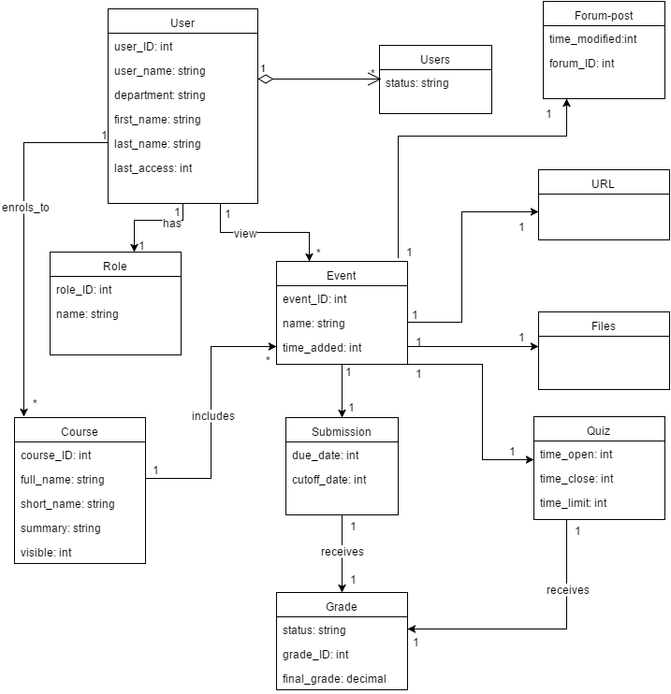
Domain Model

