Slide 1
MongoDB Schema Design Strategies and Scaling
WASAText Case Study
Database Systems Project
Case study based on the WASAText messaging application
Repository: https://github.com/malina15/WASAText-T3
By Malina Ispravnic, Group 311

Slide 2
Motivation
Modern messaging applications generate large volumes of semi-structured data and require high scalability and low-latency access. Traditional relational databases often struggle with these requirements. MongoDB, as a document-oriented NoSQL database, provides flexible schema design and horizontal scalability, making it suitable for analyzing messaging workloads.
System Overview
WASAText is a web-based messaging application developed as an academic project. The frontend is implemented using Vue and served through Nginx, while the backend is implemented in Go using the Gin framework. MongoDB is not used in production, but introduced exclusively for schema design evaluation and performance analysis.

Slide 3
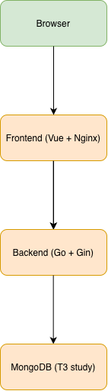
System Architecture
The diagram illustrates the runtime architecture of the WASAText system. User interactions are handled in the browser, requests are forwarded to the Vue-based frontend, processed by the Go backend, and persisted or analyzed within MongoDB for the T3 study.

Slide 4
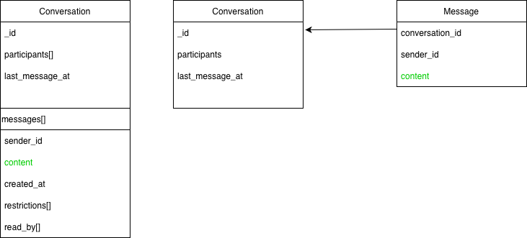
Data Model Design
Two alternative MongoDB schema design strategies are analyzed: embedded and referenced document models. The choice between these approaches affects query performance, document growth, and system scalability, especially in messaging applications with long-lived conversations.
The embedded model stores messages directly inside conversation documents, favoring read-heavy workloads. The referenced model separates conversations and messages into different collections, improving scalability for large datasets.

Slide 5
CRUD Operations in MongoDB
Create: insert conversations and messages
Read: inbox queries and message retrieval
Update: append messages and reactions
Delete: logical delete (soft delete)
Fully documented in mongodb-study/docs/crud.md

Slide 6
Benchmark Setup
A synthetic dataset was generated to simulate realistic messaging workloads. Queries retrieving the most recent conversations were executed using MongoDB explain() plans. Performance metrics were collected before and after creating indexes on relevant fields.
Benchmark Results
Before indexing, MongoDB performed full collection scans and in-memory sorting. After creating an index on the last_message_at field, query execution required fewer document scans and avoided blocking sorts, significantly improving latency.
Interpretation
The results show that embedded schemas are efficient for retrieving recent conversation data, while referenced schemas offer better long-term scalability. Indexing plays a crucial role in optimizing query execution for both approaches.

Slide 7
Aggregation Pipelines
Top users by number of messages sent
Most active conversations
Reaction type distribution
Aggregation pipelines and outputs documented in aggregations.md
Scaling Strategies in MongoDB
Indexing: demonstrated via query execution plans
Replication: 3-node replica set with automatic failover
Reaction type distribution
Sharding: design plan and justification (not implemented)
Sharding was not implemented due to complexity and time constraints; a detailed design and justification are provided.

Slide 8
Conclusion
MongoDB schema design must be aligned with application access patterns. Messaging systems benefit from embedded documents for fast reads, while referenced models and proper indexing are essential for scaling to large datasets.

