Slide 1

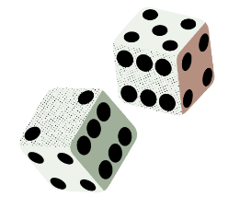


Turno
Break Cycles, Build Habits
Nazanin, Cecilia, Pedro, Malina

Slide 2


Content
01
04
About Us
Values in Design
02
05
Problem & Solution
Our Tasks
03
06
Market Research
Storyboard & Video

Slide 3

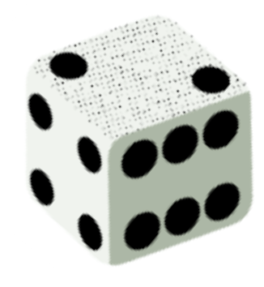
About Turno
A Randomized Task Prompter.
From the Portuguese word for shift, or round, and the idea of it being your turn. Turno. Your turn to roll the die and take agency of your life.
Notes:
Like when it’s your turn in a boardgame, turno lets you roll the die, making every moment your turn.

Slide 4
Break Cycles, Build Habits
Turno’s tagline embodies the problem we seek to solve & the solution we provide for our users

Slide 5

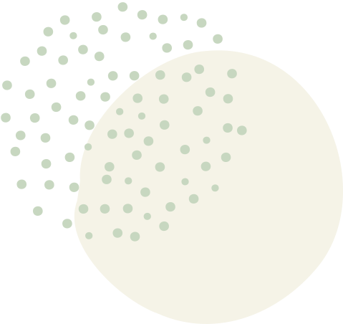

The Problem
There are daily obstacles preventing busy individuals from living an active lifestyle and accomplishing their goals — big or small.

Slide 6
The Solution
Turno allows users to input their activity goals, tasks to accomplish, & habits to build. Users roll a dice every morning to determine which of those tasks they should tackle that day, allowing them to overcome decision paralysis and establish long term habits.

Slide 7
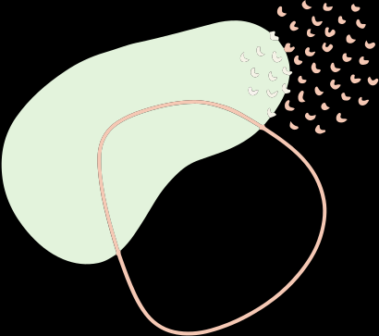
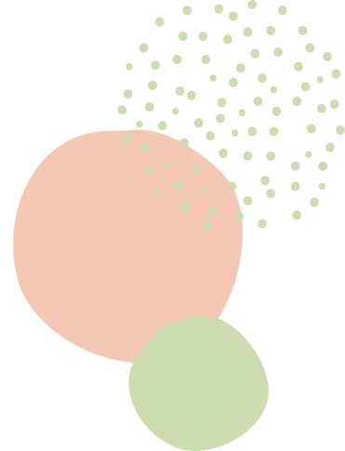
Market Research
Understanding similar products to our own

Slide 8

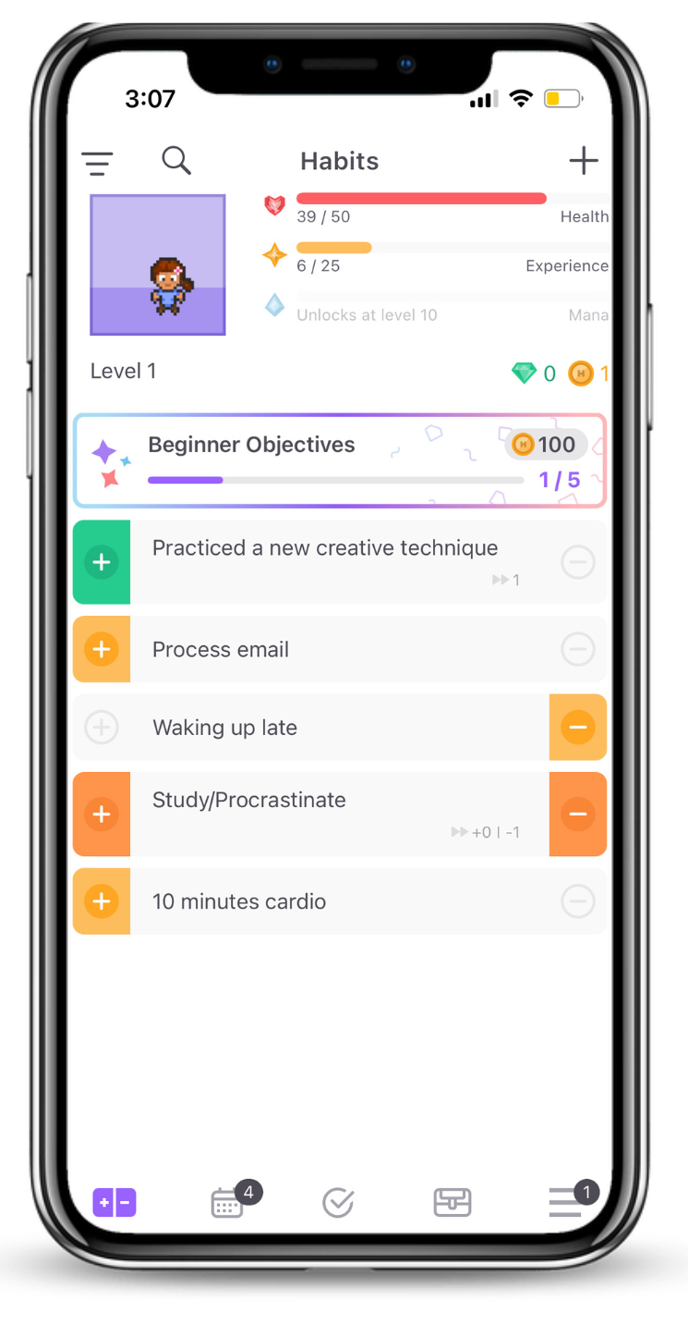

Habitica
Key Features
What Works
What Doesn’t Work
Avatar & collectibles
Health grows & shrinks as you complete or fail tasks
3 task types: Habits (to do or quit), Dailies (time sensitive tasks), To-Do’s
You can join/make a party to do “quests” & create challenges with friends
Customizable avatar makes app feel personal
Extrinsic motivation from watching avatar health rise & fall
Collectibles (pets for your avatar) & parties encourage consistent app use
UI is confusing, unintuitive
Time consuming to add tasks (name the task, assign difficulty, add tags, add time frame, etc)
3 types of tasks (habits, dailies, to-dos) are useful for organization, but it’s hard to know where to categorize certain things

Slide 9
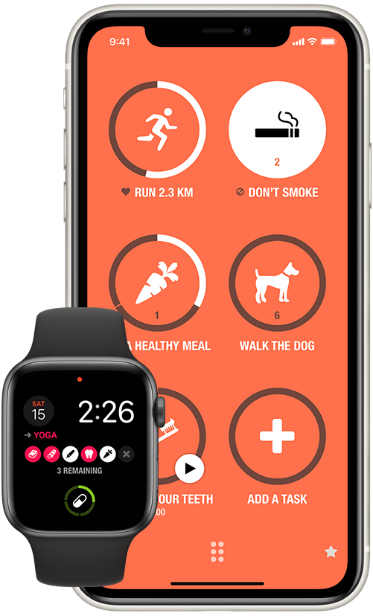
Streaks
Key Features
What Works
What Doesn’t Work
Habit-tracking capabilities; Pre-defined or custom habits.
Ability to link habits with health-related data from other apps.
Visual animations and progress reports.
Minimalist and intuitive interface
Motivating; chains of success.
Customizability
Integrates with the Health apps
Breaking streaks can be demotivating.
Customizability
Works on limited devices

Slide 10
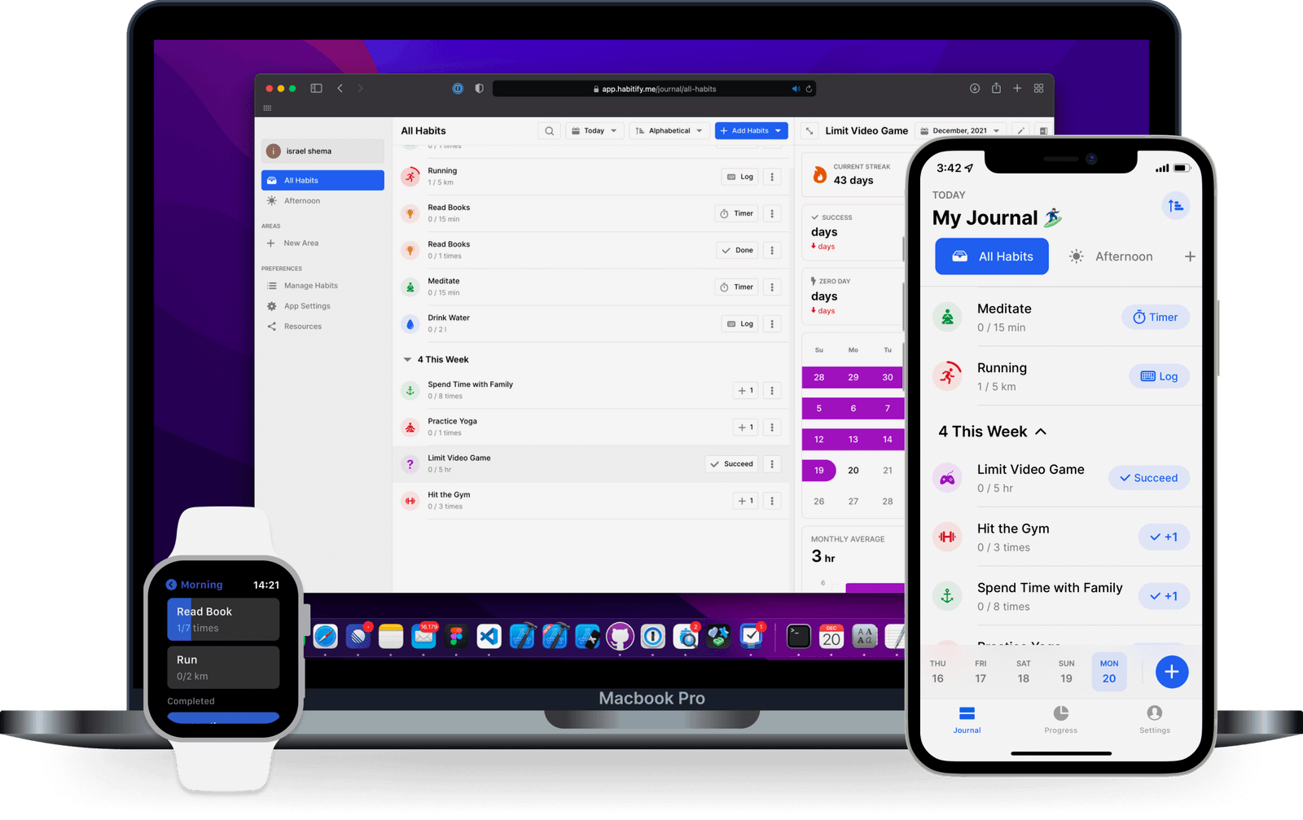
Habitify
Key Features
What Works
What Doesn’t Work
Schedules goals exercises
Built-in timer to keep track
Built-in notes to capture thoughts and mood
Syncs with Apple Health and calendars
Integrates with Google Fit
Offers friendly and monthly challenges
Tracking progress with metrics such as success and skip days, and milestone celebrations
“Clubs” and challenges with friends
Monthly competitions with reward systems
Accommodations with highly volatile schedules
UI is complex with lots of information
Timer and accountability (social and metrics) is intimidating

Slide 11
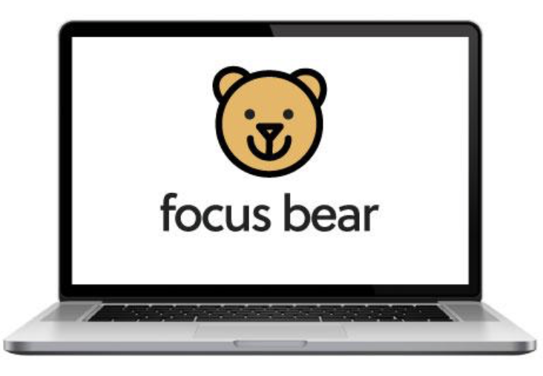
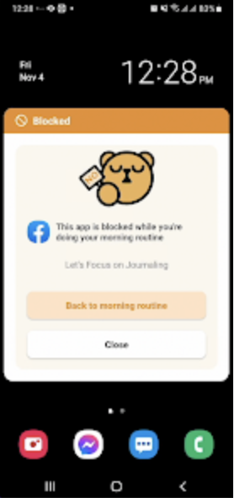
Focus Bear
Key Features
What Works
What Doesn’t Work
Curated for ND users.
Easy to use
Team is supportive/Effective troubleshooting.
Simple Applications/Extensions
Off-boarding is difficult (keeps user accountable)
No free version
Notifications can be confused for system errors
UI not great/too much text on the screen.
Onboarding takes quite a bit of time.
Not connected to calendars
Distraction Removal
Decision Fatigue Reduction
Routine Assistance
Timed Habit Routines
Productive Brain Breaks
Progress tracking
Motivation Enhancement

Slide 12
Market Research Conclusion
In some ways, Turno operates similarly to Habitica, Streaks, Habitify, and Focus Bear. We will take some inspiration from the captivating features of these apps, such as integrations, social elements, and gamification, while working to avoid the things that don’t work well, such as excessive tracking and competition.
Notes:
Also, we found interesting that some apps allows users to track negative habits that they want to stop. This indicates a lot of intentionality from the user’s part. We will look into that looking forward – how we can take that into account in our design. We also came across apps that have an off-boarding that’s complex and insistent. Can be interesting to help with accountability and motivation.

Slide 13
What Makes Us Unique?
Helps overcome decision paralysis: when overwhelmed by choices, a dice can make the decision simpler.
Novelty and fun: an element of surprise and game to make mundane tasks enjoyable.
Break monotony of routine and create variance and randomness.
Building intrinsic motivation, extrinsically.
Notes:
1. Extrinsic Motivation:
Extrinsic motivation refers to behaviors driven by external rewards such as money, praise, awards, etc. It's the motivation to act because of some external reward or the avoidance of some external punishment. Examples include working a job for a paycheck, studying to earn a good grade, or exercising to win a medal.
Advantages:
Can be very effective for short-term goals or tasks that are not inherently enjoyable.
Easier to implement, especially in workplace settings, since tangible rewards can be given.
Disadvantages:
May decrease intrinsic motivation if used inappropriately. This phenomenon is known as the "overjustification effect."
Can become less effective over time as people can get used to the rewards (habituation).
Might promote a mindset of doing things only for rewards, rather than personal satisfaction or interest.
2. Intrinsic Motivation:
Intrinsic motivation refers to behaviors that are driven by internal rewards. It's the motivation to act for the joy of the act itself, not for some external reward. Examples include reading a book for pleasure, playing a game because you find it fun, or studying a topic because you're curious.
Advantages:
Leads to more sustained, long-term engagement with activities.
Enhances creativity and problem-solving.
Often results in higher quality work or performance.
Disadvantages:
Harder to instill or cultivate, especially if a person doesn’t initially find an activity interesting.
Not always practical for every situation, especially in contexts where the task at hand isn't inherently interesting.
3. Decision Paralysis (or Analysis Paralysis):
Decision paralysis refers to situations in which an individual or group is unable to make a decision due to overthinking or overanalyzing available options. The more options available, the harder it can be to make a choice – this phenomenon is known as the "paradox of choice."
Relation to Motivation:
Overreliance on Extrinsic Motivation: When people are too focused on external rewards, they might overanalyze the best way to obtain those rewards, leading to decision paralysis.
Intrinsic Motivation as a Solution: If someone is intrinsically motivated, they may be less likely to become paralyzed by decisions because they're driven by personal interest and passion rather than an overwhelming array of external rewards.
Over-competitiveness: While healthy competition is beneficial, there's a risk that one friend might become too competitive, potentially straining in the relationship. Differences in Progress: If one friend consistently progresses faster or seems more successful in completing tasks, the other might feel discouraged or inferior. Dependency: There's a potential that friends might become overly reliant on each other for motivation. If one friend loses interest in the app or fails to complete tasks, it might demotivate the other.
Privacy Concerns: Sharing progress and tasks might make one friend feel exposed or judged based on their productivity levels or types of tasks.

Slide 14


Discussion
Stakeholders
Direct
Indirect
Users of Turno
Competitor solutions
Potential partners
(e.g. Google Calendar, Apple Health, FitBit, etc.)
Mentors, coaches, etc. people who used to hold users accountable…
User’s communities
friends, peers, employers, and those who will be exposed to the solution

Slide 15
Discussion
Values
Ethical Implications
User Autonomy and Consent
Stakeholder engagement
Impacts of task randomization on the psychology of habit formation.
Motivation crowding: mixing extrinsic motivation (e.g. rewards, streaks) with intrinsic motivation of habits.
Competition and social accountability for daily tasks and activities.
Balanced Engagement; understand use to avoid over-reliance.
User autonomy; flexibility and adaptability of tasks
Equity and Accessibility
Pricing & Monetization
Well-being and Mental Health
Environmental/Community impact
Notes:
Tarot cards brainstorming: If two friends use your product, how could it enhance or detract from their relationship?
Enhance:
Shared Experience: If the dice suggests a similar task for both friends, they could choose to do it together, fostering a mutual motivation. Accountability Partners: Knowing that someone else is aware of your goals can increase commitment. The friends can serve as accountability buddies, motivating each other to stick with tasks and celebrate their accomplishments. Healthy Competition: The streaks and progress aspect can lead to friendly competition. For instance, if one friend has a longer streak of completed tasks, it might motivate the other to catch up. Discussion and Reflection: After completing tasks, friends can share their experiences, discuss challenges, and give each other feedback. This can lead to deeper conversations and strengthen their bond.
Detract:
Over-competitiveness: While healthy competition is beneficial, there's a risk that one friend might become too competitive, potentially straining in the relationship. Differences in Progress: If one friend consistently progresses faster or seems more successful in completing tasks, the other might feel discouraged or inferior. Dependency: There's a potential that friends might become overly reliant on each other for motivation. If one friend loses interest in the app or fails to complete tasks, it might demotivate the other.
Privacy Concerns: Sharing progress and tasks might make one friend feel exposed or judged based on their productivity levels or types of tasks.
How does your product change or create new ways for people to interact?
Virtual Cohesiveness: Even if friends or users are in different locations, they can still feel connected by doing similar tasks or sharing their progress.
New Conversations: Tasks assigned by the dice can become conversation starters. Friends might discuss tasks they've never talked about before.
Collaborative Challenges: Users could create group challenges, where they aim to complete a set number of tasks collectively in a given period.
Social Motivation: Users might be motivated to pick tasks they can do together or invite others to join the app, turning productivity into a social experience.
Integration with Other Platforms: Users could share their achievements or interesting tasks on social media, sparking interaction with a broader audience.
Does your product fill or change a role previously filled by a person?
Personal Coaches/Mentors: People rely on coaches, mentors, or peers to guide them, suggest tasks, or set challenges for personal or professional growth. Turno serves as a digital coach by randomly suggesting tasks and tracking progress.
Accountability People: Friends or colleagues often acted as accountability partners, reminding each other of tasks or pushing one another to stay motivated. The app's streaks and sharing features replicate this role, creating a digital system of accountability.
Decision Making: Many times, individuals might turn to friends, family, or colleagues when they're uncertain about which task to tackle next or when they're facing decision paralysis. The dice roll aspect of your app substitutes for this, providing a random decision and potentially reducing the cognitive load.
Social Interaction Catalysts: Traditionally, community leaders or event organizers might arrange social events or activities for groups to partake in together. With your app suggesting similar tasks to various users, it indirectly fills this role, potentially bringing people together for shared activities.
Journaling, Progress Tracking: People used to manually track their progress in diaries, journals, or planners. Some might even share their achievements with loved ones verbally. The app takes on this role by maintaining digital streaks and allowing for social sharing.
THE SIRENS:
What would using your product "too much" look like?
Over-reliance on the App for Decisions: If a user turns to the dice roll for every single decision, both major and minor, instead of prioritizing based on urgency or importance, they might be overusing the app.
Compulsive Checking: Continuously checking streaks, friend updates, or rolling the dice without acting on the tasks can indicate over-engagement.
Neglecting Essential Tasks: If users start neglecting crucial tasks or responsibilities because they're too engrossed in completing app tasks or maintaining streaks, that's a red flag.
How does your product encourage users to engage?
Gamification: The dice roll introduces an element of surprise and anticipation, making task selection fun. Streaks reward consistency, creating a game-like challenge. Social Sharing & Competition: Sharing progress and seeing friends' achievements can create motivation and a sense of community. Customizable Task Lists: Allowing users to input their tasks gives them control and a personal connection to the tasks they roll.
How does it make it easy to disconnect?
Set Limits: Introduce a daily limit on the number of rolls or a "cooldown" period after a certain number of rolls to prevent overuse. Do Not Disturb Mode: Allow users to set periods when they won't receive notifications, ensuring undisturbed times. Gentle Reminders: If a user is on the app for an extended period, send reminders about taking breaks or attending to other life tasks.
How does your product respect people's boundaries and the other parts of their lives?
Privacy Controls: Ensure that users can choose what they share and with whom. Not everyone might want their progress or task lists to be public.
Flexibility in Task Completion: Allow users to skip or postpone tasks without penalty, acknowledging that life can be unpredictable.
Educational Content: Provide occasional tips or insights about balanced usage, the importance of breaks, and not being overly reliant on the app.
In what situation might it be inappropriate or distracting to use your product?
During Work or Study: If users are prioritizing app tasks over essential work/study responsibilities, it's counterproductive.
Social or Family Gatherings: Rolling the dice or checking the app during social interactions can come off as rude or disengaged.
Safety Concerns: Engaging with the app while driving, walking in busy areas, or any other situations where full attention is required can be hazardous.
Emotional Dependency: If someone is using the app to avoid dealing with emotional or psychological issues, it might be inappropriate. It's essential to ensure the app doesn't become a form of escapism from real-world problems.
Informed Decision-making:
Description: Ensure that users understand the randomness behind the dice roll and the implications it has for their productivity.
Implementation: Include an explainer about how the dice mechanic works, and allow users to customize or constrain its randomness based on their preferences.
Respect for Time:
Description: Acknowledge that users' time is valuable. Ensure tasks generated fit into users' available time and energy.
Implementation: Allow users to set parameters on tasks (e.g., quick tasks vs. longer tasks) or filter out certain tasks when they're short on time.
Balanced Engagement:
Description: While regular use can boost productivity, over-reliance can lead to burnout or decision fatigue.
Implementation: App to encourage healthy breaks. Maybe after a certain number of rolls or tasks completed, suggest a break or different activity.
Protect User Autonomy:
Description: While the dice roll introduces randomness, users should always feel in control.
Implementation: Always provide an option to skip or reroll a task. Ensure users feel empowered, not controlled by the app.
Genuine Social Interaction:
Description: If users can share tasks or progress with friends, it should encourage positive social interaction and not foster competition to unhealthy levels.
Implementation: Prioritize features that allow collaborative tasks or shared achievements over competitive leaderboards. Encourage positive reinforcement among users.
Privacy First:
Description: Any social features should prioritize user privacy.
Implementation: Allow users to choose aliases, decide what they want to share, and with whom. No sharing should occur by default without explicit user consent.
Educate Without Patronizing:
Description: Provide information and tips on productivity without making users feel like they're being lectured.
Implementation: Offer optional, bite-sized tips or facts on productivity that users can access when they wish.
Flexibility and Adaptability:
Description: Recognize that not every day is the same. Users should feel the app adapts to their changing needs.
Implementation: Allow users to modify task lists easily, adjust settings based on day or mood, and provide feedback on tasks.

Slide 16
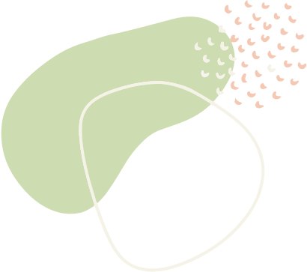
Tasks
Doing an activity you’ve been putting off.
This task is simple as it requires minimal initiative to complete a single activity that the user has been hoping to accomplish. The straightforward nature makes this a highly motivating and simple task. It is also the task most people will perform.
Receiving social positive affirmation.
This task is moderate as it requires engagement with the broader community, whether internally to the solution (through in-app social competitions and games) or externally (through acknowledgement of habits by community members), such as recognition of newfound habit efforts.
Establish a long term habit.
This task is difficult as requires continuous effort over time. It is iterative and requires consistent engagement with the solution in order to be accomplished.
Notes:
We have other tasks in our document of notes as well, such as the third task present in our video: Performing Tasks with others. Our total 4 tasks are
Simple:
Doing an activity you’ve been putting off
Medium:
Receiving social positive affirmation
Performing tasks with others
Hard:
Establish a long term habit

Slide 17

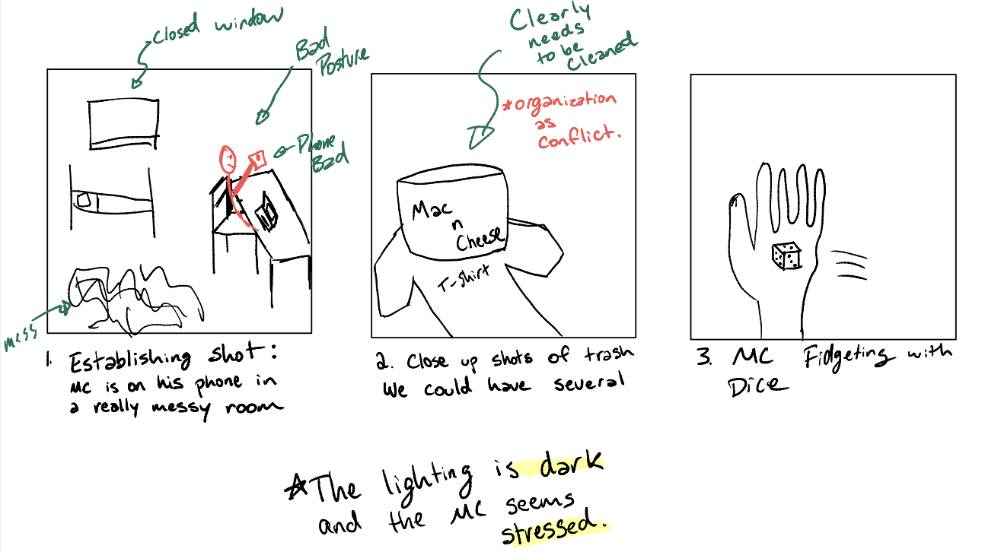
Storyboard

Slide 18
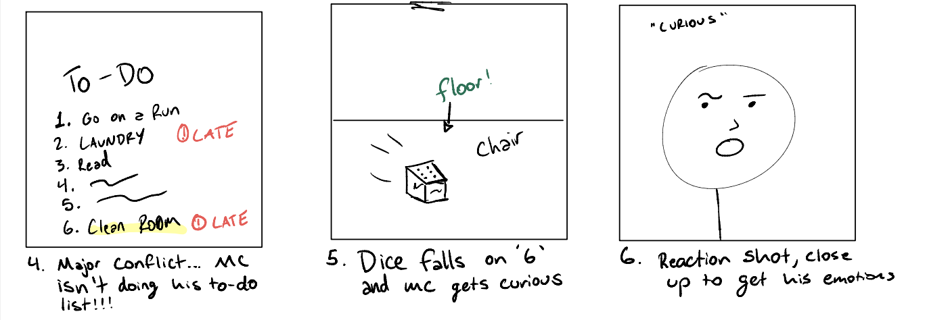

Slide 19
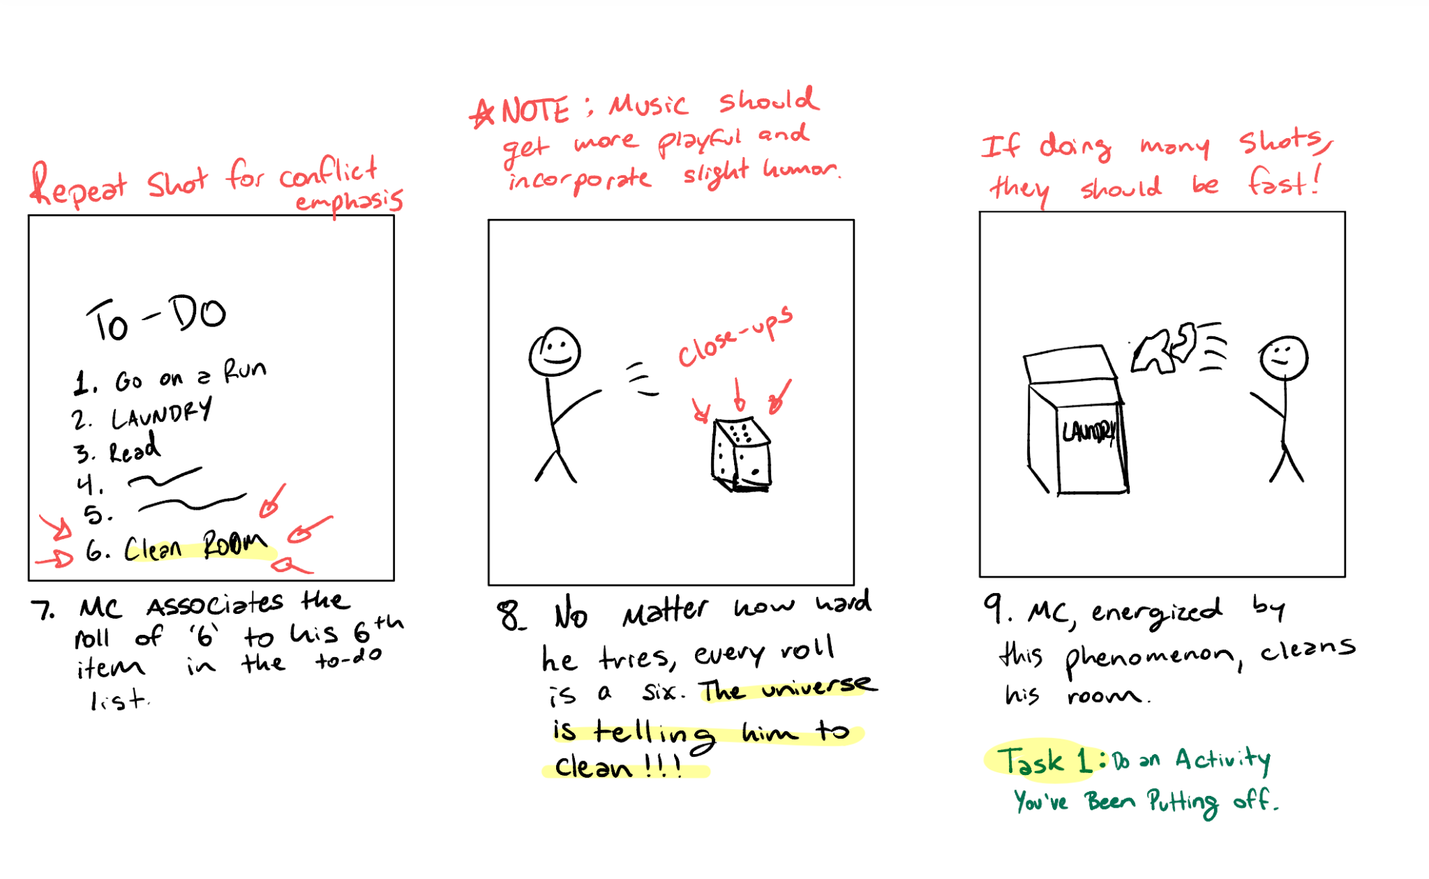

Slide 20
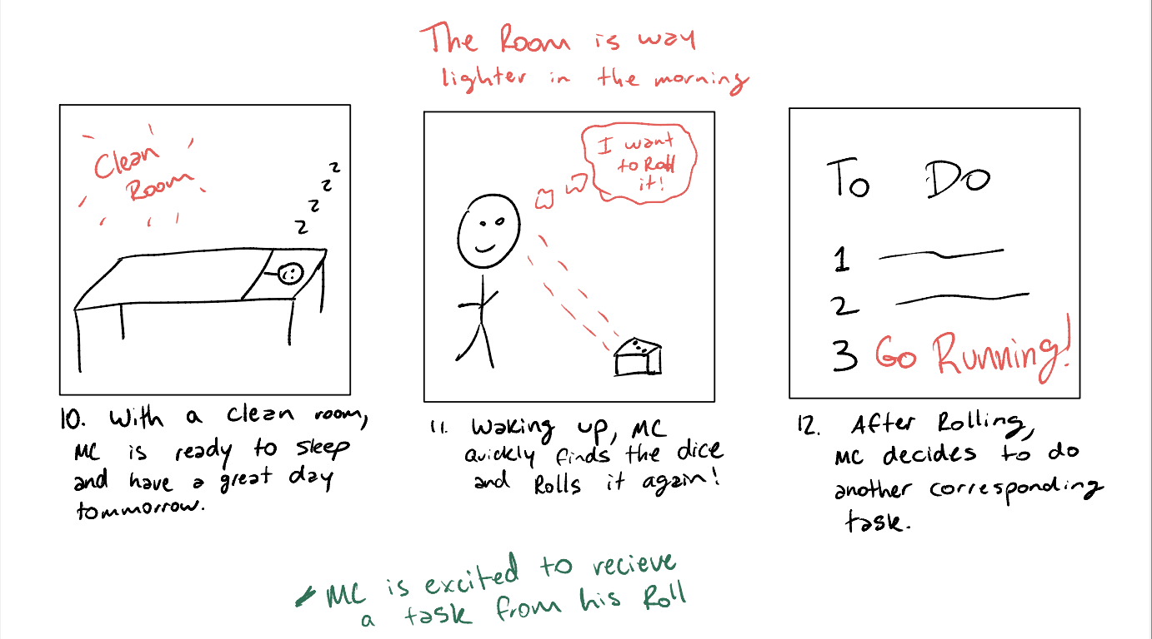

Slide 21
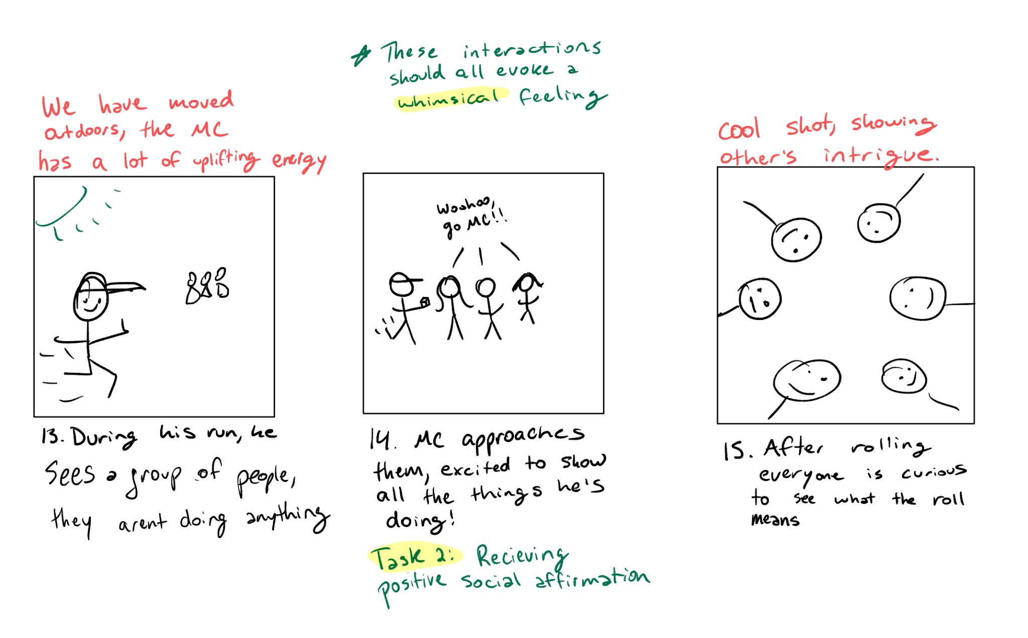

Slide 22
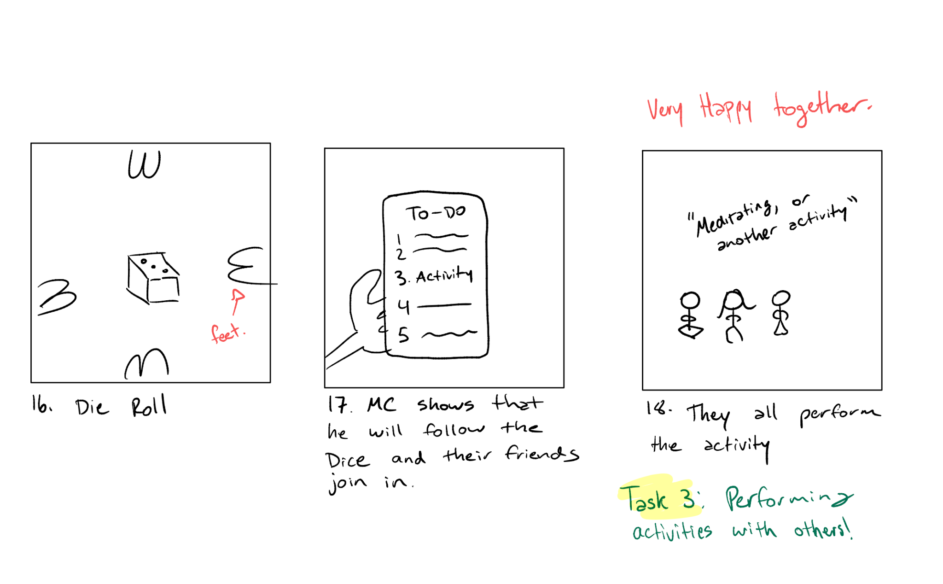

Slide 23
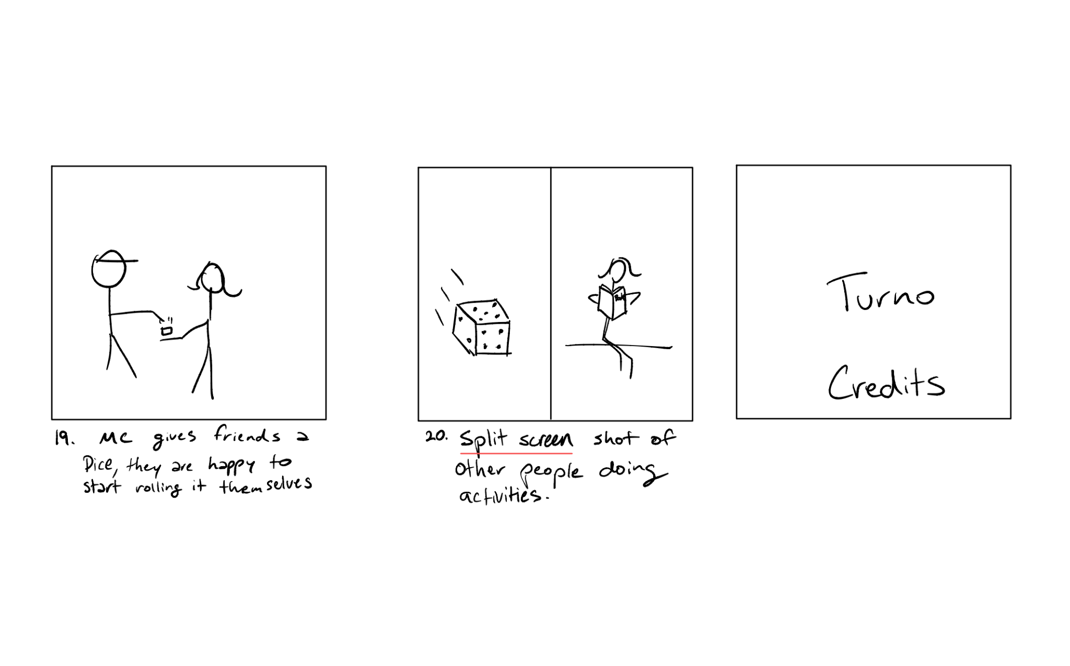

Slide 24
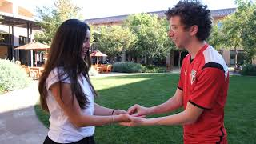

Our Video
Video Link HERE

