Slide 1
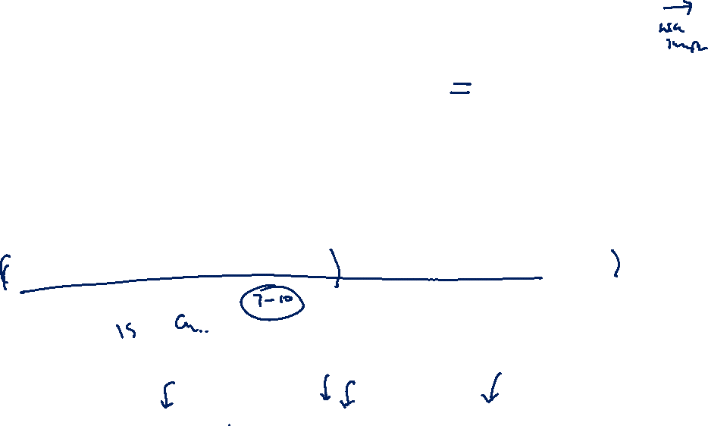

Practice thoroughly to ensure that each individual component is delivered within exactly 2 minutes.
AI-Based Multi-Modal Food Spoilage Prediction and Quality Assessment
Specialization: Information Technology (IT)
IT23348820 | Maddumage M. S. | J26-IT-333

Slide 2

AI-Based Multi-Modal Food Spoilage Prediction & Quality Assessment
Component 1 of 2: Research Problem, Gap, Proposed Solution & Objectives (J26-IT-333)
1. Research Problem & Impact
2. Proposed Solution & Research Gap
3. Component Research Objectives
The Problem in Restaurants:
• Food spoilage in perishable inventory causes massive food waste and financial loss in restaurant SMEs.
• Manual sensory inspection is inconsistent, subjective, and cannot detect early micro-decay.
• Delayed detection leads to health code violations, customer illness, and carbon emissions.
Limitations of Existing Systems:
• Standalone monitoring: either vision-only (surface) or IoT gas-only (chamber) — no fusion.
• Generic classification: binary 'Fresh vs. Spoiled' without quantitative remaining shelf-life.
• Single model used across all produce without category-specific biochemical profiles.
Our Multi-Modal Solution:
• Combines continuous IoT chamber sensing (Temperature, Humidity, NH3, CO2, VOC) with Computer Vision.
• 42-dimensional CV feature vector: color moments, biological pigment degradation (NDVI, anthocyanin), texture & morphology.
• Weighted Multi-Modal ML Fusion: Random Forest / XGBoost regressor & classifier.
The Research Gap Addressed:
• No existing restaurant system fuses environmental IoT and optical CV with food-category profiles.
• We introduce category-specific modeling for Fruits, Vegetables, Meat, Fish, and Dairy products.
• Predicts quantitative Remaining Shelf-Life (hours) with 90% confidence interval, not just binary status.
Main Research Objective:
Develop a predictive food spoilage detection system using IoT sensor data and machine learning to estimate remaining shelf-life in restaurant storage environments.
Component Tasks & Milestones:
1. IoT Sensor Module: ESP32 telemetry with DHT22, MQ-137 (NH3), MQ-135 (CO2), and SGP30 (VOC).
2. CV Quality Module: OpenCV surface analysis, pigment index extraction, ripeness stage & mould defect segmentation.
3. Category-Specific Models: Calibrated profiles across 47 produce species with 4-stage spoilage curves.
4. Multi-Modal Fusion Engine: Predict RSL hours, spoilage probability %, and 4-tier risk scores.
5. Dashboard Integration: Real-time REST API integration with alert threshold notifications.

Slide 3


AI-Based Multi-Modal Food Spoilage Prediction & Quality Assessment
Component 2 of 2: Technical Workflow, System Architecture & Prototype Contribution
System Workflow & Data Pipeline
User Requirements & Technical Novelty
1. Inputs (Heterogeneous Multi-Modal Streams):
• Vision: Food images (camera upload, ESP32-CAM stream) + food category label.
• IoT Telemetry: Temperature (°C), Humidity (% RH), NH3 (ppm), CO2 (ppm), VOC (ppm).
2. Processing Pipeline (<100ms inference on CPU):
• CV Engine: 42-dim vector (LAB/HSV color moments, NDVI, anthocyanin, Hu moments).
• Multi-Modal Fusion: 60% CV optical + 40% IoT microclimate weighting.
3. Intended Outputs:
• Quantitative Remaining Shelf-Life (RSL in hours) with 90% confidence interval.
• Spoilage Probability (%) & 4-Tier Risk Score: Low, Medium, High, Critical.
• Dynamic Storage Recommendations: adjust chiller temp/RH, prioritize for prep.
User Requirements Addressed:
• UR-1: Automatic produce species identification & ripeness verification.
• UR-2: Real-time risk alerts for kitchen staff prior to visible degradation.
• UR-3: Produce knowledge base with 4-stage spoilage progression for 47 species.
Key Technical Novelties:
1. Multi-modal sensor-vision fusion tailored specifically for restaurant storage microclimates.
2. Biological pigment index analysis (NDVI, chlorophyll degradation) beyond standard RGB.
3. Edge-deployable CPU-only ML pipeline (FastAPI + React + ESP32) without cloud GPU cost.
📸 Working Prototype Demonstration
[ SCREENSHOT PLACEHOLDER: Insert Actual UI Screenshots Here ]
• React 18 Vision Inspector with bounding boxes & pigment diagnostics
• Live ESP32 IoT Sensor Telemetry & Food Spoilage Risk Gauge
• Produce Encyclopedia modal with 47 calibrated fruits & vegetables
💬 Genuine User Feedback & Evaluation
[ USER FEEDBACK PLACEHOLDER: Insert Pilot Evaluation Feedback Here ]
• Feedback from restaurant kitchen managers, chefs, and inventory staff
• Qualitative review on alert usability, dashboard response time, and accuracy
• Documented user acceptance and operational recommendations for PP2

Slide 4
AI & IoT-Based Smart Restaurant Management System (J26-IT-333)
Commercialization, Market Feasibility & Environmental Sustainability (Overall Project)
Overall 4-Component Ecosystem: C1 Demand Prediction | C2 Kitchen Staff Optimization | C3 Food Spoilage (This Component) | C4 Smart Waste Bin
Customer Persona & Uniqueness
Market Size & Business Model
Sustainability & Cost Recovery
Customer Persona:
• Target: SME Restaurant Owners, Kitchen Operations Managers, Executive Chefs.
• Pain Points: 15–25% inventory loss from spoilage, inaccurate preparation quantities, unpredictable dining peaks.
• Goal: Minimize food waste, reduce ingredient costs, and maintain hygiene audit compliance.
What Makes Solution Unique:
• Unified Ecosystem: Demand forecasting, kitchen scheduling, spoilage prediction, and automated waste tracking on a single dashboard.
• Closed Feedback Loop: Spoilage & waste data feed directly back into purchasing models.
Market Opportunity:
• Global Food Waste Management Market: Estimated multi-billion dollar sector driven by sustainability mandates (SDG 12/13).
• [ PLACEHOLDER: Insert verified market size / TAM-SAM-SOM figures with formal citation ]
Commercialization Strategy:
• Tiered B2B SaaS: Monthly subscription per kitchen outlet (Basic, Pro, Enterprise).
• Modular IoT Hardware Kit: Low-cost plug-and-play ESP32 sensor pods sold at margin.
• API Licensing: White-label integration with existing POS & ERP restaurant systems.
Environmental & Social Impact:
• Environmental: Directly reduces organic waste in landfills, lowering methane/GHG emissions.
• Energy Efficient: Edge microcontrollers (ESP32) operate on ultra-low power.
• Social: Prevents foodborne illness by intercepting microbially degraded ingredients.
Cost Recovery for Restaurants:
• Direct Waste Savings: Target 15–20% reduction in food spoilage losses provides rapid ROI.
• Estimated payback period: 3–6 months based on average SME kitchen procurement savings.
• [ PLACEHOLDER: Insert formal financial payback projection table for PP2 ]

