Slide 1
CUSTOMER SHOPPING ANALYSIS
Customer Shopping Behavior
Business findings and recommendations from 3,900 customer records.
Notes:
This deck separates what the dashboard shows from what should be tested next. Revenue values read from chart gridlines are approximate; customer counts and dataset preparation figures are reported as supplied.

Slide 2
DATASET AND PREPARATION
3,900 customers, 18 attributes, one clean dataset
3,900 records across 18 columns, spread over 50 locations and 25 items, give a broad enough base to trust the patterns that follow.
50
25
4
Locations
Items
Clothing, Accessories,
Footwear, Outerwear
Only review rating had gaps: 37 missing values, filled with category medians.
Source: customer shopping dataset and dashboard
02
Notes:
The cleaning intervention was limited to review rating. Category medians filled 37 missing values; keep this imputation in mind when interpreting the average rating.

Slide 3
HEADLINE MEASURES
Headline KPIs: $59.76 average purchase, 3.75 average rating
$59.76
3.75 / 5
3.9K
Average purchase amount
Average review rating
Total customers
A $59.76 average purchase means each order is mid-sized, so lifting basket size is the quickest revenue lever; a 3.75 / 5 rating signals satisfied but not delighted customers, leaving room to improve experience before it limits repeat buying.
Source: customer shopping dashboard
03

Slide 4
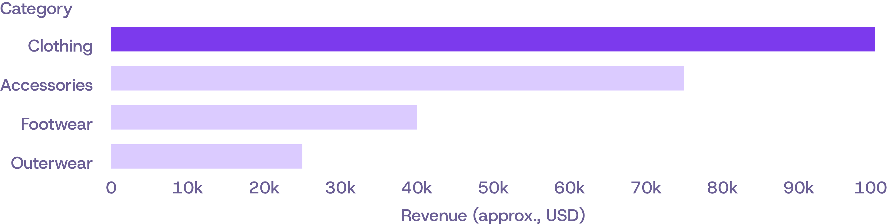
CATEGORY PERFORMANCE
Clothing carries revenue, and Outerwear lags far behind
Approximate revenue by category (USD), read from dashboard chart gridlines
Clothing earns roughly $100K; Accessories about $75K; Footwear about $40K; Outerwear about $25K.
Sales volume follows the same order. Clothing accounts for 1,737 purchases.
04
Notes:
The revenue attachment contains approximate readings, not exact transaction totals. The purchase-volume ranking agrees with the revenue ranking, strengthening the case for protecting Clothing and Accessories while testing an Outerwear lift plan.

Slide 5
AGE-GROUP PERFORMANCE
Young adults spend the most, but every age group is close
Young Adult leads with roughly $65K revenue and about 950 sales.
YOUNG ADULT
MIDDLE-AGED
ADULT
SENIOR
$65K
$60K
$55K
$55K
Roughly, in revenue
About, in revenue
About, in revenue
About, in revenue
A $55K–$65K spread means every age group is worth serving, so age alone is a weak targeting lever; use Young Adults for pilot offers.
Source: dashboard chart gridlines; all revenue figures are approximate
05
Notes:
These are aggregate revenues, not per-customer spending comparisons. Prioritise Young Adults for offer tests, but avoid excluding other age groups on this evidence alone.

Slide 6
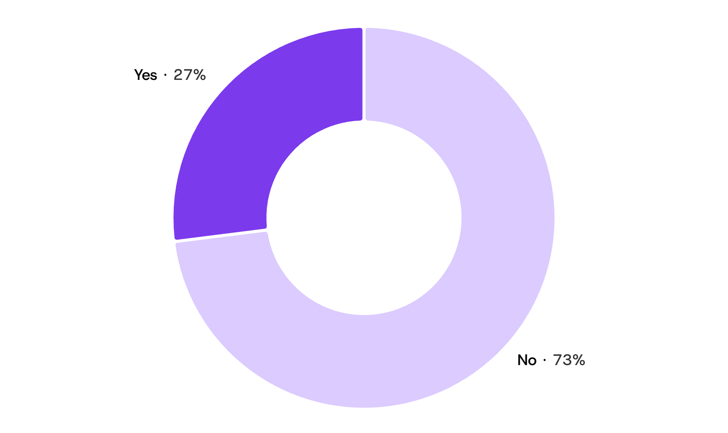
SUBSCRIPTION OPPORTUNITY
Only 27% of customers subscribe
27%
Only about one in four customers subscribes, so roughly 2,847 shoppers are an untapped base for recurring revenue; converting even a small share would add predictable income.
Non-subscribers are about 73% of the base.
Most common purchase cadence is every 3 months.
06
Source: customer shopping dashboard and dataset

Slide 7

DELIVERY PREFERENCES
Shipping: six options, with free shipping the most used
675
Free shipping is used on about 17% of orders, so customers value it, but its cost needs checking against any extra spend it drives.
Dashboard filters
Standard · Express · 2-Day · Next Day Air · Free Shipping · Store Pickup
07
Notes:
Free shipping is the most frequent single option, but accounts for about 17% of orders. Popularity alone does not show whether it increases purchase value; test that before expanding the offer.

Slide 8
PROMOTION USAGE
Discounts reach 43% of orders, driven by promo codes
43%
Nearly half of orders (1,677 of 3,900) use a discount, so margin is routinely traded for volume, and promotions need testing to prove they add spend.
Discount and promo code matched on every record, so they are one signal.
Source: customer shopping dataset
08
Notes:
Do not interpret discount applied and promo code used as separate explanatory variables in this dataset. Their exact match creates redundant information. The observed usage rate does not establish incremental spend.

Slide 9

RETURNING CUSTOMERS
Customers are loyal: 25 previous purchases on average
25.4
Customers have bought about 25 times before, so the base is highly repeat-driven and retention and loyalty perks are worth more than chasing new buyers.
PayPal is the top payment method.
68% of customers are male.
09
Source: customer shopping dataset · illustrative shoppers
Notes:
The previous-purchase measure describes a customer base with substantial purchase history. It is not a measured retention rate. Payment preference and gender composition describe the base; they do not explain loyalty by themselves.

Slide 10
ACTIONS TO TEST
Recommendations
Grow subscriptions: 73% are not yet subscribers
Protect Clothing and Accessories, and test a lift plan for Outerwear
Focus offers on Young Adults, the top spenders, without neglecting other groups
Test whether free shipping or discounts raise spend before widening them
Use the dashboard findings to prioritise tests, not to claim causal effects.
10
Notes:
Evaluate subscription conversion, category revenue and purchase value against the current baseline. Keep the tests separable so an observed change can be attributed to the offer being evaluated. The dataset describes associations; it does not prove that shipping or discount incentives cause higher spend.

