Slide 1

Case Study Analysis of Myntra Apparel
Presented by
Malini Roy Choudhury
Freelance Analyst | Data Enthusiast

Slide 2
Company Overview
Myntra is a leading Indian online fashion retailer, offering a wide variety of clothing, footwear, accessories, beauty products, and home decor. The company caters to diverse customer needs, from budget-friendly to premium products, and features popular global and domestic brands.
Myntra is known for its customer-centric approach to personalize the shopping experience and improve product offerings.

Slide 3
Challenges and Objectives
Challenges
Data Cleaning: Removing duplicates, standardizing the "DiscountOffer" column, and filling missing values (e.g.,"DiscountPrice" with category averages, "SizeOption"with "Not Available")
Data Analysis: Calculating average prices for high-rated products, counting products with discounts over 50%, and categorizing products as "HighDiscount" or "LowDiscount".
Product Lookup: Using VLOOKUP/XLOOKUP and INDEX/MATCH to retrieve product details (e.g., brand, price, rating) for specific product IDs.
Size Distribution: Identifying the number of products available in size "M".
Objectives
Clean and standardize the dataset, handling missing or inconsistent values.
Analyze pricing, discounts, and ratings to gain insights into product trends.
Classify products based on discount offers and count size-specific availability.
Use lookup functions to retrieve specific product details efficiently.

Slide 4
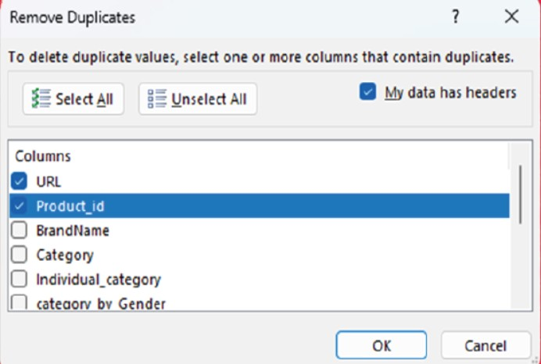
Data Cleaning and Preparation
Checking for duplicate values in dataset and removing them.
To check for duplicates in our dataset, we can ignore columns like Category,
Brand Name, Price, and Discount Offered, as they naturally repeat.
Instead, we will focus on the
Product ID column and URL,
which should be unique, and
identify any duplicate entries.

Slide 5
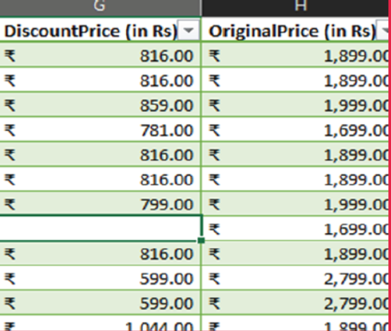
Data Cleaning and Preparation
Standardizing the "Discount Offer" column to single format, ensuring all values are uniform
Apply Formula Where Discount Offer = Original Price – Discount Price
We will need Discount % for our further analysis so we need to insert a new column titled “Discount %” and use formula
Discount % = Discount Offer / Original Price.
Make sure to convert it to % format.
Note:- Keep in Mind that the data also have
blank values in between so currently original
price would be reflected in Discount offer
column for blank values. Once we deal with
Blank values in our next step, they will be
replaced with our desired values.

Slide 6
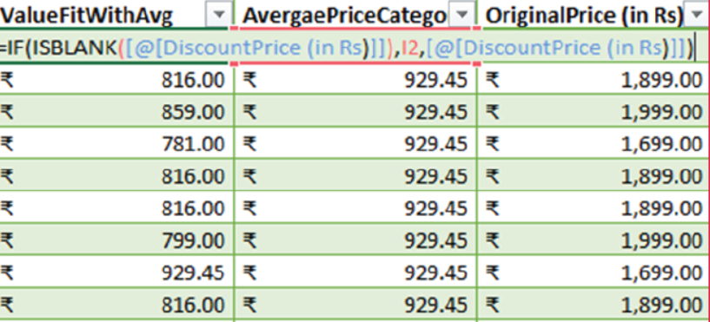
Data Cleaning and Preparation
Identifying rows where both "Discount Price“ and "Discount Offer" are null and fill the "Discount Price" with the average discount price of the respective category.
Replace Blank Values with Category Average: Using the AVERAGEIF function to calculate the average discount price for each category based on the Category column.
Formula Explanation: The AVERAGEIF function uses the Category column for the range, cell D2 for the criteria, and the Discount Price column for the average range to compute the average discount for each category.
Apply IF and ISBLANK Functions:
Use a combination of IF and
ISBLANK functions to replace
blank values in the Discount
Price column with the calculated
Average for the respective category.

Slide 7
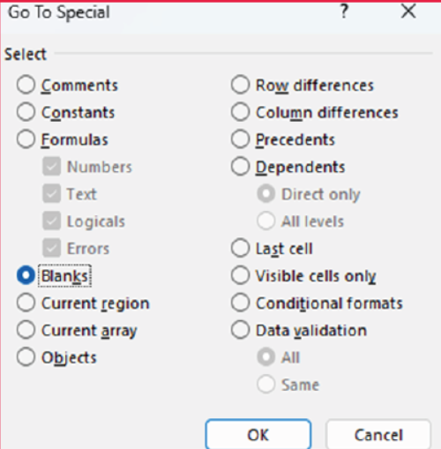
Data Cleaning and Preparation
Replace all null values in the "SizeOption" column with the text "Not Available".
Identify Null Values: Press F5, select "Go To,“ then choose "Special" and select "Blanks" to find null values in the "Size Option" column.
Replace Nulls: Enter "Not Available" and press Ctrl + Enter to replace null values with the intended text.
Validate: Confirm that no null values were found
and replaced, as needed.

Slide 8
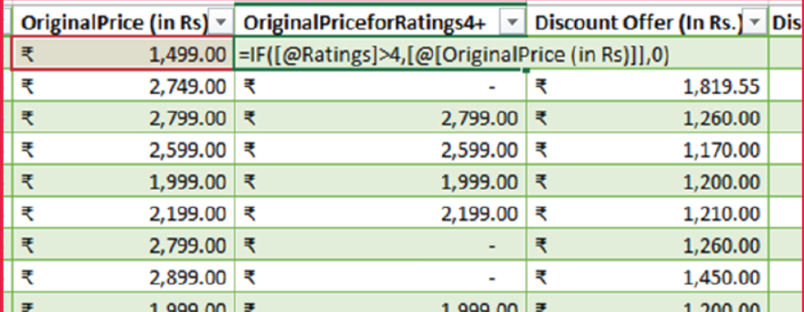
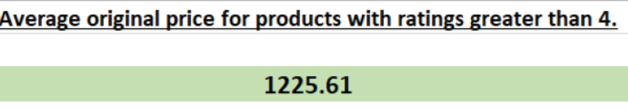
Data Analysis
Calculate the overall average original price for products with ratings greater than 4.
Insert New Column: Add a column titled "Original Price Average for 4+ Ratings."
Apply Logical Formula: Use an IF
function to display the
"OriginalPrice" if ratings are
greater than 4, otherwise show 0.
Calculate Average: Use the
AVERAGE function to compute
the average of these values, then
round it to 2 decimal places.

Slide 9
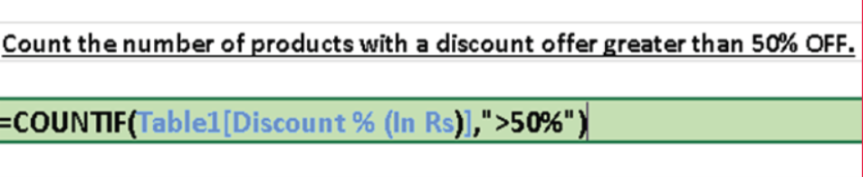
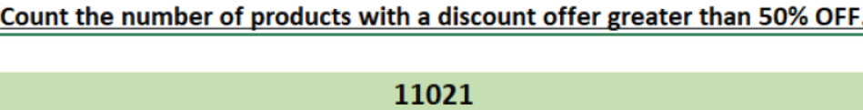
Data Analysis
Count the number of products with a discount offer greater than 50% OFF.
Count Products with High Discount: Use the COUNTIF function to count products where the discount percentage exceeds 50%.
Apply Formula: Enter the formula=COUNTIF(Table1[Discount% (In Rs)],">50%") to count products with a discount greater than 50%, ignoring others.

Slide 10
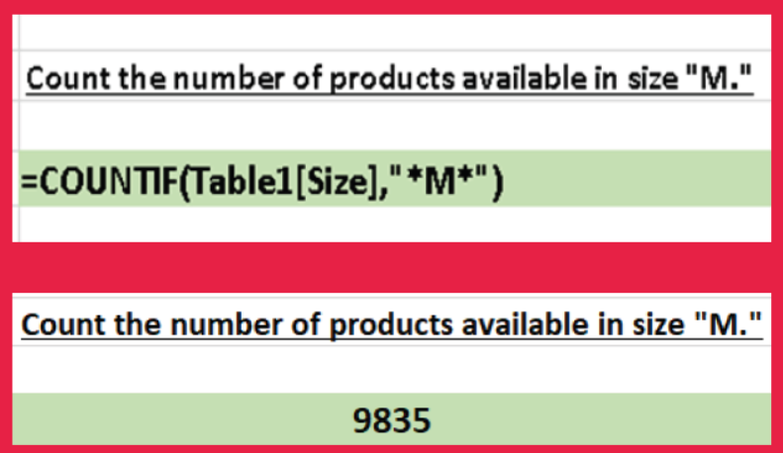
Data Analysis
Count the number of products available in size "M ".
Count Products with Specific Character: Use the COUNTIF function to count products that contain the character "M" in their descriptions.
Apply Formula: Enter the formula=COUNTIF(Table1[Size],"*M*") to count cells containing the character "M" anywhere in the text.
Note: The asterisk (*) acts as a wildcard, allowing the COUNTIF function to match "M" even when it’s part of a larger text string.

Slide 11
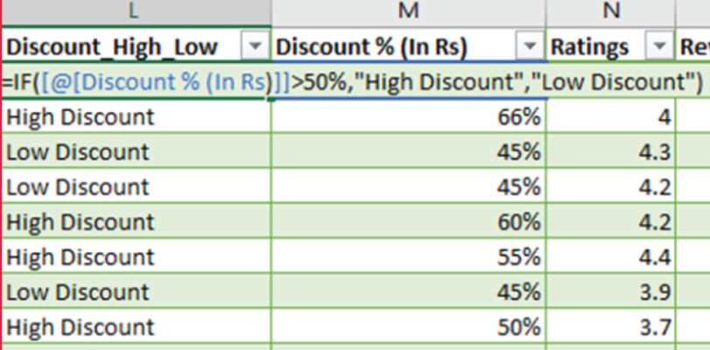
Data Analysis
Create a new column to label the products as "High Discount" if the discount offer is greater than 50% OFF, otherwise label them as "Low Discount."
Create New Table: Set up a new table named "Discount_High_Low" to categorize discounts as High or Low.
Apply Logical Formula: Use the IF function with the formula =IF([@[Discount % (In Rs)]]>50%,"High Discount","Low Discount") to label discounts based on the percentage.
Formula Explanation: The formula checks if the discount is greater than 50%. If true, it displays "High Discount"; otherwise, it shows "Low Discount".

Slide 12
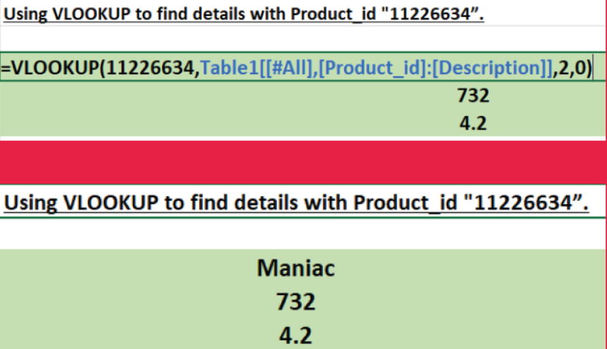
Data Retrieval and Lookup
Use VLOOKUP/XLOOKUP to find the product brand,price, and rating of the Product with Product_id "11226634".
Apply VLOOKUP: Use =VLOOKUP(11226634,Table1[[#All], [Product_id]:[Description]],2,0) to retrieve the Brand Name for Product_ID 11226634 (column index 2).
Modify Column Index: Change the column index (e.g., 10 for price, 13 for rating) to fetch other details for the same Product_ID.
Formula Function: VLOOKUP searches the
first column for the Product_ID and
returns the value from the specified
column in the same row.

Slide 13
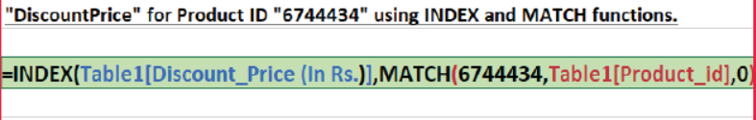
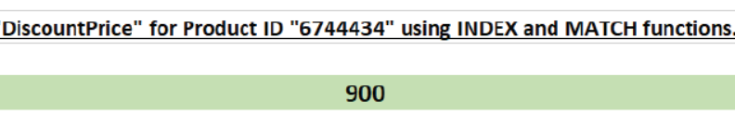
Data Retrieval and Lookup
Find the "DiscountPrice" for the product with the Product ID "6744434" using the INDEX and MATCH functions.
Apply INDEX and MATCH: To find the Discount Price for the Product_ID, use a formula combining INDEX and MATCH.
Formula:=INDEX(Table1[Discount_Price (In Rs.)],MATCH(6744434,Table1[Product_id],0))
INDEX Function: The INDEX function returns the Discount Price from the specified range based on the row number found by the MATCH function.
MATCH Function: The MATCH
function searches for the
Product_ID (11226634) within
the Product_ID range and
returns the row number where
it’s found.
Exact Match: The "0" in the
formula ensures an exact
Match when looking up the
Product_ID.

Slide 14
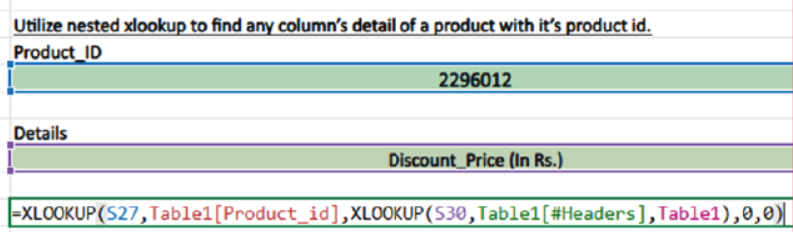
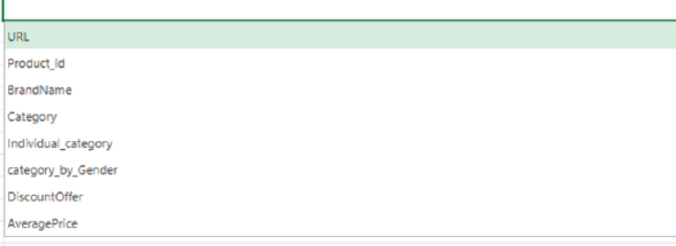
Data Retrieval and Lookup
Utilize nested xlookup to find any column’s detail of a product with it’s product id.
Create Data Validation: Set up data validation for a cell to allow users to choose from column headers (e.g., Brand, Price, Rating) in a dropdown list.
Apply Nested XLOOKUP: Use the formula =XLOOKUP(S27, [Product_ID Range], XLOOKUP([Header Choice], [Detail Range], [Result Range])) to retrieve details based on the selected
Product_ID and column header.
Formula Explanation: The first
XLOOKUP searches for the
Product_ID (from cell S27) in the
Product_ID range.
The second XLOOKUP searches
for the column header choice within the
details range, returning the
corresponding value.

Slide 15
👗 Thank You
Myntra Apparel Data Analysis
Presented by Malini Roy Choudhury Freelance Analyst | Data Enthusiast
Empowering insights through clean data and smart decisions.

