Slide 1
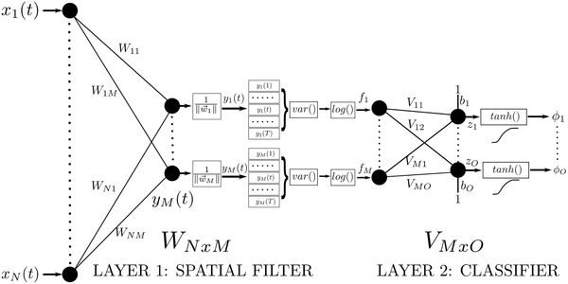

Fig 1. Structure of the proposed spatial filter network (SFN).
Yuksel A, Olmez T (2015) A Neural Network-Based Optimal Spatial Filter Design Method for Motor Imagery Classification. PLOS ONE 10(5): e0125039. https://doi.org/10.1371/journal.pone.0125039
http://journals.plos.org/plosone/article?id=10.1371/journal.pone.0125039

