Slide 1
SE-115 Project Report
Muhammet Ali Ökan 20230601057
Section-5

Slide 2
07/12/2024
I created classes (City, CountryMap, WayFinder) and I learnt how to use text files. I get text file’s location from the user by using Scanner class.By using FileReader class and BufferedReader class together, I created an object called reader. By using while loop I printed all the lines on the screen to see is it work or not.

Slide 3
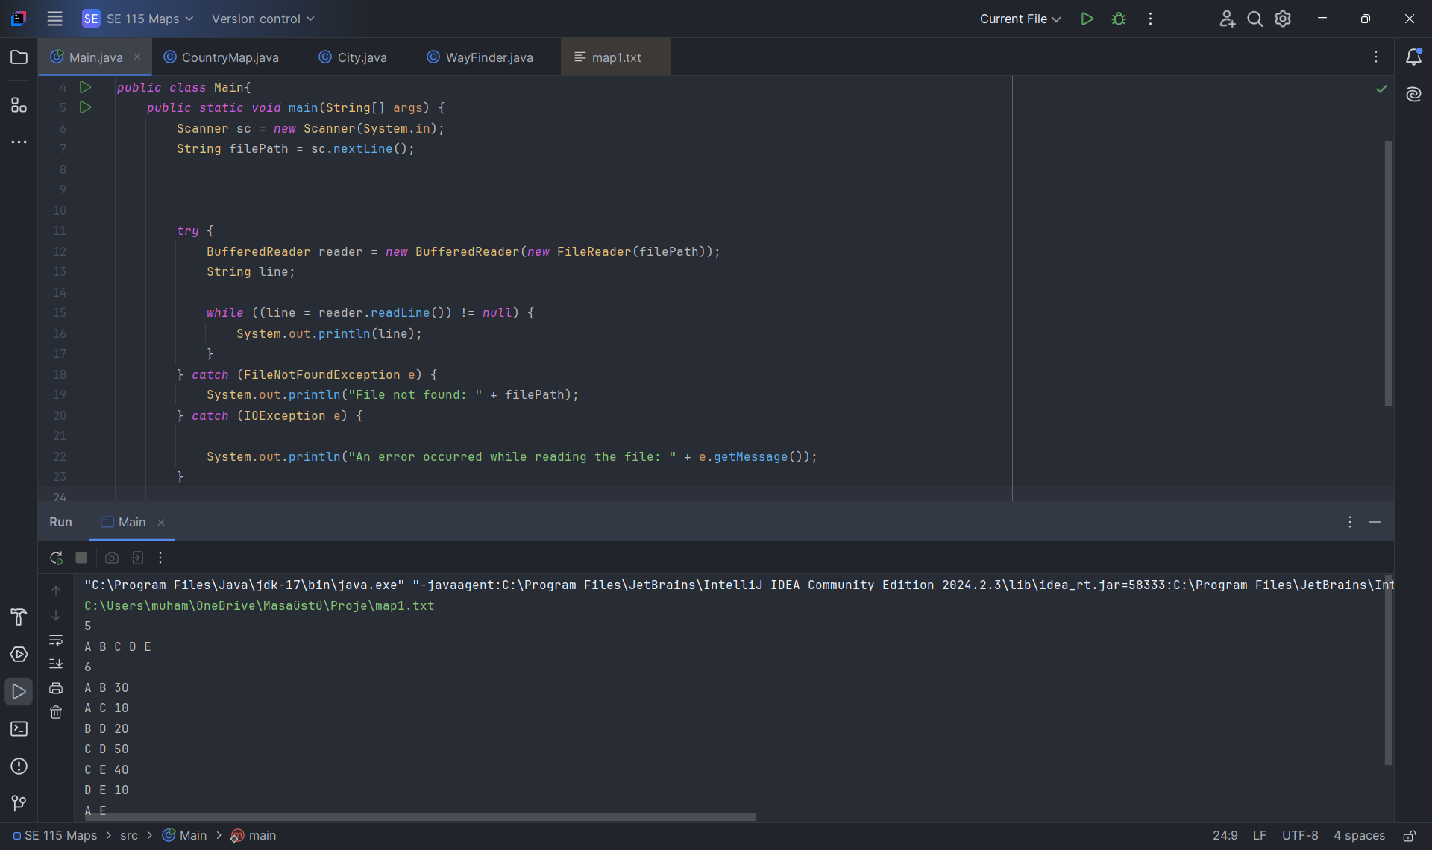

Slide 4
09/12/2024
I learnt how to read text file line by line and I stored all the values

