Slide 1
SE-115 Project Report
Muhammet Ali Ökan 20230601057
Section-5

Slide 2
07/12/2024
The classes (City, CountryMap, WayFinder) were created, and working with text files was learned. The text file's location was obtained from the user using the Scanner class. An object called 'reader' was created by combining the FileReader and BufferedReader classes. All the lines were printed on the screen using a while loop to check if it was working properly.
The try-catch structure was used so that potential errors could be caught by the program.

Slide 3
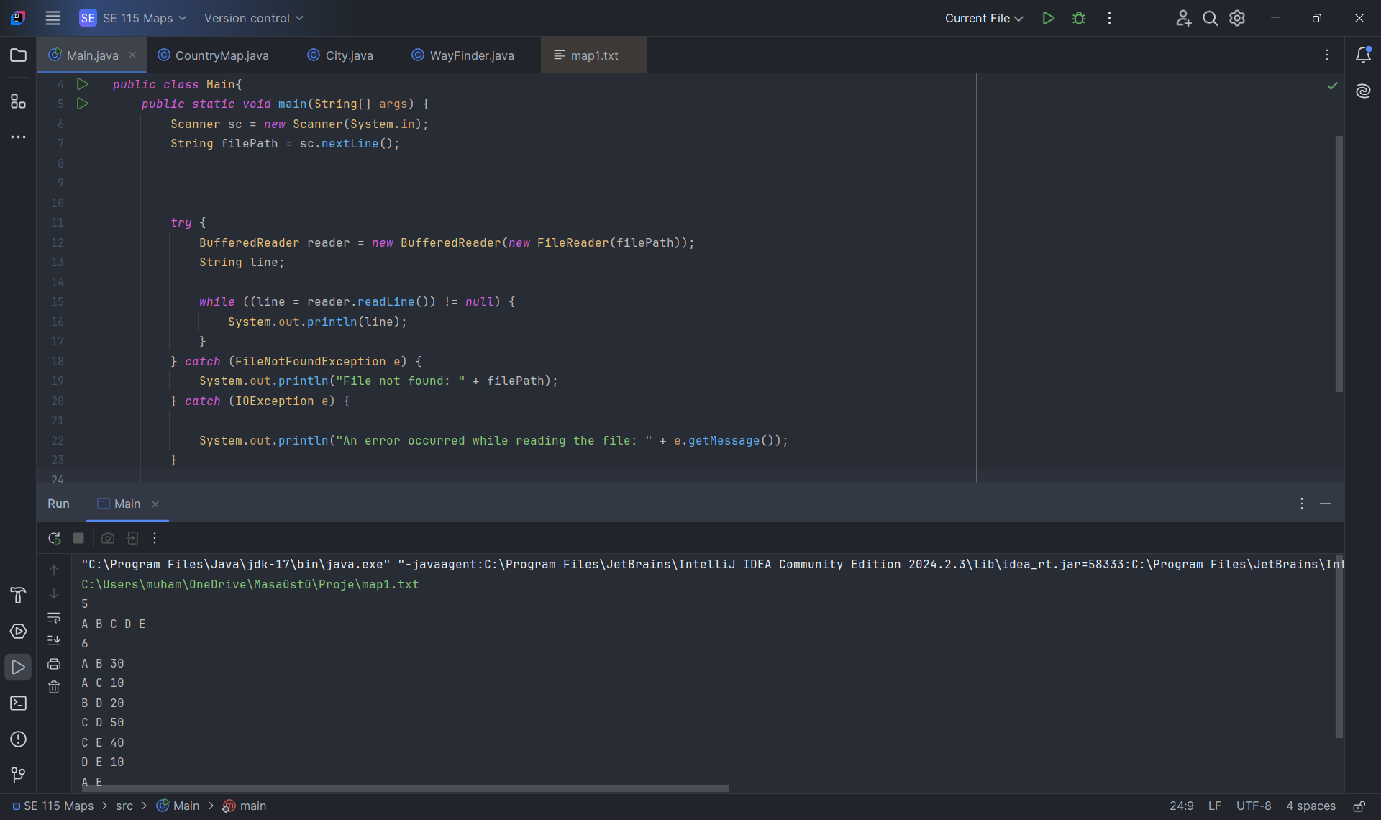

Slide 4
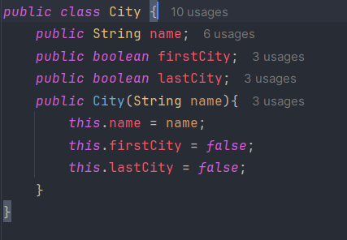
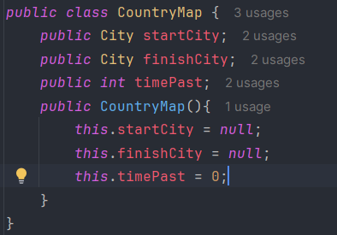
11/12/2024
The City and CountryMap classes have been implemented.

Slide 5
11/12/2024
After the entire file was read, some significant changes were made. The text file was chosen to be read line by line, and the values were stored separately.
.split(“ “) method have been used to separate the values based on spaces.
Some necessary values were printed on the screen to verify whether the program works properly.
The text reading process has been completed.

Slide 6
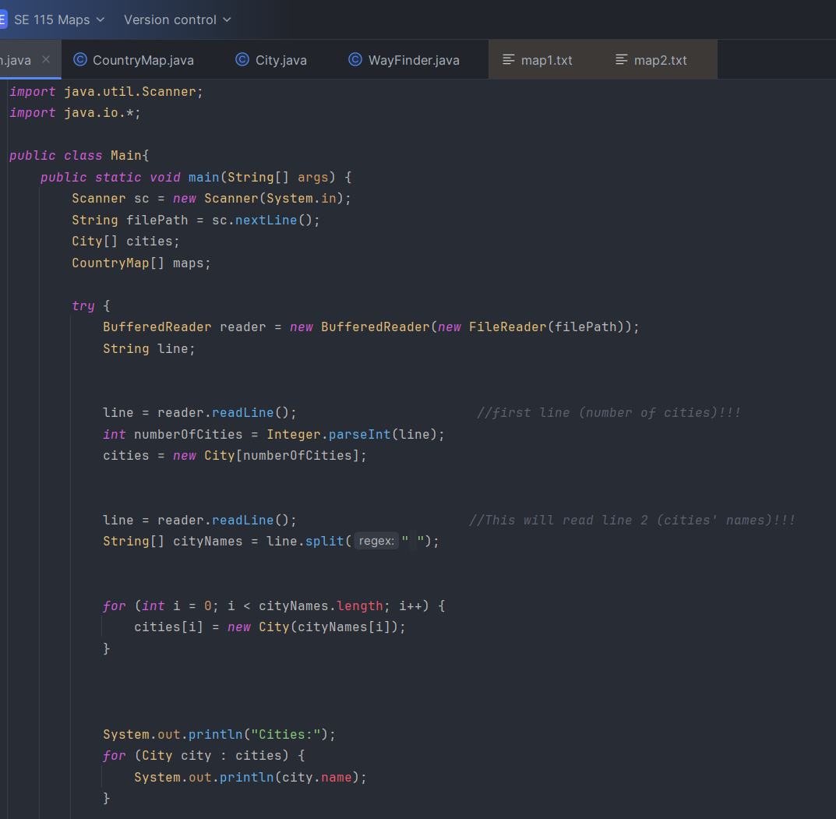
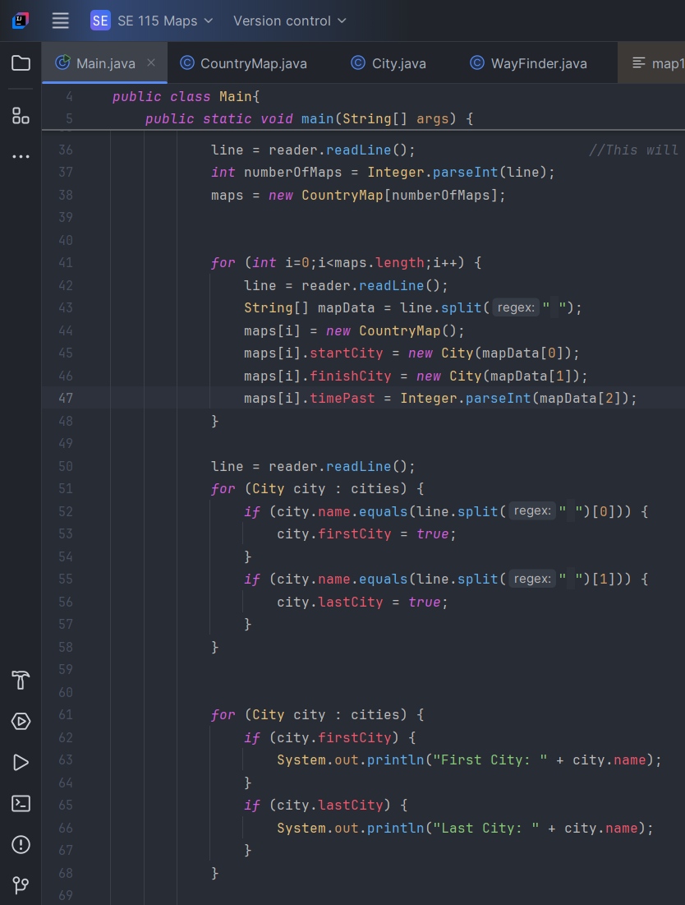

Slide 7
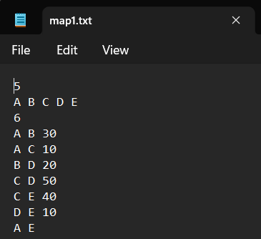
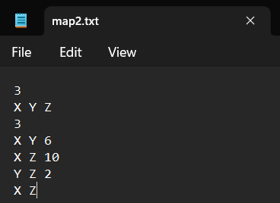
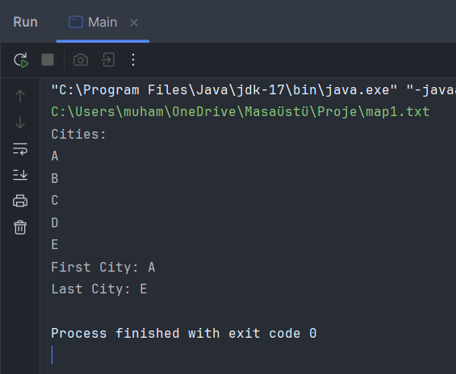
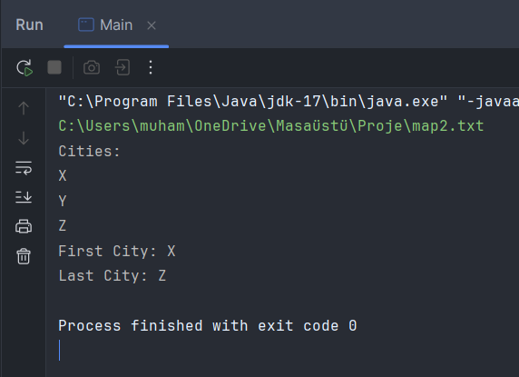

Slide 8
15/12/2024
Significant changes were made to the code after the issues encountered during the definition of the WayFinder class.
The text reading process was initially implemented in the Main class, which resulted in the class becoming overly complex and difficult to manage.
Then, the text reading process and all other functions related to the input were implemented in the CountryMap class.

Slide 9
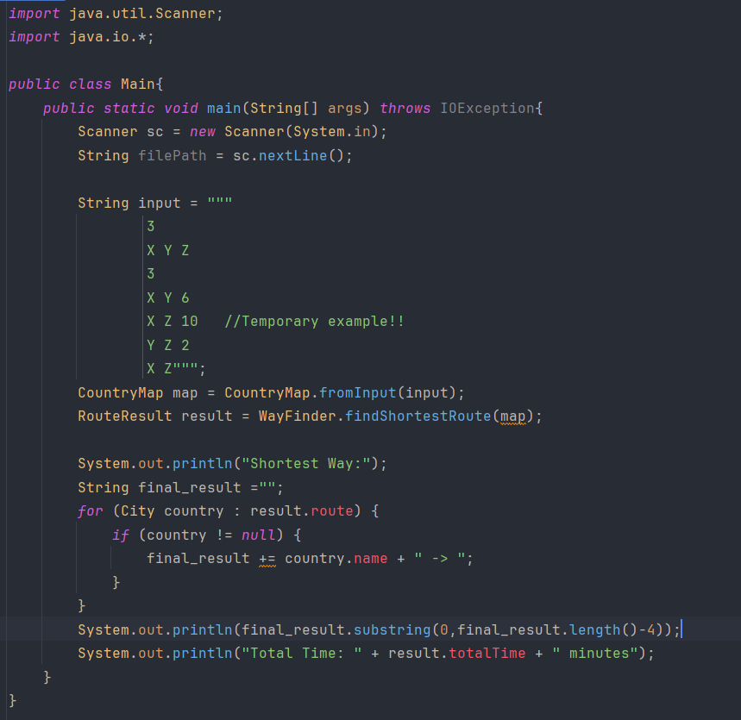
Main Class
“Throws IOException” means the method might throw an IO Exception that must be handled.
This is used to obtain the file path from the user (not used in this example).
A temporary input was used to verify if the code was functioning correctly.
City, CountryMap and WayFinder classes and their methods were used here.

Slide 10
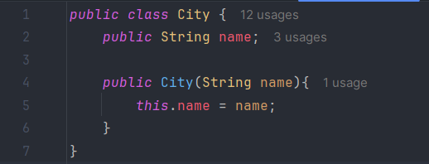
Class attribute
Constructor Method
City Class
String name stores the city’s name.
Constructor assigns the name to the “name” property.
The 'this.' keyword is used to differentiate between a class attribute and its parameter value.
The purpose of this class is to model and organize cities' data for structured storage, easy access, and efficient processing.

