Slide 1

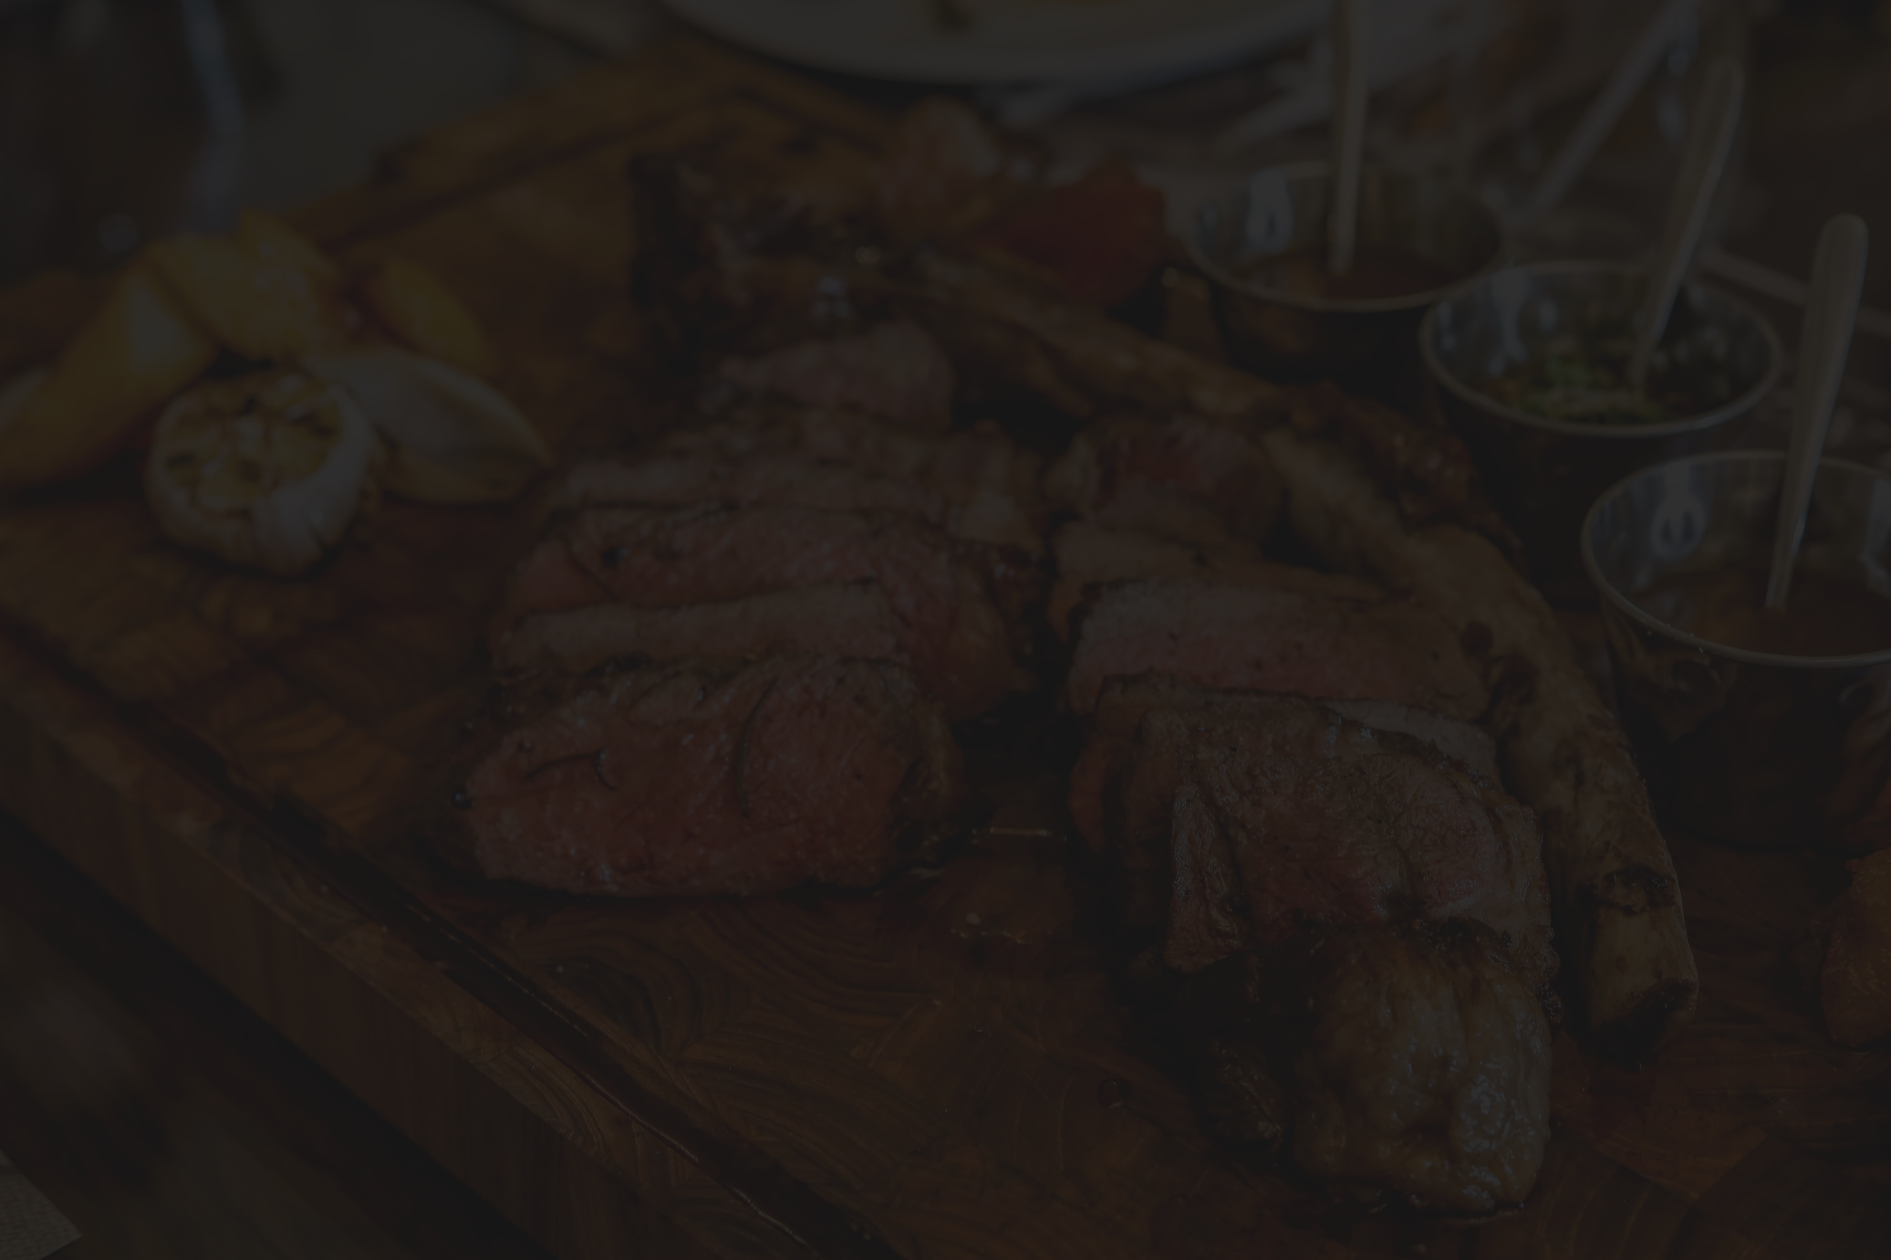


Discover Your Next Favorite Eatery : Restaurant Recommendation
Om Mali

Slide 2
Problem Statement
With the rising demand in the food industry, we aim to analyze a customer dataset comprising restaurants visited, reviews submitted, and ratings provided. Our goal is to develop a robust recommendation system leveraging this dataset. By understanding user preferences based on their history of likes, reviews, and ratings, we intend to recommend new restaurants that align with their tastes and enhance their dining experiences.

Slide 3
Dataset Review
The Yelp dataset comprises essential information about businesses and users within the Yelp platform. It consists of several distinct files, each providing specific details:
1. Business.json : Contains comprehensive business details such as business ID, name, address, location coordinates, star ratings, review counts, categories, and more.
2. Review.json: Provides data on individual reviews, including review ID, user ID, business ID, star ratings, and the review text itself. It contains 95013 records and 6 Features.
3. User.json: Includes user profiles with details such as user ID, name, review count, and average rating.

Slide 4
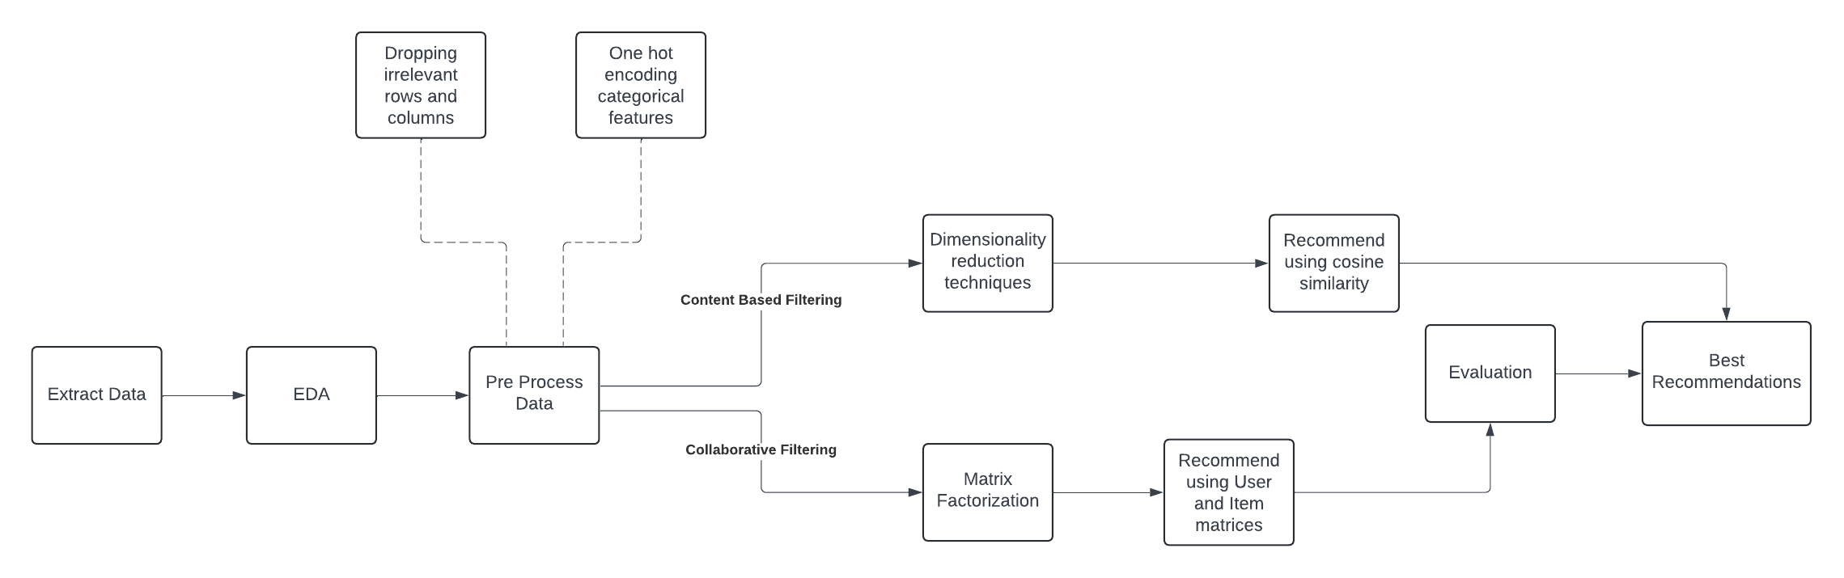
Flowchart

Slide 5
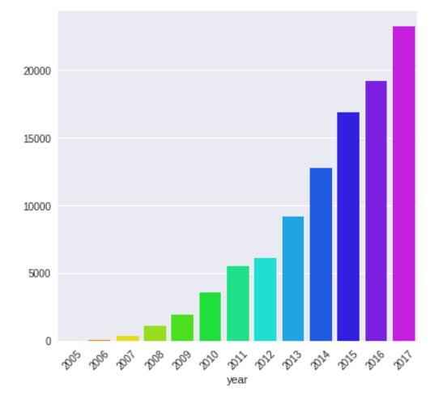
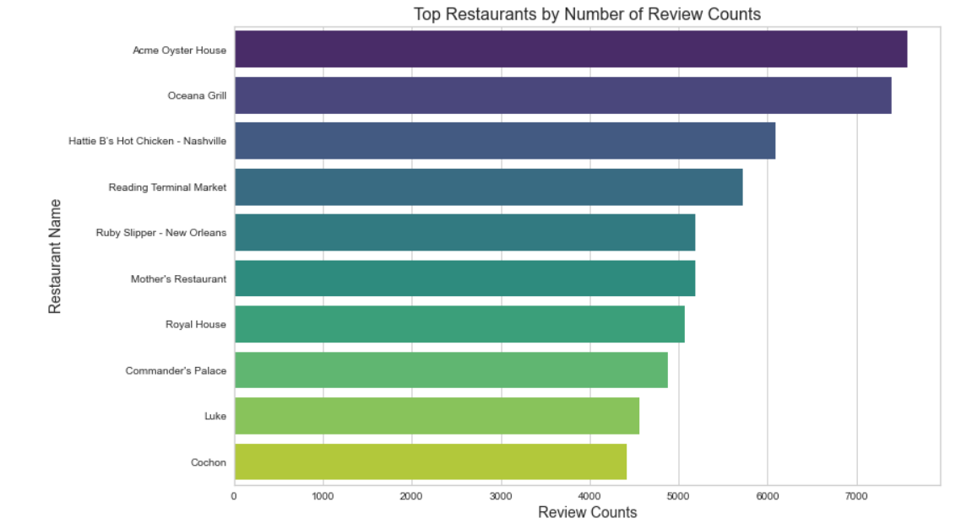
EDA
The figure illustrates a trend of increasing review counts over the years
Restaurants in decreasing order based on the number of review counts

Slide 6
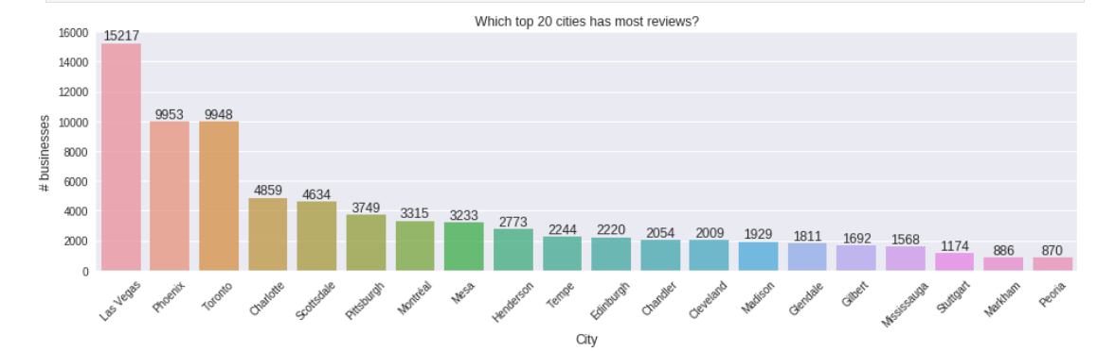
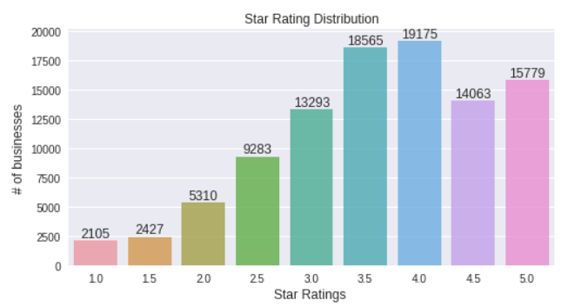
In typical scenarios, people are more inclined to leave reviews when their experience is either exceptionally positive or negative, leading to a potential bias in the dataset towards extreme ratings.
However, in this dataset, the reviews seem to cover a range of experiences without this typical bias, which can provide a more balanced perspective on the businesses or restaurants.

Slide 7
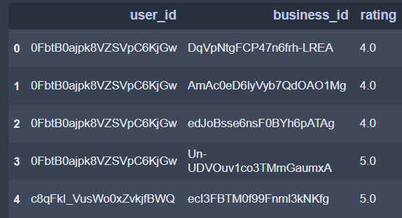
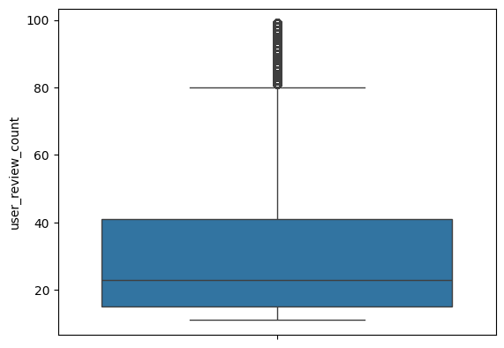
Collaborative Filtering
Reasons for using model based collborative filtering:
The dataset had a sparsity of 99.4% which makes it difficult to recommend using conventional methods.
Matrix factorization effectively manages large datasets.
Pre Processing Steps
Aggregate restaurant locations and data to represent restaurant chains as a single entity.
Remove users with a low number of reviews, as those with higher review counts are considered more valuable due to their greater contribution to the dataset.

Slide 8
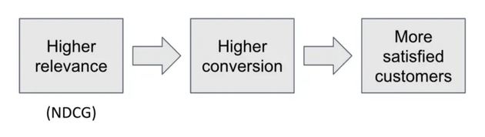
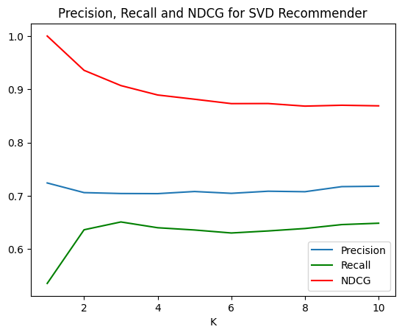
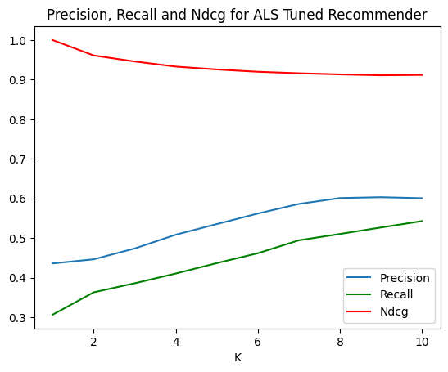
A threshold of 3.5 was determined through the eda process to identify relevant restaurants.
ALS model was the better model as it achieves higer NDCG while using fewer features and is better than svd at handling sparse matrices.
Baseline - SVD with 200 features
SVD with 100 features
ALS using 50 features

Slide 9
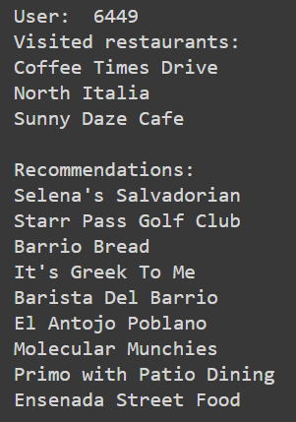
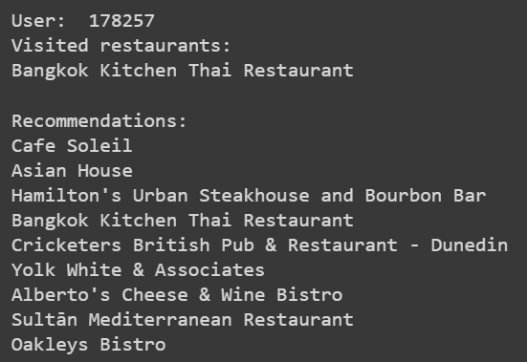
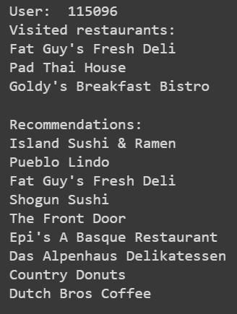
Problem !
Cold Start Problem

Slide 10
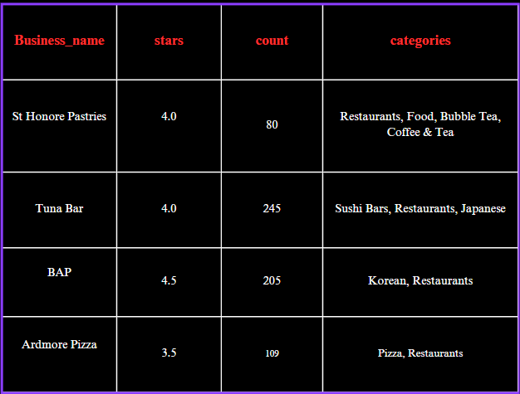


Content Based Filtering
Content-based filtering is a recommendation approach that utilizes item features or characteristics to suggest similar items based on user preferences.
Use ‘reviews’ dataset to find the similarity score for each restaurant
Crucial features include average_rating , review_counts,categories(~cuisine)
ONE HOT ENCODING
The categories column containing strings/objects was encoded using one-hot encoding to convert categorical data into numerical form.
As a result, approximately 30 new columns were added to the dataset, each corresponding to a distinct category present in the original categories column.
DIMENSIONALITY REDUCTION
PCA (Principal Component Analysis) was employed to reduce the dimensions of the dataset.
A graph was plotted to determine the optimal number of components.
After analysis, it was determined that using 20 components provided the best variance explained while reducing the dataset's dimensionality effectively.
FORMATTING THE TABLE
The original dataset contained multiple categories listed within the same row for each restaurant.
Some rows had inappropriate or inaccurate category entries, which were cleaned and corrected.
Additionally, certain rows had duplicate category entries for the same business, which were resolved during the data cleaning process.
NORMALIZATION
The stars (ratings) and review_counts columns required scaling to normalize their values between 0 and 1.
MinMaxScaler was applied to these columns, which rescaled the values to a consistent range .

Slide 11
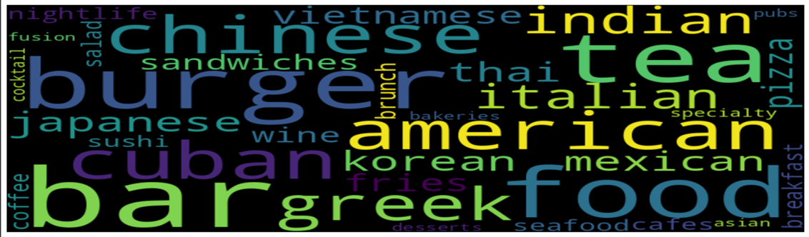
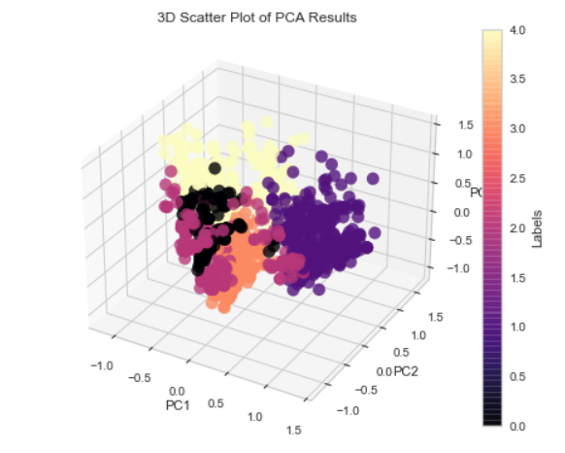
TEST SAMPLE
Business_name | Stars | Review_counts | Category
St Honore | 4.0 | 80 | Burger/Pizza
Ardmore Pizza | 3.5 | 109 | Burger/Pizza
Twin Peaks | 3.5 | 257 | Burger/Pizza
39 North Taproom & Grill | 4.5 | 25 | Burger/Pizza
Clusters formed after using k-means clustering

Slide 12

Personality Based Recommendation
Data Cleaning
User Personality Prediction using a pretrained BERT model on MBTI personalities
Filtering Data according to the dining persona
User Reviews
Finding Similarities using Cosine Similarity
Dimension Reduction using SVD
Creating the User-item Matrix
Recommendation
Description of Dining Persona:
The Adventurous Foodie: Always eager to explore new flavors and cuisines.
The Comfort Food Connoisseur: Prefers cozy settings and classic comfort dishes.
The Health-Conscious Eater: Prioritizes nutritious options and mindful dining experiences.
The Culinary Explorer: Enjoys experimenting with innovative flavors and techniques.
The Social Foodie: Thrives in lively atmospheres, connecting over great food."

Slide 13
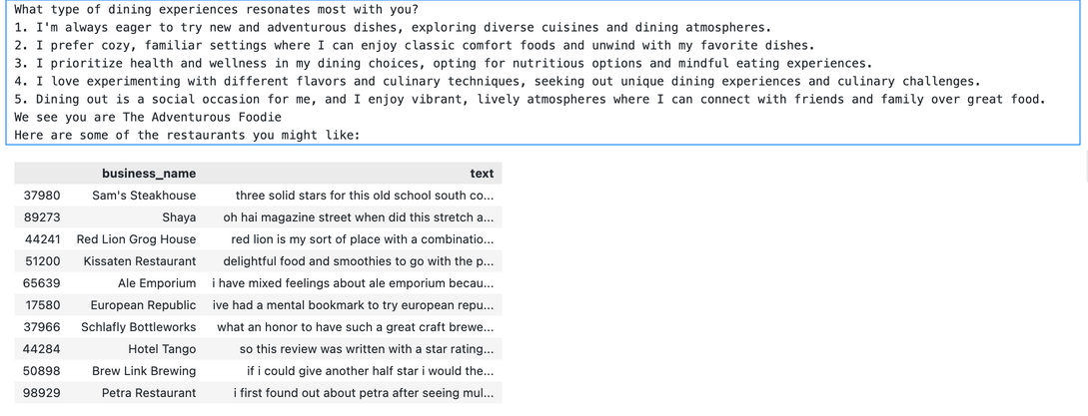
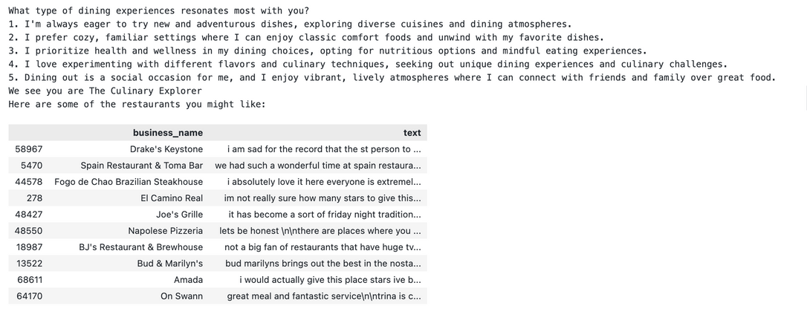
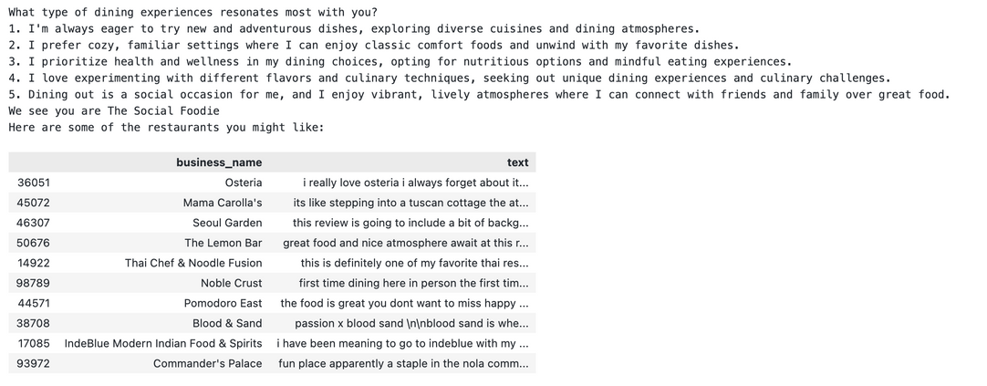
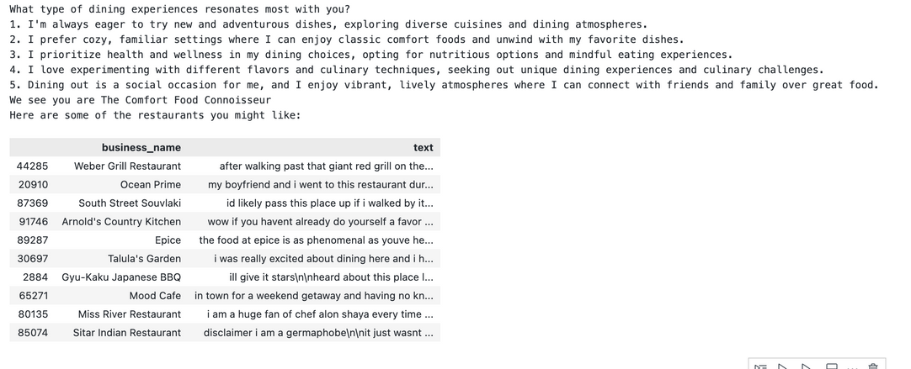
Results

Slide 14
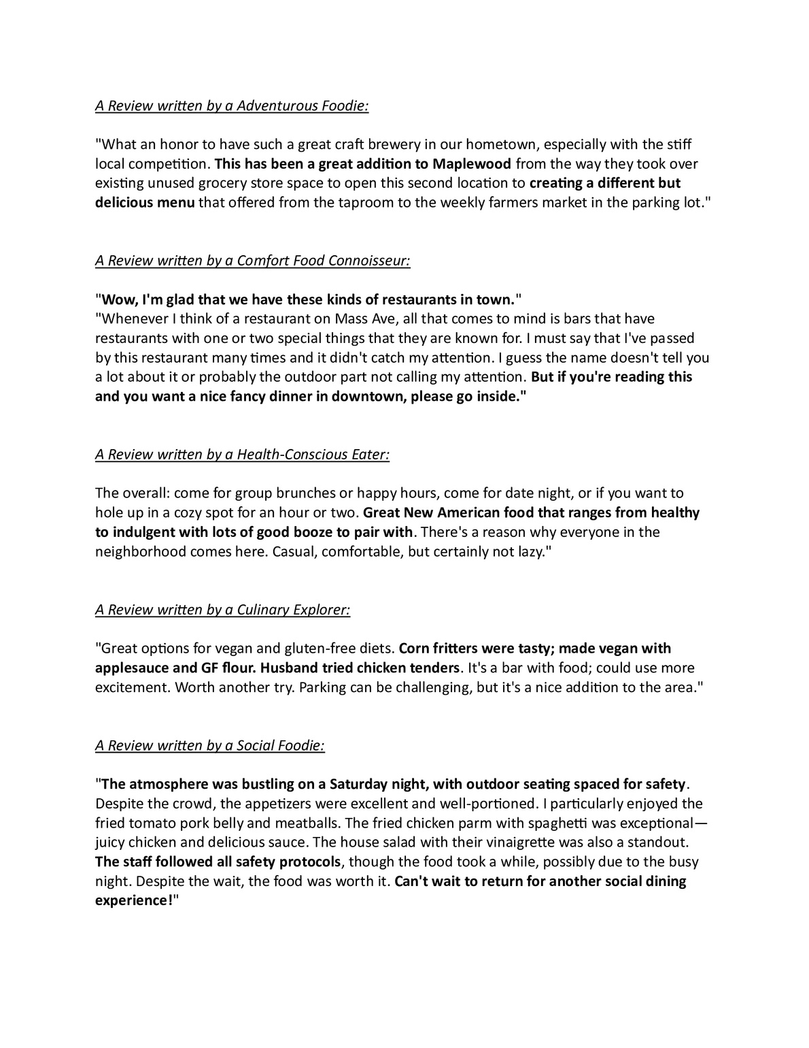

Slide 15
THANK YOU

