Slide 1
Linear Regression
18 Dec 2020

Slide 2
Gapminder Dataset
you will work with Gapminder data that we have consolidated into one CSV file
Specifically, your goal will be to use this data to predict the life expectancy in a given country based on features such as the country's GDP, fertility rate, and population.
Since the target variable here is quantitative, this is a regression problem. To begin, you will fit a linear regression with just one feature: 'fertility', which is the average number of children a woman in a given country gives birth to.

Slide 3
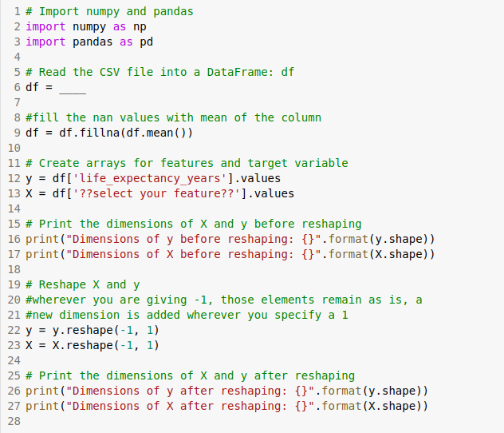
Instruction
Read the file ‘gapminder.csv’
Select the feature which affects the life_expectancy_years

Slide 4
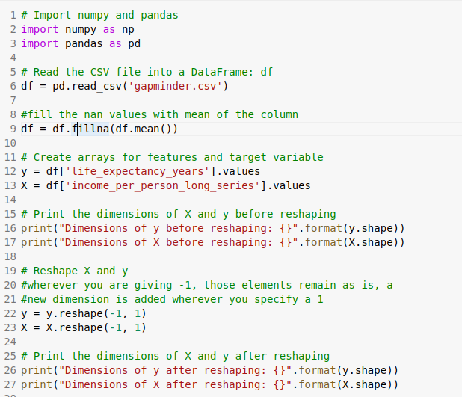
Solution

Slide 5
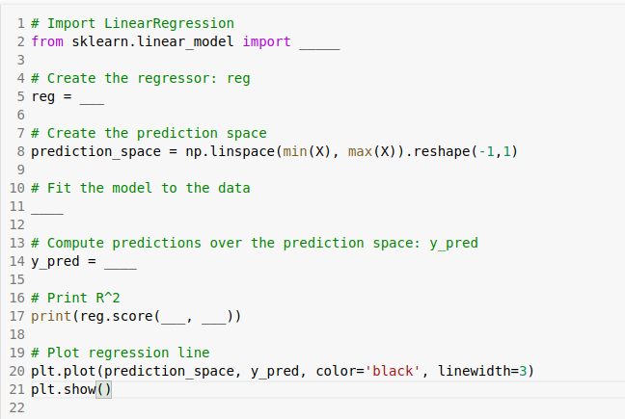
Fit & predict for regression
Import LinearRegression from sklearn.linear_model
Create a LinearRegression regressor called reg.
Set up the prediction space to range from the minimum to the maximum of X. (this for done already for you)
Fit the regressor to the data (X and y) and compute its predictions using the .predict() method and the prediction_space array.
Compute and print the R2 score using .score() method.

Slide 6
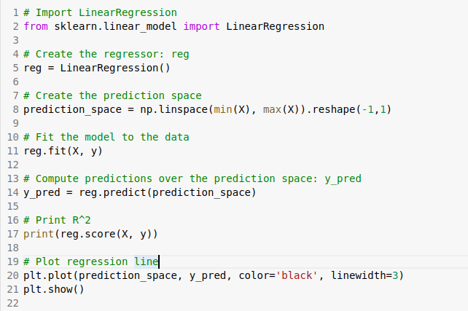
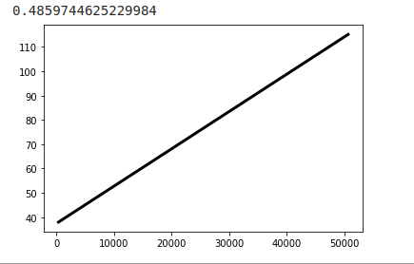
Solution

Slide 7
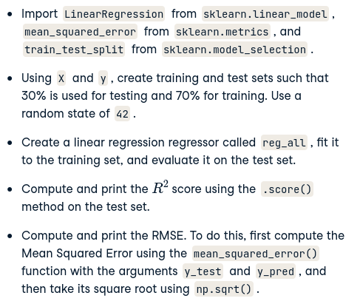
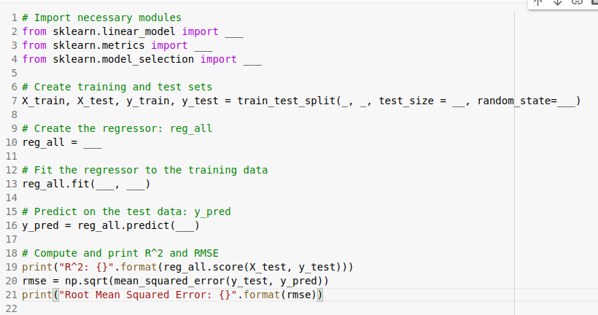
Train/test split for regression

Slide 8
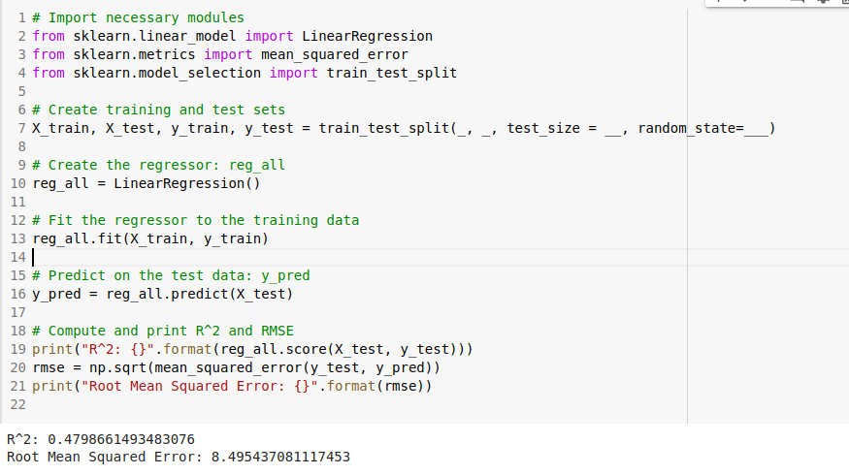
Solution

Slide 9
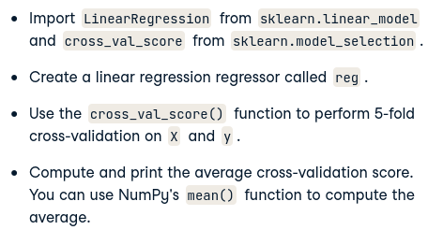
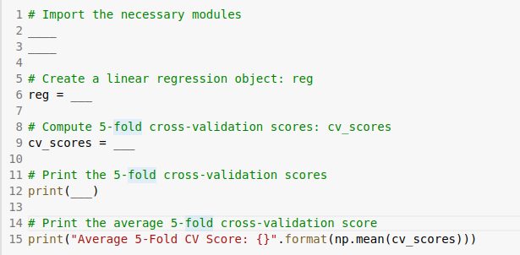
5-fold cross-validation

Slide 10
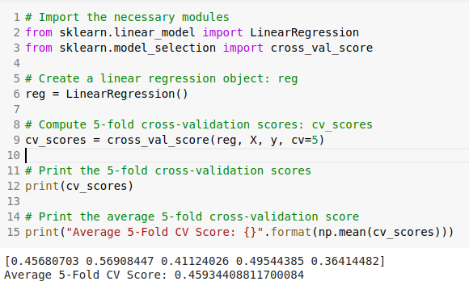
Solution

Slide 11
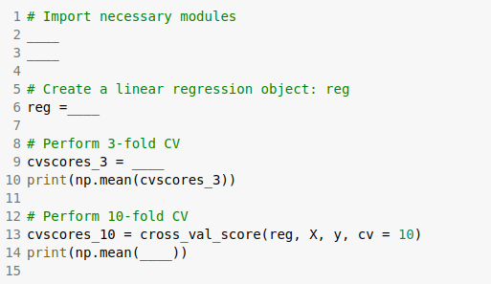
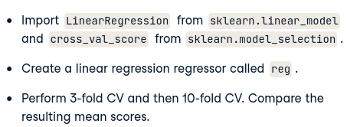
K-Fold CV comparison

Slide 12
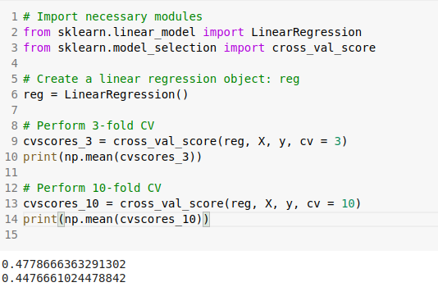
Solution

Slide 13
Logistic Regression
18 Dec 2020

Slide 14
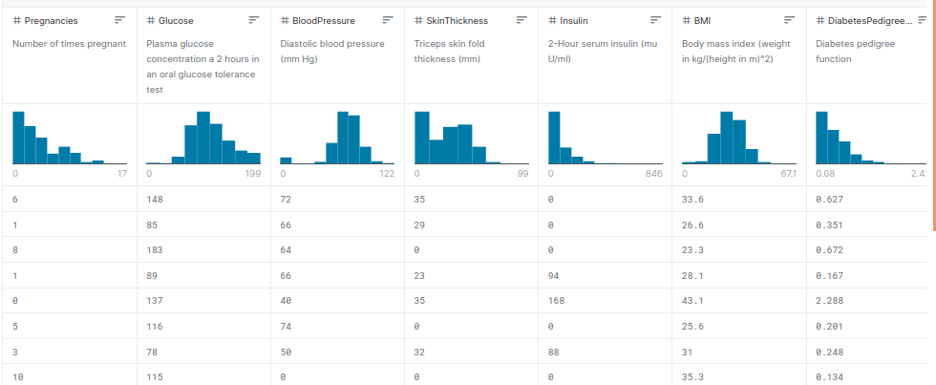
PMI Dataset
the PIMA Indians dataset obtained from the UCI Machine Learning Repository
The objective of the dataset is to diagnostically predict whether or not a patient has diabetes, based on certain diagnostic measurements included in the dataset. Several constraints were placed on the selection of these instances from a larger database. In particular, all patients here are females at least 21 years old of Pima Indian heritage.

Slide 15
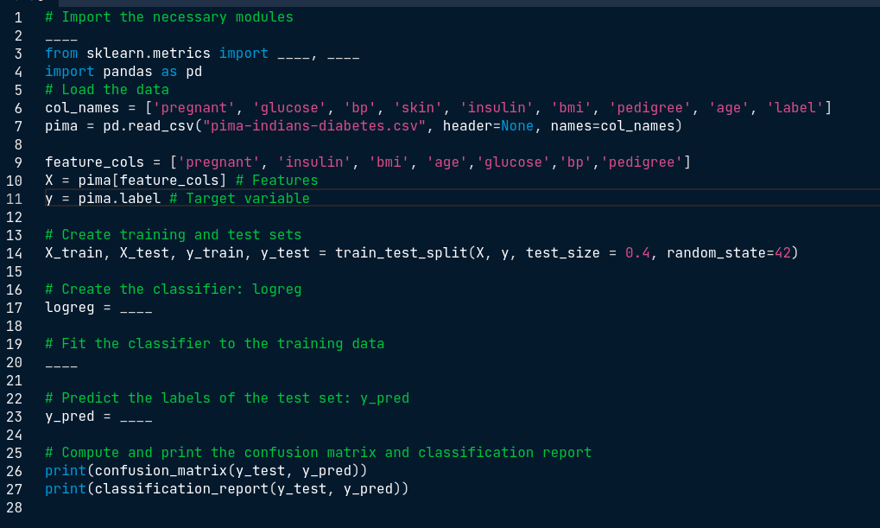
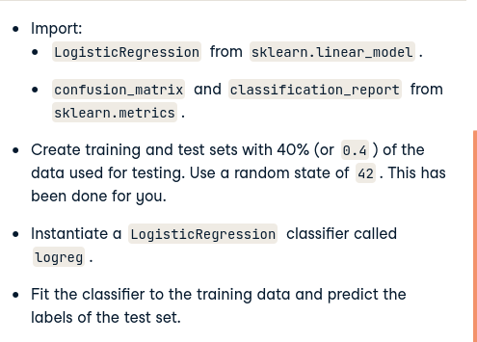
Building a logistic regression model

Slide 16
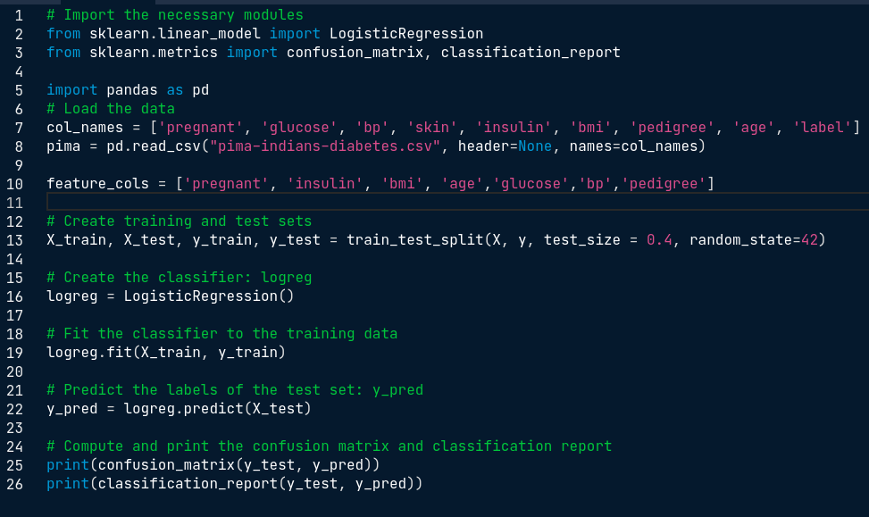
Solution

Slide 17
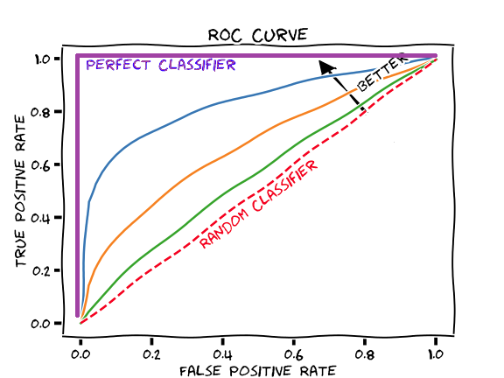
AUC Curve

Slide 18
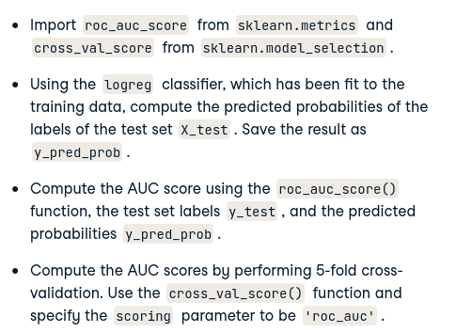
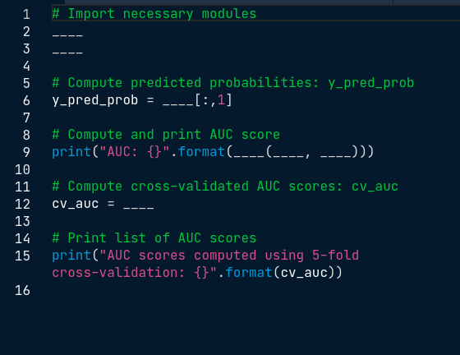
AUC computation

Slide 19
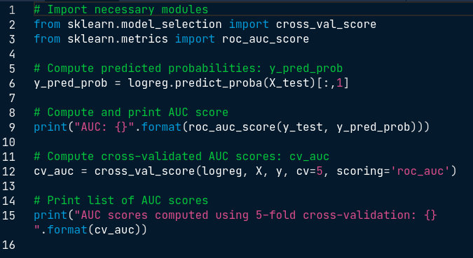
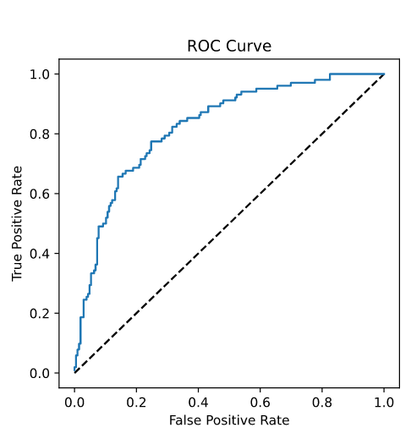
Solution

Slide 20
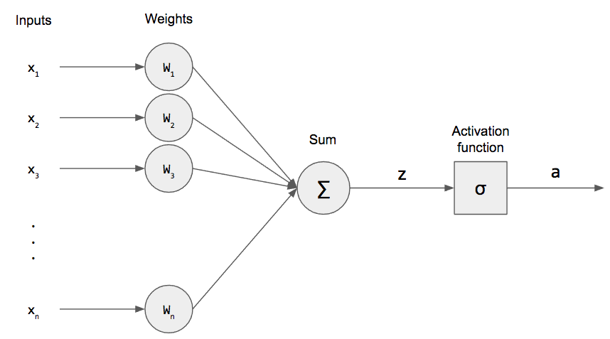
Logistic Regression Model

Slide 21
Binary cross-entropy / log loss
https://ml-cheatsheet.readthedocs.io/en/latest/loss_functions.html
https://towardsdatascience.com/understanding-binary-cross-entropy-log-loss-a-visual-explanation-a3ac6025181a

