Slide 1
Kalman Filter and Pair Trading
20 Nov 2020

Slide 2
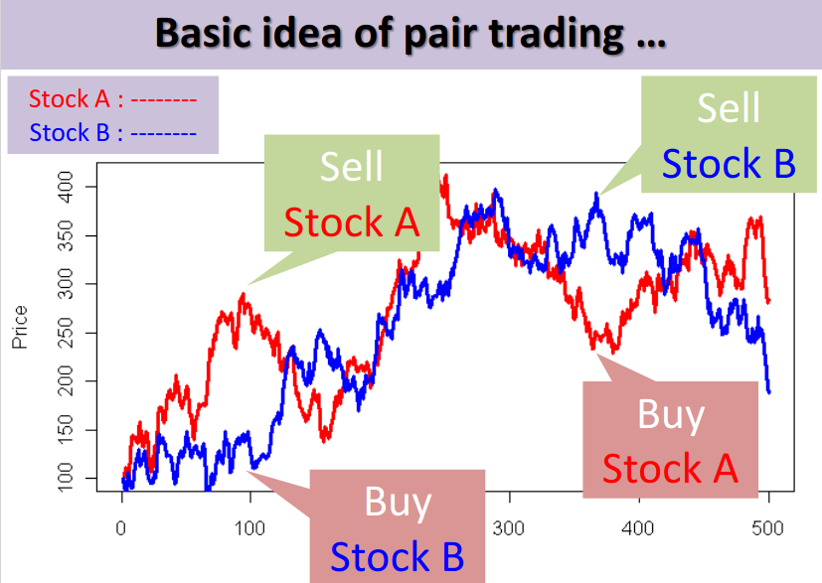
Introduction to pair trading
Pair trading is Market neutral trading strategy, it belongs to statistical arbitrage.
The mechanism of this strategy is to wait for weakness in the correlation of two similar stocks, and then go long on the under-performer while simultaneously going short on the over-performer, closing the positions as the relationship returns to its statistical norm.
Select two stocks which move similarly, Sell high priced stock Buy low priced stock

Slide 3
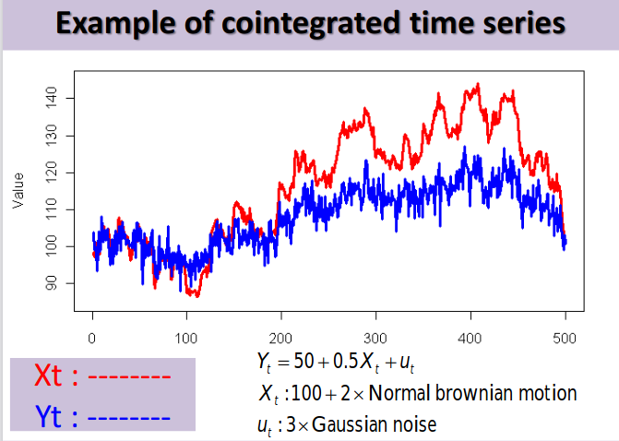
What is cointegration?
Cointegration is Statistical property of time series,
It not correlation! Correlation –Specify co-movement of return –Short term relationship
Cointegration –Specify co-movement of price –Long term relationship

Slide 4
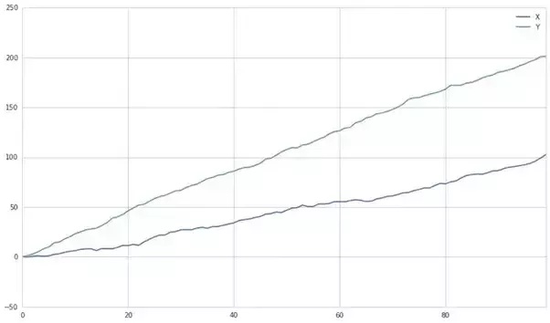
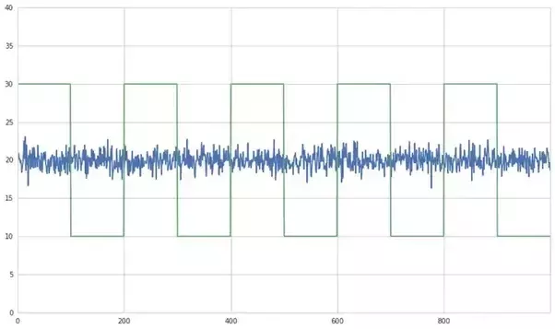
Cointegration Test to Choose Pairs
The trick of pairs trading is to find two stocks are not just correlated but also cointegrated ( ‘they might not necessarily follow a similar path, but they both end up at this destination’).
The examples below show one of them is missing.
two lines with the correlation with each other but no cointegration since they are not approaching to the same destination
one has two lines may not correlate with each other but they have cointegration.

Slide 5


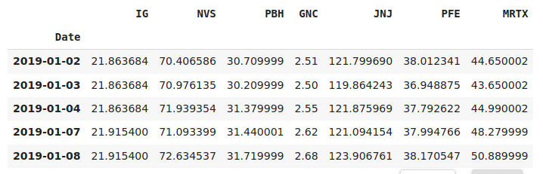
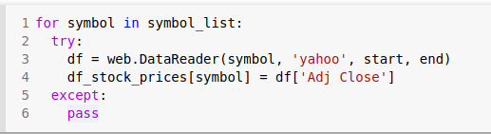
Cointegration Test to Choose Pairs
Suppose you work with on Biotech industry and get following stock data
The given date between;
Output should be like that;
Collect the Close price,

Slide 6
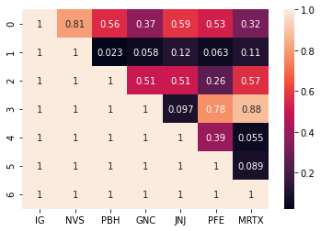
Cointegration Test to Choose Pairs
The p-value of NVS and MRTX set 0.11, which is smaller than 0.05 so we cannot reject the null hypothesis.(These stocks have cointegeration relationship.)
Dickey Fuller test is a hypothesis test which gives pValue as the result.
If this value is less than 0.05 or 0.01, we can say with 95% or 99% confidence that the signal is stationary and we can choose this pair.
The assumption we have here is: these two stocks have cointegration
(confidence coefficiency I set is 95%) which is measured by p-value. If p-value <= 0.05 then we cannot reject the hypothesis.

Slide 7
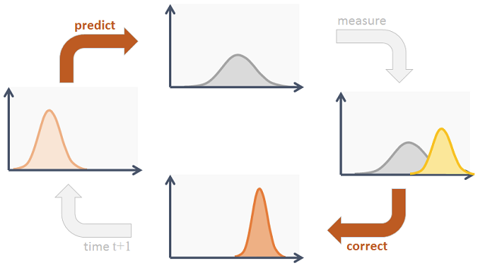
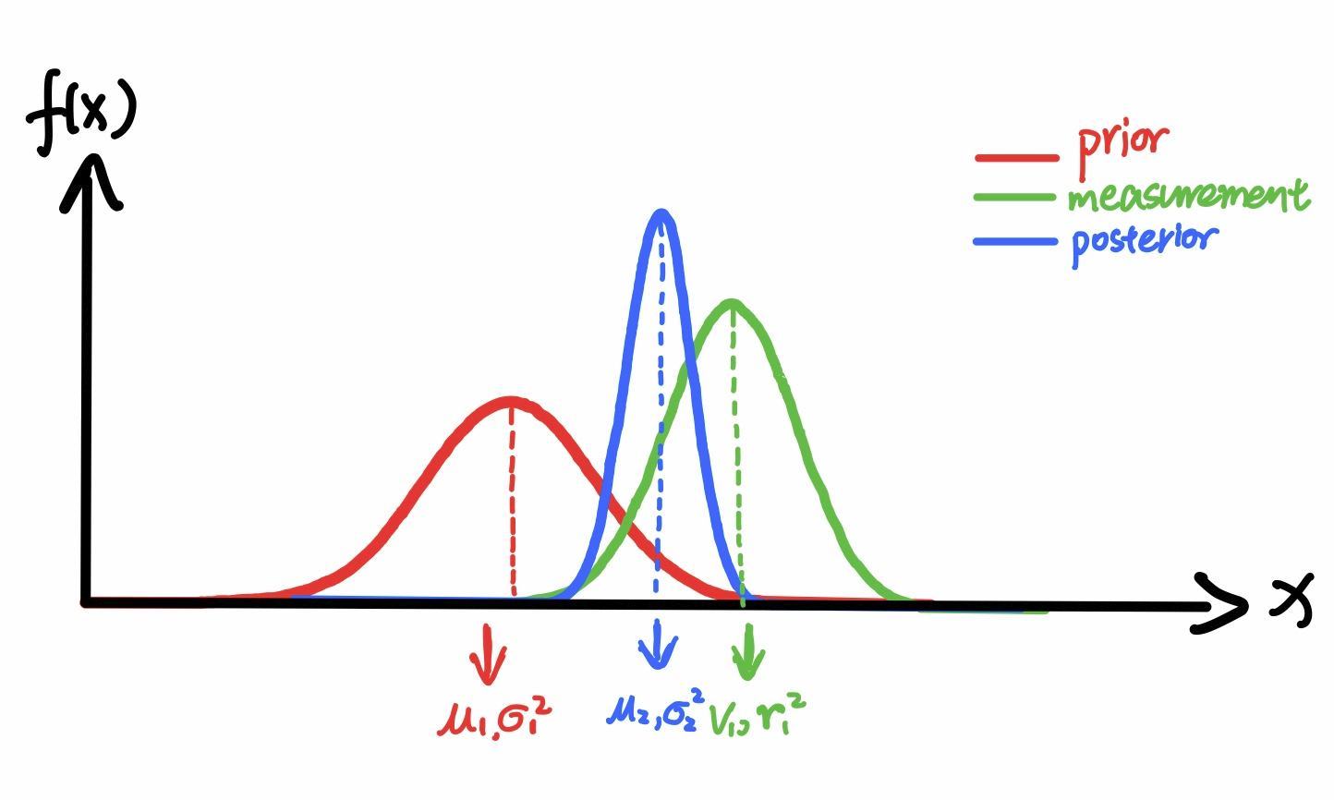
Kalman Filter
Kalman filter is an algorithm that uses noisy observations of a system over time to estimate the parameters of the system (some of which are unobservable) and predict future observations. At each time step, it makes a prediction, takes in a measurement, and updates itself based on how the prediction and measurement compare.
Hyperparameters of kalman filter can be changed for say use:
1. Multi dimensional transition matrices, to use more of past information for making predictions at each point
2. Different values of observation and transition covariance

Slide 8
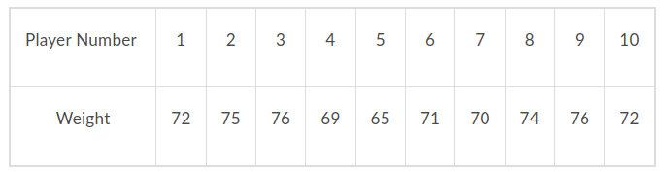
Statistical terms and concepts used in Kalman Filter
Kalman Filter uses the concept of a normal distribution in its equation to give us an idea about the accuracy of the estimate. Let us step back a little and understand how we get a normal distribution of a variable.
Let us suppose we have a football team of ten people who are playing the nationals. As part of a standard health check-up, we measure their weights. The weights of the players are given below.

Slide 9
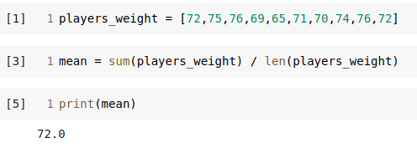

Statistical terms and concepts used in Kalman Filter
Now if we calculate the average weight, ie the mean, we get the value as (Total of all player weights) / (Total no. of players)
= 720/10 = 72 -The mean is usually denoted by the Greek alphabet μ. If we consider the weights as w₁, w₂ respectively and the total number of players as N, we can write it as: μ = (w₁ + w₂+ w₃+ w₄+.....+ w_{n})/N

Slide 10
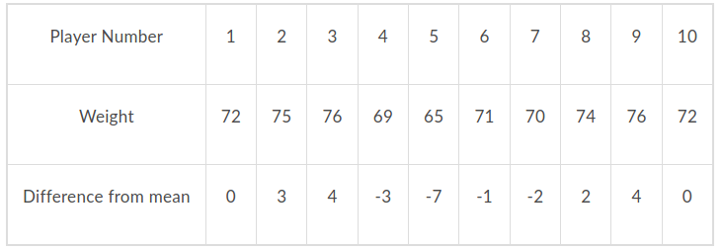
Statistical terms and concepts used in Kalman Filter
Now, on a hunch, we decide on seeing how much each player’s weight varies from the mean. This can be easily calculated by subtracting the individual’s weight from the mean value.
Now, the first team player’s weight varies in the following manner, (Individual player’s weight) - (Mean value) = 72 - 72 = 0.
Similarly, the second player’s weight varies by the following: 75 - 72 = 3. Let’s update the table now.

Slide 11
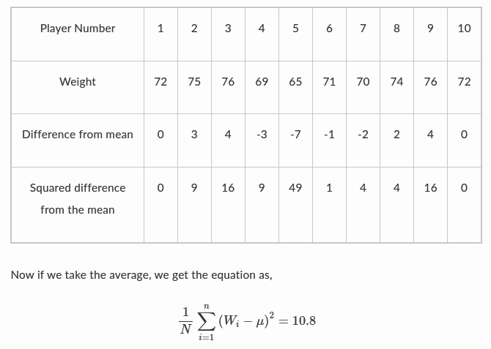
Statistical terms and concepts used in Kalman Filter
Now, we want to see how much the entire team’s weights’ varies from the mean. A simple addition of the entire team’s weight difference from the mean would be 0 as shown below. Thus we square each individual’s weight difference and find the average. Squaring is done to eliminate the negative sign of a score + penalise greater divergence from mean.
The updated table is as follows:

Slide 12


Statistical terms and concepts used in Kalman Filter
The variance tells us how much the weights have been spread. Since the variance is the average of the squares, we will take the square root of the variance to give us a better idea of the distribution of weights. We call this term the standard deviation and denote it by σ.
Since standard deviation is denoted by σ, the variance is denoted by σ2.
But why do we need standard deviation?
While we calculated the variance and standard deviation of one football team, maybe we could find for all the football teams in the tournament, or if we are more ambitious, we can do the same for all the football teams in the world. That would be a large dataset.

Slide 13
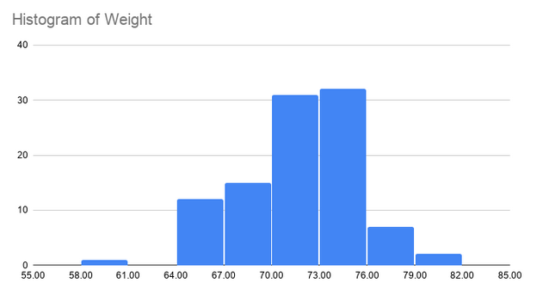
Statistical terms and concepts used in Kalman Filter
Now, looking at different researches conducted in the past, it was found that given a large dataset, most of the data was concentrated around the mean, with 68% of the entire data variables coming within one standard deviation from the mean.
This means that if we had data about millions of football players, and we got the same standard deviation and variance which we received now, we would say that the probability that the player’s weight is +-3.46 from 72 kg is 68.26%. This means that 68.26% of the players’ weights would be from 68.53 kg to 75.46.
Of course, for this to be right, the data should be random.
Let’s draw a graph to understand this further. This is just a reference of how the distribution will look if we had the weights of 100 people with mean as 72 and standard deviation as 3.46.

Slide 14
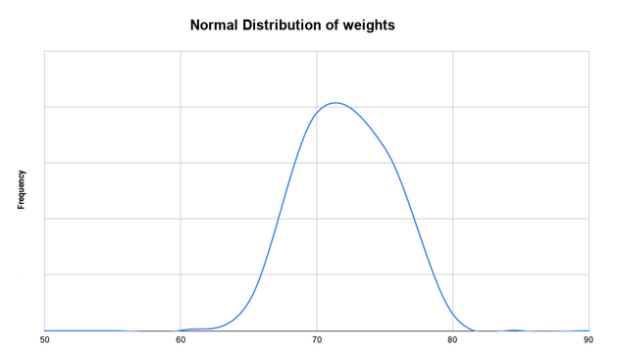

Statistical terms and concepts used in Kalman Filter
This shows how the weights are concentrated around the mean and tapers off towards the extremes. If we create a curve, you will find that it is shaped like a bell and thus we call it a bell curve. The normal distribution of the weights with mean as 72 and standard deviation as 3.46 will look similar to the following diagram.
Normal distribution is also called a probability density function. While the derivation is quite lengthy, we have certain observations regarding the probability density function.
One standard deviation contains 68.26% of the population.
Two standard deviations contain 95.44% of the population while three contain 99.74%.
The probability density function is given as follows.

Slide 15
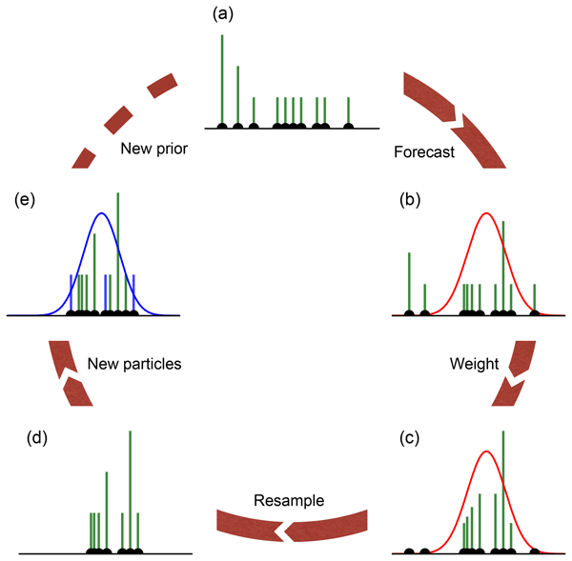
Equations in Kalman Filter
Kalman Filter is a type of prediction algorithm.
Thus, the Kalman Filter success depends on our estimated values and its variance from the actual values. In Kalman Filter, we assume that depending on the previous state, we can predict the next state.
Values into Kalman Filter
True value
The estimated or predicted value
Measured value

Slide 16

Measurement Noise
Process Noise
If the system itself contains some errors, then it is called measurement noise.
For example, if the weighing scales itself shows different readings for the same football player, it will be measurement noise.
If the process when the measurement takes place has certain factors which are not taken into account, then it is called as process noise.
For example, if we are predicting the Apollo Rocket’s position, and we could not account for the wind during the initial blast off phase, then we will encounter some error between the actual location and the predicted location. Kalman Filter is used to reduce these errors and successfully predict the next state.

Slide 17
Status update equation
(measured value - predicted value of the state)
Current state estimated value
Predicted value of current state
=
+
Kalman Gain
x

Slide 18
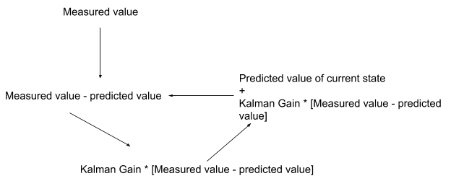
Status update equation
Given the measured values of all ten measurements, take the average of the values to estimate the true value.
take one measurement which becomes the measured value. In the initial step, we guess the predicted value.
Now since the average is computed, in this example, the Kalman gain would be (1/N) as with each successive iteration, the second part of the equation would be decreasing, thus giving us a better-estimated value.
For now, we knew that the actual weight is constant, and hence it was easy to predict the estimated value.
! But what if we had to take into account that the state of the system (which was the weight in this case) changes. For that we will now move on to the next equation in the Kalman Filter -> State extrapolation

Slide 19

State extrapolation equation
find the relation between the current state and the next state
predict the next state of the system
Let’s say that we have a straight road and we have to control the bike’s velocity. For this, we would have to know the bike’s position.
As a simple case, we measure the wheels’ rotation to predict how much the bike has moved.
the rotation at a certain instant of time, ie Δt.
bike has a constant velocity v
Distance = Δt * v
Why we need state extrapolation? 2 m/s * 5 second = 10 metres predicted for next state But what if we check and next time bike moved 12 metres? This gives us an error of 2 metres
The predicted position of the bike
the current estimated position of the bike
the distance covered by the bike in time Δt
=
+

Slide 20
State extrapolation equation
The error may come from;
The device used to measure the velocity has error (measurement error)
The bike is moving with different velocities, in this instance maybe it is a downhill slope (process error)
We try to find out how to minimise this error by having different gains to apply to the state update equation.
The α - β filters.

Slide 21
α filter ( The Update State Equation for position)
(measured value - predicted value of the state)
Current state estimated value
Predicted value of current state
=
+
Kalman Gain
x
α is used to reduce the error in the measurement, and thus it will be used to predict the value of the position of the object.
if we keep the α in place of the Kalman gain, a high value of α gives more importance to the measured value and a low level of α gives less weightage to the measured value.
In this way, we can reduce the error while predicting the position.
If α=0.99 (we trust too much our measurement tool) , then the estimated range very close to the measured range

Slide 22
β filter ( The Update State Equation for velocity)
(measured value - predicted value of the current state)
Current state estimated value
Predicted value of current state
=
+
Kalman Gain
x
Δt
β is used to reduce the error in the process, if we assume that the bike is moving with different velocities, we use β in place of Kalman gain to estimate the velocity of the bike.
https://www.kalmanfilter.net/alphabeta.html

Slide 23
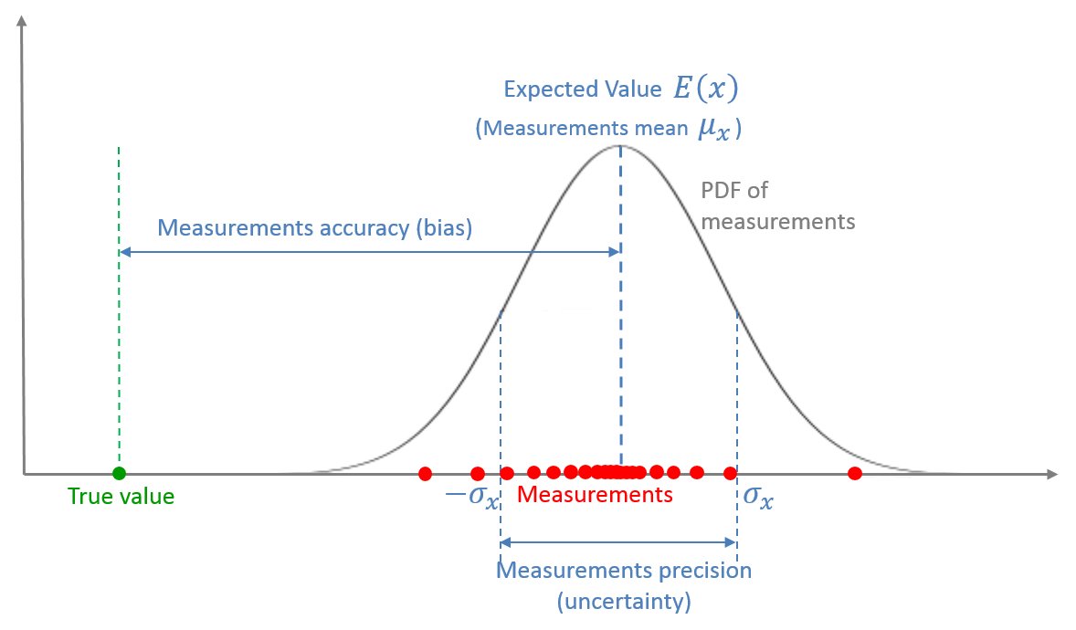
Kalman Gain equation
STATISTICAL VIEW OF THE MEASUREMENT
Recall, the normal distribution.
Now, we can say that the errors, whether measurement or process, are random and normally distributed in nature.
In fact, taking it further, there is a higher chance that the estimated values will be within one standard deviation from the actual value.
Kalman gain is a term which talks about the uncertainty of the error in the estimate. Put it simply, we denote ρ as the estimate uncertainty
(Uncertainty in estimate)
(Uncertainty in estimate)
+
(Uncertainty in measurement)
Notes:
SPEAKER NOTES ABOUT MEASUREMENT GRAPH
The measurement is a random variable, described by the Probability Density Function (PDF).
The measurements mean is the Expected Value of the random variable.
The offset between the measurements mean and the true value is the measurements accuracy also known as bias or systematic measurement error.
The dispersion of the distribution is the measurement precision, also known as the measurement noise or random measurement error or measurement uncertainty.

Slide 24

Example Application on Jupyter Notebook
CLICK TO VIEW JUPYTER NOTEBOOK

Slide 25
Further Reading
How to Create Kalman Filter in Python — https://blog.quantinsti.com/kalman-filter/
Kalman Filter — https://www.kalmanfilter.net/alphabeta.html
Kalman Filter — https://en.wikipedia.org/wiki/Kalman_filter
material — link
material — link
material — link
material — link

