Slide 1
K-Neighbors Classifiers with Sklearn
04 Dec 2020

Slide 2
Instance-Based Learning
Idea:
Similar examples have similar label.
Classify new examples like similar training examples.
Algorithm:
Given some new example x for which we need to predict its class y
Find most similar training examples
Classify x “like” these most similar examples
Questions:
How to determine similarity?
How many similar training examples to consider?
How to resolve inconsistencies among the training examples?

Slide 3
Nearest Neighbor
The k-nearest neighbors algorithm (k-NN) is a non-parametric method used for classification and regression.
In both cases, the input consists of the k closest training examples in the feature space.
In k-NN classification, the output is a class membership. An object is classified by a plurality vote of its neighbors, with the object being assigned to the class most common among its k nearest neighbors (k is a positive integer, typically small). If k = 1, then the object is simply assigned to the class of that single nearest neighbor.
Simple idea: label a new point the same as the closest known point.
Label it red.

Slide 4
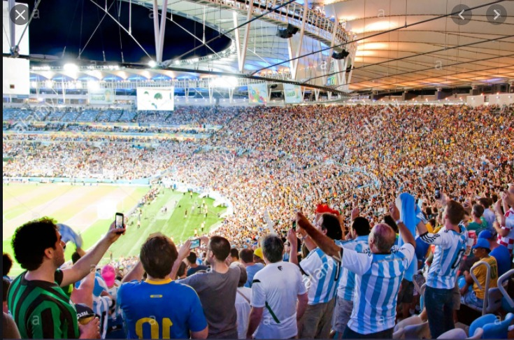
Which team does this man support ?
k=8
Argentinian
Brazilian
k=3
Jamaican

Slide 5
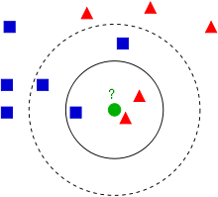
Nearest Neighbor Example
Example of k-NN classification.
The test sample (green dot) should be classified either to blue squares or to red triangles.
If k = 3 (solid line circle) it is assigned to the red triangles because there are 2 triangles and only 1 square inside the inner circle.
If k = 5 (dashed line circle) it is assigned to the blue squares (3 squares vs. 2 triangles inside the outer circle).
Label it red, when k = 3
Label it blue, when k = 7

Slide 6
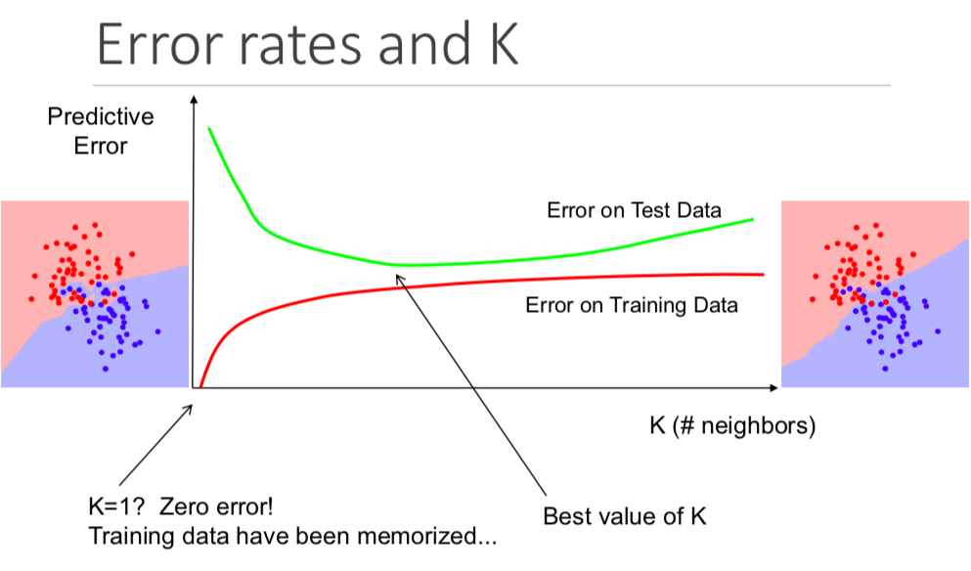
Selecting the Number of Neighbors
Increase k:
Makes KNN less sensitive to noise
Decrease k:
Allows capturing finer structure of space
🡺 Pick k not too large, but not too small (depends on data)

Slide 7
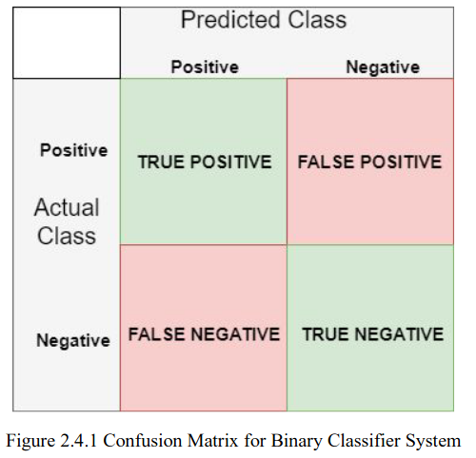
Validation of results
A confusion matrix or "matching matrix" is often used as a tool to validate the accuracy of k-NN classification.
In the field of machine learning and specifically the problem of statistical classification, a confusion matrix, also known as an error matrix, is a specific table layout that allows visualization of the performance of an algorithm.
This matrix include predicted and actual values for each side. The number of true predicted and the number of false predicted samples for each class can be shown. The performance of the classification can be exhibited easily with it. It allows us to compare predicted classes with actual classes.

Slide 8



Useful Metrics in ML
Accuracy simply returns to ratio of total positives and total negatives divided by number of all items.
It says to us the how the model accurate in given sample.
Precision shows the ratio of true positives to total retrieved as positives.
Recall shows the ratio of the positives to the total positives we tested.
F1 Score is the weighted average of Precision and Recall. This score getting both false positives and false negatives. It is generally better metric to use than accuracy if the class
distribution uneven.

Slide 9
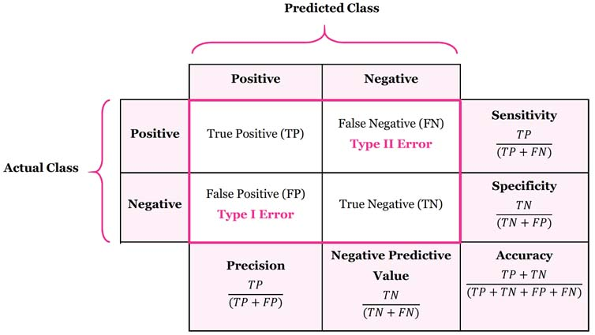
Metrics Representation on Confusion Matrix
Read more on Wiki - https://en.wikipedia.org/wiki/Confusion_matrix

Slide 10

Example Application on Jupyter Notebook

Slide 11
Further Reading
Sklearn KNeighborsClassifier
K-nearest_neighbors_algorithm
Scores & Metrics — link
Confusion Matrix and Metrics — link
material — link

